Slide 1
INFLUENCE OF THE LIGNOCELLULOSIC STRUCTURE ON THE KINETIC MODEL OF ENZYMATIC HYDROLYSIS
Ivo Valchev, Stoyko Petrin, Nikolay Yavorov
Department of Pulp, Paper and Printing Arts
University of Chemical Technology and Metallurgy
8, Kliment Ochridski Blvd., Sofia 1756, Bulgaria

Slide 2
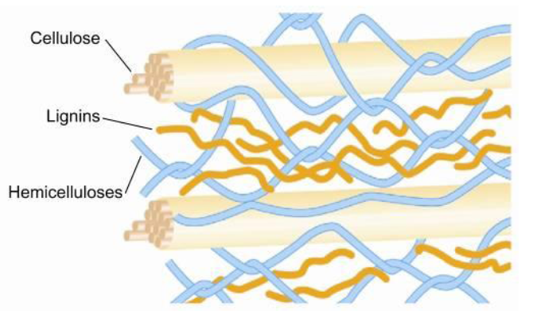
BACKGROUND
The inhomogeneous distribution of cellulose, hemicelluloses and lignin as well as the difference in its structure throughout the pulp matrix make the classical rate equation of Michaelis-Menten inadequate to describe the kinetics of enzyme catalysed hydrolysis.

Slide 3
BACKGROUND
The alternative approach suggests that the accessibility of substrates to enzymes depends on the structural features of the substrate including cellulose crystallinity, degree of cellulose polymerization, surface area, and content of lignin.

Slide 4
PURPOSE
The objective of the study is to determine the relationship between fibres structural features of the lignocellulosic materials and the kinetic mechanism of the enzymatic hydrolysis.

Slide 5
PURPOSE
The objective of the study is to determine the relationship between fibres structural features of the lignocellulosic materials and the kinetic mechanism of the enzymatic hydrolysis.
Exponential kinetic model
Topochemical kinetic model

Slide 6
Exponential kinetic model
The exponential kinetic equation provides a good interpretation of the kinetics of cellulase hydrolysis of different agricultural lignocellulosic materials (wheat straw and maize stalks) and cellulase treatment of pulp for beating efficiency improvement.
The exponential kinetic equation is valid for processes taking place on uniformly inhomogeneous surfaces.
According to the model, the active centers on the surface are distributed linearly, referring to their energy and entropy.

Slide 7
Exponential kinetic model
The exponential kinetic equation is applied in the form:
(1)
where the dimensionless quantity α is a degree of hydrolysis,
v = dα/dt and v₀ are the current and the initial rate of enzymatic hydrolysis, respectively.
The kinetic coefficient of inhomogeneity a accounts for the energy and the entropy inhomogeneity of the system.

Slide 8
Exponential kinetic model
The approximate integral form of Eq. 1 is used for determination of the kinetic parameters:
(2)
The exponential equation does not provides a good interpretation of the extended cellulase hydrolysis of steam-exploded wood.

Slide 9
Topochemical kinetic model
In that case the modified topochemical equation of Prout-Tompkins
(P-T) is valid.
(3)
where k₁ = k/χ is an apparent rate constant and χ is a power factor that characterizes the system.
The topochemical model also provides a good interpretation of the kinetics of xylanase action of different enzyme products with reference to the structure and location of xylan in pulp matrix.

Slide 10
Topochemical kinetic model
According to P-T model, the rate of hydrolysis v is a function of the amount of product that subsequently becomes soluble (degree of hydrolysis) α and of the amount of residual undissolved substrate at any time (1 - α) :
(4)
where k is the rate constant. The power factors m=(χ – 1)/ χ and
n=(χ + 1)/ χ determine the relative contributions by the dissolved and undissolved parts of the substrate, respectively to the rate of hydrolysis.

Slide 11
Topochemical kinetic model
Table 1. Effect of product formed and substrate left on the hydrolysis rate for different values of α (theoretical values of a are used)
In general, the amount of substrate left (1 - α) exerts a predominant effect on the process rate.

Slide 12
Topochemical kinetic model
Table 1. Effect of product formed and substrate left on the hydrolysis rate for different values of α (theoretical values of a are used)
The coefficient χ provides information about the influence of the amount of product formed α and of the substrate left (1 - α) on the process rate.

Slide 13
Topochemical kinetic model
Table 1. Effect of product formed and substrate left on the hydrolysis rate for different values of α (theoretical values of a are used)
For lower values of χ the product formed has a significant role, while for higher values of χ, that factor affects only the start of the process.

Slide 14
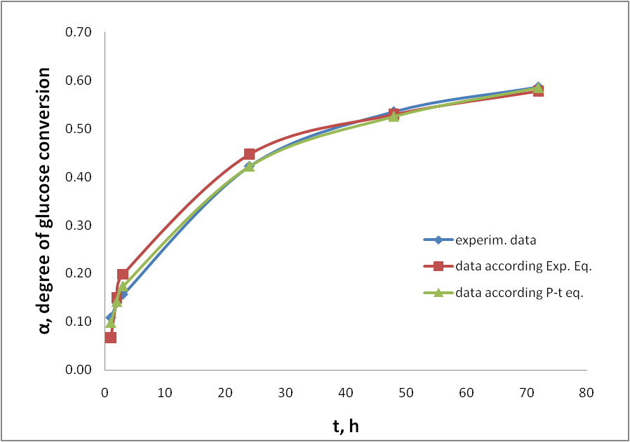
Fig. 1 Experimental and calculated kinetic data of cellulase hydrolysis of steam-exploded poplar (5% NS 22086 + 0.5% NS 22118)

Slide 15
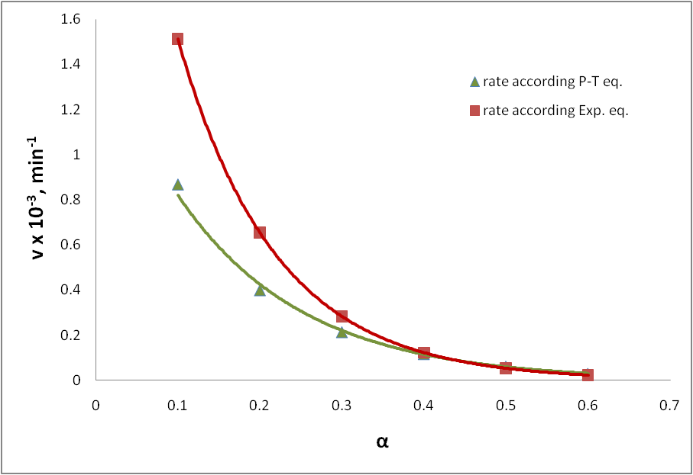
Fig. 2 Calculated rates of cellulase hydrolysis

Slide 16
CONCLUSIONS
The presented study shows that the structural features of the lignocellulosic material are the controlling factor on the type of the kinetic mechanism.
The topochemical model provides a good interpretation of cellulase hydrolysis of steam-exploded wood.
The Prout-Tompkins model evaluates the effect of the reaction product on the process rate.

Slide 17
Tank you for your attention!

