Slide 1
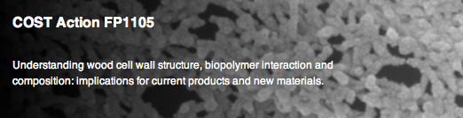



USE OF NFC IN PAPERMAKING APPLICATIONS
FPS COST Action FP1105
González, I.; Alcalà, M.; Pèlach, M.A.; Vilaseca, F.; Mutjé, P.
Laboratory of Paper Technology and Polymer Materials (LEPAMAP Group)
Dept. of Chemical Engineering, University of Girona
C/ M. Aurèlia Capmany, 61, 17071 Girona (Spain)
email: fabiola.vilaseca@udg.edu

Slide 2
Content
INTRODUCTION
PREPARATION OF “OUR” NFC
APPLICATIONS OF NFC IN PAPERMAKING: SOME RESULTS
STRATEGIES APPLIED TO BLEACHED EUCALYPTUS PULPS

Slide 3
Introduction
Sustainability
Saving of forest resources
Prevent the use of large amounts of virgin fibers
Convert recycling as central part of paper activities
Diminish de basis weight of paper-based products
Major use of fillers (instead of fiber content)
Addition of nanostructures……..NFC!!!!

Slide 4
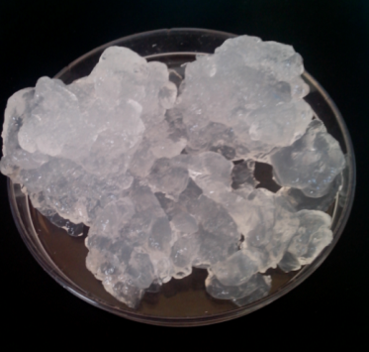
Preparation and characterization of NFC
Fiber pretreatment
Refining
Fiber
de-structuring
Homogenizer PANDA 2K-GEA
NFC characterization
Fiber oxidation
Bleached eucalyptus pulp oxidized at neutral pH, TEMPO-mediated.

Slide 5
Preparation and characterization of NFC
  Degree of polymerization DP = 400
  Carboxylic content CC = 0,4 mmol/g
  Water Retention Value WRV = 17 g/g
  Cationic demand CD = 860 μeq-g/g

Slide 6
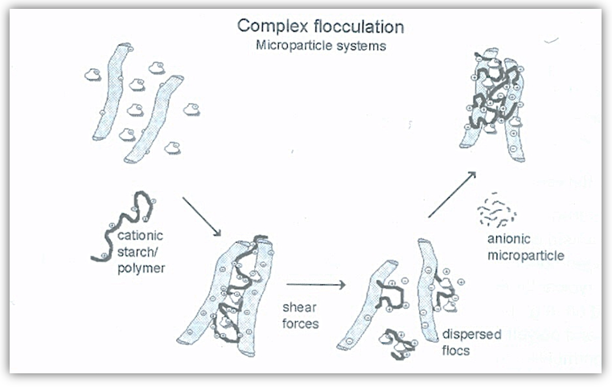
Application of NFC – Retention agents
0,5% cationic starch and 0,8% micronized silica
(respect to fiber weight)

Slide 7
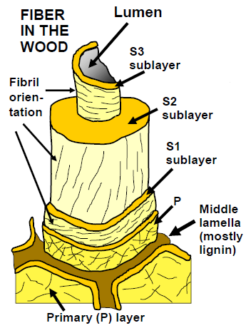
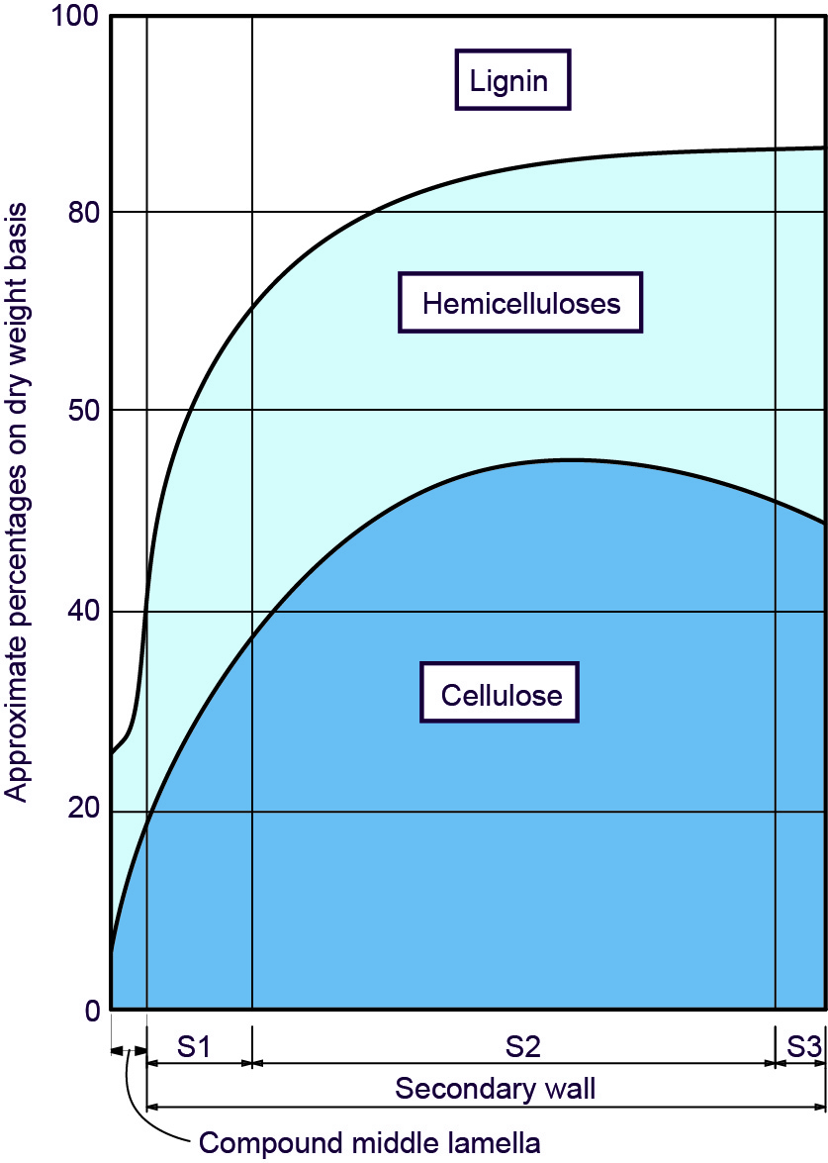
Case Study
Hubbe, M. A.
BioResources (2014), 9(1):1634-1763
Reixach, R.et al.
BioResources (2013), 8(3):3231-3246

Slide 8
Applications of NFC in papermaking
BLEACHED KRAFT PULP
FROM HARDWOOD
UNBLEACHED KRAFT PULP
FROM HARDWOOD
NFC (%) | ºSR | B.L. (m)
0 | 18 | 1880
3 | 29 | 3254
6 | 45 | 4365
9 | 54 | 5233
NFC (%) | ºSR | B.L. (m)
0 | 19 | 3542
3 | 33 | 5508
6 | 55 | 6873
9 | 67 | 7627
73%
55%

Slide 9
Applications of NFC in papermaking
RECYCLED DEINKED PULP
MECHANICAL PULP
NFC (%) | ºSR | B.L. (m)
0 | 64 | 3326
1,5 | 80 | 4650
3 | 84 | 5068
4,5 | 87 | 6054
NFC (%) | ºSR | B.L. (m)
0 | 34 | 1190
1,5 | 40 | 1487
3 | 49 | 1903
4,5 | 55 | 2363
50%
60%

Slide 10
Applications of NFC in papermaking
CTMP FROM RAPESEED RESIDUES
NFC (%) | ºSR | B.L. (m)
0 | 52 | 2609
3 | 62 | 3350
6 | 78 | 3827
9 | 88 | 4473
73%
In all cases, 6-9wt% of NFC would be desirable, regarding the improving on physical properties.

Slide 11
STRATEGIES FOR EUCALYPTUS PULP
Bleached
virgin fibers
Goal: 33-35 ºSR (drainage)
(I)
(II)
(III)
Mild beating
Bio-beating
NFC
in bulk
NFC
NFC
NFC
at surface
González, I. et al.
BioResources (2012), 7(4):5167-5180
González, I. et al.
Cellulose (2013), 20:1425-1435
Unpublished results

Slide 12
Strategies for eucalyptus pulp
(III)
NFC
in bulk
NFC
at surface
0% NFC bulk
L_{R} = 1880 m
ºSR = 16
3% NFC bulk
L_{R} = 3360 m
ºSR = 33
NFC applied at surface:
0,45% NFC^{surf}
in water
L_{R} = 4709 m
TEMPO at basic pH
Highly oxidized
0,45% NFC^{surf}
in starch
L_{R} = 6008 m

Slide 13
Strategies for eucalyptus pulp
(III)
NFC
in bulk
NFC
at surface
6008
4709
3360
1880

Slide 14
Strategies for eucalyptus pulp
(III)
NFC
in bulk
NFC
at surface
5616
4756

Slide 15
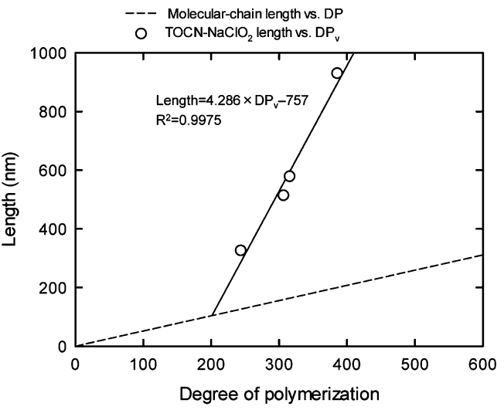
Strategies for eucalyptus pulp
Relationship between oxidation level and degree of polymerization:
Shinoda, R. et al. BioMacromolecules (2012), 13:842-849

Slide 16
Conclusions and challenges
Forthcoming challenges:
Mineral particles (fillers) retention??? Role of NFC ???
Use of retention agents and drainage agents to improve drainage

Slide 17
USE OF NFC IN PAPERMAKING APPLICATIONS
Fabiola Vilaseca
email: fabiola.vilaseca@udg.edu

Slide 18
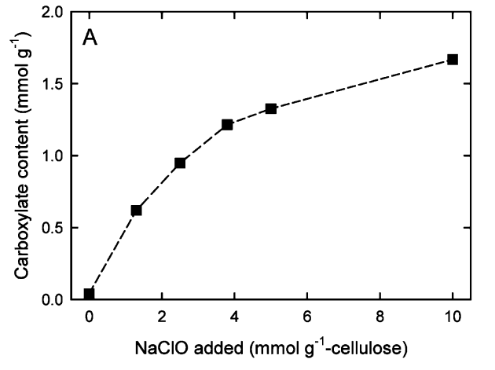
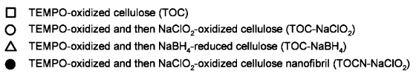
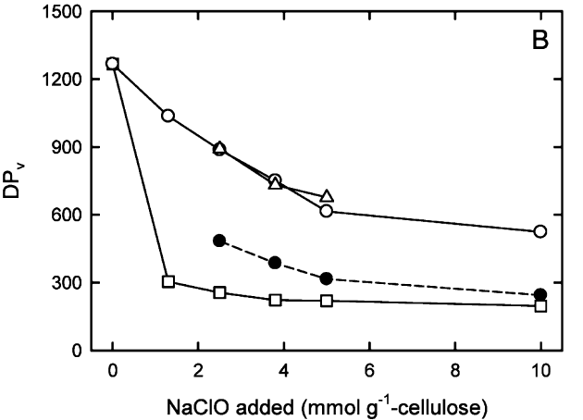
Strategies for eucalyptus pulp
Relationship between oxidation level and degree of polymerization:
Shinoda, R. et al. BioMacromolecules (2012), 13:842-849
The degree of polymerization is affected by the carboxylic content

