Slide 1

LEPAMAP group
-research lines-
J. A. Méndez, F. Vilaseca, M. A. Pèlach, J. Puig, P. Mutjé
University of Girona
EPS, building PI, C/. M. Aurèlia Capmany 61
17071, Girona, Spain
http://lepamap.udg.edu
jalberto.mendez@udg.edu
pere.mutje@udg.edu

Slide 2
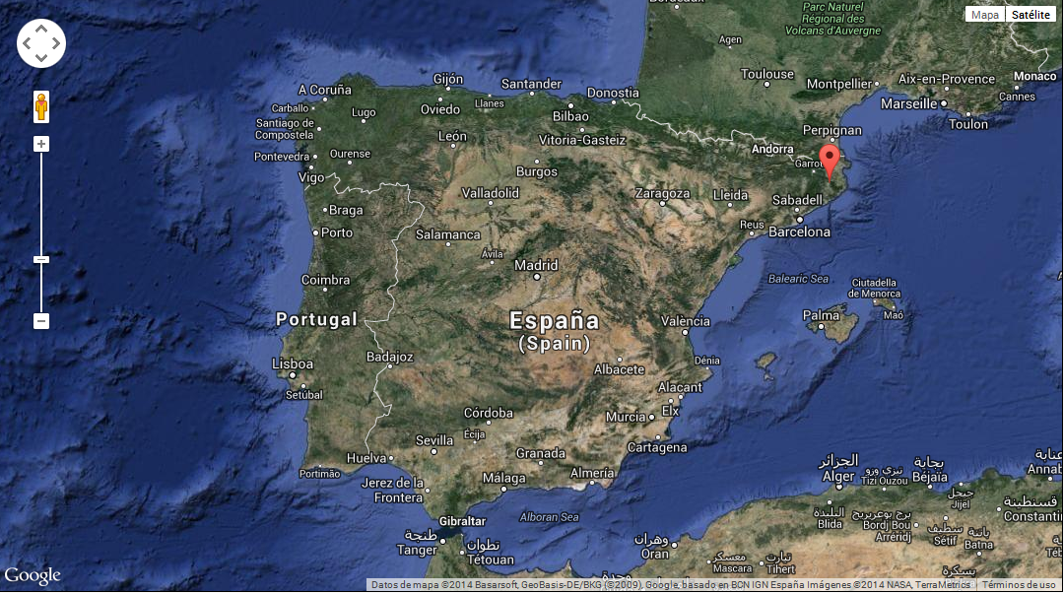
City of Girona
Catalonia. 100 km from Barcelona
Universitary city
Population: 97000 in.

Slide 3
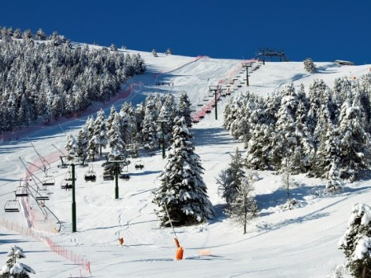

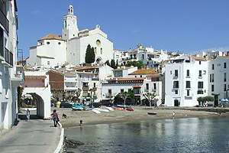

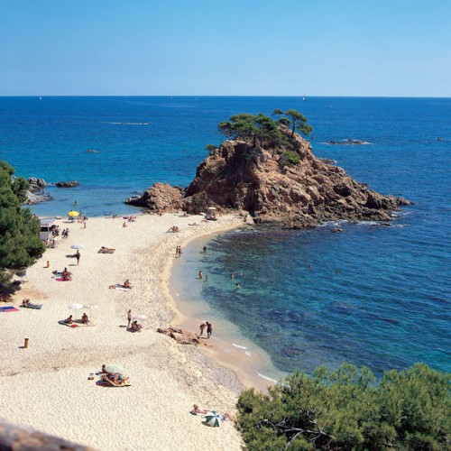
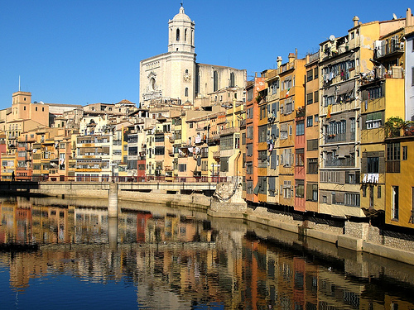
City of Girona

Slide 4
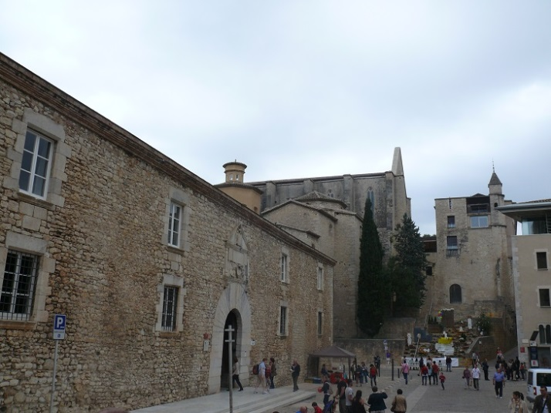
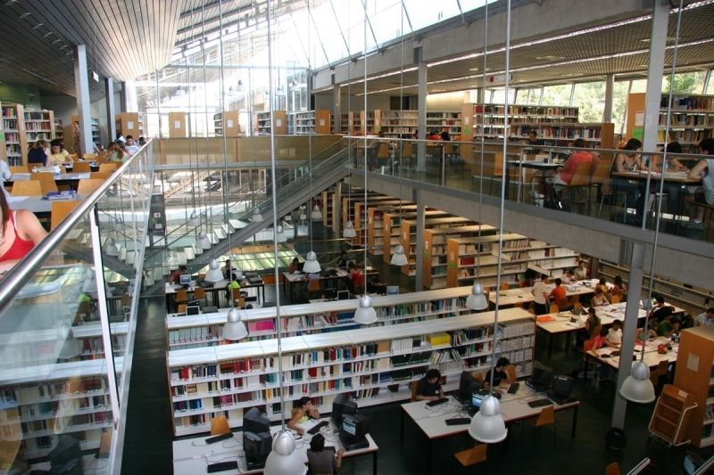
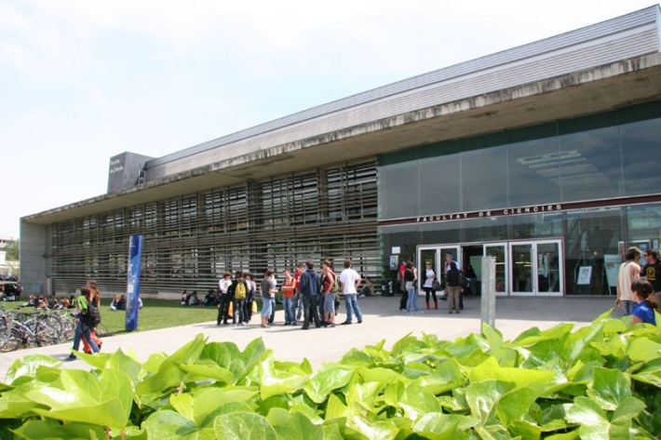
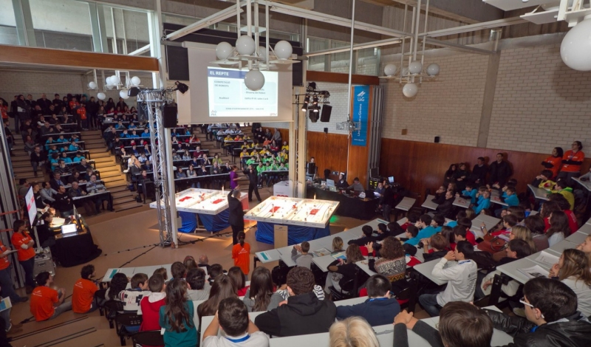
University of Girona
13000 students
1200 professors
Science, letters, polytechnical studies

Slide 5
EPS-Technical Degrees
Industrial sector
  Chemical Engineering (DQE)
  Mechanical Engineering (DME)
  Electrical Engineering (DEE)
  Industrial Electronics & Automatics (DIEA)
  Industrial Technologies (DIT)
  Double degree IT + adm. and direction of companies
  Double degree EE+ IEA
Construction sector
  Architecture
  Construction Engineering
Informatics sector
  Informatics Engineering
Agroalimentary sector
  Agroalimentary Engineering
  Innovation and food security (coming soon)

Slide 6

EPS – LEPAMAP group
Paper technology
Composite materials reinforced with natural fibres
Nanotechnology (nanocellulose)
Biomaterials for biomedical applications

Slide 7
BACKGROUND
Origin…
LIGNOCELLULOSE
Papermaking
Natural Reinforced
Composites
Deinking
Mechanical pulp
Recycled fibres
Annual plants (flax, hemp)
Agroforest residues
Thermoplastic matrices
Bio and non biodegradable
Coupling agents
Mechanical characterisation

Slide 8
CURRENT SITUATION

Slide 9
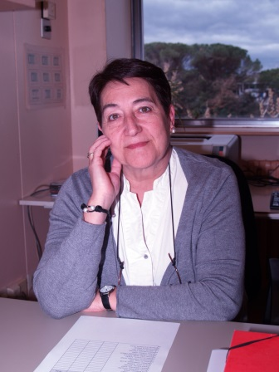
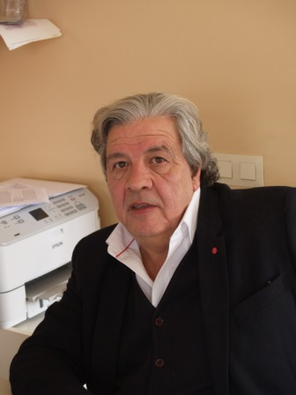
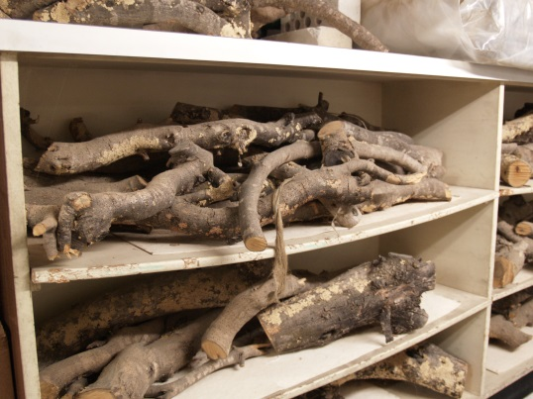
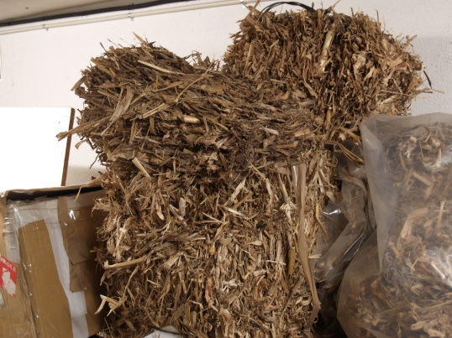
L-1
Laboratory of chemistry and technology
of fibrous materials
RAW MATERIALS
Rapeseed
Corn
Orange tree pruning
Olive tree pruning
Forest pruning
Lignocellulosic fibres
High yield
Higher than 80%
→ L-4, L-5, L-6 and L-7
Dr. N. Pellicer
Dr. P. Mutjé

Slide 10
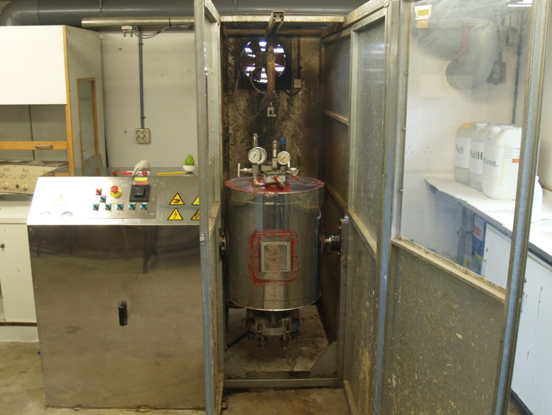
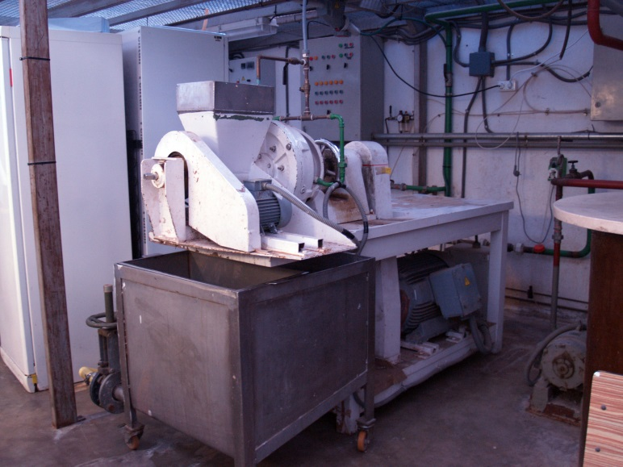
L-1
Laboratory of chemistry and technology
of fibrous materials
COOKING CONDITIONS
NaOH/Antraquinone
Organosolv: ethanolamine
Semichemical pulp
Chemical thermomechanical pulp
Thermomechanical pulp
Mechanical pulp

Slide 11
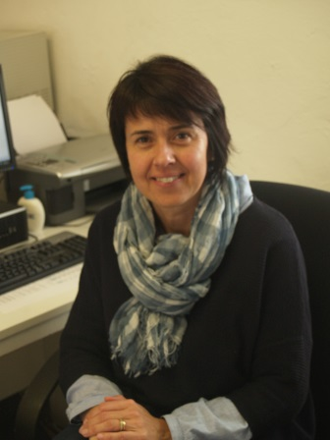
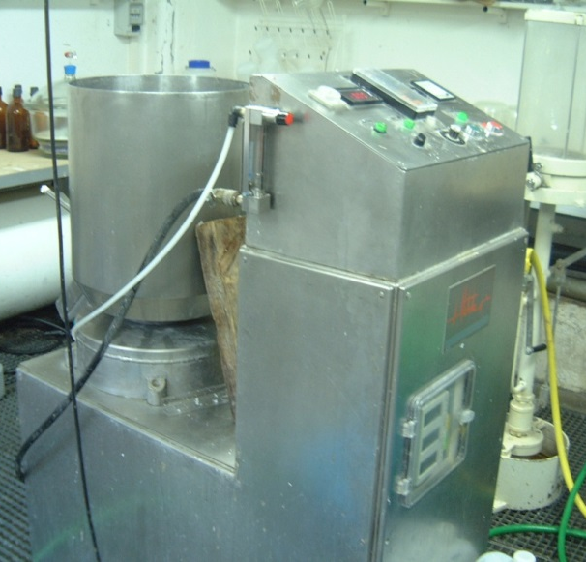
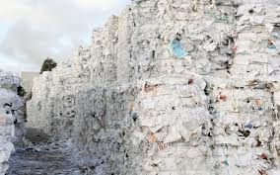
L-2
Laboratory of secondary fibres
Paper disintegrator
Old newspaper paper (ONP)
Disintegration process
Deinking (flotation)
Raw material for papermaking
Raw material for composite reinforcing
Dr. M.A. Pèlach
Current suspension composition (54%)

Slide 12
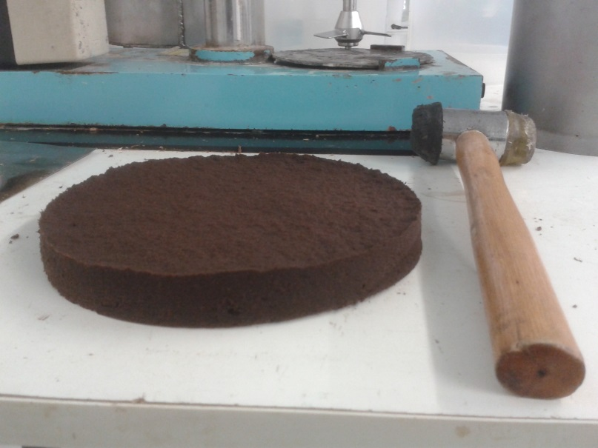
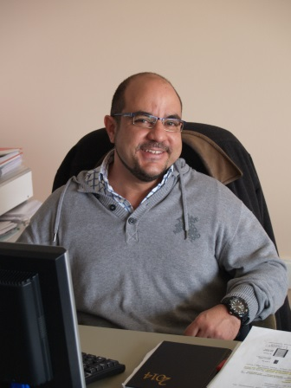
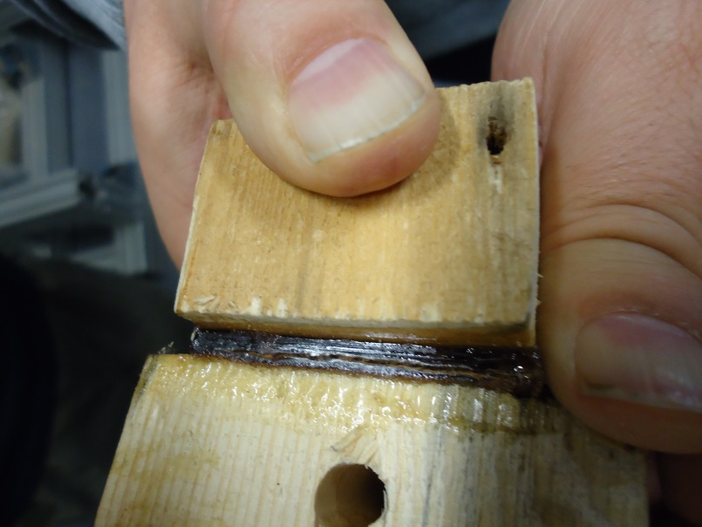
L-3
Laboratory of all lignocellulosic composites
Fibres produced in L-1
Lignin consolidated boards
/ NFC’s
Pre-decanting → sheet former
Compression molding
Characterisation
  Water uptake
  Tensile strength //
  Tensile strengh
Dr. G. Arbat
Dr. P. Mutjé

Slide 13
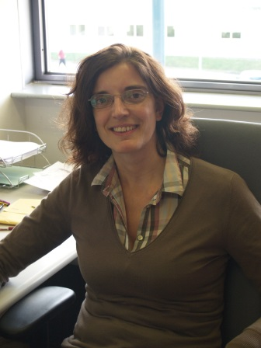
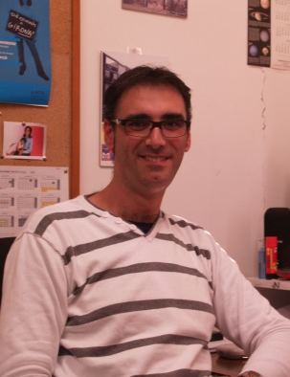
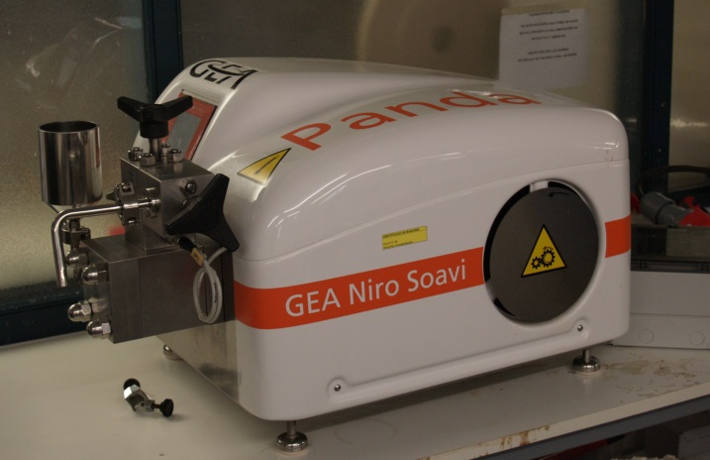
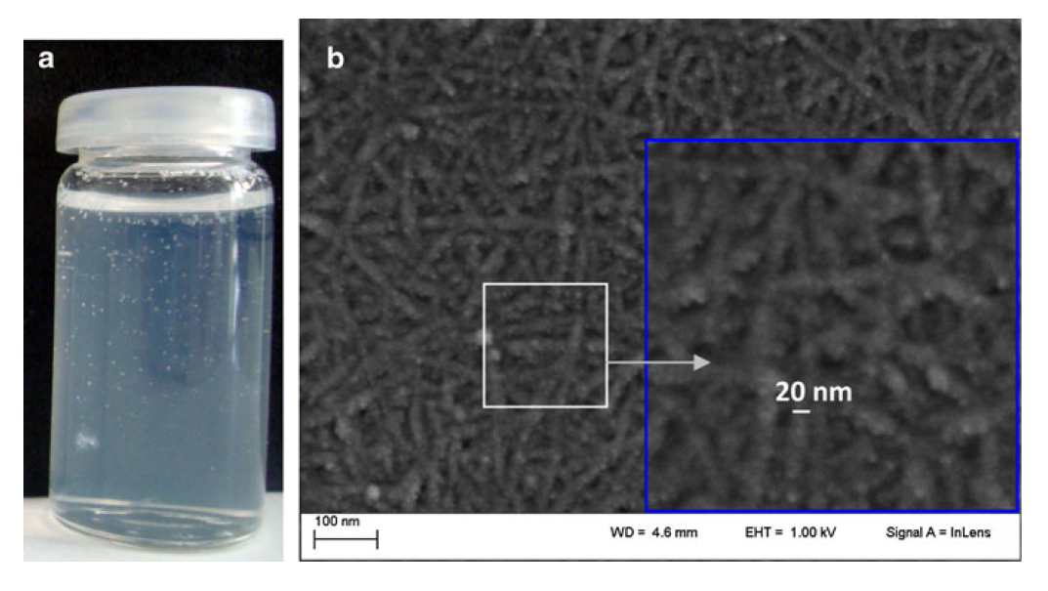
L-4
Laboratory of chemical and biochemical
technology
Production of NFC
TEMPO ASSISTED OXIDATION
Homogeneization
Gel texture
Bacterial cellulose production
Characterisation
NFC chemical modification
Biomedical applications
Dr. F. Vilaseca
Dr. J.A. Méndez

Slide 14
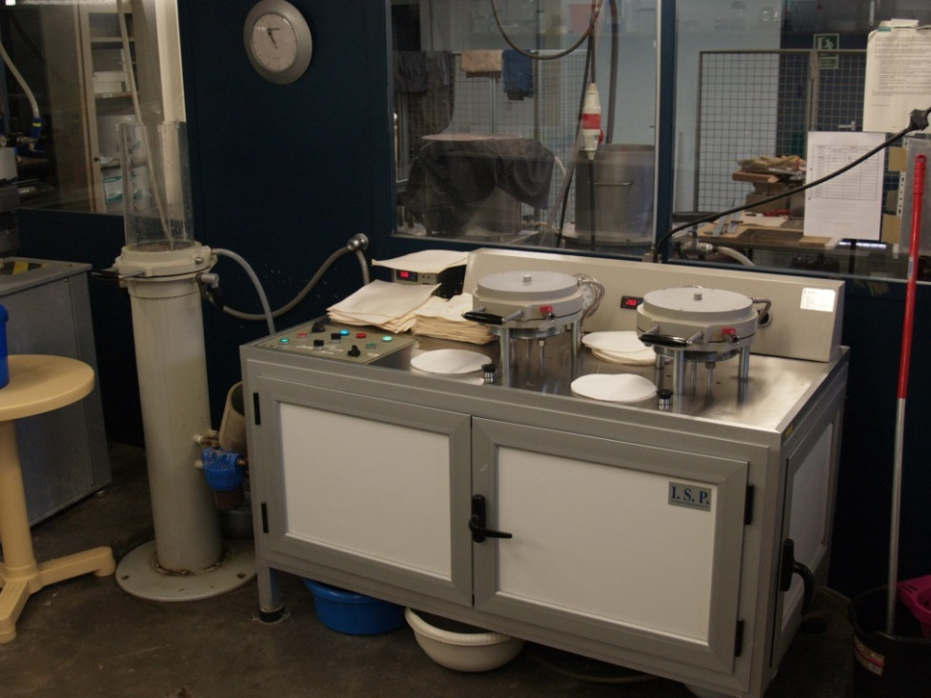
L-5
Laboratory of paper biotechnology
and nanotechnology
  Alternative compositions and procedures
    ↑ % mineral fillers
    Bulk NFC
    Surface NFC
    Biobeating
Dr. P. Mutjé
    Less aggresive processing
    Increase of mechanical properties
    Better use of secondary fibres

Slide 15
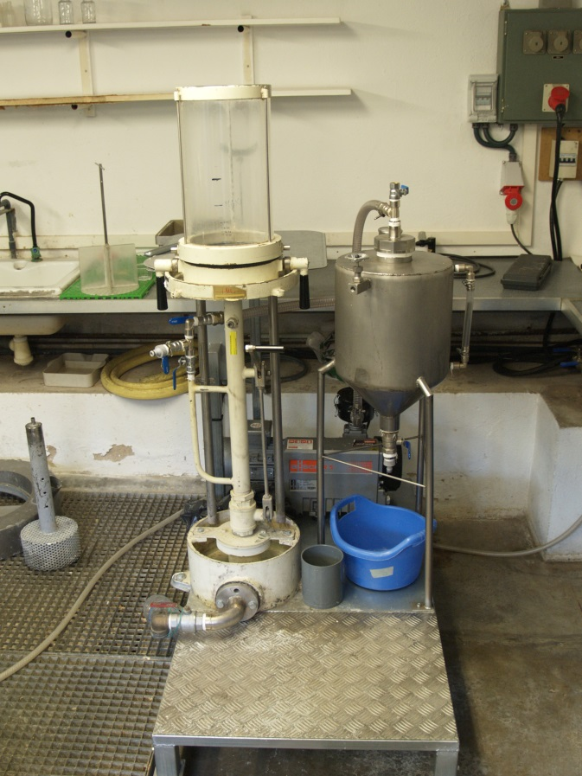
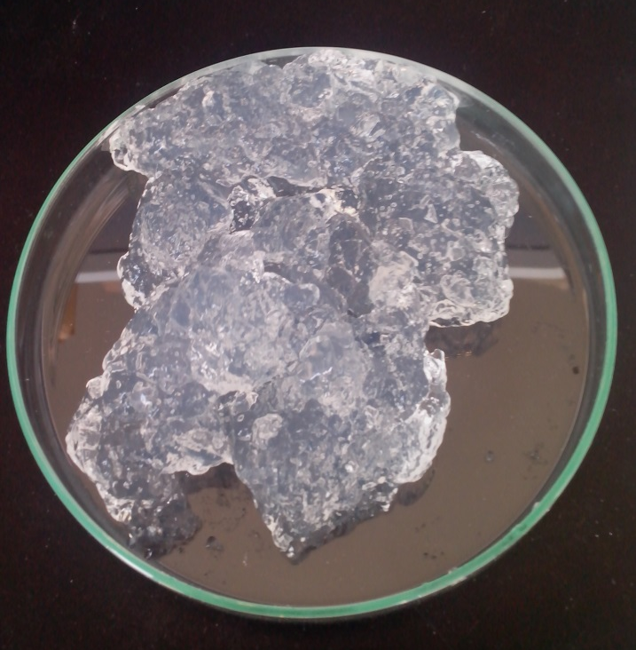
L-6
Laboratory of nanopaper
Nanopaper sheet former
Vacuum assisted former
Millipore membranes
Long time formation
Dr. F. Vilaseca
Dr. M.A. Pèlach

Slide 16
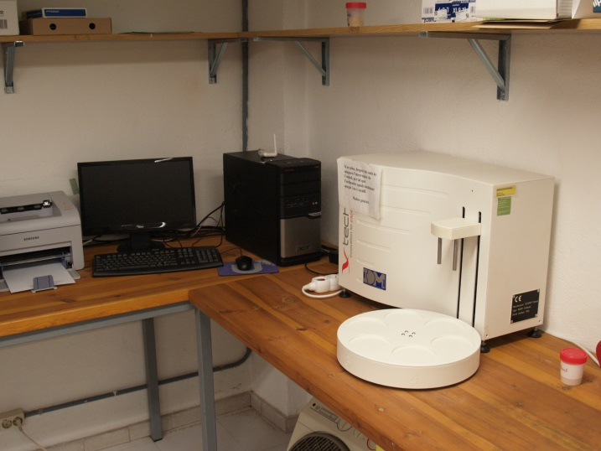
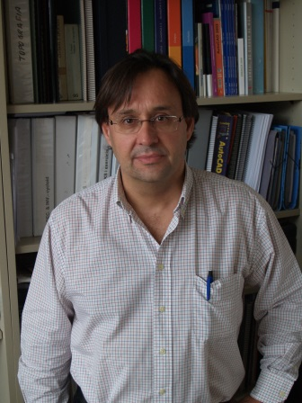
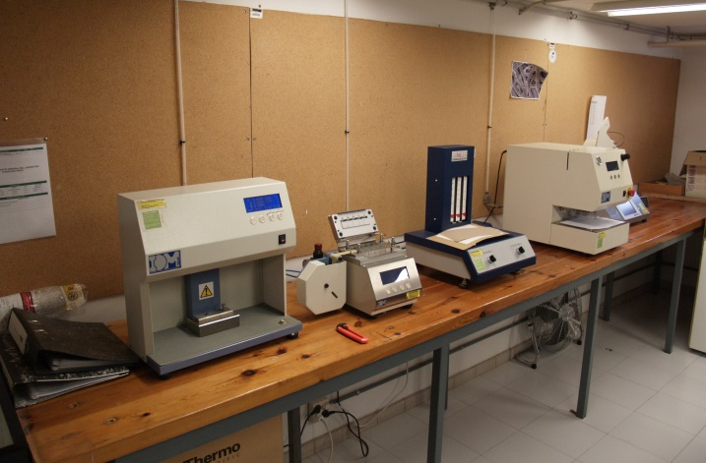
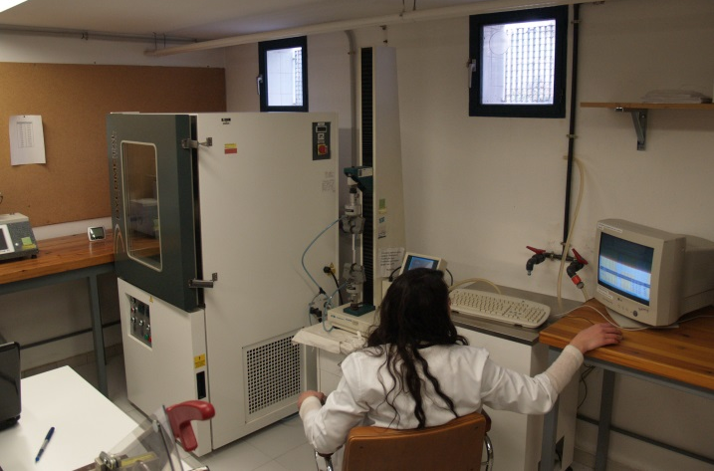
L-7
Laboratory of assays
  Roughness
  Air permeance and air resistance
  Tearing resistance
  Fibre dimensions
  Tensile strength
  Resistance to bending
  Bursting strength
Dr. M.A. Pèlach
Dr. M. Alcalà

Slide 17
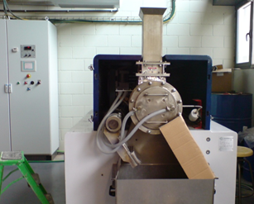
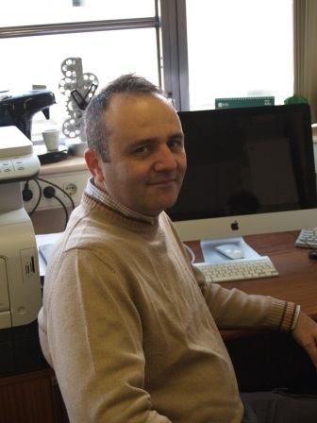
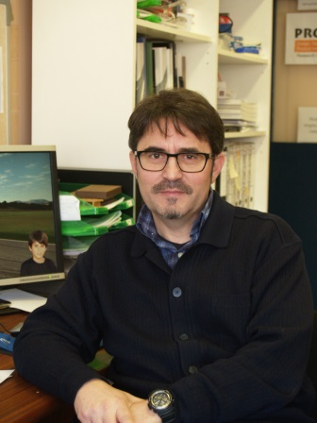
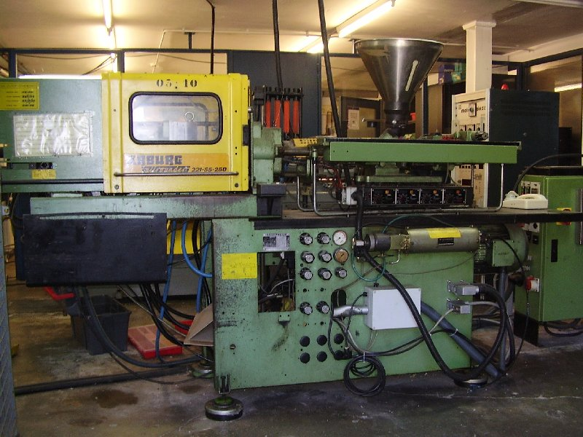
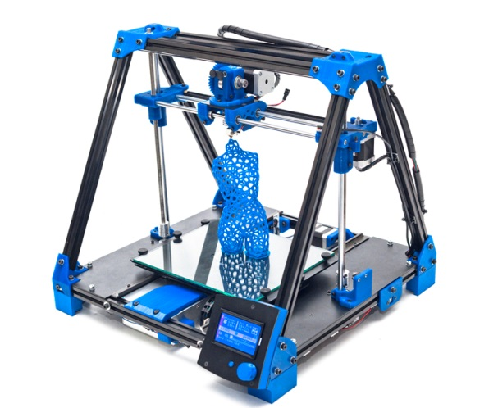
L-8
Laboratory of composite materials
Fibres produced in L-1 / strands
Polyolefins/biodeg. Matrices
Compounding: kinetic comp.
Processing
  Injection-moulding
  Extrusion
Transforming
  Rapid prototyping
Dr. X. Espinach
Dr. F. Julián

Slide 18
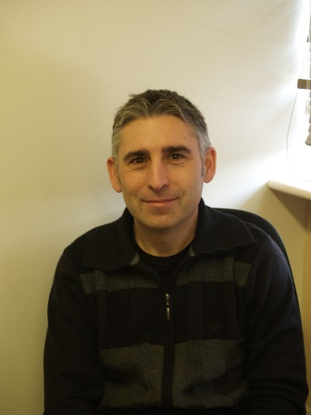
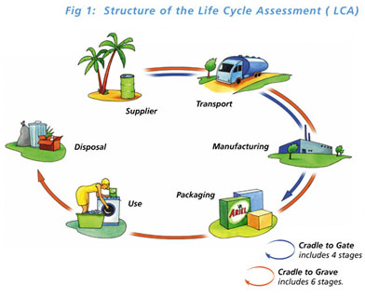
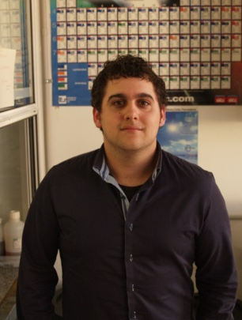
L-9
Laboratory of life cycle analysis
Dr. J. Pujol
Sr. M. Delgado

Slide 19
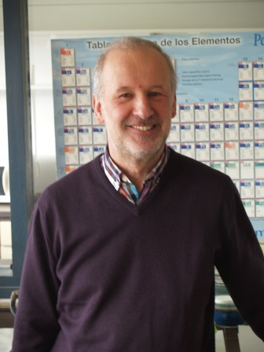
L-10
Laboratory of food contact
Fastness of fluorescent whitened paper and board
Colour fastness of dyed paper and board
Metals
Security in toys
Microbiology
Pentachlorophenol
Optical properties
Heavy metals in packaging
Dr. J. Puig

Slide 20
Main focus
Papermaking
Bio-nano
composites
NFC
Film reinforcement
Special properties of nanopaper

Slide 21




Acknowledgement
Sponsors
Members of LEPAMAP Group, PRODIS and Modifibres
Audience for your kind attention

