Slide 1
Structure evaluation of composite materials based on CNC
Maria-Cristina Popescu, Carmen-Mihaela Popescu
Petru Poni Institute of Macromolecular Chemistry of the Romanian Academy, Iasi, Romania

Slide 2
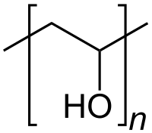
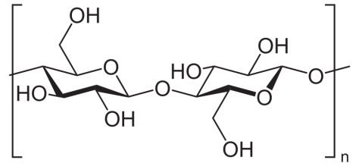
AIM
renewable
wide available
high specific strength
and modulus
high aspect ratio
low density
safety
nontoxic
linear synthetic polymer
water-soluble
nontoxic
biocompatible
noncarcinogenic
higher tensile strength
good swelling properties,
bioadhesive characteristics
Nanocomposite materials as polymeric matrix for antimicrobial membranes.

Slide 3
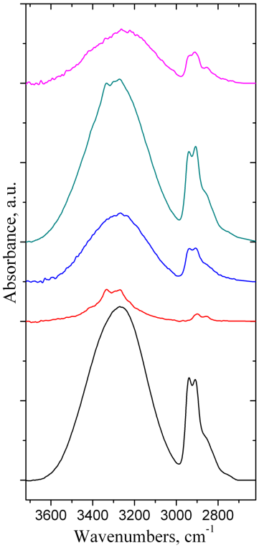
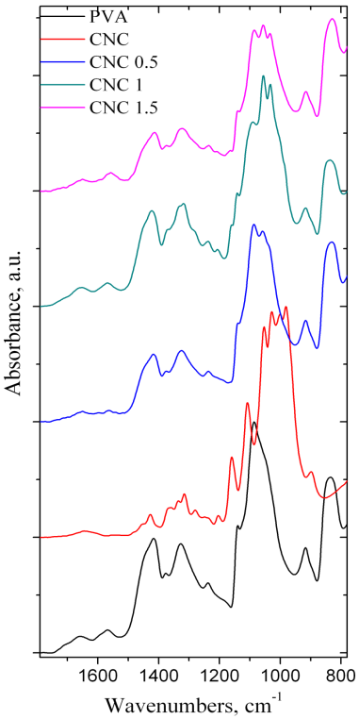
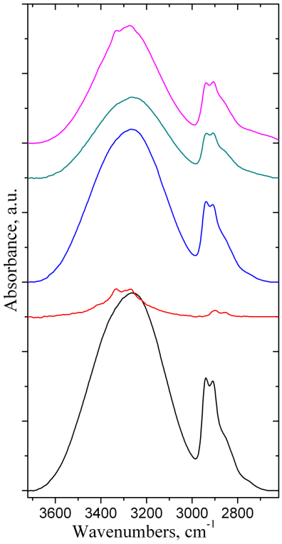
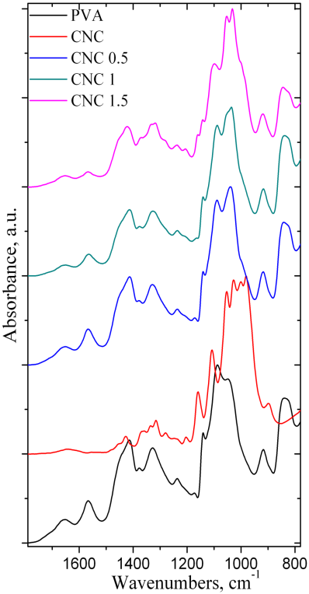
the spectra of the composite materials indicate firstly the presence of the PVA bands, but also bands assigned to different stretching vibrations from CNC structure can be observed
compared to pure components, physical and chemical crosslinks between components and structural rearrangements in the composite materials were evidenced by modification of the bands maxima to higher or lower wavenumbers in the infrared spectra

Slide 4
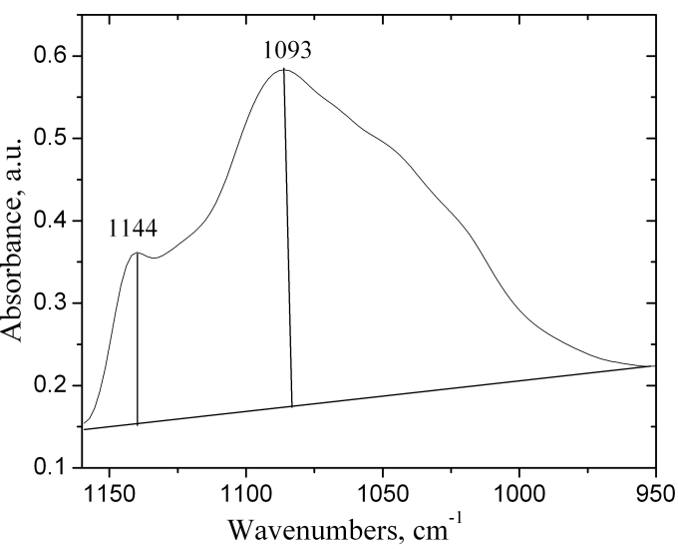
α(%) = −13.1 + 89.5(A1144⁄ A1094)
PVA | 14.58539 | 27.04929
CNC 0.5 | 9.873856 | 18.07063
CNC 1 | 10.68241 | 10.07463
CNC1.5 | 7.897997 | 5.819797
the degree of crystallinity increase if the glycerol is added and decrease with increasing the CNC content

Slide 5
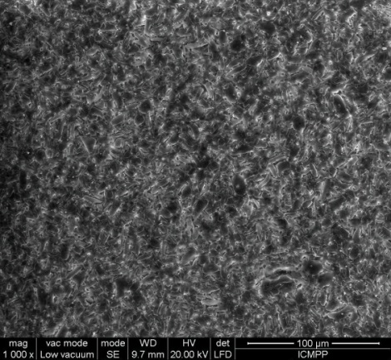
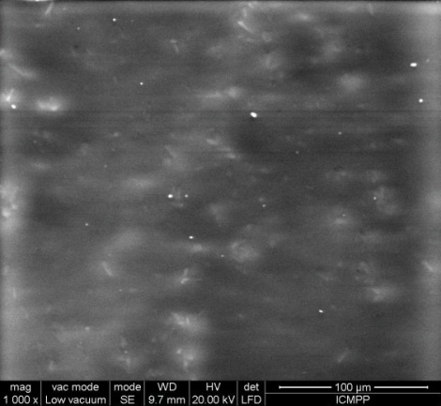
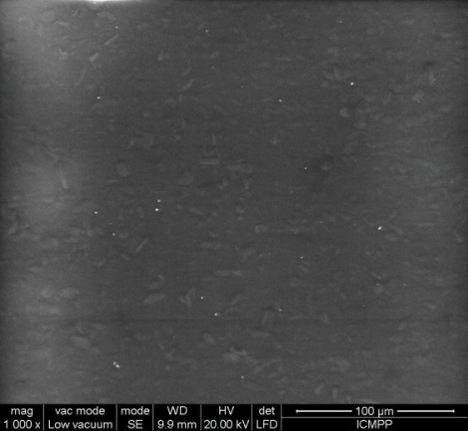
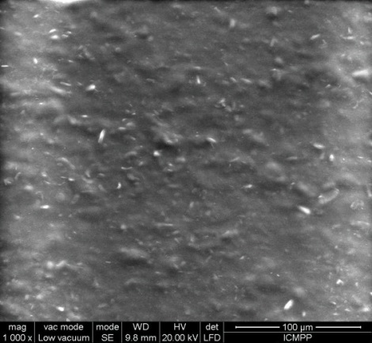
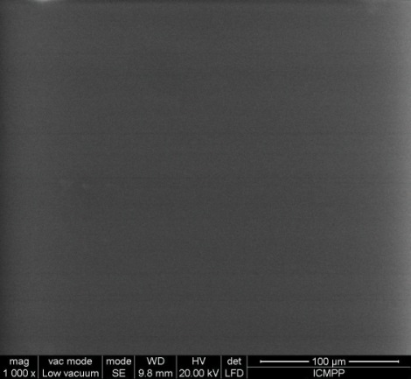
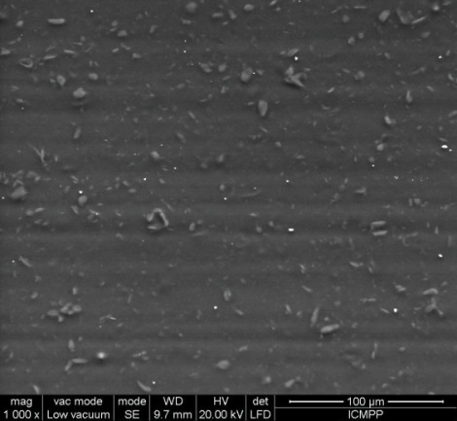
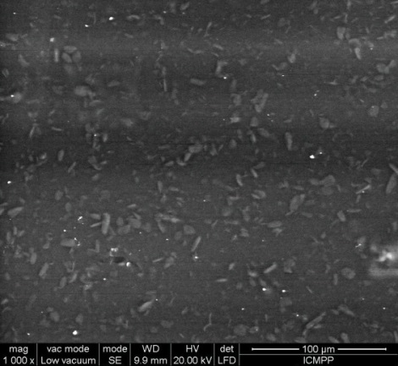
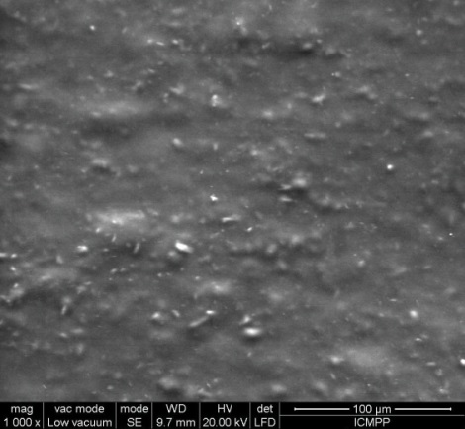
Scanning Electron Microscopy
SEM micrographs indicate the uniform spread ability of CNC into the composite materials

Slide 6
Thank you!

