Slide 1


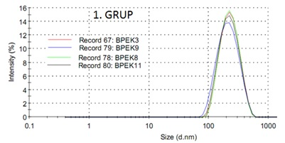
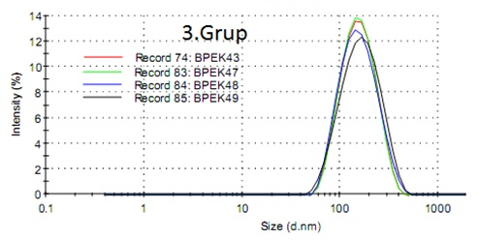
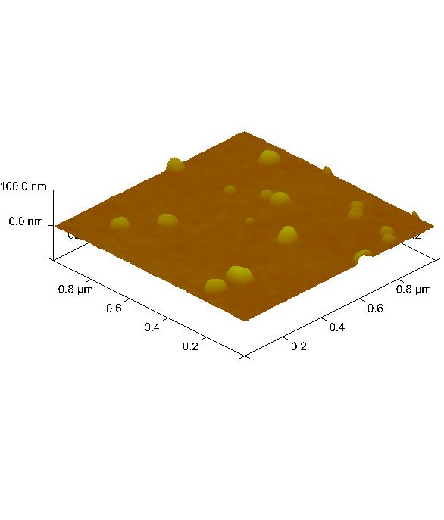
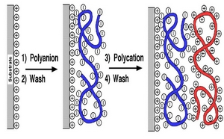
POLYELECTROLYTE COMPLEX AND LAYER BY LAYER TECHNIQUE OF STARCHES
Sedat Ondaral, Güliz Hocaoğlu, Mehmet Emin Ergün, Orçun Çağlar Kurtuluş, Evren Ersoy Kalyoncu
Department of Pulp and Paper Technology, Forets Product Engineering, Faculty of Forestry, Karadeniz Technical University, 61080 Trabzon, Turkey
Polyelectrolyte complexes
Mixing cationic and anionic starches
Schematic representation of (a) ladder and scrambled egg structures
Multilayer (Layer by Layer)
Size distribution in solution (Zetasizer) and images on silicon oxide surface (AFM)
Adding cationic and anionic starches, sequentially

Slide 2
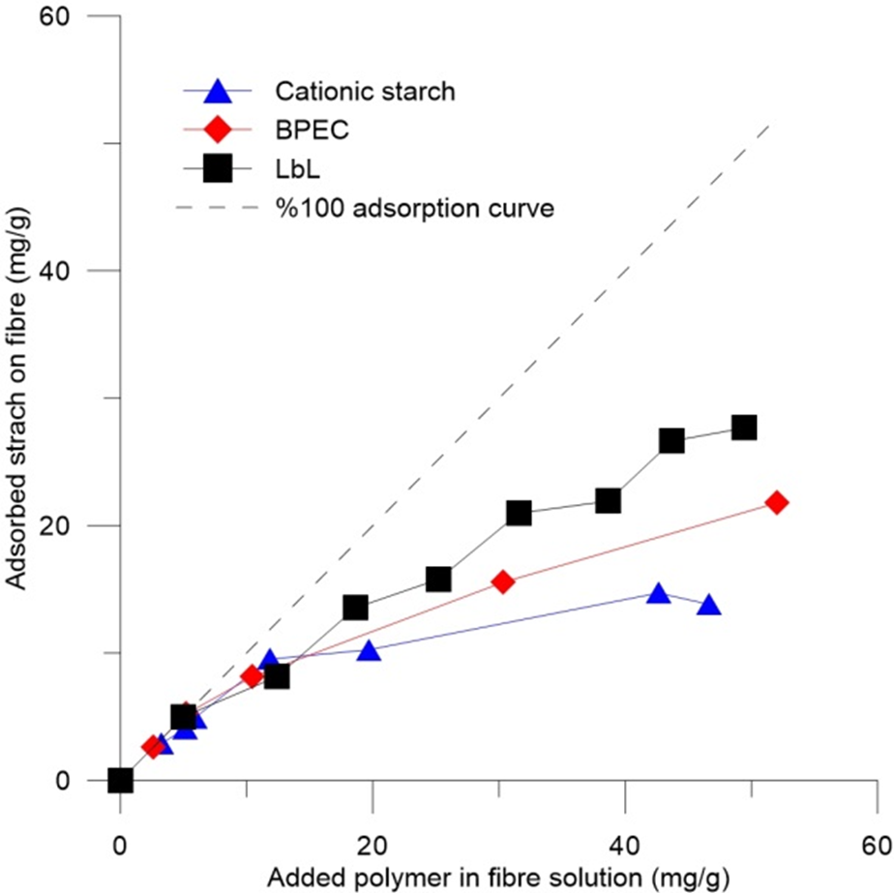
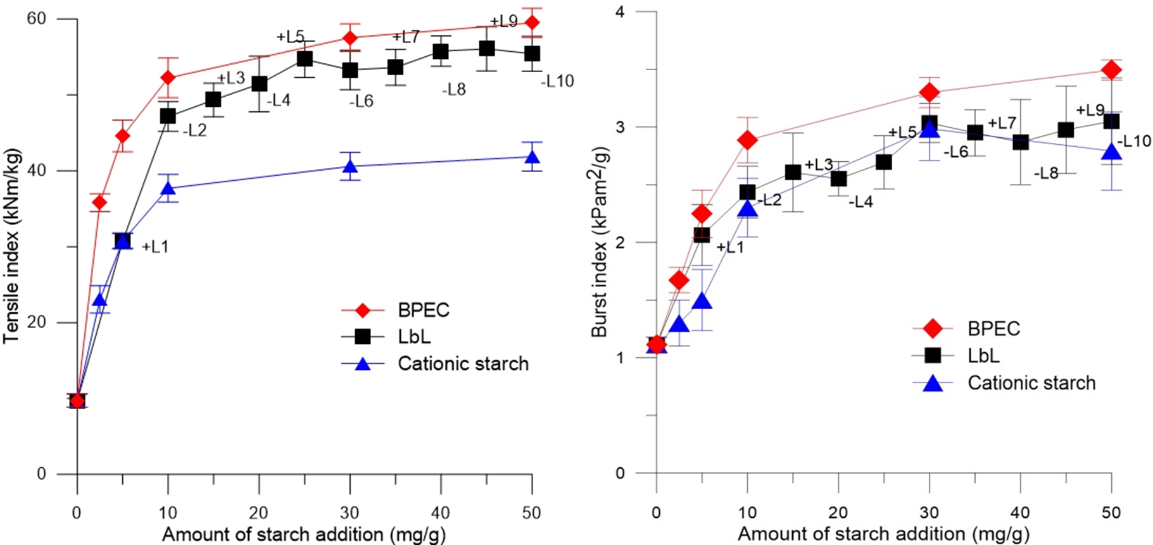
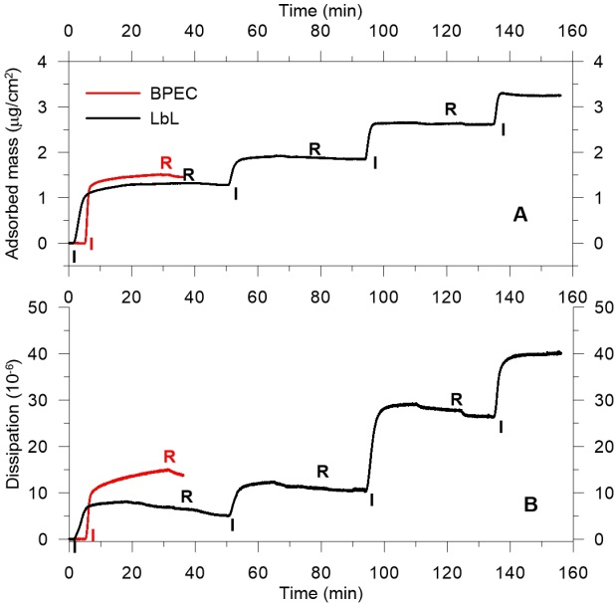
Which is more convenient technique for papermaking?
The LbL technique can provide more polymeric layers on the fibre surface giving also different functionalities to paper. However, building multilayer is not easy before sheet formation in the papermaking process. It is still possible to make 3-4 layers on the fibre surface.
BPEC application needs one addition point and thus, has enough shearing forces and mixing time.
ADSORPTION ON FIBRE
PAPER STRENGTH
ADSORPTION SiO2 SURFACE

