Slide 1
Understanding wood cell wall structure, biopolymer interaction and composition for current products and new materials
FP1105: WoodCellNet
Start date: 01/07/2012
End date: 23 May 2016
Year: 3
Workshop No 6
Philip Turner
Chair of the Action

Slide 2
FP1105 Action overview

Slide 3
Activities to the end of the Action.
Coordination of multidisciplinary proposals.
Planning and promoting training schools. Two this coming year.
Broadening access to skills and specialist equipment (STSM’s and joint proposals)
Two more multidisciplinary workshops
Publications (please let us know)
End of Action publication

Slide 4
Reimbursement forms
Ensure you submit your reimbursement forms online as quickly as possible.
Within 2 weeks!

Slide 5
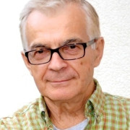
Arnis Tremanis Latvia Vice chair of FP1105
Arnis passed December 19th
1940-2014.
He will be missed
RIP

Slide 6
Thank you
Maria, Luis and Jalel from the Basque Country University for organising and hosting this workshop.

