Slide 1
Understanding The Cell Wall Structure – How it can Help the Pulp and Paper Industry
Gopal Goyal
Chief Scientist, International Paper
October 9th, 2013

Slide 2
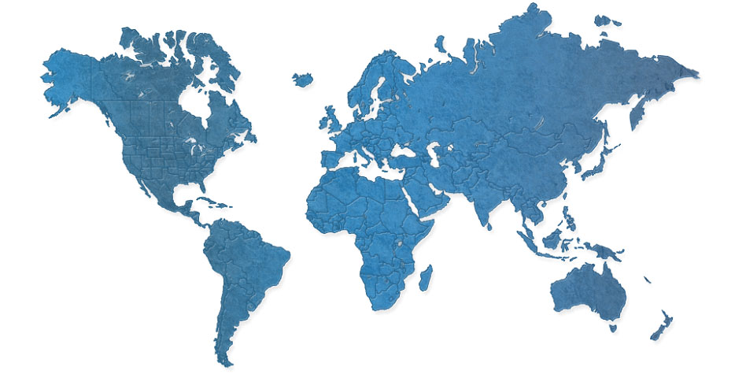
Global Manufacturing
IP Europe
2.5 MM Tons
4,450 mill employees
Ilim - Russia
2.5 MM Tons
6,600 mill employees
North America
18.9 MM Tons
11,000 mill employees
IP India
0.2 MM Tons
3,600 mill employees
IP Sun - Asia
0.9 MM Tons
1,600 mill employees
IP Brazil
1.7 MM Tons
3,100 mill employees
Support Resources
Technology 179
Global Sourcing 410
EHS&S 40
44 Mills / 27MM Tons / 30,350 people
Notes:
GLOBAL MANUFACTURING - IP has manufacturing operations in North America, Europe, Latin America, Russia, Asia and North Africa.
We have 44 mills word wide and we have grown through acquisition over the period last 10 years
We have the largest global technology group made of world class subject matter experts engaged in manufacturing support and research

Slide 3
International Paper Company
PAPERS and
FLUFF PULP
INDUSTRIAL
PACKAGING
CONSUMER
PACKAGING
Notes:
In 2008 we divested our coated and SC, forest lands and Arizona chemicals and decided to focus on these three businesses
we have grown our fluff business by converting our Franklin mill to fluff pulp

Slide 4
A Pulp Mill Case Study
Can a single wood sps. produce two very different pulps from two different lines at same location?
What could cause this phenomenon?
Can the difference in the cell wall structure explain these differences since starting wood material has the same cell wall structure?

Slide 5
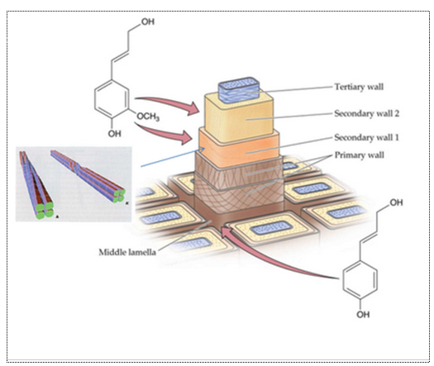
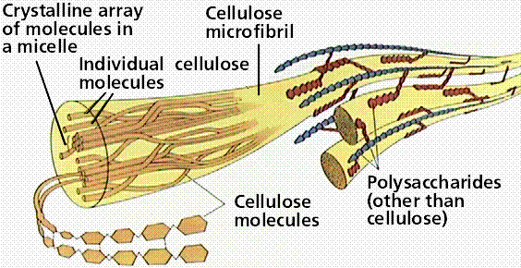
Cell Wall Structure

Slide 6
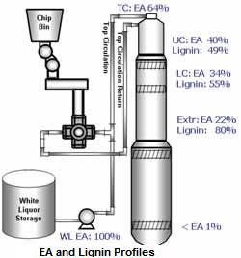
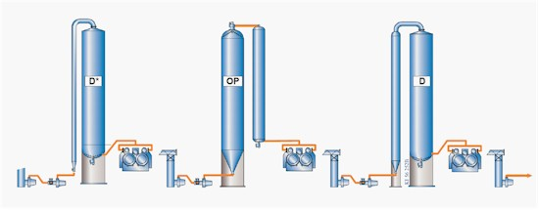
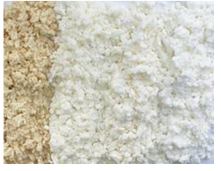
An Overview Of a Pulp Mill
Pulping
Bleaching
5% Lignin removal requires
Three Bleaching Stages
95% Lignin
Removed

Slide 7
Background
During recent D₀ washer failure on the K2 hardwood line, the K1 line was utilized for hardwood.
Samples were profiled through the K1 bleach plant.
Comparison was made to the samples profiled through the K2 bleach plant in February

Slide 8
Zero Span
K1 pulp better than K2
K2 Hardwood (February 9): Brownstock O2 Delig Fully Bleached
K1 Hardwood (April 23): : Brownstock O2 Delig Fully Bleached

Slide 9
Curl and Kinks
K2 Hardwood (February 9): Brownstock O2 Delig Fully Bleached
K1 Hardwood (April 23): : Brownstock O2 Delig Fully Bleached

Slide 10
Observations:
Brown stock from K1 digester is stronger than K2 from same wood source
Both K1 and K2 brown stocks loose strength in oxygen deliginification stage.
Further strength loss occurs in ECF bleachig sequence of these which is very unusual

Slide 11
Comparison of Oxygen Delignification stages at two Different Mills
Brownstock
O₂ Delignification
Fully Bleached

Slide 12
Tensile Index
Tex: No strength loss
K2 Hardwood (February 9): Brownstock O2 Delig Fully Bleached
Texarkana Hardwood (Jan): : Brownstock O2 Delig Fully Bleached

Slide 13
Zero Span
Tex: No loss in zero span tensile across O2. (did not measure on fully bleached)
K2 Hardwood (February 9): Brownstock O2 Delig Fully Bleached
Texarkana Hardwood (Jan): : Brownstock O2 Delig Fully Bleached

Slide 14
Lab versus Mill PUlp

Slide 15
Refining Response of Mill Brown Stock (K1)Followed by Lab O2 and DEopD Bleaching
Lab K1 pulp did not show much change in CSF through process

Slide 16
Refining Response of Mill Brown Stock (K2)Followed by Lab O2 and DEopD Bleaching
Lab K2 pulp did not show much change in CSF through process
K2 pulp showed similar CSF with that of K1

Slide 17
Tear Index Vesus Freeness (K1)
Lab K1 pulp did not show much change in tear through process

Slide 18
Tear Index Vesus Freeness (K2)
Lab K2 pulp did not show much change in tear through process
K2 pulp showed similar tear with that of K1

Slide 19
Tensile Index Versus Freeness(K1)
Lab O2 did not decrease the tensile, while fully bleached K1 pulp showed a little higher tensile

Slide 20
Tensile Index Versus Freeness(K2)
K1 and K2 showed similar trend in tensile strength

Slide 21
Bulk Versus Freeness (K1)
Bulk decreases at D1 stage for K1

Slide 22
Bulk Versus Freeness (K2)
Similar trend for K2
K2 showed similar bulk compared to K1

Slide 23
Tear versus tensile K1
Tear vs tensile did not change much through the process for K1

Slide 24
Tear versus Tensile K2
Tear vs tensile did not change much through the process for K2
K2 showed similar tear vs tensile compared to K1

Slide 25
Observation from the Lab Studies
Brown stock from either K1 or K2 does not lose strength after lab oxygen delignification
Lab oxygen delignified pulp do not lose strength in subsequent ECF bleaching

Slide 26
Colclusions
All these pulps started out with the same wood and the same cell wall structure
However upon further processing the same cell wall results in two very different end products

Slide 27
Role of Cell Wall Structure?
Can these differences be explained be explained based on the cell wall structres of theses pulps?
Chemical differences?
Morphological differences?

