Slide 1
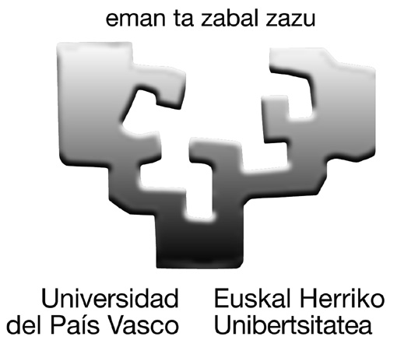
Obtaining of eucalyptus microfibrils for adsorption of aromatic compounds in aqueous solution
Iñaki Urruzola, Eduardo Robles, Luis Serrano, M. Ángeles Andrés, Jalel Labidi
Department of Chemical and Environmental Engineering. University of the Basque Country, Pza. Europa 1, 20018 San Sebastián, Spain jalel.labidi@ehu.es

Slide 2
Objectives
Chemical and mechanical treatments have been used to obtain cellulose microfibils using bleached eucalyptus pulp as raw material
Modification of microfibrils to increase the adsorption capacity
Adsorption studies, using different organic solutes in an aqueous solution.
Methodology
ACETILATION
2ml HNO₃ + 12ml CH₃COOH+ 0,6gFm
T = 130 ºC t = 30min
HYDROLYSIS
8.75ml H₂SO₄ (32%) + 1g FMA
T = 45 ºC t = 60min
Chemical Microfibrils
EUKALYPTUS BLEACHED PULP
HOMOGENIZATION
40 passes
1000 bar
Mechanical Microfibrils
Functionalization of microfibrils
Elimination of water by azeotropic distillation. Next, Addition of palmitic acid, a dehydration agent N-N’ Dicyclohexylcarbodiimide (DCC), and the catalyst (DMAP). Finally, putting all in a toluene/DMF (60/40) mixing at 80ºC for 3h with reflux
Notes:
From which jute microfibrils were obtained. step

Slide 3
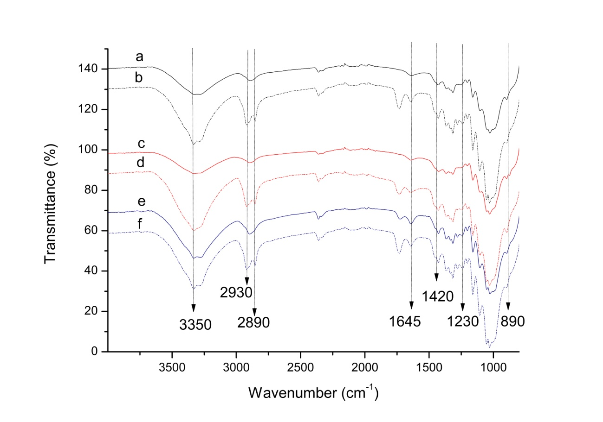
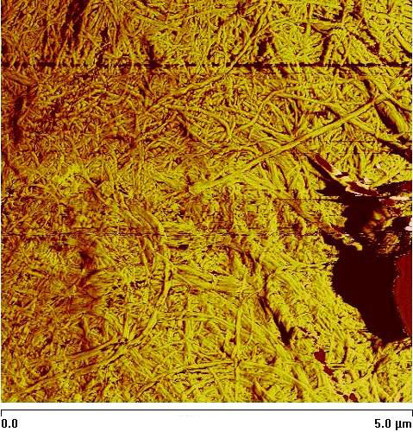
Results
Infrared spectroscopy
Contact angle measurements
 | Eucalyptus Pulp | Modified Eucalyptus | Chemical microfibrils | Modified Chemical microfibrils | Mechanical microfibrils | Modified Mechanical microfibrils
θ | 38.17 ± 3.81 | 94.27 ±6.27 | 46.58. ± 3.8 | 87.48 ± 2.81 | 42.63± 3.74 | 98.76 ± 6.77
a) Eucalyptus pulp, b) Modified Eucalyptus, c) Mechanical microfibrils, d) Modified Mechanical microfibrils, e)Chemical microfibrils, f) Modified Chemical microfibrils
left) Chemical microfibrils, right) Modified chemical microfibrils
Chemical and mechanical treatments have been reduced the fibers size significantly
FTIR spectrum of microfibrils, after treatment with palmitic acid, shows a new peak at 1745cm⁻¹ corresponding to the carbonyl vibration of the ester group formed in the reaction.
Contact angle measurements reveals that modified fibres have a higher hydrophobic characters.
The nanofibres obtained with mechanical treatments did not show significant differences
AFM image of mechanically treated fibers with the homogenization method

Slide 4
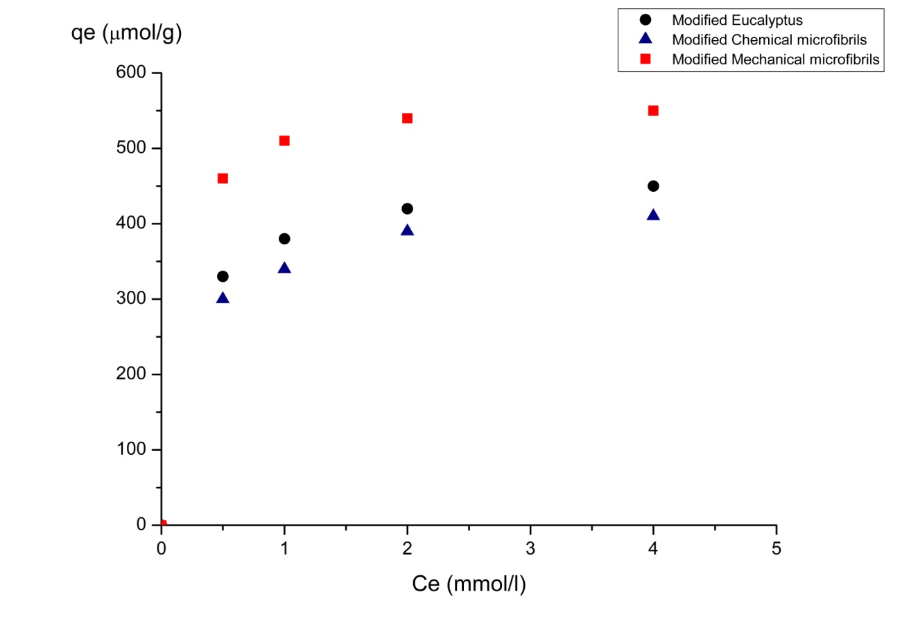
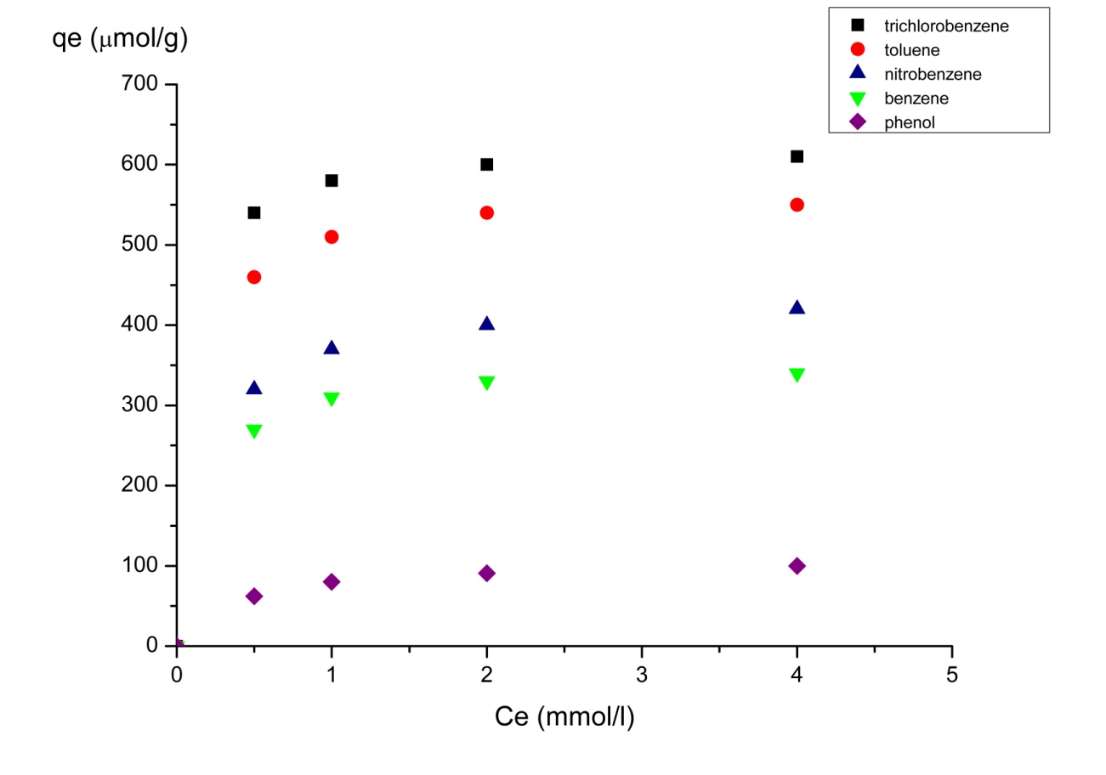
Batch adsorption studies
Langmuir isotherms for toluene with modified fibers
Langmuir isotherms for various organic solutes using modified mechanical microfibrils
The adsorption capacity of the modified fibers was measured with toluene
Mechanical microfibrils presented the best results, adsorbing more than 600 µmol/g.
These mechanical microfibrils were used to measure the adsorption capacity with various organic solutes and Langmuir isotherms were established.

Slide 5
Acknowledgements
Thank you for your attention
Iñaki Urruzola, Luis Serrano, Rodrigo Llano-Ponte, Ma. Ángeles de Andrés, Jalel Labidi, Obtaining of eucalyptus microfibrils for adsorption of aromatic compounds in aqueous solution, Chem. Eng. J. 229(2013) 42-49

