Slide 1
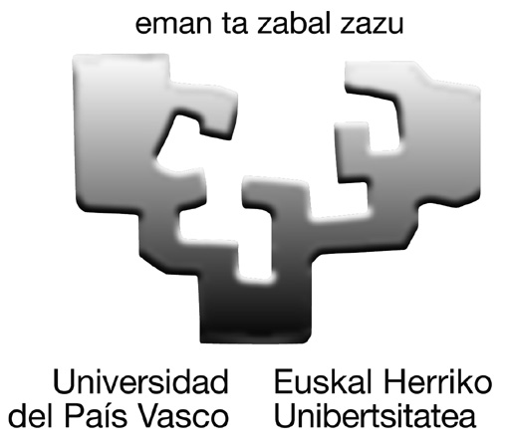
Extruded PLA/Lignin based composites: effect of lignin on PLA THERMAL properties
Oihana Gordobil,
Itziar Egüés, Rodrigo Llano-Ponte, Jalel Labidi
Trabzon, 8th October 2013
Biorefinery Processes Group
Department of Chemical and Environmental Engineering. University of the Basque Country, Pza. Europa 1, 20018 San Sebastian, Spain
jalel.labidi@ehu.es

Slide 2
Objectives
• Increase the thermal stability of the PLA by the addition of different lignins
• Extract lignin from natural resources such as almond shells
• Acetylation of lignins to improve affinity with PLA
• Characterization of unmodified and acetylated lignins
• Elaboration composites and evaluate the effect of lignin addition in thermal properties of PLA
Methodology

Slide 3
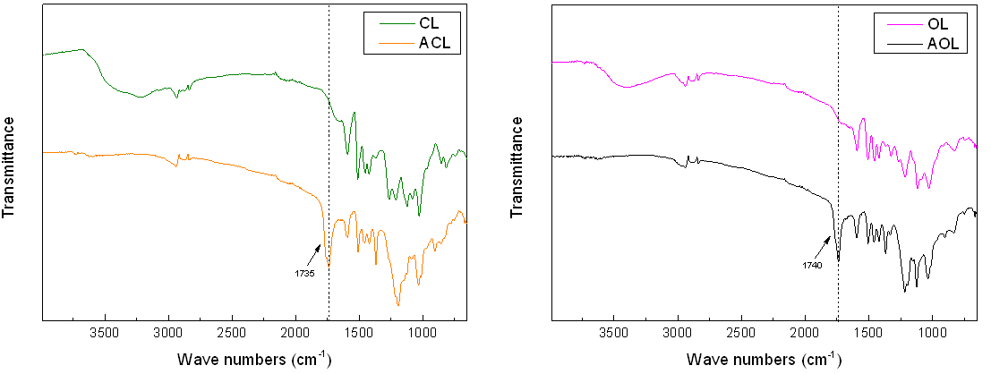
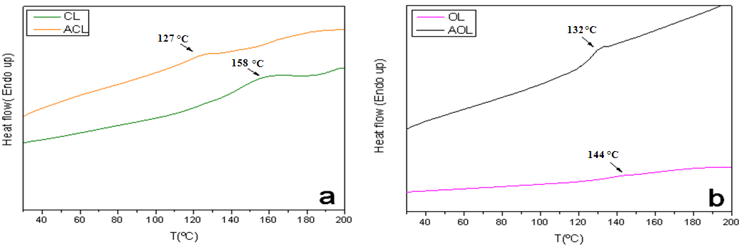
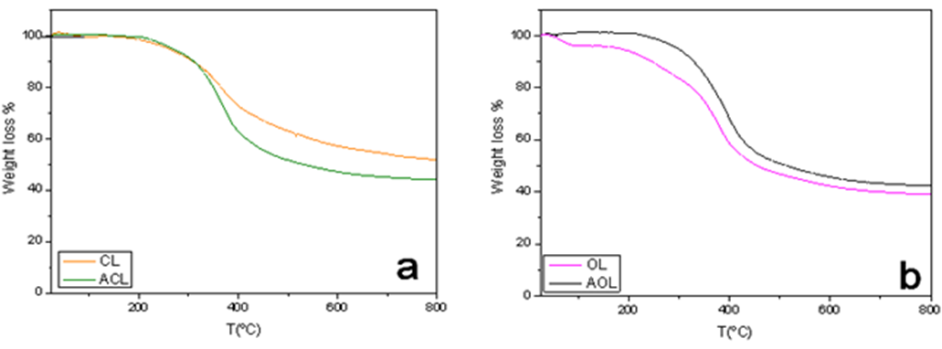
Results
Lignin purity analysis
Infrared spectroscopy
 | CL | ACL | OL | AOL
Klason Lignin % | 82.6 | 88 | 81.4 | 90.2
Total Sugars % | 1.2 | 0.3 | 3.8 | 0.7
Xylose | 1 | 0.3 | 3.6 | 0.7
Arabinose | 0.2 | - | - | -
Glucose | - | - | 0.1 | -
Acetic acid % | 0.4 | 7.5 | 0.9 | 7.8
FTIR of commercial lignin (CL), acetylated commercial lignin (ACL), organosolv lignin (OL) and acetylated organosolv lignin (AOL).
Thermal properties
• All the used lignins for the composites elaboration, showed high purity (>80%) with low quantities of sugars (0.3-3.8%). In both cases, acetylated lignins reflected an increased purity and a reduction of sugar content.
• FTIR spectrum of CL and OL after acetylation treatment showed a new peak at 1735 cm⁻¹, corresponding to a carbonyl vibration of the ester group formed in the reaction. This indicates that the acetylation process was successful.
• Acetylated lignins showed lower glass transition temperature and higher thermal stability than unmodified lignins.
DSC of (a) CL and ACL and (b) OL and AOL
TG curves of (a) CL and ACL, (b) OL and AOL

Slide 4
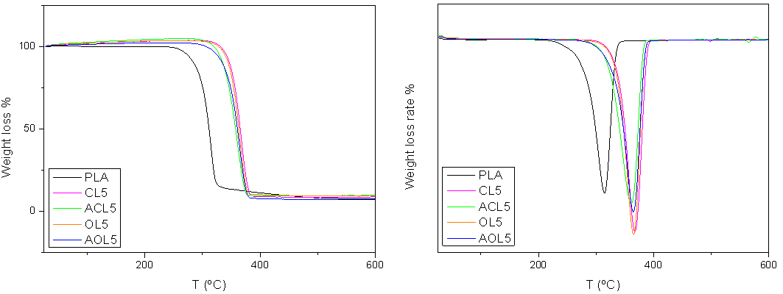
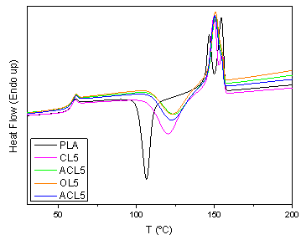
Results
Thermal properties of composites
The addition of lignin showed:
- Thermal stability of the PLA increses.
- No significant change in T_{g} of PLA.
- Crystallization temperature increase.
- Melting temperature increase.
TG and DGT curves of PLA and composites 5%
The introduction of lignin (amorphous in nature) affected the interactions among the PLA chains.
This cause that the PLA chains had less mobility and crystallize with greater difficulty and higher temperatures.
DSC thermogram of PLA, composites with unmodified lignins and acetylated lignins (2º heating)

Slide 5
Acknowledgements
Thanks for your attention

