Slide 1
FP1105: Understanding wood cell wall structure, biopolymer interaction and composition: implications for current products and new material innovation
Management Committee meeting
Empa Academy, Switzerland 1st of September 2015

Slide 2
1. Adoption of the Agenda
1. Adoption of agenda
2. Matters arising
3. COST Action FP1105 update
3.1 Status of Action, including participating countries
3.2 Budget Status, budget planning and allocation process (LOS t.b.a)
3.3 COST office update
4. Action planning
4.1 Action Budget Planning
4.2 Action Planning (including meetings)
4.3.1 Location and date of next meeting
4.3.2 Plans for the remainder of the Action (locations and dates of future meetings)
5. STSM status, applications
6. Publications, dissemination and outreach activities
7. Promotion of gender balance and of Early Stage Researchers (ESR)
8 Non-COST country participations
9. AOB

Slide 3
2. Matters arising from previous MC meeting
Finalize the provisional budget for the 2015/16 financial year

Slide 4
Agenda
1. Adoption of agenda
2. Matters arising
3. COST Action FP1105 update
3.1 Status of Action, including participating countries
3.2 Budget Status, budget planning and allocation process (LOS t.b.a)
3.3 COST office update
4. Action planning
4.1 Action Budget Planning
4.2 Action Planning (including meetings)
4.3.1 Location and date of next meeting
4.3.2 Plans for the remainder of the Action (locations and dates of future meetings)
5. STSM status, applications
6. Publications, dissemination and outreach activities
7. Promotion of gender balance and of Early Stage Researchers (ESR)
8 Non-COST country participations
9. AOB

Slide 5
3.2. Status of the COST Action
MoU | oc-2011-1-9681
CSO Approval date | 01/12/2011
Start of Action | 24 My 2012
Entry into force | 12/01/2012
End of Action | 23 May 2016
24 May 2012

Slide 6
3.2. Status of Action: participating countries
24 COST countries
Austria | Latvia
Bulgaria | Luxembourg
Croatia | Norway
Czech Republic | Poland
Denmark | Portugal
Finland | Romania
France | Slovenia
Germany | Spain
Greece | Sweden
Hungary | Switzerland
Israel | Turkey
Italy | United Kingdom

Slide 7
3.2. Status of Action: COST countries not participating in the Action
COST countries NOT signed up to the FP1105 Action
Bosnia and Herzegovina
Brussels
Cyprus
Estonia
Iceland
Ireland
Lithuania
Malta
Netherlands
Slovakia
Sebia
Former Yugoslav Republic of Macedonia Montenegro

Slide 8
3.2. Status of Action: FP1105 Participation
24 countries participating from a total of 36

Slide 9
FP1105 Cost Action Links
COST Action FP1006: Bringing new functions to wood through surface modification
COST Action FP1205: Innovative applications of regenerated wood fibres
COST Action FP0901: Analytical techniques for biorefineries
COST Action MP1006: Fundamental Problems in Quantum Physics

Slide 10
3.2. Budget Status: Changes approved
Seventh and last Workshop: Zurich. Original budget €35,700 for 35 participants changed to €45,900.00 for 45 participants.
Training school €21,440.00 last year cancelled and moved to this financial year. Budget available for two training schools.
Summer school in Espoo: 23,080€
Training school in Latvia: 20,020€
12,150 € for STSM's for 8 that will be increased to 13,820 €.

Slide 11
3.3. Budget Status: Local organiser support
Local organiser support for Zurich requires MC approval:
45 participants x 20€ per day/per participant = 1,800€ (depends on the number of participants that have finally attended the workshop, so this amount it can vary)

Slide 12
Agenda
1. Adoption of agenda
2. Matters arising
3. COST Action FP1105 update
3.1 Status of Action, including participating countries
3.2 Budget Status, budget planning and allocation process (LOS t.b.a)
3.3 COST office update
4. Action planning
4.1 Action Budget Planning
4.2 Action Planning (including meetings)
4.3.1 Location and date of next meeting
4.3.2 Plans for the remainder of the Action (locations and dates of future meetings)
5. STSM status, applications
6. Publications, dissemination and outreach activities
7. Promotion of gender balance and of Early Stage Researchers (ESR)
8 Non-COST country participations
9. AOB

Slide 13
3.2. Budget Planning
Grant period: 01/07/2015 - 23/05/2016
Allocated budget: € 128, 333
A. SUMMARY BUDGET
(1) TRAVEL COST FOR MEETINGS 56810 €
(2) SHORT-TERM SCIENTIFIC MISSIONS 13820 €
(3) TRAINING SCHOOLS 40,420 €
(4) PUBLICATIONS, DISSEMINATION, OUTREACH 500 €
(5) OTHER EXPENSES 0 €
B. TOTAL SCIENCE EXPENDITURE (sum of (1) to (5)) 111,550 €
C. Financial & Scientific Administration and Coordination
(max. of 15% of B.) 16,732.50 €
D. TOTAL EXPENDITURE (B+C) 128,282.50 €

Slide 14
4.2. Action budget planning
Workshops
Final workshop
Location: | Zurich, Switzerland
Date: | 31 August and 1 September 2015
Number of participants to be reimbursed: | 45
Travel costs: | £500.00 | 22,500.00 €
Accommodation costs (3 nights): | 120.00 | 16,200.00 €
Daily allowance: | £20.00 | 5,400.00 €
Organisational support: | £40.00 | 1,800.00 €
 |  | 45,900 €
Final Core group/publication task group
Location: | Belgium, Brussels
Date: | t.b.d.
Number of participants to be reimbursed: | 11
Travel costs: | 500.00 | 5,500.00€
Accommodation costs (3 nights): | £120.00 | 2,640.00 €
Daily allowance: | £20.00 | 1,320.00 €
Organisational support: | £40.00 | 440.00 €
 |  | 9,900 €

Slide 15
4.2. Action budget planning
STSM
8 STSMs |  | 13820 €

Slide 16
4.2. Action budget planning
TRAINING SCHOOLS
Title: | Frontiers in lignocellulosic nanoparticles: metrology and applications
Location: | Espoo, Finland
Date: (4 days) | 22-25 September
Number of participants to be reimbursed: | 20
Trainees daily grant: | 160 € | 12,800.00
Trainees Flight | 300 € | 6,000.00
Number of Trainers to be reimbursed: | 2
Travel, accommodation & meals costs: |  | 2,960.00
Organisational support: | 20€/day | 1,320.00
 |  | 23,080.00 €

Slide 17
4.2. Action budget planning
TRAINING SCHOOLS
Location: | Riga, Latvia
Date: (4 days) | March 2016
Number of participants to be reimbursed: | 15
Trainees daily grant: | 160 € | 9,600.00
Trainees Flight | 300 € | 4,500.00
Number of Trainers to be reimbursed: | 3
Travel, accommodation & meals costs: |  | 4,560.00
Organisational support: | 20€/day | 1,360.00
 |  | 20,020.00 €

Slide 18
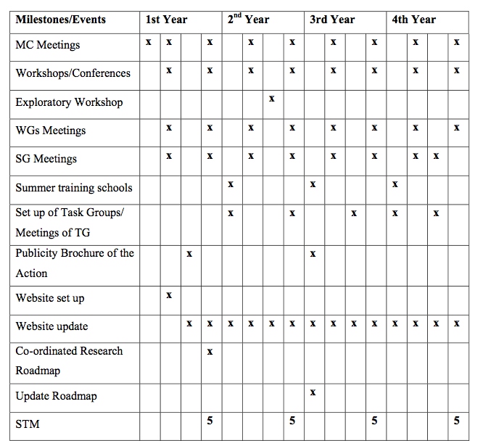
4.3. Action planning

Slide 19
4.3.1 Action planning: Location of next meeting
N/A

Slide 20
4.3.2 Action planning: Long term planning
N/A

Slide 21
Agenda
1. Adoption of agenda
2. Matters arising
3. COST Action FP1105 update
3.1 Status of Action, including participating countries
3.2 Budget Status, budget planning and allocation process (LOS t.b.a)
3.3 COST office update
4. Action planning
4.1 Action Budget Planning
4.2 Action Planning (including meetings)
4.3.1 Location and date of next meeting
4.3.2 Plans for the remainder of the Action (locations and dates of future meetings)
5. STSM status, applications
6. Publications, dissemination and outreach activities
7. Promotion of gender balance and of Early Stage Researchers (ESR)
8 Non-COST country participations
9. AOB

Slide 22
STSM status
 | 1st Year | 2nd Year | 3rd Year | 4th Year
STSM | 8 | 8 | 8 | 8
SHORT-TERM SCIENTIFIC MISSIONS BUDGET (14/15): 18,000 (2 250€/STSM)
SHORT-TERM SCIENTIFIC MISSIONS BUDGET (15/16): 13820 (1725€/STSM)

Slide 23
5. STSM applications
Approved STSM for 2014 - 2015
Applicant | Host Institution | Duration (days) | Grant (€)
Dr Emil Engelund Thybring | Aalto University | 5 | 800
Dr Beata Podkoscielna | The Royal Institute of Technology, KTH, | 14 | 1,800
Ms Gabriella Josefsson | University of Helsinki | 5 | 650
Ms Marina Jajcinovic | Tampere University of Technology | 5 | 1,039
Dr Olena Sevastyanova | Maria Curie University | 7 | 840
Mr Alejandro Salvador Polo | University of Coimbra | 14 | 1,200
Dr Carmen-Mihaela Popescu | The Norwegian Forest and Landscape Institute | 14 | 1,900
Mr Florian Zikeli | University of Rome | 18 | 1,330

Slide 24
5. STSM applications
Approved STSM for 2015 - 2016
Applicant | Host Institution | Duration | Grant
Mr Abdul Ghafar | Hamburg University | 3 months | 2,500
Michael Kowalzky | Latvian State Institute of Wood Chemistry | 3 months | 2,500
Dr Olena Sevastyanova | Latvian State Institute of Wood Chemistry | 10 days | 1,020
Mr Florian Zikeli | University of Rome, Department of Chemical Sciences and Technologies | 53 days | 1,800
Juan Buffa | VTT | 60 days | 1,500
Alina Lozhechnikova | ETH Zurich | 83 days | 1,500
Jon Trifol | KTH | 54 days | 1,500€
Emiko Murozuka | Tor Vergata University | 43 days | 1,500€

Slide 25
Agenda
1. Adoption of agenda
2. Matters arising
3. COST Action FP1105 update
3.1 Status of Action, including participating countries
3.2 Budget Status, budget planning and allocation process (LOS t.b.a)
3.3 COST office update
4. Action planning
4.1 Action Budget Planning
4.2 Action Planning (including meetings)
4.3.1 Location and date of next meeting
4.3.2 Plans for the remainder of the Action (locations and dates of future meetings)
5. STSM status, applications
6. Publications, dissemination and outreach activities
7. Promotion of gender balance and of Early Stage Researchers (ESR)
8 Non-COST country participations
9. AOB

Slide 26
6. Publications, dissemination and outreach activities
Main focus - end of Action scientific publication - on track, directed by the publication task group:
Planned dissemination for the end of Action publication. To be discussed.

Slide 27
7. Promotion of gender balance and ESR
 | Year 1 | Year 2 | Year 3 | Year 4
Total No. of Individuals | 147 | 192 | 230 | 285
ESRs | 30 | 30 | 52 | 78
Female | 42 | 66 | 85 | 102

Slide 28
8. Non-COST country participations
8 Non-COST countries
Argentina
Australia
Brazil
Canada
China
New Zealand
South Africa
US

Slide 29
11. AOB

