Slide 1

Centre for Mind and Creativity Research (CEDAR)
Marina Wimmer (SAS), Suha Jaradat (SCEBE)

Slide 2
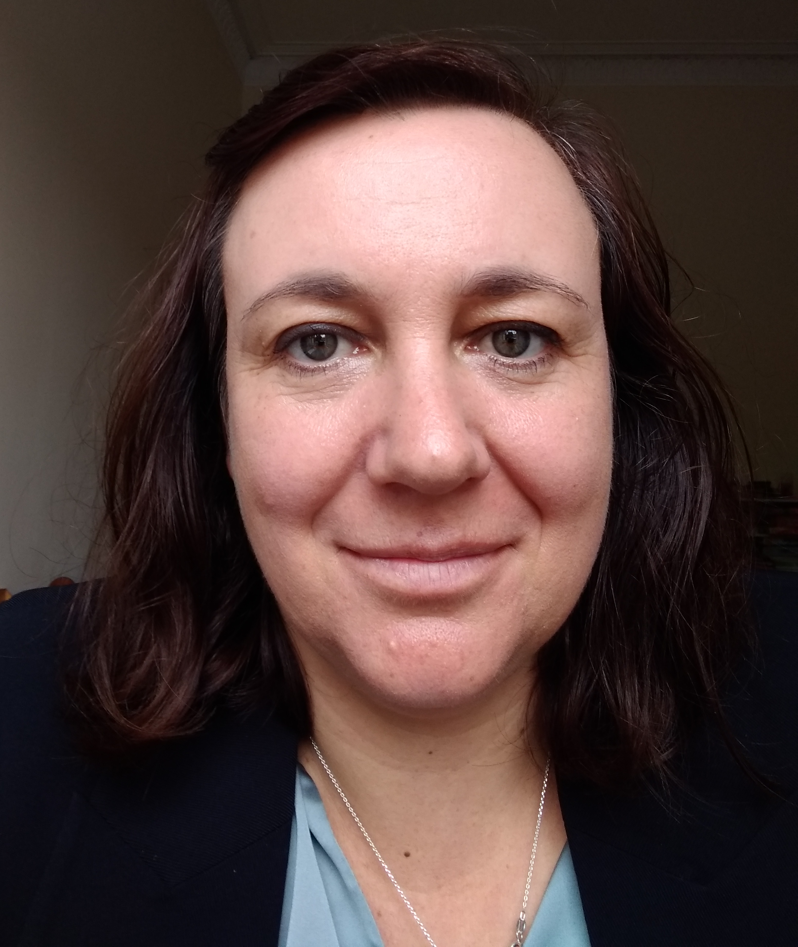
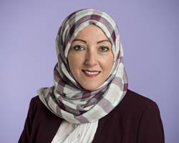
CEDAR (Centre for Mind and Creativity Research) Leads
Marina Wimmer (SAS, Psychology)
  Research lead- Psychology
  Expert in cognition and cognitive development
Suha Jaradat (SCEBE, Computing, Engineering and Built Environment)
  Research lead-Built Environment
  Expert in architectural technology, interaction of buildings and people

Slide 3
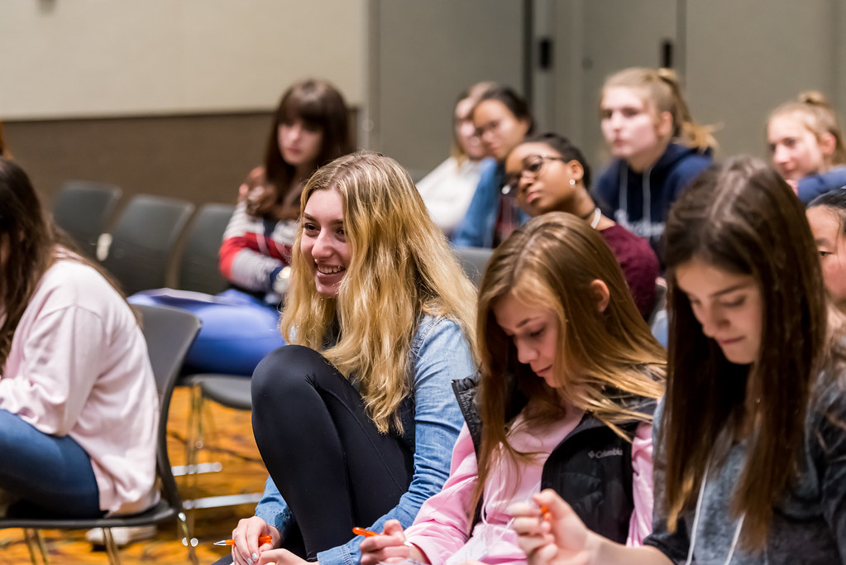

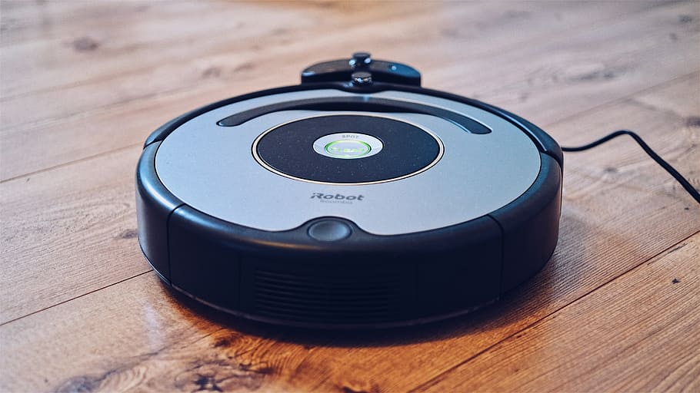

Societal and Economic Challenges: “Mind and Creativity” needed
Challenge 1: Humans need to adapt in a fast changing world for sustained productivity
  OECD, Education Project, 2030
  WEF, Future of Jobs Report, 2020
  WHO, 2019
Challenge 2: Environments are limited in adaptation (buildings, infrastructure, software, machines)
  Darpa, 2018
  UN, 2021 (“urgent need for resilient infrastructure”. sustainable development goals 9: industries, innovation and infrastructure; 11 sustainable cities and communities)

Slide 4

Vision for CEDAR
(Centre for Mind and Creativity Research)
Challenge 1: Humans adapting to environmental changes
  Address a societal challenge relating to security or the environment (STFC, £2,000,000)
  Healthy ageing catalyst awards (UKRI, £1,600,000)
Challenge 2: Environmental adaption with human cognition at its core
  Build a network to enable resilient solutions for future UK systems (EPSRC, £2,250,000)
  High-risk speculative engineering and ICT research: new horizons (EPSRC, 10,000,000)

Slide 5

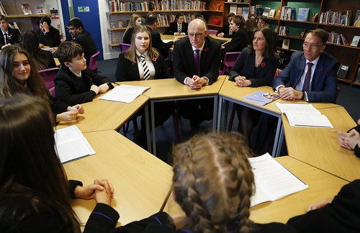


Vision for CEDAR
(Centre for Mind and Creativity Research)
Challenge 1: Humans adapting to environmental changes
  Research from Arts
  Research from Psychology
  Decision Science
Challenge 2: Environmental adaption with human cognition at its core
  Research from the Built environment
  Research from computing

Slide 6
Key Features
Overlap with computer science?
  Cognition at its core and not an add on
  Broader environment: climate, buildings, software, infrastructure in general
Professorial input
  4 professors
  International external professorial advisory group
Critical mass
  £700k in current grants =19 active grants, excluding 4 professors
  13 PhD students with DoS in CEDAR
  Potential for growth: bringing smaller excellence clusters together

Slide 7
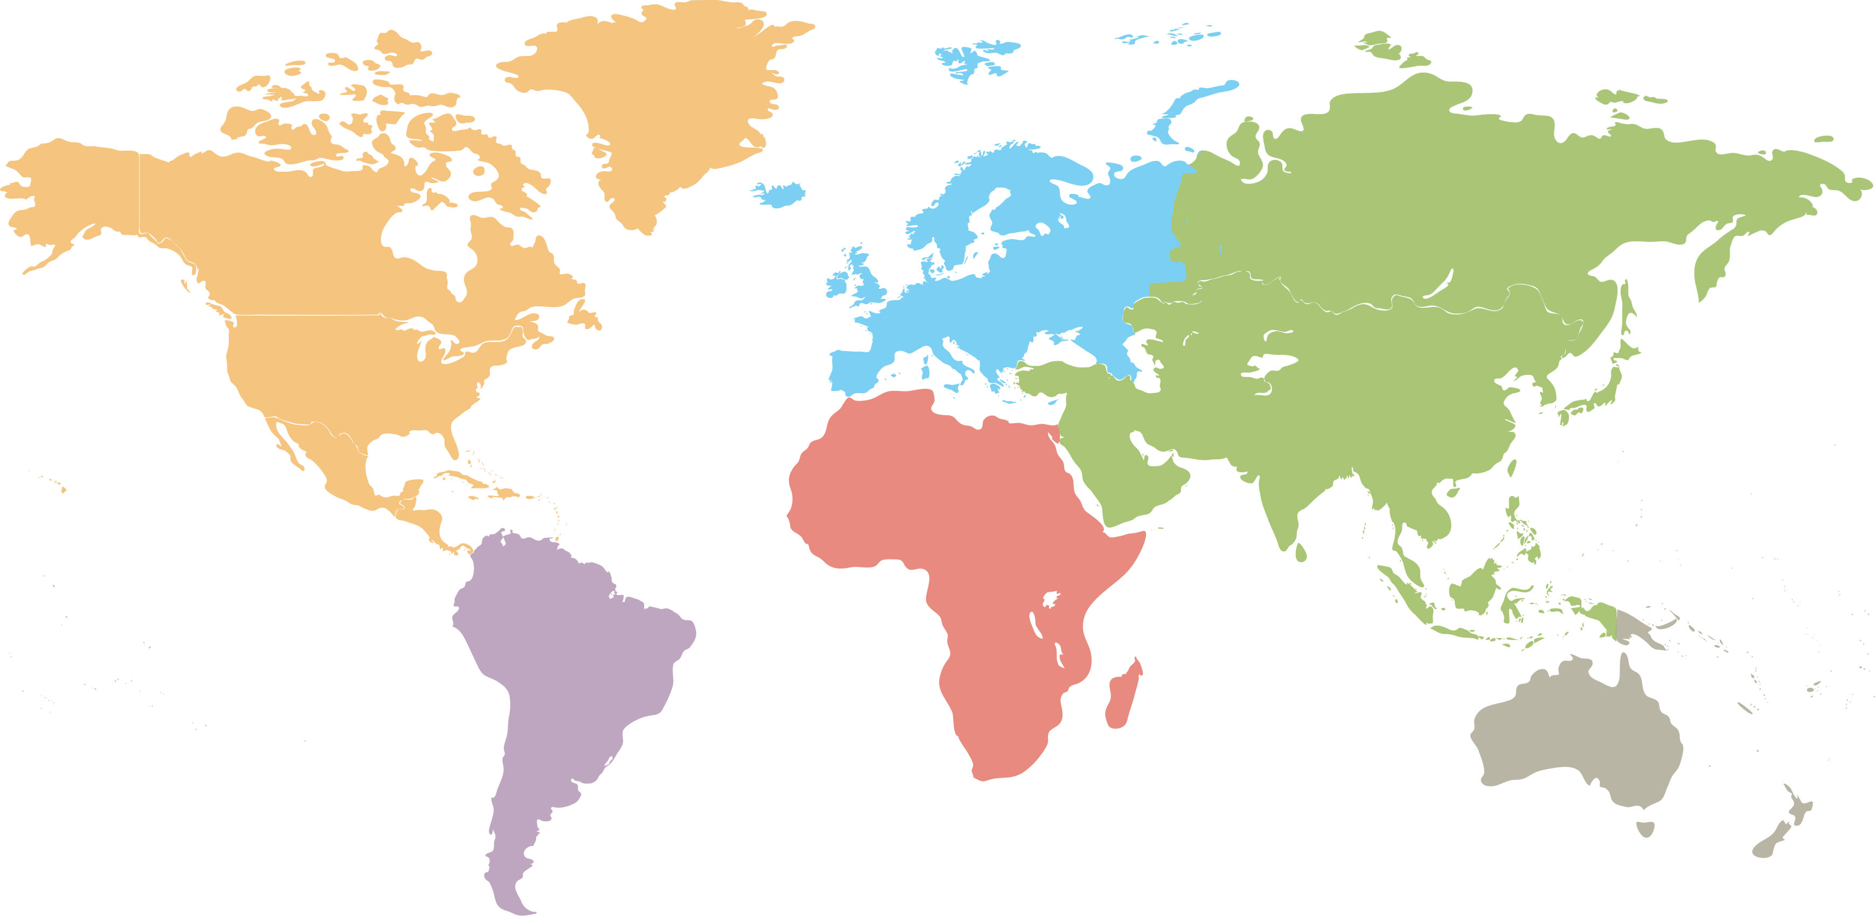
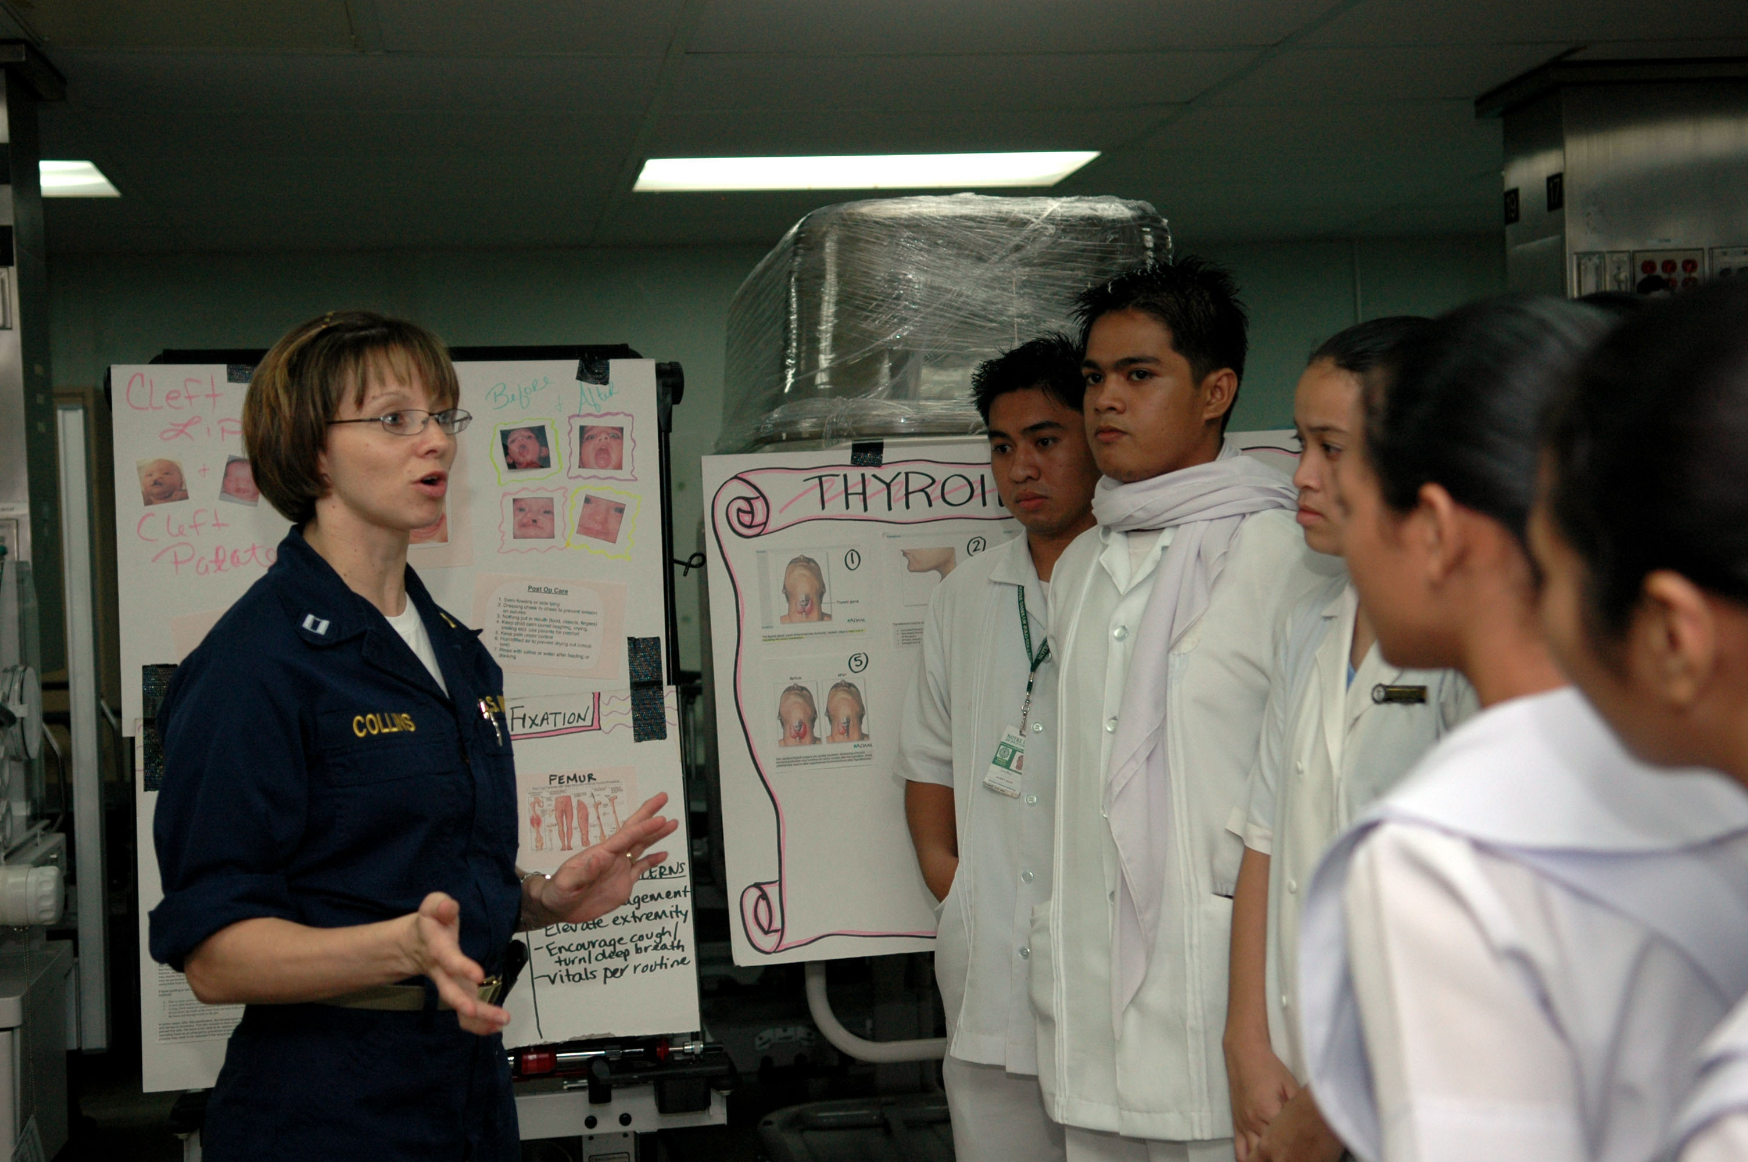
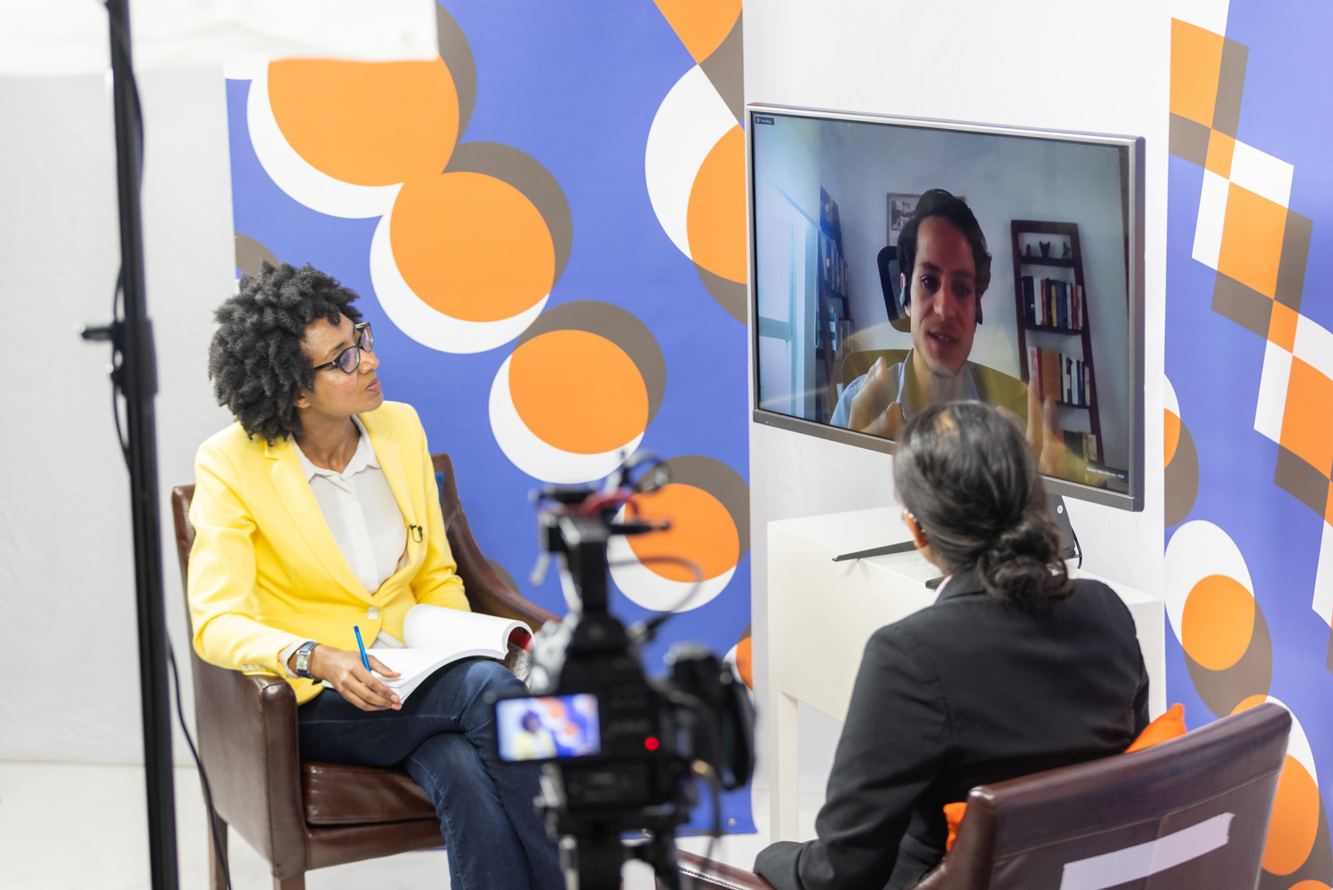
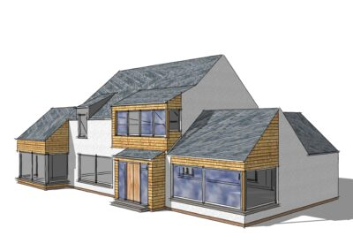
Critical Mass and Activity
Napier: Psychology, Teacher Education, Computing, Arts, Ecology, Climate and Built Environment (N = 22, plus 13 PhDs)
Edinburgh University
Dundee University
Glasgow University
19 active grants from Napier’s CEDAR members: £700K
SFC, SIPR, British Academy, Scottish housing construction infrastructure, Innovate UK and GCRF,
Kyoto University
Middle Eastern Technical University
This Photo by Unknown Author is licensed under CC BY-SA

Slide 8
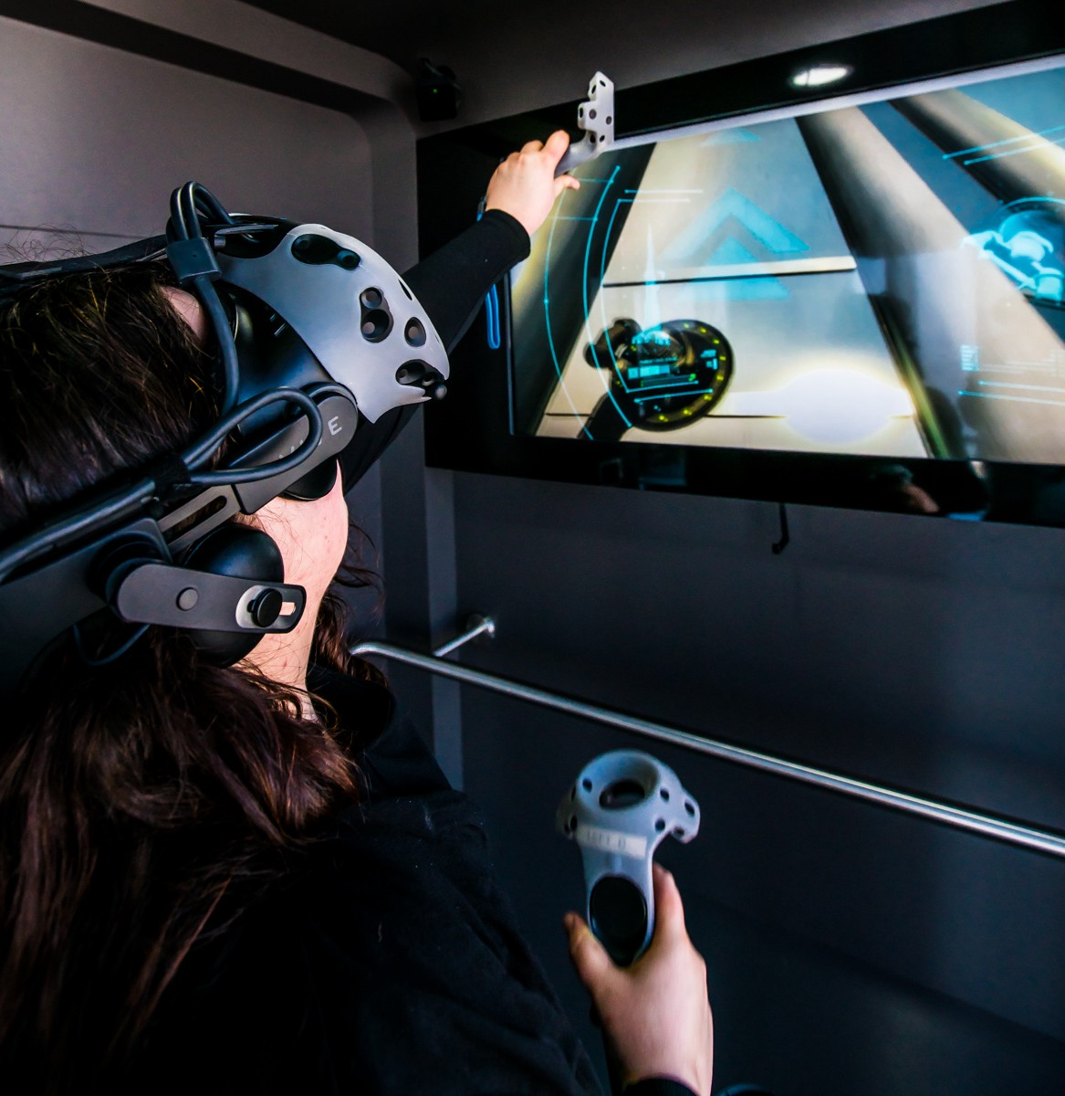
CEDAR’s
(Centre for Mind and Creativity Research) Physical Footprint
Immersive environment suite: laboratory housing state of the art VR equipment (including combined eye tracking and software that is used in the building industry) that is unique to CEDAR and reflective of its interdisciplinarity – Floor 1 at Sighthill

Slide 9
Example of key immediate priorities and activities
Funding
  FindAPhD
  Preparation of Marie Sklodowska-Curie doctoral training centre – new EU horizon program has internationality and engagement of social science and humanities in consortia at the core of its strategic priority.
Commercial and social enterprise
  Establish a commercially successful CPD training course for teachers promoting cognitive flexibility and creativity in education tying in with key strategic priorities promoting creativity and cognitive flexibility (OECD’s Future of Education Report 2030; OECD report on Scottish Education and the curriculum for excellence of 2021)

Slide 10

First success story
Funding
  PhD for CEDAR
  Iyad Sawaftah
    Digital twins and virtual reality: Assessing environmental impact on cognitive flexibility and creativity

Slide 11
Thank you!
m.wimmer@napier.ac.uk
s.jaradat@napier.ac.uk

