Slide 1
NHS Scotland Assure
Quality in the healthcare environment
Julie Critchley
Director of NHS Scotland Assure

Slide 2
NHS Scotland Assure - overview
NHS National Services Scotland has designed NHS Scotland Assure to improve the management of risk in new builds and refurbishment projects across NHS Scotland.
We co-designed our service with users to deliver a coordinated approach – our world-first multi-disciplinary team includes microbiologists, infection prevention and control nurses, architects, planners, and engineers.
NHS Scotland Assure launched in June 2021.
We’re accountable to the Scottish Government. We provide assurance that the healthcare built environment is safe, fit for purpose, cost effective and capable of delivering sustainable services over the long term.
Notes:
Notes
Multi-disciplinary team – we have subject matter experts in the fields of infection prevention and control, hard and soft facilities and building management. We’re bringing together experts in both clinical and technical disciplines to collaborate with stakeholders throughout each stage of the development of a healthcare building.

Slide 3
NHS Scotland Assure - overview
The ‘healthcare built environment’ – we’re talking about:
all NHS Scotland health and care environments where healthcare is delivered
new builds and refurbishment projects
the full lifecycle of a build – from commissioning and strategic assessment, building operations and ongoing maintenance, to decommissioning

Slide 4
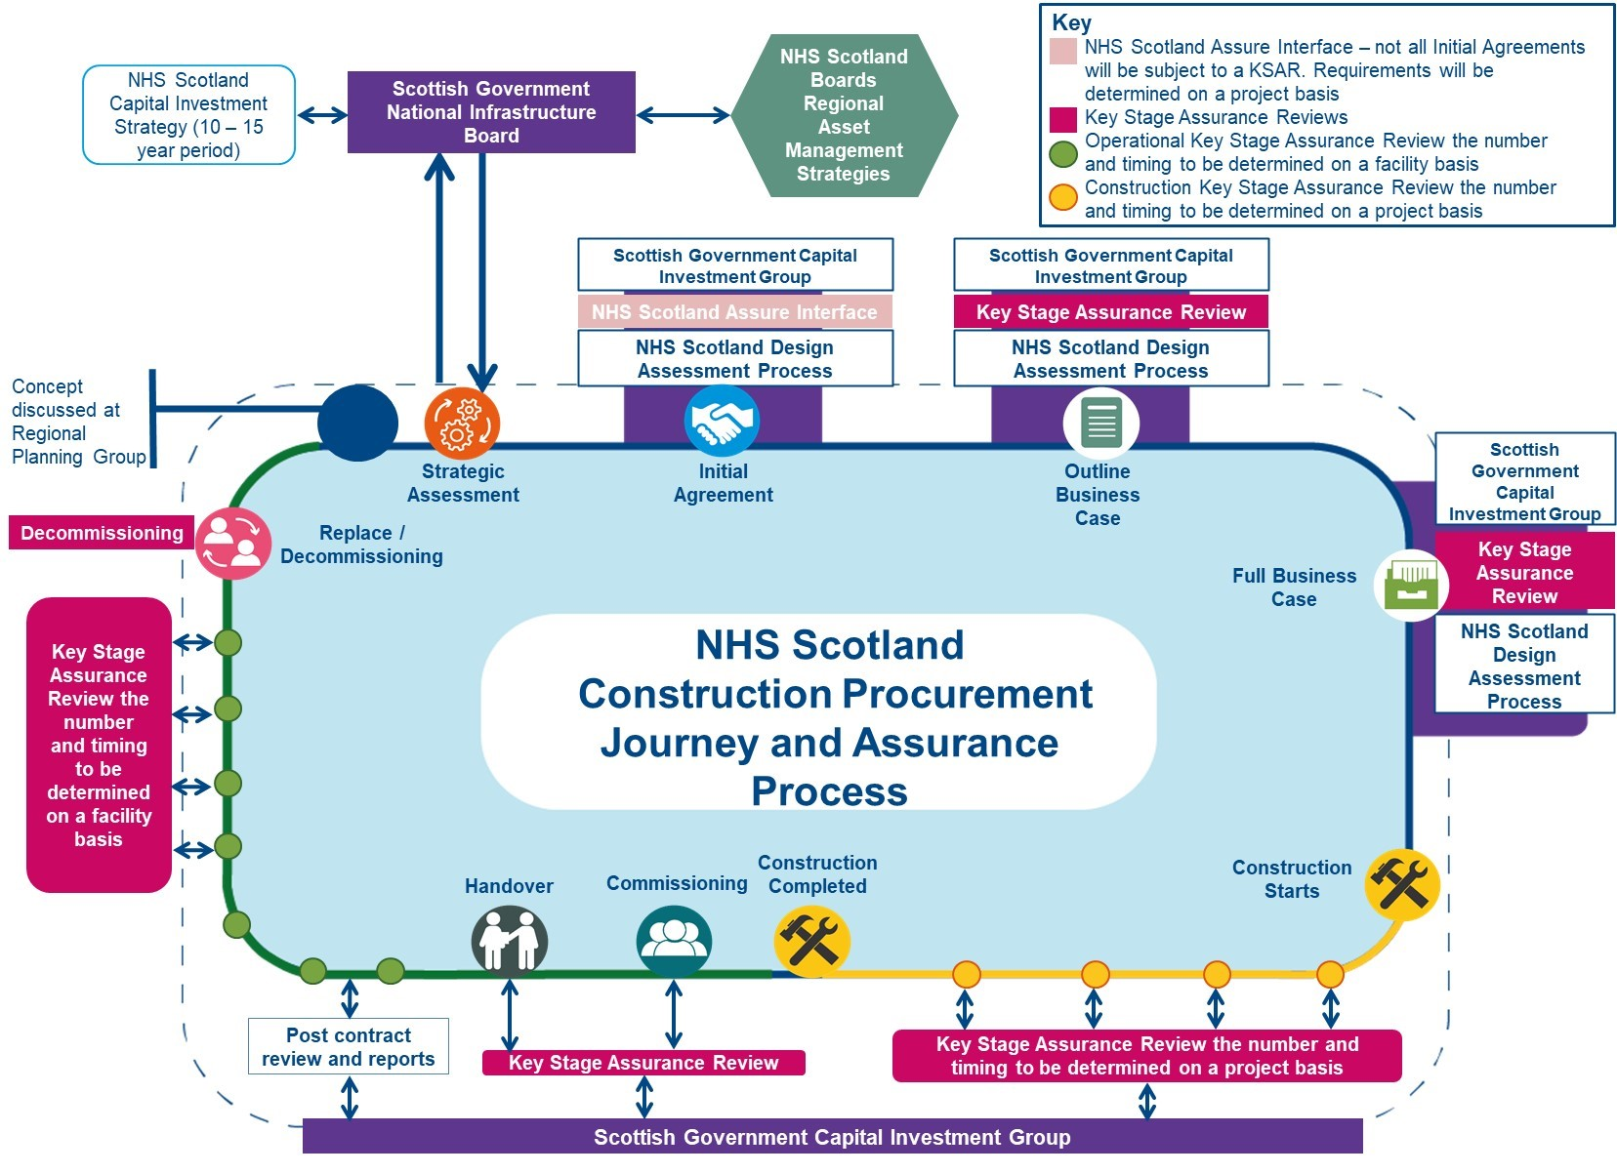
Notes:
Notes
NHS Scotland Assure is here to support health boards and partners to manage risk in the healthcare built environment across Scotland – you can see here how we consider all types of risk, throughout the full lifecycle of a build.
Managing risk in the right way gives those involved in maintaining NHS buildings, facilities and equipment confidence and reassurance.

Slide 5
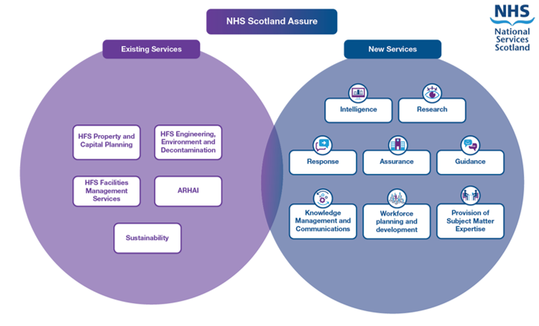
Our services
Notes:
Notes
We (new and existing services) have been working together under the NHS Scotland Assure umbrella since June 2021.
Services overview for speaking notes
Existing services
HFS Property and Capital Planning – working across 5 main service areas (capital projects, architecture and design, digital estate and asset management, PPP and equipping services), this team provides a range of services covering advisory, assurance, design assessment, guidance, procurement, systems, national survey programmes, contract management, equipping management and others.
HFS Engineering, Environment and Decontamination – providing engineering support and guidance to NHS Scotland boards, managing High Voltage database and incident alerts. Leading and supporting the decontamination of reusable medical devices agenda, through setting standards, guidance and advice, audit, investigation and certifying decontamination equipment.
HFS Facilities Management Services – providing technical and operations guidance to NHS boards. Improving health and financial outcomes. This includes supporting the development of national policy, sharing best practice, developing technological solutions, and innovation, and advice and guidance to strategic and operational facilities services teams.
ARHAI Scotland – provides expert intelligence, support, advice, evidence based guidance, clinical assurance and clinical leadership to local and national government, health and care professionals, the general public and other national bodies with the aim of protecting the people of Scotland from the burden of infection and antimicrobial resistance.
Sustainability – working together to deliver a more sustainable health service. Putting sustainability at the heart of decision-making. Supporting NHS Scotland boards with climate change and sustainability tools including the NHSScotland Climate Change Mapping Tool, the NHSScotland Sustainability Assessment Tool (NSAT) and more.
New services
Intelligence – monitoring built environment risk factors, enabling informed and holistic decision making on future projects and maintenance requirements at local and national levels. Using predictive and integrated technologies and delivering improvements in data integrity to proactively identify potential problems.
Research – researching and sharing best practice and changes in standards/models for the built environment across the world to inform guidance and capital projects.
Response – responding to issues in the built healthcare environment (e.g. RHCYP). Assessing the risk against the current estate and projects, and mobilising a response.
Assurance – monitoring compliance with guidance and supporting boards to demonstrate compliance at key stages within the full lifecycle of an acute build, from procurement through to construction, building operations, maintenance and decommissioning, providing assurance to boards and the Scottish Government. (Note, in the ‘overview of services’ doc, where this wording was taken from, this was listed as compliance but aware this has changed to assurance)
Guidance – developing and maintaining guidance to inform the design, build and maintenance of acute healthcare built environments to ensure that they are free from avoidable risk and infection.
Knowledge management and communications – liaising with boards to collectively manage stakeholders and national level external communications. Sharing developments in research guidance and intelligence with boards, targeting specific boards where the updates are pertinent to existing projects. Supporting the routine and effective collation and appropriate dissemination of lessons learned across and outwith the service. Delivering an alerts system to push key information and alerts into the system.
Workforce planning and development – providing a progressive, cohesive and integrated approach to specialist workforce education development for this multi-agency and multi-professional staff group (both internal and external to QHBE) in agreed partnership with NES and boards. Undertaking strategic needs assessment and planning around the skills required across boards to manage risks in the healthcare environment and deliver actions to address immediate and anticipated workforce shortages.
Provision of subject matter expertise – Ensuring boards have the right staff/skills for projects, and assigned staff have access to national training and support to undertake their roles. Coordinating and deploying subject matter experts (SMEs) to support boards/regions to deliver building projects based on identified needs. Connecting boards to other NSS services such as Central Legal Office, Procurement and to the rest of the UK and beyond.

Slide 6
Connected to our NHS – working together
Our support for NHS Scotland boards includes:
supporting boards with risk management throughout the build lifecycle, across new builds and refurbishments
supporting across the build lifecycle
helping boards to ensure healthcare buildings are designed with infection prevention and control practice in mind, protecting patients and improving safety
working with leadership teams to develop learning and training to help them understand what changes they need to make and what support is needed
Partnership working is key.
We need to work in partnership with boards, as well as the supply
chain and the people we commission to build and plan our
buildings. And we need to work in partnership across disciplines
to ensure we get the best outcomes for patients and staff.
Notes:
Notes – on ‘what aren’t we?’ (wording from Julie’s senior leadership webinar in December 2021)
So what aren't we? Well, we won't seek or change legal responsibility of the NHS boards or primary legislation. We will not take on the responsibilities or risk of a project. These will remain with the health boards. We're not going to create a central building division, as NHS boards need to remain accountable for their current estate and any projects that they may have within that. We won't give assurance to a non-NHS building, so we won't give that to a private dental practice and we wouldn't give it to a private hospital. We are looking purely at NHS-owned estates. We won't develop an inspection function. We are not a mandated compliance inspectorate. What we are here is a support for health boards in getting that build environment as good as it can be.

Slide 7
The importance of research
We know how important research, development and innovation are in the healthcare built environment.
NHS Scotland Assure guidance and advice helps ensure that patients, their carers and those delivering healthcare are in an environment which is not only safe but also effective and person centred.
Research plays a pivotal role in supporting this – it ensures that guidance and advice is based not only on best practice but also on best evidence.
Find more information on NHS Scotland Assure at
https://www.nss.nhs.scot/browse/nhs-scotland-assure
Notes:
Notes – handover slide, from Julie to Geraldine.

Slide 8
NHS Scotland Assure – research service overview
Quality in the healthcare environment
Dr Geraldine O’Brien
Research Manager, NHS Scotland Assure

Slide 9
NHS Scotland Assure research service – aims
We aim to:
be renowned for producing and commissioning quality healthcare-built environment research
be internationally recognised as an expert in this field, encouraging and facilitating wider collaboration
support research that will provide evidence to help reduce risks within the healthcare built environment
Research plays a pivotal role in ensuring that guidance and
advice is based not only on best practice but also on
best evidence.
Notes:
Notes
As Julie mentioned, research plays a pivotal role in supporting this – it ensures that guidance and advice is based not only on best practice but also on best evidence.

Slide 10
NHS Scotland Assure research service –objectives
Address knowledge and evidence gaps through commissioning, publication and dissemination of research and develop supporting structures and processes.
Establish relationships with key stakeholders and develop a network of expertise.
Notes:
Notes
User feedback has suggested that we need to built capacity and capability
Traditional ways of commissioning research may not give us the outcomes that we currently need if they are too focussed on one specific discipline
A multi-disciplinary approach to research was key in order to build capacity and capability, answer research questions and to move away from silo working.
There is a need to grow academic/research capacity and capability and ensure this is sustainable and research institutions can work in partnership with NHS Scotland Assure in the future.
Calls issued on behalf of NHS Scotland assure should allow for flexibility in order for parties to bid for all funding either via a consortium or bid for individual studies which are multidisciplinary in focus.

Slide 11
NHS Scotland Assure research service
Priority risk areas – research service priorities
Water and drainage
Ventilation
Medical gases
Fire
Electrical
Infection prevention and control
Notes:
Notes
The priority risk areas are the main focus of NHS Scotland Assure currently.
Issues faced?
Design, installation, commissioning and maintenance of water systems including drainage – input from engineering , ipc ,water chemistry discipline, design
Design, installation, commissioning and maintenance of Ventilation systems
Pathogens, the microbiome, AMR, transmission risks and burden of disease in the hospital environment
Hospital design including size and single room provision; e.g. hand wash basin provision / waterless / surface design to reduce transmission
The built environment post-pandemic and lessons learned from COVID-19
Human factors/Ergonomics and Infection Prevention and Control in hospital design and the built environment and how it is used Procurement, Design, health and safety ,Psychology
Climate change requirements and the unintended consequences on built environment risks
The role of safety and harms in relation to medical gases, electrical systems and fire safety, and their impact on patient and staff safety in the hospital environment
How does this relate to the delivery of research? What we know is most of these are multifactorial in nature so we need a multi-disciplinary approach to support research to mitigate risks.
What is the impact of this research on NHS Scotland?
Draw in Mike and Richards Presentations

Slide 12
NHS Scotland Assure research service
Collaborative working with Edinburgh Napier University
Building networks / consortia – multidisciplinary approach
Building capacity and critical mass in research field
Investing in future academia – clinical and technical
Notes:
Notes
Research contract with Napier = collaborative working with Edinburgh Napier University
Why
What outcomes / benefits do we expect?
Building capacity in research field.

Slide 13
NHS Scotland Assure research service – research commissioned to date
Completed projects
To investigate the prevalence and concentration of Cupriavidus and other Opportunistic Premise Plumbing Pathogens (OPPPs) in healthcare water systems across Scotland and England.
Hospital sinks and drains as a source of antimicrobial resistant microorganisms: studies to investigate colonisation, dispersal and decontamination.
Whole genome sequencing of potable water derived Cupriavidus species.
Notes:
Notes
Richard and Mike will give more detail around the some of the key concerns that are emerging. Share some pieces of research that are already been taken completed.

Slide 14
NHS Scotland Assure research service – research commissioned to date
Ongoing projects
Far ultraviolet-C (UVC) light for reducing airborne transmission of bacteria and viruses.
Use of hand hygiene wipes to remove spore forming bacteria.
Development of laboratory methodology to identify opportunistic premise plumbing pathogens other than legionella and pseudomonas aeruginosa from hospital water systems.

