Slide 1

NHS Scotland Assure Research Service Fund
Project Mechanics
24th June

Slide 2
Agenda
Who Are We
Scope and What will be funded
Who can apply
Building consortia and Individuals
How to apply
Year 1 closing dates and Funding ranges
High level process
Useful Information

Slide 3
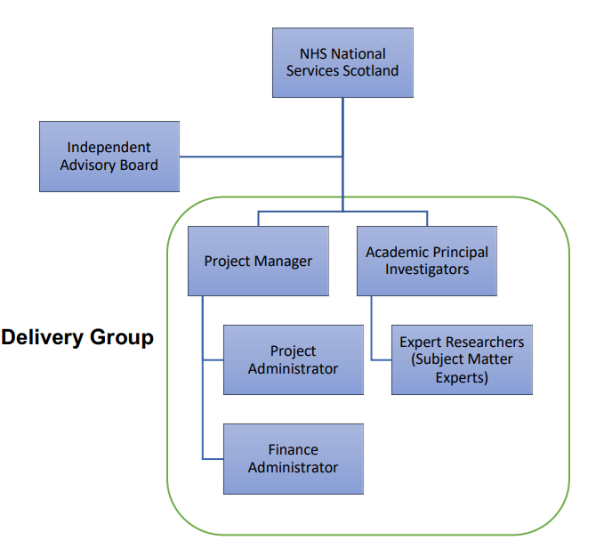
Who Are We
Project Manager – Linda Johnston
Project Administrators – Hazel Irvine/Amber Millar
Finance – Morag Cherry
Academic PI (SAS) – Prof Stephanie Dancer
Co – PI (SEBE) - Prof Pat Langdon
Co-Is – Dr Donald Morrison (SAS) & Dr Fateh (Abdelfateh) Kerrouche (SEBE)

Slide 4
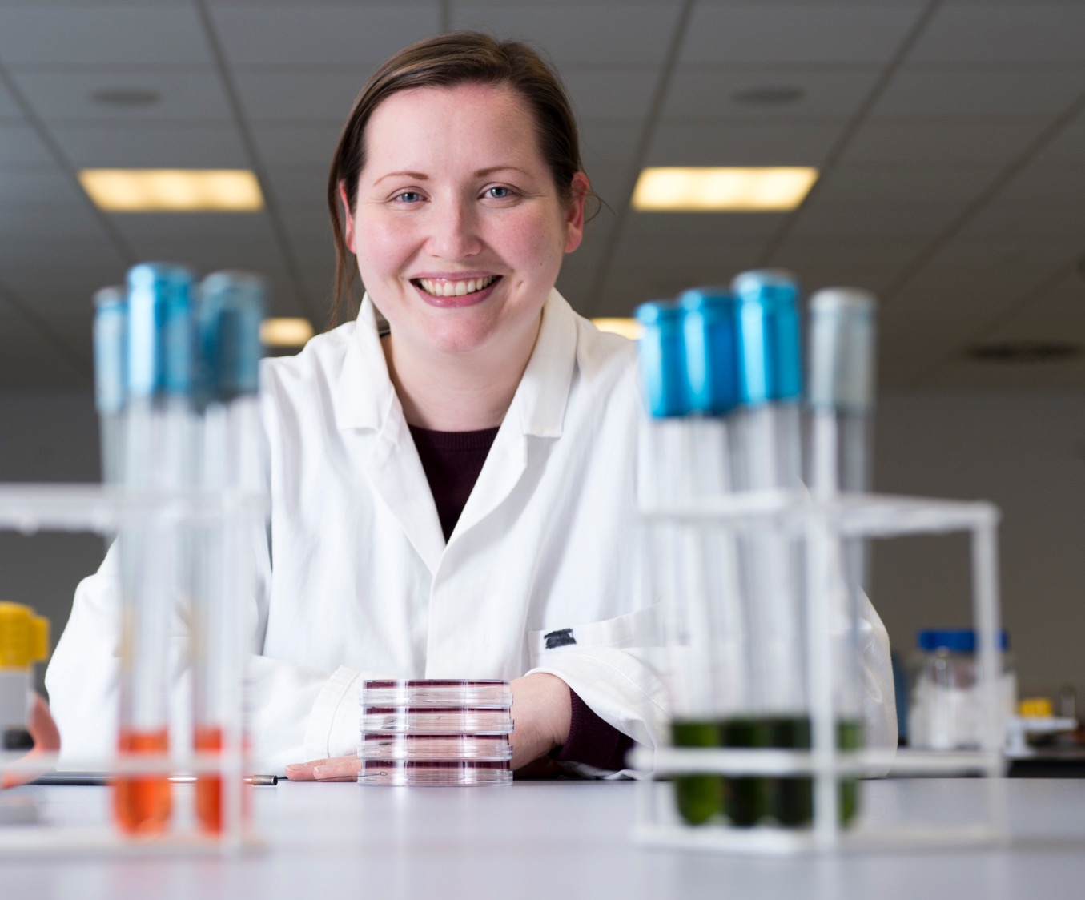

Scope – Eight Themes
Water systems, including drainage (design, installation, commissioning and maintenance (DICM))
Ventilation systems (DICM)
Pathogens, the microbiome, AMR, transmission risks and burden of disease in the hospital environment
Hospital design, including size and single room provision
Lessons learned from COVID-19
Human factors/Ergonomics and Infection Prevention and Control
Climate change requirements and the unintended consequences on built environment risks.
The role of safety and harms in relation to medical gases, electrical systems and fire safety.

Slide 5
What Will We Fund?
Research and Innovation
Knowledge Exchange with policy makers, practitioners and service users
Pilot, proof of principle and other research projects that cannot be funded under existing mechanisms and cross the remits of several funding organisations
New academic posts ranging from post doctorates to junior fellowships
Training, career development and capacity building programmes
Infrastructure support, including technical staff, IT systems and equipment, administrative support and other underpinning costs
Verification and evaluation of emerging technologies
New approaches to dealing with reoccurring issues within the healthcare built environment

Slide 6


Who Can Apply?
The fund is open to researchers from any country who are looking at ways to deliver safe healthcare environments that are free from avoidable risk.
We are particularly interested in applications from consortia and inter-disciplinary teams
We want to nurture an inclusive approach between professional roles within the built environment and across infection, prevention & control (IP&C); healthcare providers; academia; research institutions; and business and industry.
The outcomes must benefit NHS Scotland and align with the key priorities of NHS Scotland Assure.

Slide 7





Building Consortia and Individuals

Slide 8
How To Apply
Go to the Webpage
Read the Guidelines
Download & Complete the Application Form
Submit the form & any attachments to our email address

Slide 9
Year 1 Closing Dates
31st July 2022
30th September 2022
6th January 2023
31st March 2023

Slide 10
Funding Ranges
Expect majority will fall between £25k - £300k
Will consider all bids £10k, £500k

Slide 11
Initial review of submitted bids after closing date by PI, PM and Delivery Group (DG)
Peer Reviews completed
Bids submitted to DG & Independent Advisory Board
Decision on what bids to fund/not fund
Funds allocated & post award management commences
High Level Process

Slide 12
Useful Information
Webpage https://www.napier.ac.uk/nhsassure
Application Form & Guidelines (on webpage)
Email any queries to NHSAResearchService@napier.ac.uk

Slide 13
Thank you!

