Slide 1
Clinical Risks Associated with Waterborne and Airborne Microorganisms
NHS Scotland Assurance Services
Paul Weaving
Nurse Consultant Infection Prevention & Control

Slide 2
Nursing ‘…ought to signify the proper use of fresh air, light, warmth, cleanliness, quiet, and the proper selection and administration of diet.’
Nightingale, 1860

Slide 3
Water

Slide 4
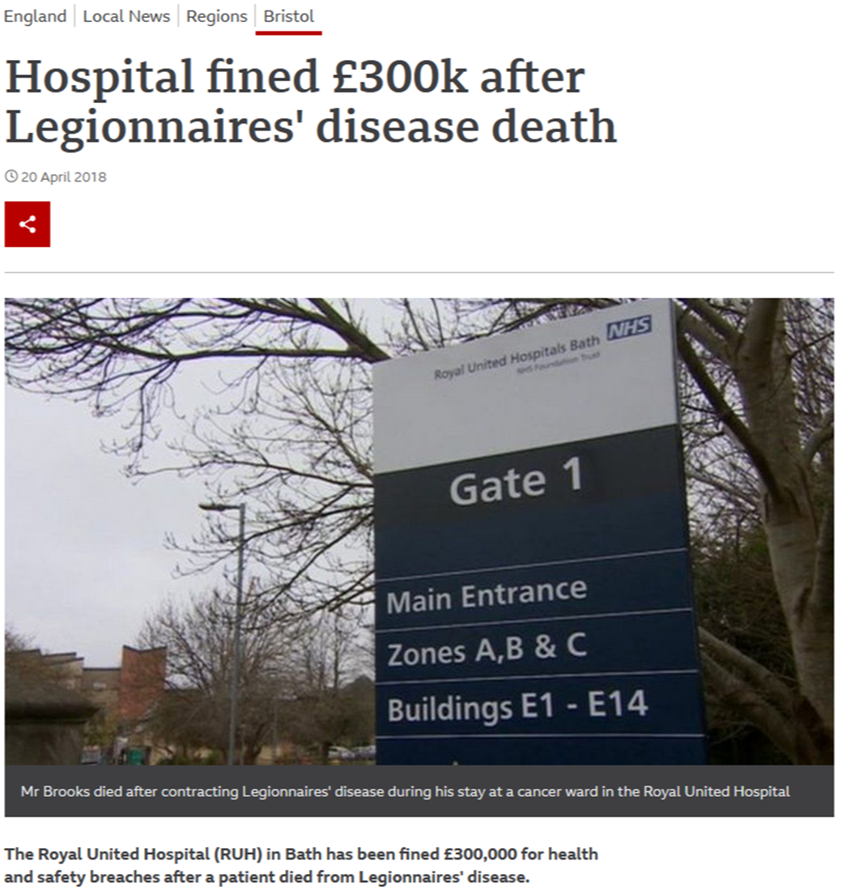
TL;DR: People in hospital can die following infection with waterborne microorganisms

Slide 5
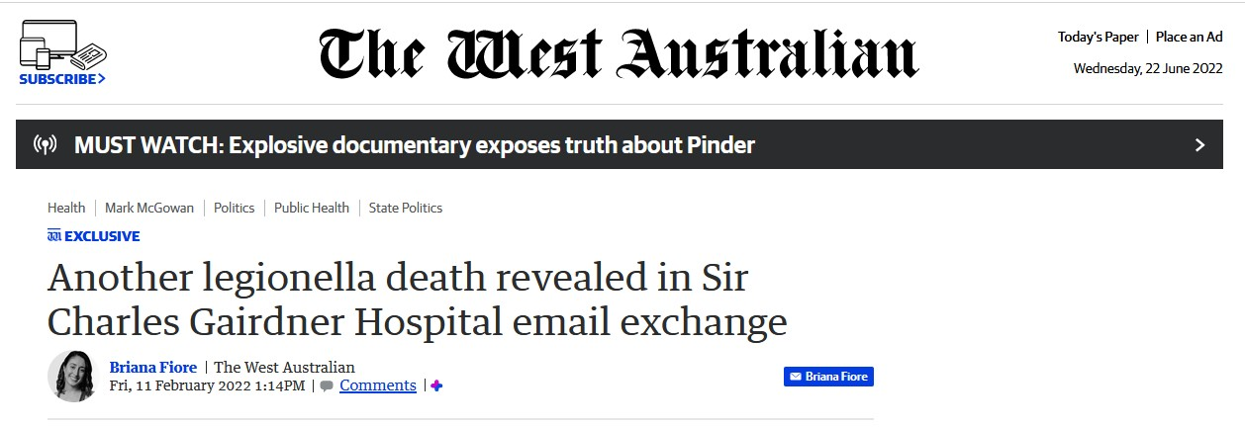
TL;DR: People in hospital can die following infection with waterborne microorganisms

Slide 6
Legionella
Hospital-acquired Legionnaires' disease has been reported from many hospitals since the first identified outbreak in 1976
Potable water has been the environmental source for almost all reported hospital outbreaks
Micro-aspiration is the major mode of transmission in hospital-acquired Legionnaires' disease
Sabria, M & Yu, VL. (2002) Hospital-acquired legionellosis: solutions for a preventable infection. Lancet Infectious Disease 2 (6) 368-73

Slide 7
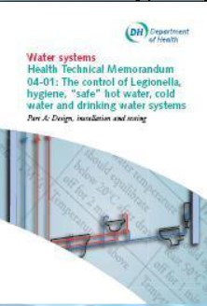
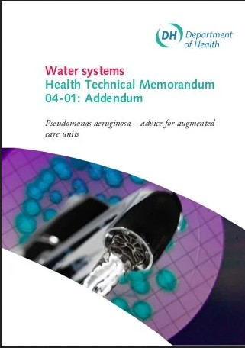
Legionella
Water hygiene guidance for healthcare was almost entirely focused on legionella until 2013

Slide 8
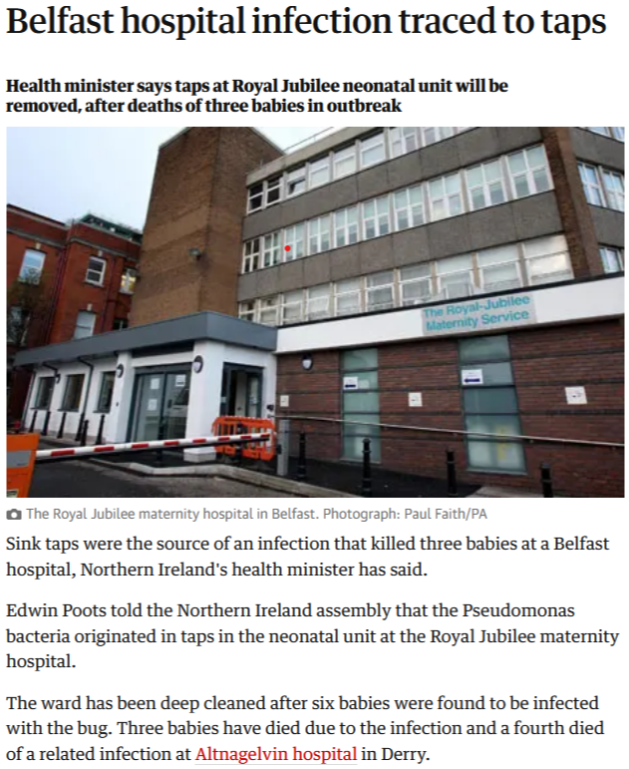
Pseudomonas in Belfast

Slide 9
Pseudomonas in Belfast
The same strain of Pseudomonas aeruginosa was isolated from five out of six sensor taps in the main intensive care room
As a result of the outbreak organisations throughout the NHS in the UK were instructed to make changes to water management systems:
Remove flexible hoses
Regular water testing in augmented care areas

Slide 10
New version of HTM 04-01 in 2016

Slide 11
Waterborne Outbreaks and Infections
A 2016 literature review* identified 73 papers describing healthcare outbreaks associated with a water reservoir.
The most common pathogens were bacteria, including Legionella and other Gram –ve organisms such as Pseudomonas
* Kanamori, H, Weber, DJ & Rutala, WA (2016) Healthcare Outbreaks Associated with a Water Reservoir and Infection Prevention Strategies. Healthcare Epidemiology 62 (11) 1423-35

Slide 12
Waterborne Outbreaks and Infections
Other pathogens included non-TB mycobacteria, fungi, protozoa and viruses
Infections caused included bacteraemia, pneumonia, UTI, meningitis and wound infections
Vulnerable groups are particularly at risk, including neonates, critically ill adults and people who are immunocompromised

Slide 13
Waterborne Outbreaks and Infections
Reservoirs identified included
Faucet (tap) aerators
Showers
Toilets
Dialysis water
Ice & ice machines
Water baths
Flower vases
Eyewash stations
Dental units
Cardiac surgery heater-cooler units

Slide 14
Air

Slide 15
Risks from Airborne Microorganisms
When we talk about airborne pathogens, we tend to think of infections that are spread by the airborne route
Influenza
Tuberculosis
SARS
COVID 19 (SARS CoV 2)

Slide 16
Risks from Airborne Microorganisms
However, microorganisms are small, and almost any microorganism can end up ‘in the air’ in some circumstances, for a greater or lesser period of time
Staphylococci on skin scales shaken from bedclothes
Fungal spores in dust generated by demolition or building work
Pseudomonas or legionella in aerosols from water systems

Slide 17
Risks from Airborne Microorganisms
Hence, theoretically, almost any microorganism can be spread ‘through the air’
Some will cause infections if they come into contact with a vulnerable site on a susceptible person
E.g. Bacteria entering an open wound during surgery

Slide 18
Controlling these Risks
We try to control these risks, using a combination of
Filtration to remove particles from the air
Ventilation to regularly replace the air in a space with clean air
Directed air flows to protect vulnerable people and sites
Isolation

Slide 19
Controlling these Risks
The control measures used are determined by an assessment of the vulnerability of the patient and the potential impact of an infection
E.g. A postoperative infection following orthopaedic implant surgery can be catastrophic, so orthopaedic surgery is carried out in ‘ultra clean’ operating theatres

Slide 20
Controlling these Risks
The actual effectiveness of any control measure, or combination of controls, is difficult to determine, so a precautionary principle is often applied, possibly at high cost or with detrimental effects on the patient
E.g. prolonged isolation following bone marrow transplant
Increasing the knowledge base to inform risk assessment would be helpful to clinicians!

Slide 21
Thank you
NHS Scotland Assurance Services
Paul Weaving
Nurse Consultant Infection Prevention & Control

