Slide 1
Examining domestic water systems and ventilation design systems in the healthcare environment
NHS Scotland Assurance Services
Richard Beattie
Senior Engineer

Slide 2
Presentation overview
  Domestic water systems
  Ventilation
  Research
  Objective

Slide 3
Domestic water system

Slide 4
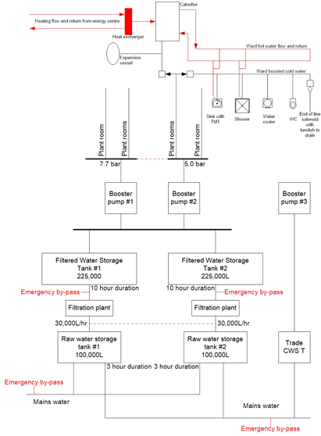
Typical domestic water system schematic
Subordinate run
Tertiary runs
Principal runs

Slide 5
Engineering considerations
Factors that influence bacterial growth can include:
Temperature – with consideration to scalding.
Disinfectant type and levels.
Hydraulic conditions – avoiding stagnation.
Presence of nutrients.
Pipe material.
Presence of distal outlets.
Extent of aerosol formation.
Some of the above factors come into play during design and commissioning, whilst some can be adjusted in existing systems. Pipe sizing, materials and devices/ outlets used are determined prior to construction and operation.
Factors such as temperature, disinfection and distal devices/ outlets can be more easily adjusted.
The effect and control of bacteria can be based on limiting its growth, but also limiting opportunities for exposure pathways to people i.e. POUFs, drift eliminators etc.

Slide 6
Engineering considerations
Factors that influence effectiveness of engineered systems can include:
Roles and responsibilities
Control measures
Usage of water
Impact of hand hygiene practices
Flushing
Drains
Refurbishments
Commissioning
Testing
Results interpretation
Handover
Cleaning

Slide 7
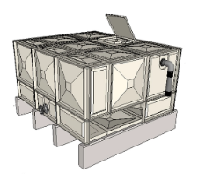
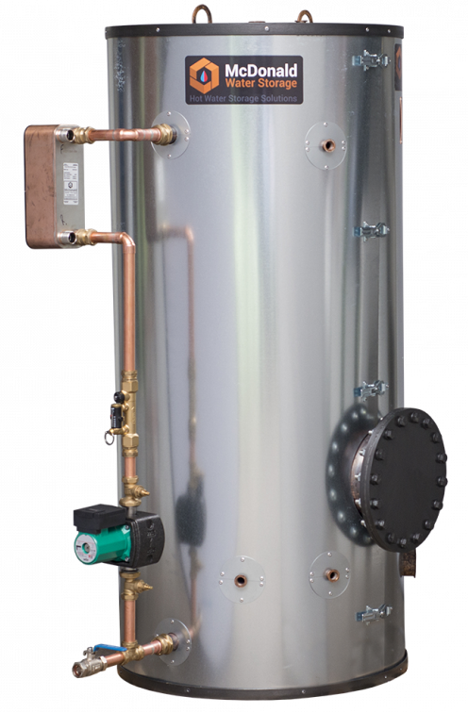


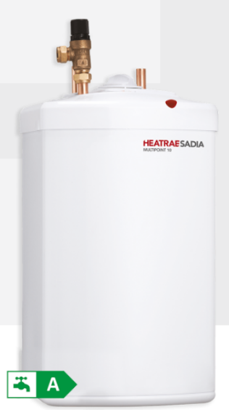
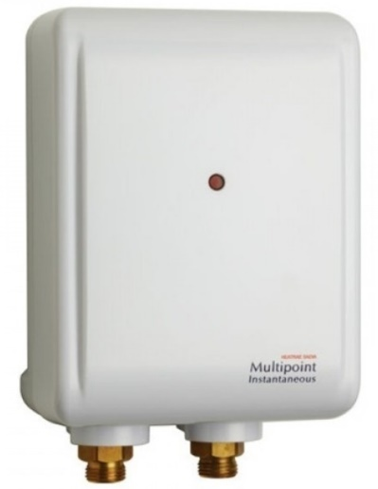
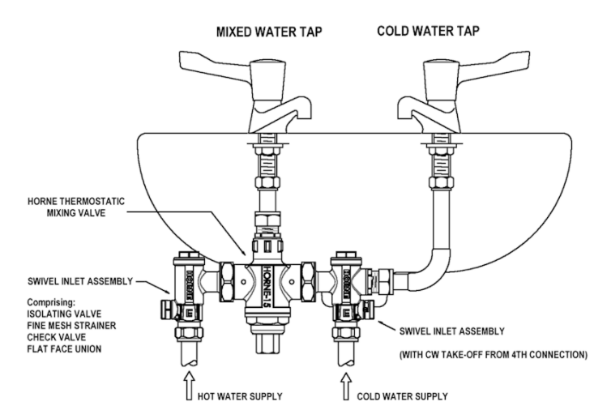
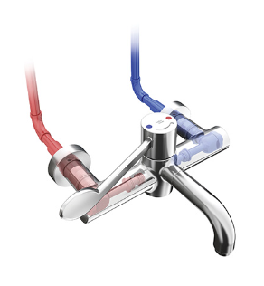
Domestic water components
Typical hot water generator (McDonald water heating)
Typical cold water storage tank
(Nicholson Plastics Ltd)
Typical Thermostatic Mixer Tap (Marwik 21+)
Inline ‘T’ type TMV (Horne)
POU water heater
(Heatrae sadia)

Slide 8
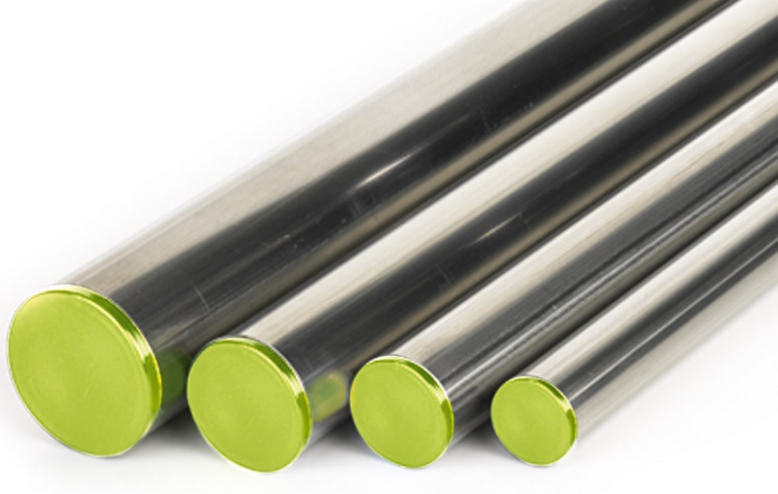
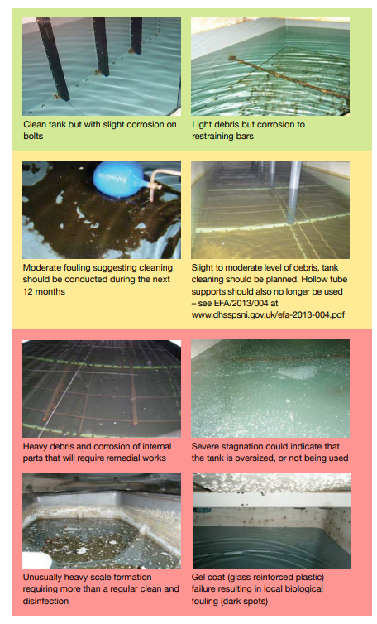
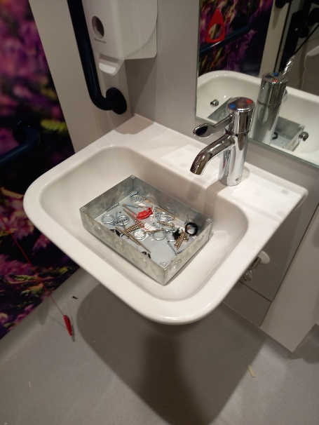
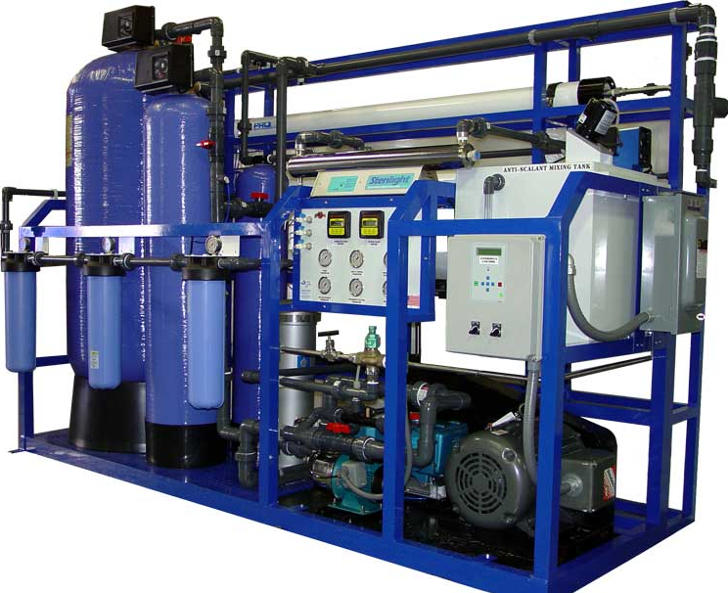
Domestic water contamination
Typical temporary pipe end capping (Peglar)
Cold water storage tanks (HSG274 Part 2)
Cleanliness of WHBs
Typical filtration unit (Hgenviro)
Typical Thermostatic Mixer Tap (Marwik 21+)

Slide 9
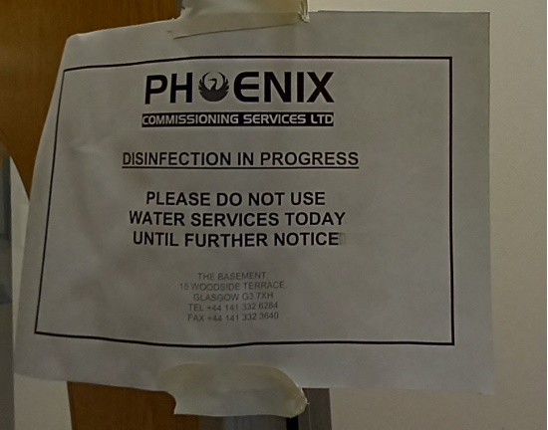
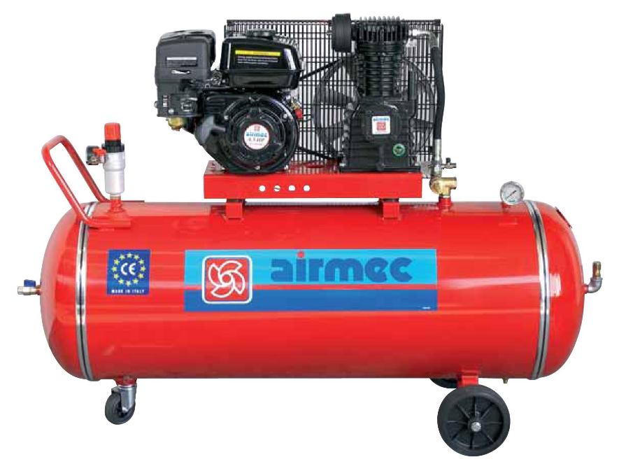
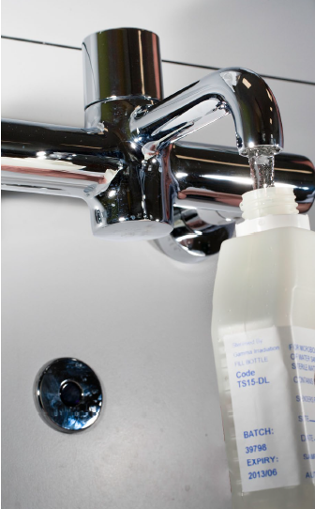
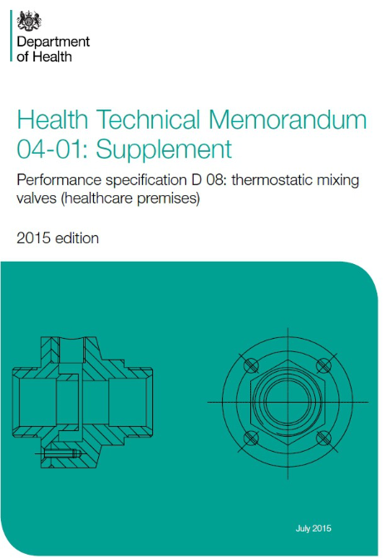
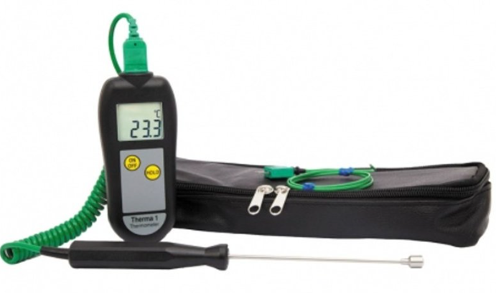
Domestic water testing
Typical compressor for pneumatic pressure testing (Airmac)
Typical notice of system disinfection (phoenix)
Typical water sampling technique (HTM 04-01 Part B)
HTM D08: TMV testing
Typical water temperature probe (priggen)

Slide 10
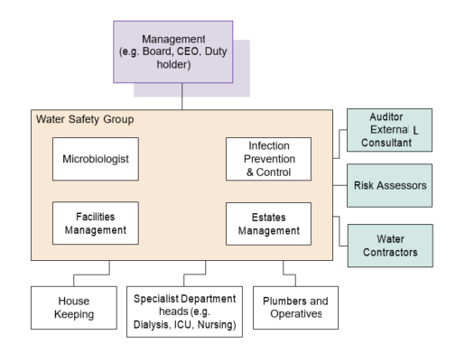
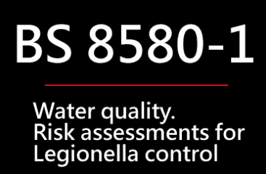
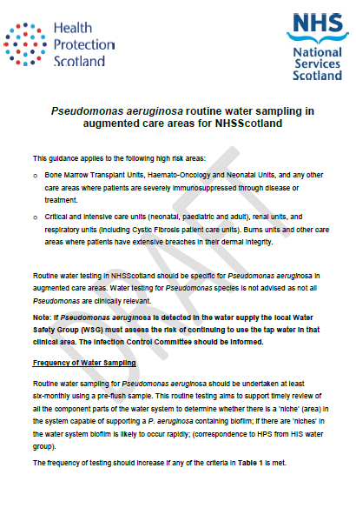
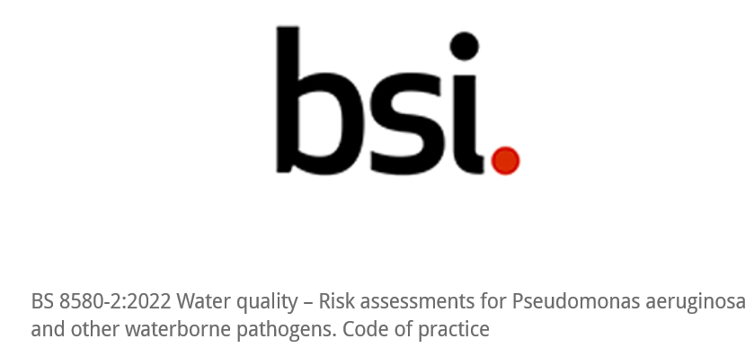
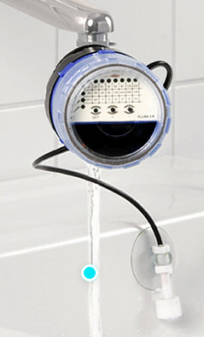

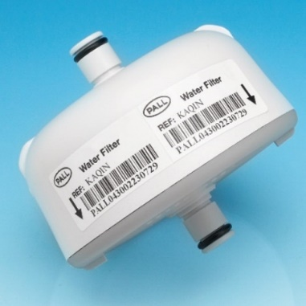
Domestic water management measures
Typical tap flushing unit (Aquafree)
Typical tap water filter (Pall)

Slide 11
Ventilation

Slide 12
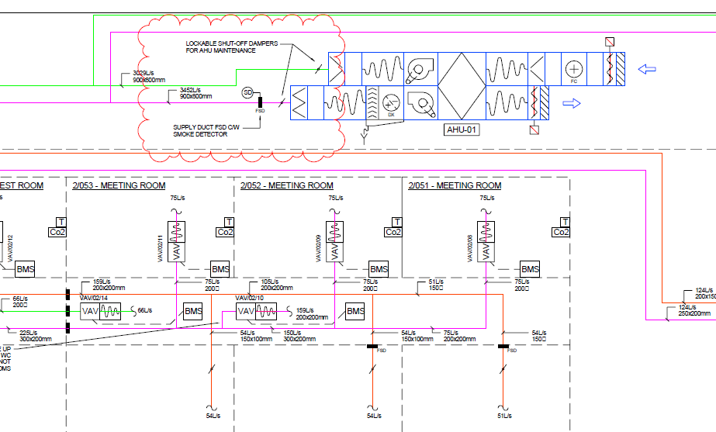
Typical ventilation schematic

Slide 13
Engineering considerations
Factors that influence effectiveness of engineered systems can include:
Clinical function/ procedures
Passive/ active
Risk
Air changes
Air flows
Air pressures
Single rooms/ isolation rooms/ PPVL
Pathways
Testing
Results interpretation

Slide 14
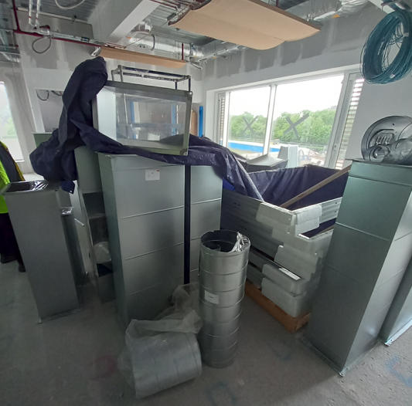
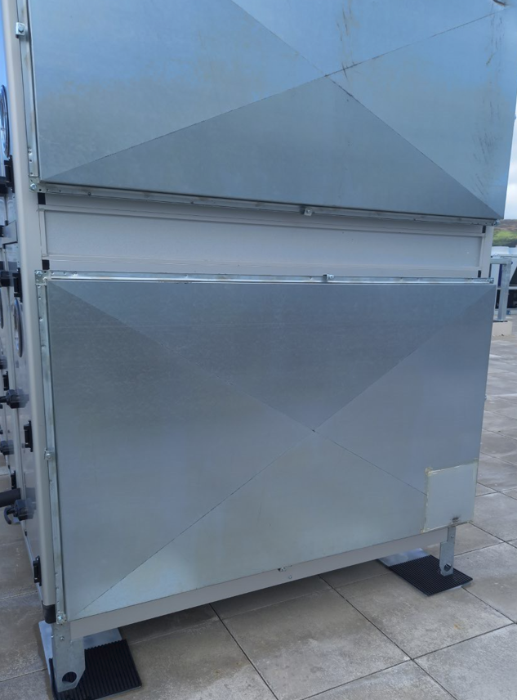
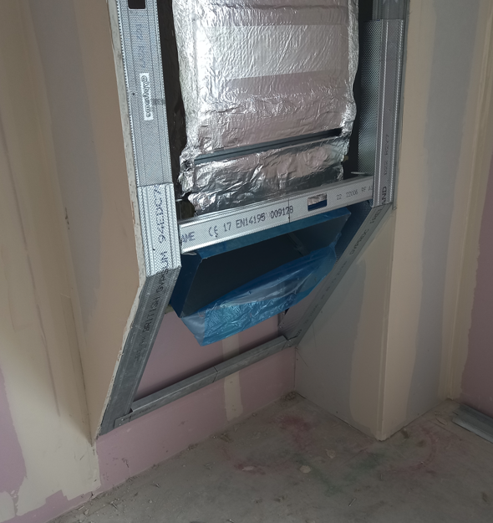
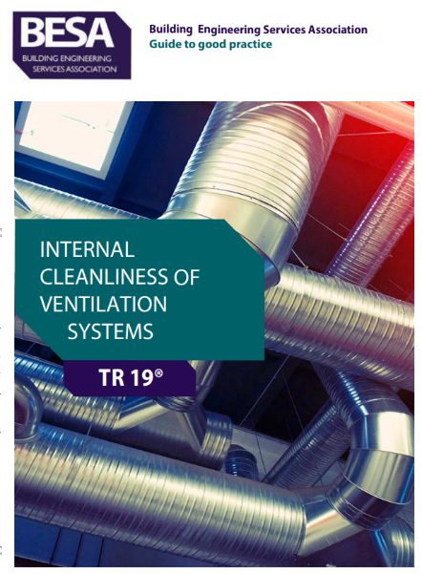
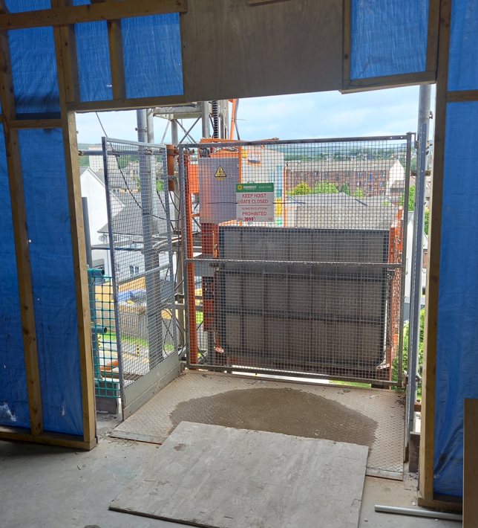
Ventilation contamination
SHTM 03-01 Part A – Ventilation Safety Group (VSG) to have clear roles and responsibilities, covering design process, commissioning and validation, operational management and maintenance, etc

Slide 15
Collaboration
Healthcare facilities
NHS Scotland Assure
Research

Slide 16
Guidance and research
Examples of potable water system potential research:
Water consumption in various types of facilities.
Use of alcohol hand gel.
Heat gain to cold water pipework.
Sanitaryware quality.
HWS – can the hot water flow temperature run at 45ºC with a suitable disinfectant.

Slide 17
Guidance and research
Examples of ventilation system potential research:
Natural ventilation / and mixed mode – considering air quality, infection control, comfort, fire, acoustics, energy efficiency, pressure regimes and resilience.
Recirculated air vs full fresh air as currently used.
Definition of treatment room types (such as “enhanced treatment rooms”) and understanding of clinical procedure vs ventilation requirements.

Slide 18
Remember
Water is not sterile.
Air is not always clean.
Systems must be safe.
Our objective is to provide a safe environment for patients, staff and visitors.

Slide 19
Examining domestic water systems and ventilation design systems in the healthcare environment
NHS Scotland Assurance Services
Richard Beattie
Senior Engineer

