Slide 1

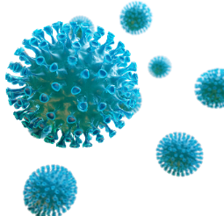


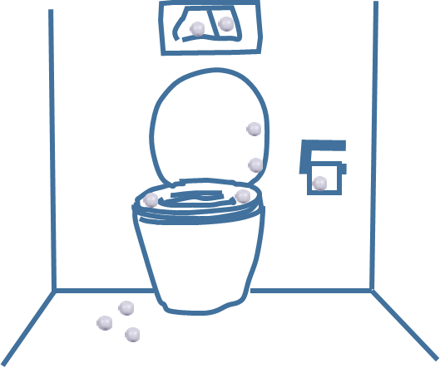


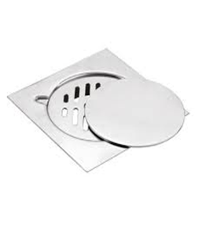
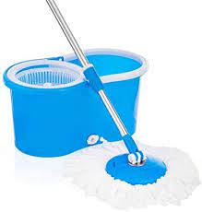
Infection Prevention and Control Takes Centre Stage
Stephanie J. Dancer
NHS Lanarkshire and Edinburgh Napier University

Slide 2
NHS ASSURE: Subject categories
Water Systems (plumbing; maintenance & monitoring; waste water)
Ventilation (natural vs HVAC; IAQ; standards; monitoring)
Pathogen transmission and AMR (stewardship; environmental reservoirs)
Hospital design (single vs multi-bedded rooms; ward layout; size and space; theatres)
COVID-19 (lessons learned; surveillance; vaccination; PPE)
Infection Prevention & Control (hand hygiene; cleaning & decontamination; sterile services; human behaviours & ergonomics)
Climate issues and conflicts with energy conservation
Risks from fire safety; medical gases; and electrical systems
Additional topics:
Antimicrobial surfaces; Biofilm; Infection prevention ‘bundles’; Catheter care; Prophylaxis; Screening; Pests; Linen & laundry; Storage; Education & Training; Surveillance; Pollution; Hospital building and renovation; Food & drink hygiene, etc

Slide 3
Properties of hospital pathogens
Survival time Infectious dose Reservoir
MRSA 7 days -7 mths 4 cfus Hand-touch; dust; air
Acinetobacter 3 days - 5 mths 250 cfus Dust; hand-touch; air
C.difficile >5 mths 7 spores Air; hand-touch; dust
VRE 5 days - 4 mths <10³ cfus Dust; hand-touch; air
Norovirus 8 hours -7 days <20 virions Air; hand-touch
SARS-CoV-2 72 hours 100 virions? Air; hand-touch??
E. coli 12 months 10-10⁶ cfus Water; hand-touch; air
P. aeruginosa 2 days-16 mths 10-10⁶ cfus Water; hand-touch; air
Candida spp. 1-120 days ? Dust; hand-touch; air
Kramer et al, BMC Infect Dis, 2006; Wagenvoort, JHI 2000; Chiang, Crit Care Med 2009; Wilcox M, 2010; Larson, Lancet 1978; Kjerulf et al, APMIS 1998
Notes:
Kramer, BMC Infect Dis, 2006; Wagenvoort, JHI 2000; Chiang, Crit Care Med 2009;
Wilcox M, 2010; Larson, Lancet 1978; Kjerulf et al, APMIS 1998

Slide 4

‘…wet dirt is dangerous….’ Florence Nightingale

Slide 5
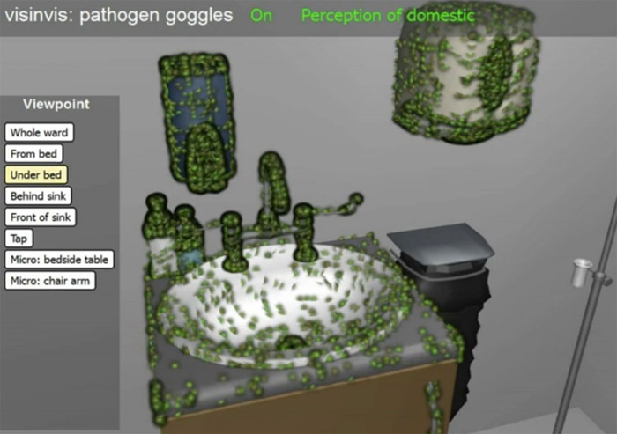
www.visinvis.org/

Slide 6
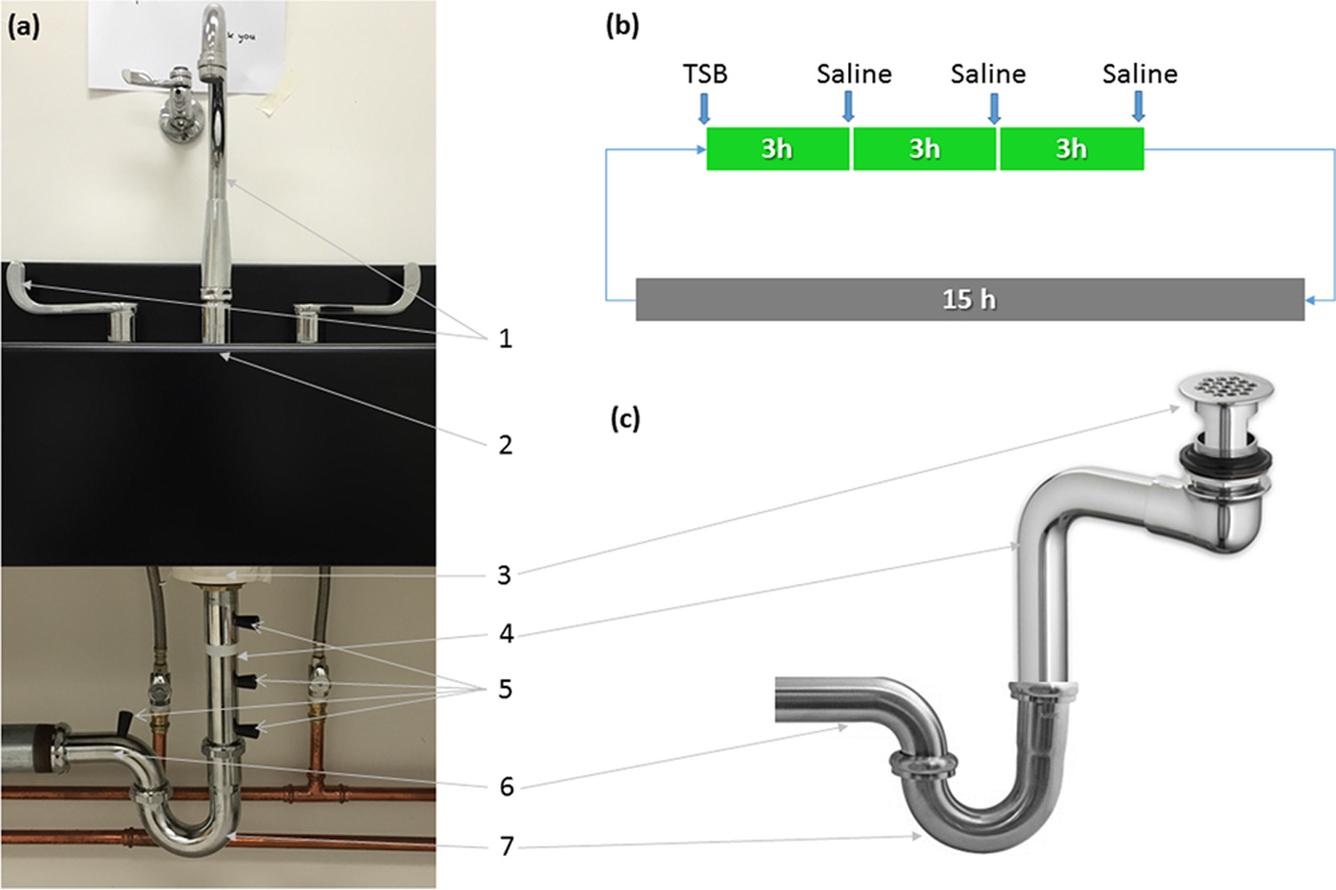
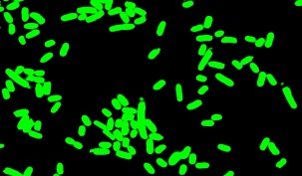
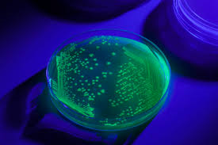
Spread from the sink to the patient!
In situ study using green fluorescent
Escherichia coli to model bacterial dispersion from reservoirs in hand washing sinks
Kotay S et al, Appl Environ Microbiol 2017; 83:e03327-16
Notes:
a) Parts of the sink drain line: 1, faucet and handles; 2, sink counter; 3, strainer; 4, tailpipe; 5, sampling ports;
6, trap arm; 7, P-trap. (b and c) Schematic of the nutrient regimen (b) and offset drain tailpiece used for dispersion
experiments (c).
When GFP-expressing E. coli cells were allowed to mature in the P-trap under conditions similar to those in a hospital environment, E. coli-containing putative biofilm extended upward over 7 days to reach the strainer. This subsequently resulted in droplet dispersion to the surrounding areas (30 in.) during faucet operation. We also demonstrated that P-trap colonization could occur by retrograde transmission along a common pipe.

Slide 7

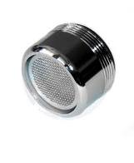
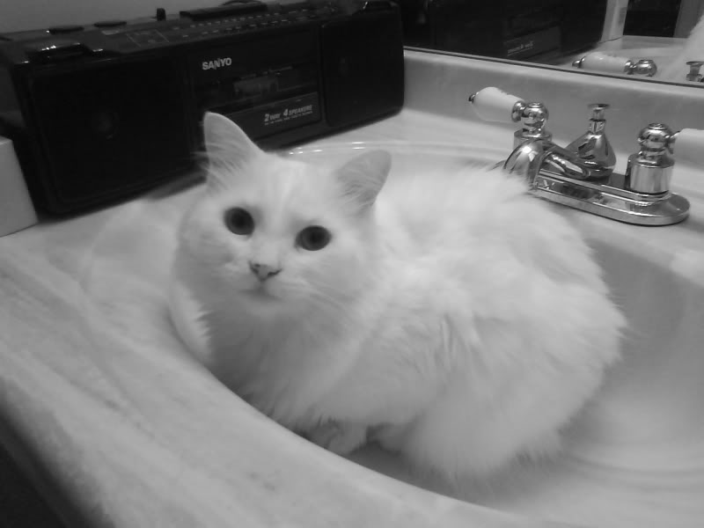
What are the most cost-effective methods for reducing HAI risk from water outlets?
Don’t pour waste fluids down the sink!
Frequent cleaning of sinks, plugs, strainers and faucets
Regular removal & replacement of tap filters
Water treatment on a regular basis, eg. Sodium hypochlorite,
electrolysed water, chlorine dioxide, acetic acid, H2O2, UV light, etc
Attention to blind ended loops and stagnant pooling
Regular checks of drains and traps for biofilm
Increase rate of drainage
Sink design: drain at the back
Move patient beds away from sinks….
Smolders et al, J Hosp Infect 2018; Kizny Gordon et al, Clin Infect Dis 2017; Deasy et al, J Hosp Infect 2018
Notes:
Clin Infect Dis. 2017 May 15;64(10):1435-1444. doi: 10.1093/cid/cix132.
The Hospital Water Environment as a Reservoir for Carbapenem-Resistant Organisms Causing Hospital-Acquired Infections-A Systematic Review of the Literature.
Kizny Gordon AE¹, Mathers AJ², Cheong EYL^{3,4}, Gottlieb T^{3,4}, Kotay S², Walker AS^{1,5}, Peto TEA^{1,5}, Crook DW^{1,5}, Stoesser N¹.
J Hosp Infect. 2018 Acetic acid as a decontamination method for ICU sink drains colonized by carbapenemase-producing Enterobacteriaceae and its effect on CPE infections.
Smolders D¹, Hendriks B², Rogiers P², Mul M³, Gordts B³.
BACKGROUND:
Carbapenemase-producing Enterobacteriaceae (CPE) are emerging pathogens representing a major concern for public health. In Belgium, the OXA-48 carbapenemase resistance gene is identified most frequently. Sink drains in intensive care units (ICUs) are known to be colonized by Gram-negative bacilli. A correlation between environmental contamination and CPE infections in ICUs has been established. A long-term CPE epidemic in a local ICU proved difficult to control.
METHODS AND RESULTS:
A variety of CPE strains, all carrying the OXA-48 resistance gene, were isolated from almost all sinks in patient rooms in the ICU. Decontamination of the sinks with 250 mL 25% acetic acid three times weekly was implemented. Sink drain colonization was followed up for six months thereafter. Both the number of CPE-colonized sinks and the number of patients colonized or infected with CPE decreased drastically, to the extent that the epidemic was considered to be eradicated. In-vitro growth of all isolates was inhibited by a concentration of acetic acid equal to or smaller than that used for decontamination. Epidemiological analysis demonstrated a positive and significant relationship between contaminated sinks and CPE acquisition of patients admitted to ICU rooms, indicating the importance of contaminated sinks as the environmental reservoir of the epidemic.
CONCLUSION:
Decontamination of sink drains with acetic acid is a valuable alternative to other methods, such as heated sinks and water-free care, especially when other options are not feasible in the short term. Acetic acid is cheap, widely available, effective and manageable from a safety and technical point of view.

Slide 8
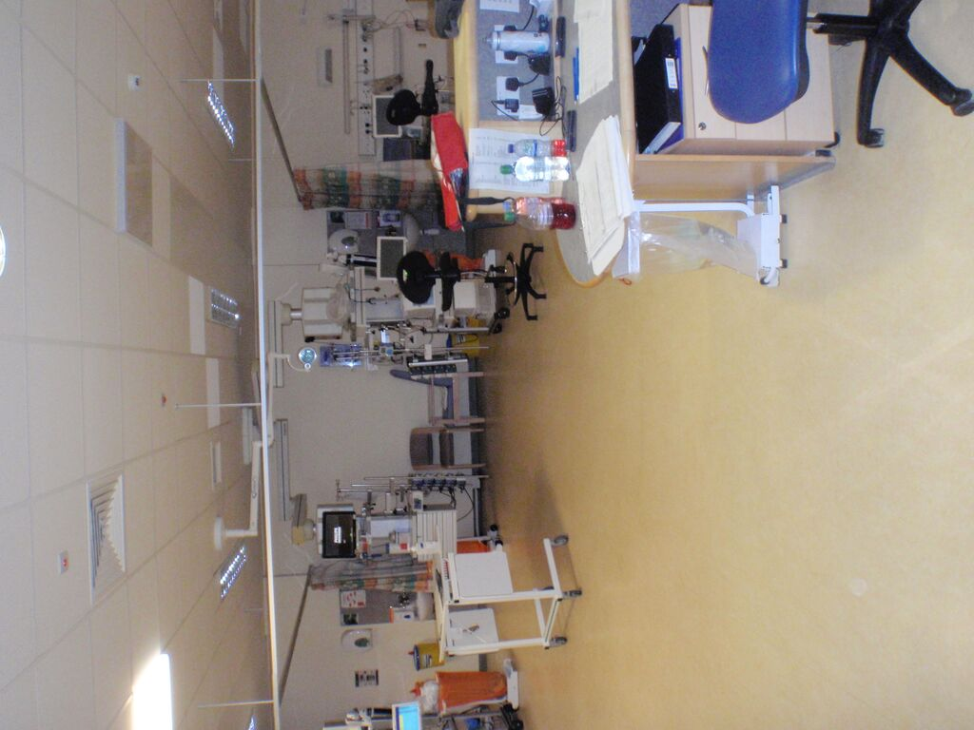
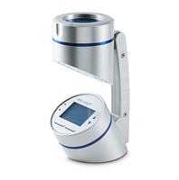
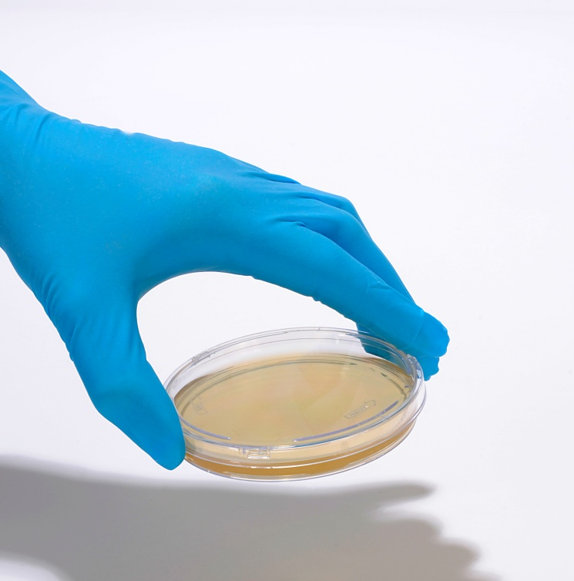
What is the role of the air in HAI?
Passive
Active
Notes:
Staph aureus E.coli Klebsiella Acinetobacter Ps. aeruginosa Klebsiella C.difficile
Norovirus Colds and flu COVID SARS1 MERS
Smallpox

Slide 9
Comparing microbial counts from surfaces and air in ICU using preset standards
Hygiene standard for surfaces: <5 cfu/cm²
Hygiene standard for air (passive): <2 cfu/9cm plate/hr
Hygiene standard for air (active): <10 cfu/m³
Dancer SJ, J Hosp Infect 2004; Pasquarella C, J Hosp Infect 2004

Slide 10
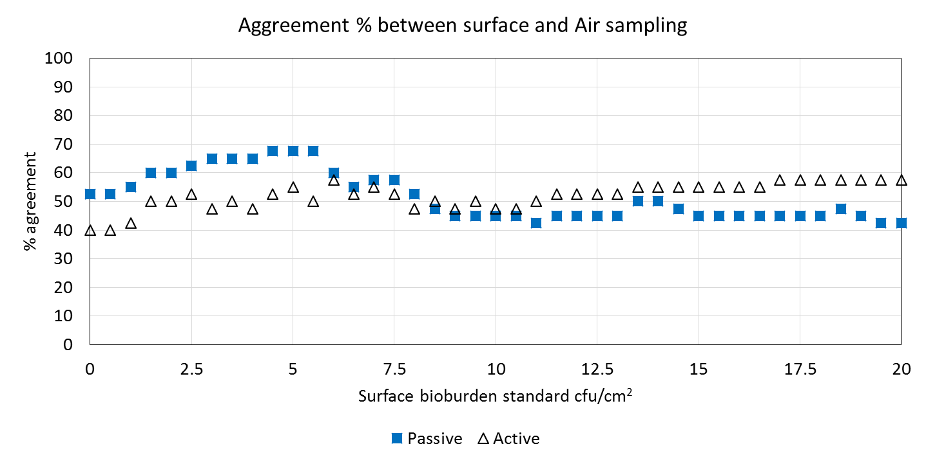
Is surface bioburden associated with air bioburden?
Agreement % between Surface and Air Counts in a mechanically ventilated ICU
Smith et al, J Hosp Infect 2018
Notes:
The pass/fail proportion of microbial counts on settle plates (from passive air sampling) more closely resembles pass/fail proportion of surface bioburden
160 air samples (active & passive) modelled against 500 surface samples on 10 days during 10 months
How does this help when predicting risk of HAI in critical care? It suggests that you don’t need to do surface sampling; you could potentially use settle plates to tell you whether bioburden in the unit is acceptable or not.

Slide 11

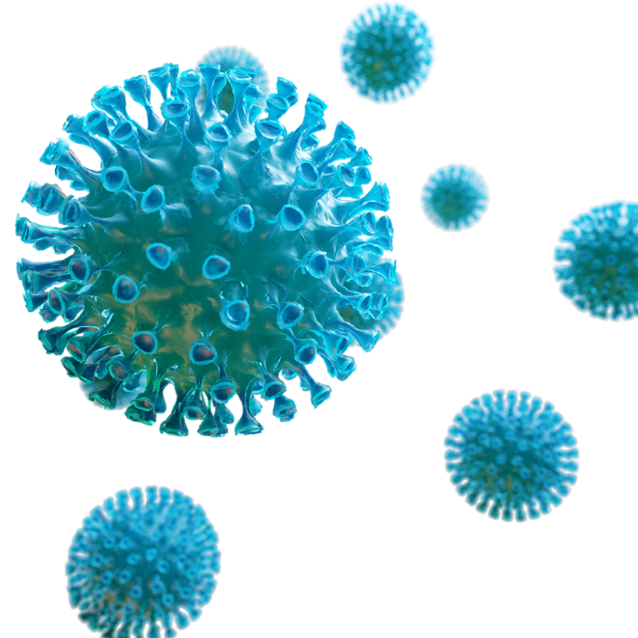


PANDEMIC!

Slide 12
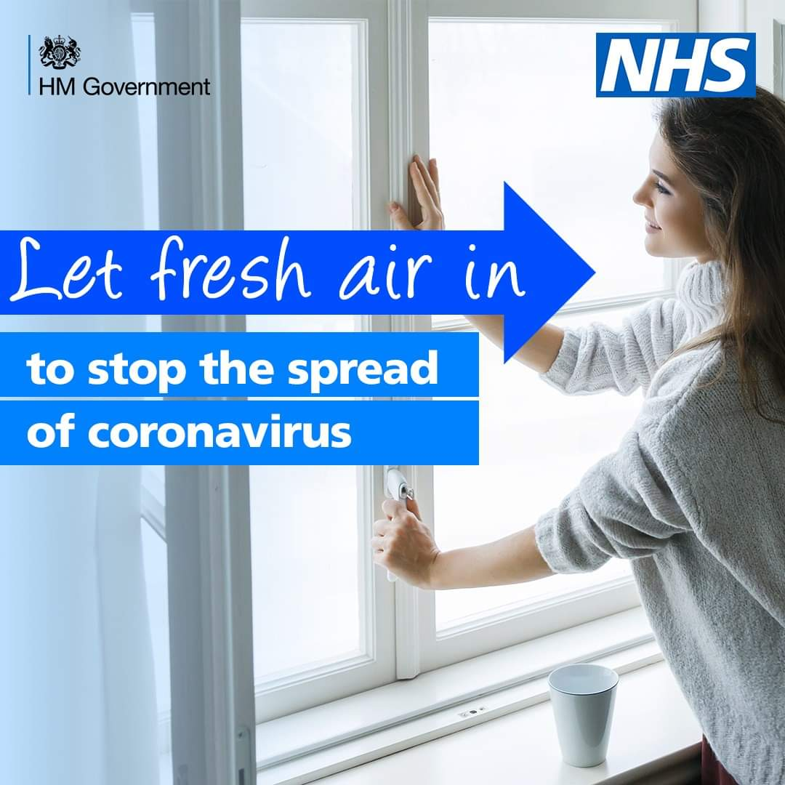
How should we protect patients from respiratory viruses?
Natural ventilation: open windows & doors
Open trickle vents!
Bathroom or kitchen exhaust fans; portable air conditioning units
Reduce ward occupancy rates
Stagger staff breaks, social distancing, restrict time spent face-to-face
Appropriate use of PPE (personal protective equipment)
Heating, ventilating and air conditioning (HVAC) systems, providing at least 6 air changes/hour and avoiding recirculation of used air unless filtered or disinfected; use 100% outside air
Air filtration: High Efficiency Particle Air (HEPA) filters
Air purification: UV germicidal light
Morawska L, et al. Environ Int 2020; 142:105832.
Lynch RM, Goring R. J Am Med Dir Assoc 2020 Jul;21(7):893-894.
Notes:
Not yet universal agreement on transmission of SARS 2, so prevention and control methods are unresolved.

Slide 13
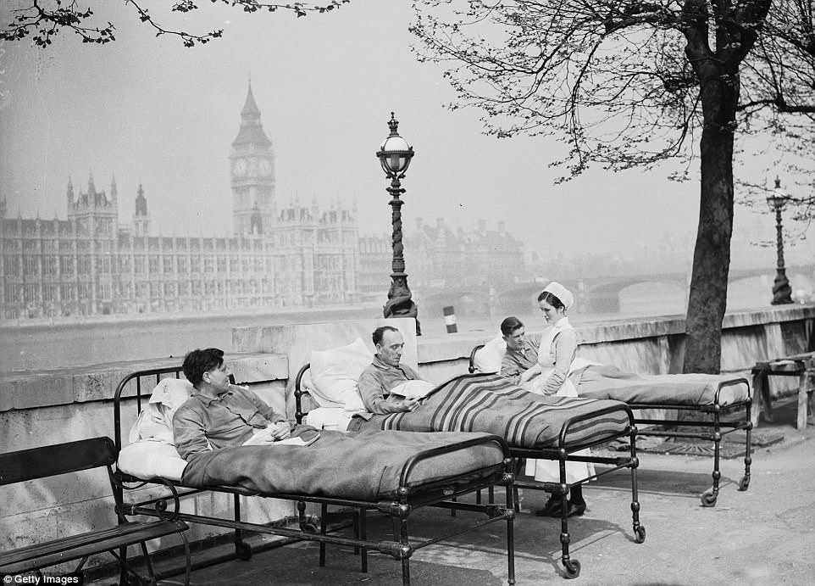

The ‘Open Air Factor’….. and sunlight??
Natural ventilation may be more effective than mechanical systems for preventing infection
Escombe AR et al, Plos Med, 2007
Sunlight is germicidal
Enhances resistance to infection
Role for surface decontamination
Ross JR et al. Effect of sunshine through window glass and fresh air on resistance to infection. Am J Dis Child 1933; Hobday RA & Dancer SJ. Effect of sunlight and natural ventilation for controlling infection in hospitals. J Hosp Infect 2013; Hobday RA, Cason JW. The open-air treatment of pandemic influenza. Am J Public Health 2009; Gilkeson CA et al. Measurement of ventilation and airborne infection risk in large naturally ventilated hospital wards. Build & Environ 2013.
Notes:
‘…detailed specifications needed to prevent airborne dispersal of pathogens are still unknown’
Closing hospital windows increases infection risk.. ’Measurement of ventilation and airborne infection risk in large naturally ventilated hospital wards’, Gilkeson et al, Build Environ 2013
‘Sunlight therapy and solar architecture’, Hobday RA, Med Hist 1997

Slide 14
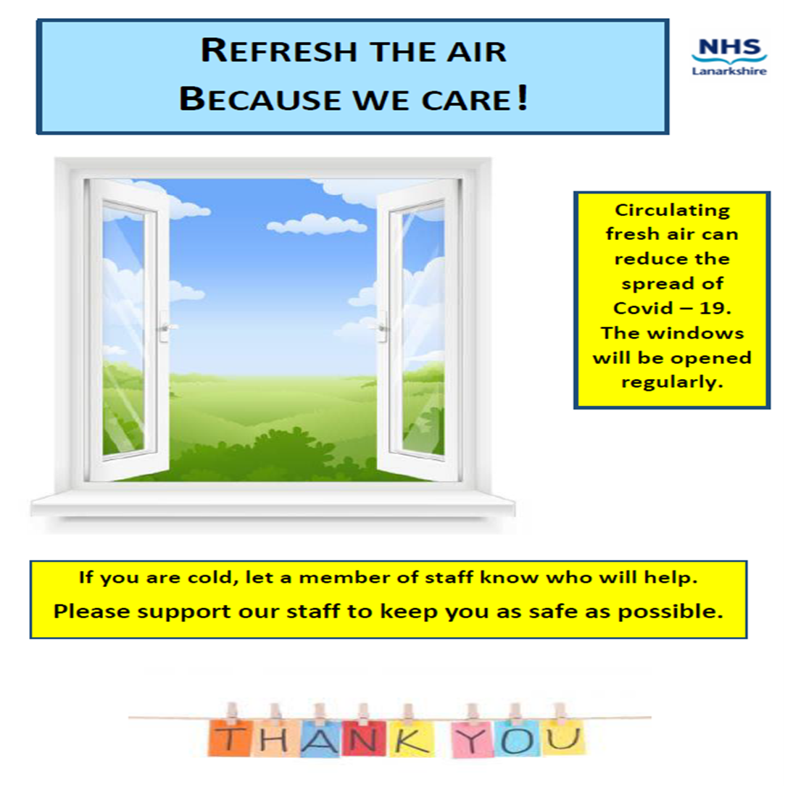
Climate, thermal regulation and conflicts with energy conservation
‘Pumping in adequate amounts of fresh outside air, however engineered, will compromise running costs as well as carbon status. Outdoor air generally differs from indoor air in terms of temperature and humidity, and conditioning outdoor air needs significant energy’
Dancer SJ et al, BMJ 2021;375:n2895
Notes:
Most buildings are neither designed nor well operated from the air quality aspect, with energy conservation and thermal comfort at the top of the list of requirements. Pumping in adequate amounts of fresh outside air, however engineered, will challenge running costs as well as carbon status. Outdoor air generally differs from indoor air in terms of temperature and humidity, and conditioning outdoor air needs significant energy. While evolving green technologies might be able to offset some of these increased energy requirements, any revision or upgrade of existing systems is a big undertaking and enormously expensive

Slide 15
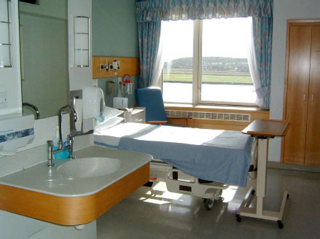
Pathogens in this room could be acquired by the next patient
Mitchell et al, J Hosp Infect 2015
The closer a contaminated surface is to a patient, the more critical it is likely to be
Notes:
The closer the surface is to a patient, the more critical it is likely to be

Slide 16
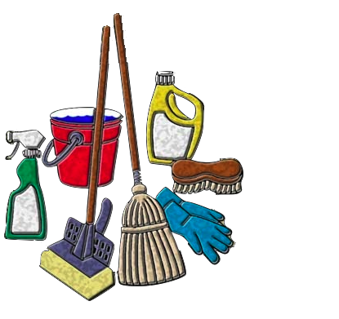
The removal of dirt is a science
Where are the pathogens?
Why were they missed during the terminal clean?
What can we do to locate them and remove them?
Indeed, what are the best methods for keeping a hospital clean?
What IS clean?
Dancer SJ & Kramer A, J Hosp Infect 2019;
Scott E, Am J Infect Control, 2013
Notes:
What does the word science really mean?
Science refers to a system of acquiring knowledge. This system uses observation and experimentation to describe and explain natural phenomena. The term science also refers to the organized body of knowledge people have gained using that system.
Cleaning can be measured; monitored; improved; observed; modelled; calibrated; experimented; and investigated…
*Banfield & Kerr, J Hosp Infect 2005
There is a small but growing body of evidence indicating an association between hand-touch sites in the home and the potential for transmission of infectious agents (Elizabeth Scott)
So how do we clean to reduce the risk as far as possible?

Slide 17
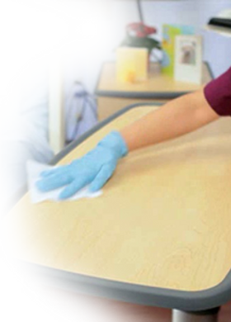
ONE wipe;
ONE site;
ONE direction
Siani H, Cooper C, Maillard JY. Efficacy of "sporicidal" wipes against Clostridium difficile. Am J Infect Control 2011; 39: 212-8.
Notes:
We are in danger of forgetting the simple principles of basic cleaning-One wipe; one site; one direction; DISCARD!
Little evidence for the removal of dirt rather than its obliteration

Slide 18
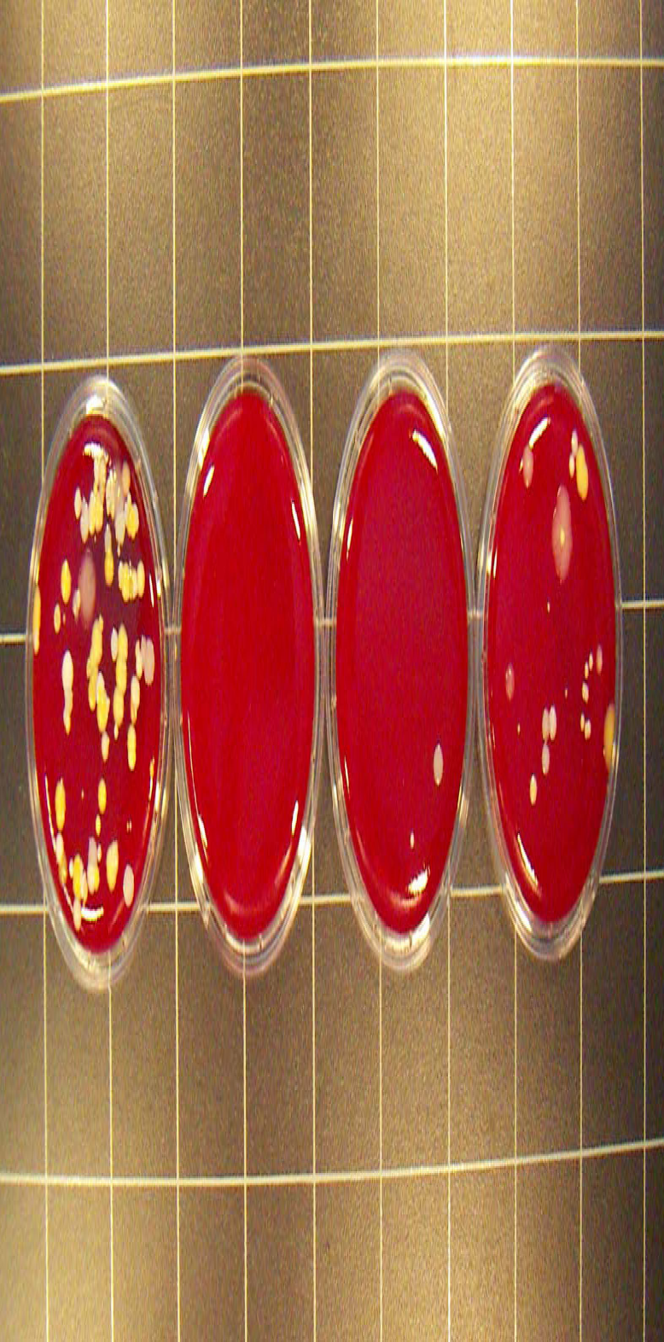
How long do hospital surfaces stay ‘clean’?
Contact plates from patient locker surface
Left to right: Pre-clean, 1 hour, 2 hour, 3 hour assessment
Photo courtesy of Mike Rollins
MRSA rapidly recontaminates high-touch sites in ICU after H202 vapour
Hardy KJ et al, J Hosp Infect 2007
Notes:
Does rapid recontamination of near-patient hand touch sites constitute a risk for patients??
Yes, patients COULD acquire pathogens with their own hands, in situ

Slide 19
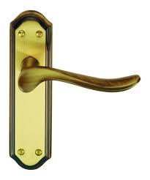
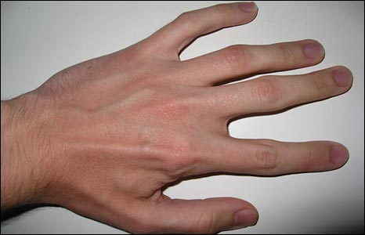
The Hand-Touch equation
=
Hand
Hand-touch site
There is a lot of emphasis on cleaning hands, but not so much on the surfaces that they touch
Notes:
Surface area of hands vs surface area of hand-touch sites
No brainer!

Slide 20
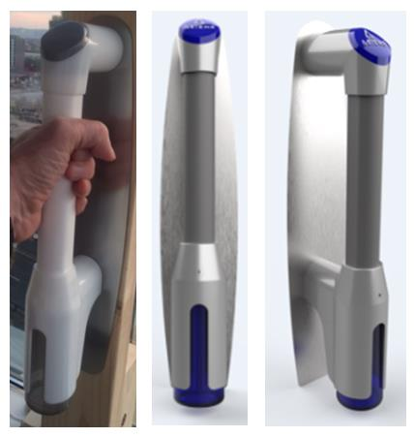
Novel technology for door handle design
Muirhead E et al, J Hosp Infect 2017

Slide 21
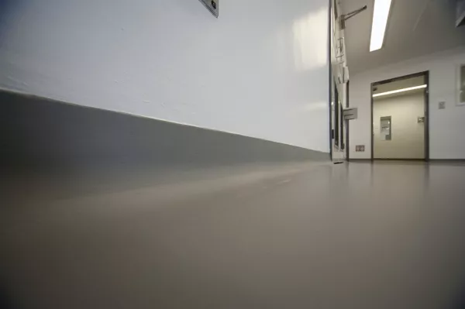
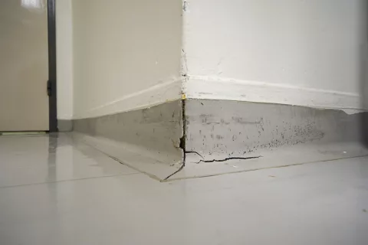
Designing a hospital or healthcare facility that actively promotes well being as well as preventing infection
Photos from Sika solutions
All assemblies between the floor, the walls and the ceiling can be finished in a rounded form to prevent dust accumulation and facilitate cleaning;
A sharp interface between surfaces are more difficult to clean and will harbour dust and pathogenic microbes; but damaged surfaces also present a risk for reservoirs of microbial soil
Notes:
Infection prevention and control is of utmost importance in hospitals and other healthcare facilities. Building owners, facilities managers, healthcare architects and others involved in healthcare design decisions need to consider how the materials used best promote health and safety

Slide 22
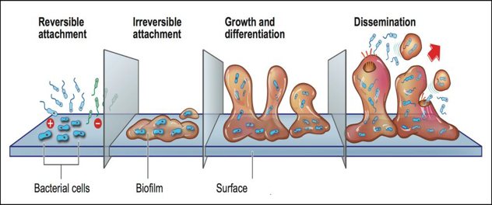
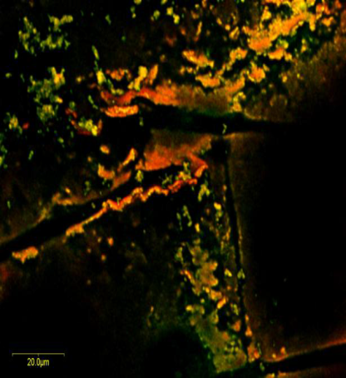
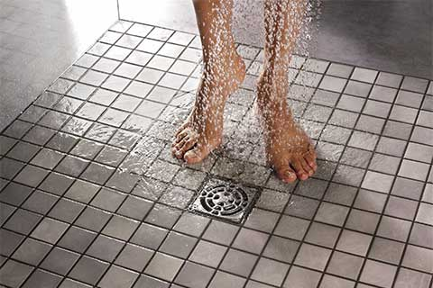
Biofilms on hospital surfaces protect viable pathogens… so disinfectant use could release long lost friends
Vickery K et al, J Hosp Infect 2015; Fernando S et al, J Hosp Infect 2018
Notes:
Confocal laser scanning micrograph of biofilm stained with BacLight LiveDead stain showing the presence of live bacteria (green) and dead bacteria (orange-red) on a dry hospital surface. Staining conducted after twelve months of storage at room temperature.
Fernando- disruption of wet surface biofilms following bleach exposure resulted in increased detection of MDROs including CPE
Can H202 penetrate microscopic crevasses in surfaces and eradicate biofilm? Can UVC? UVC will not get anywhere near biofilm hideouts.

Slide 23
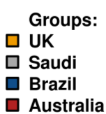
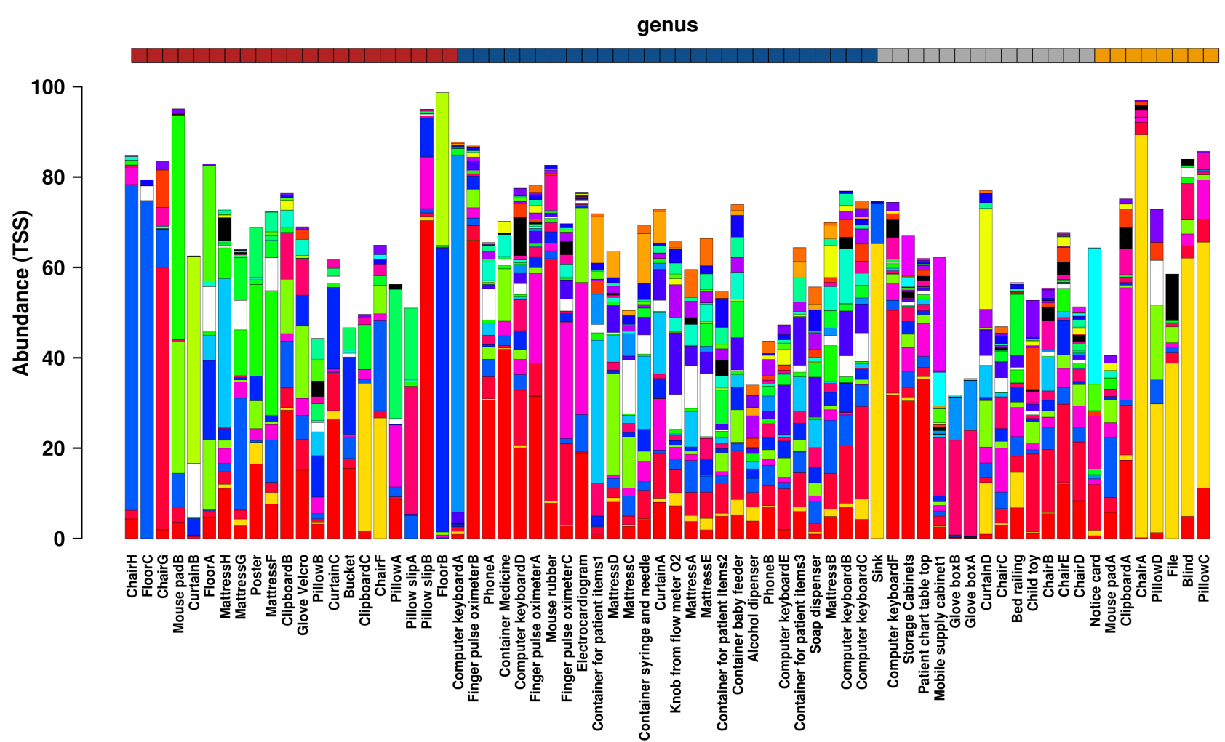
What’s in hard surface biofilm: ICU’s across the world
UK samples contained more environmental flora and significantly less gut flora…..but WHY? Vickery K et al, 2018
Notes:
When you feed a patient with multiple antibiotics....C.diff; so what do you get if you feed the environment with lots of powerful disinfectants?
HSBs varied in their bacterial composition from sample to sample and region to region but on average, were composed of ~ 60% environmental, 30% skin and 10% gut bacteria. Most HSB contained skin flora including Staphylococcus, Streptococcus, Corynebacterium and Propionibacterium spp.
Aus, Brazil and Saudi samples contained more Escherichia/Shigella/Klebsiella spp while UK samples contained more environmental Methylobacterium and significantly less gut flora
Australia also had more pseudomonas and enterococci

Slide 24
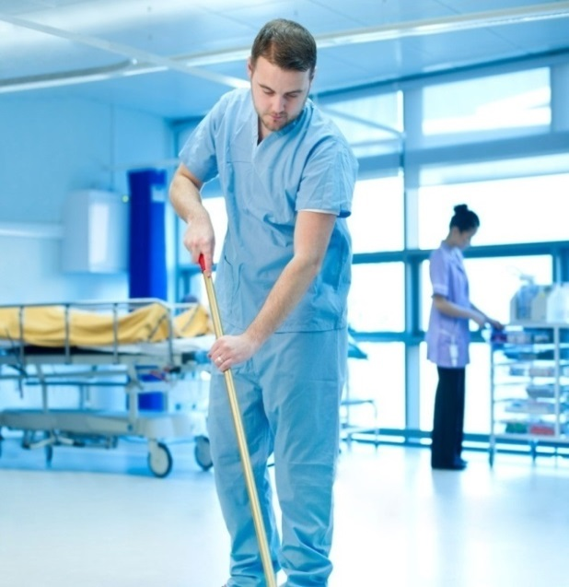

Does routine exposure of hospital environment to disinfectant affect the hospital microbiome?
Yes!
Resistant pathogens are more common in healthcare environments regularly exposed to disinfectants
Kampf G, ‘Antiseptic Stewardship for Surface Disinfectants’, 2018
‘The traditional approach to hospital hygiene has been to sterilize surfaces as much as possible, but this kill-all approach isn’t working’
Mora M et al, ‘Microorganisms in confined habitats: intensive care units, operating rooms, cleanrooms and the international space station…’ Front Microbiol 2016; 7:1573
Notes:
More cleaning does not necessarily decrease the risk of infection; on the contrary, it is correlated with a higher incidence of infection and appearance of multi-resistant strains; There is evidence that UV causes mutated bacteria from a distance and these bacteria are developing a resistance to UV light in water and possibly air.
‘One wipe; one site; and one direction’ is easy, cheap and effective; and it won’t upset the surface ecology
Huet- expose hospital pathogens to sublethal disinfectant and generated tolerance to disinfectant with cross-resistance to antibiotics used in humans Expose S.aureus to biocides and generate efflux pumps with cross-resistance to quinolones: Huet AA et al, Microbiol 2008
Microorganisms in Confined Habitats: Microbial Monitoring and Control of Intensive Care Units, Operating Rooms, Cleanrooms and the International Space Station.
Mora M, Mahnert A, Koskinen K, Pausan MR, Oberauner-Wappis L, Krause R, Perras AK, Gorkiewicz G, Berg G, Moissl-Eichinger C.
Front Microbiol. 2016 Oct 13;7:1573. eCollection 2016. Review.
Can automated decontamination devices eradicate biofilm??

Slide 25
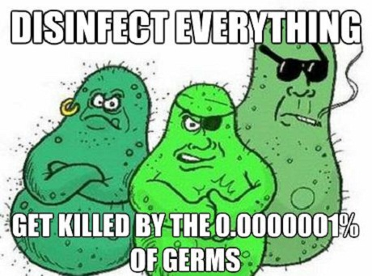
‘Disinfectant use leads to loss of microbial diversity, which correlates with an increase in resistance among survivors.....’
Nature abhors a vacuum
‘Manmade microbial resistances in built environments’,
Mahnert A et al, Nature Comm 2019; 10: 968.
Notes:
Resistance or tolerance or both?

Slide 26
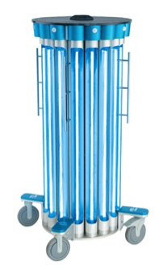
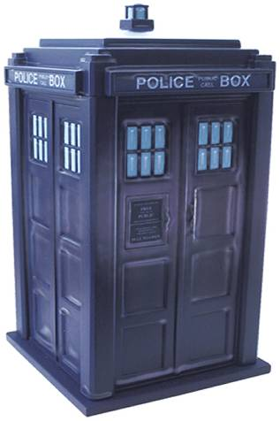
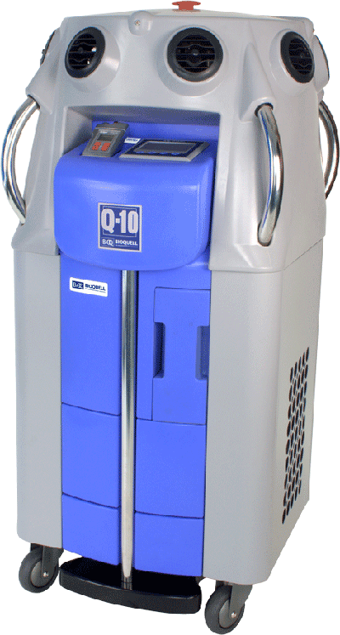
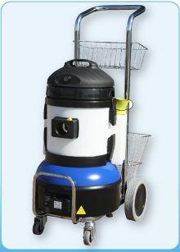

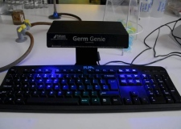
Just a quick blast…
The efficacy of any cleaning/disinfectant agent tested is dependent
on physical action.... Alfa MJ et al, BMC Infect Dis 2010, 10: 268
Notes:
Cost; require area to be cleared; impact on turnaround; light doesn’t go round corners or get into fabrics; vapours and gases can’t penetrate fabrics either; potential toxic effects on humans; are we really reliant on robots dispersing noxious vapours to keep our patients safe?

Slide 27
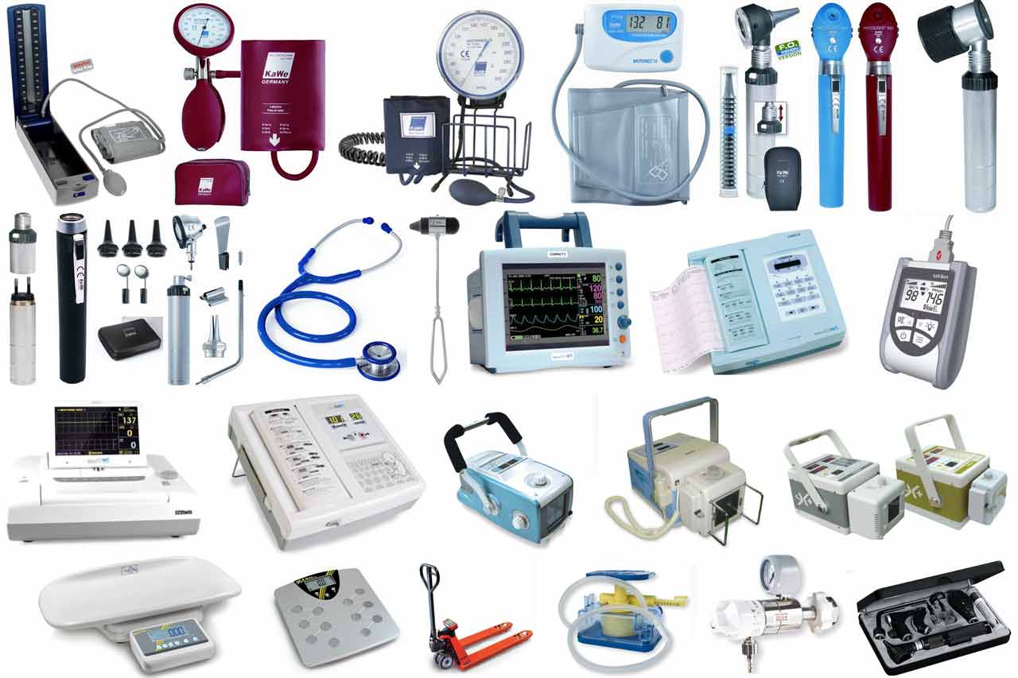
Anderson RE et al, ‘Cleanliness audit of clinical surfaces and equipment: who cleans what?’
J Hosp Infect 2011; 78: 178-181
Notes:
Clinical equipment
Endoscope decontamination
Ultrasound probes
Oxygen sensors for diabetic feet

Slide 28
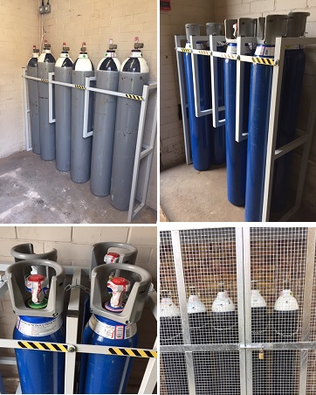
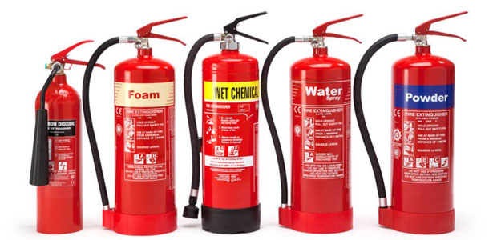
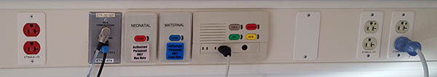
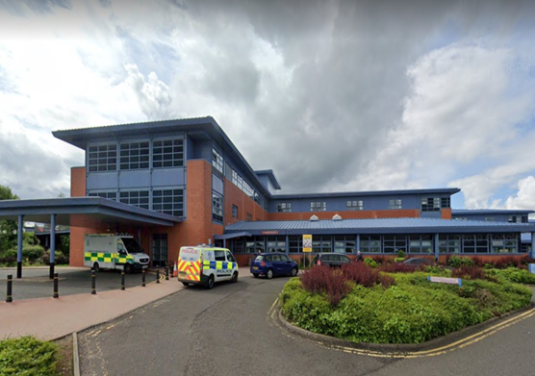
Fire safety; medical gases; and electrical systems
‘Hairmyres Hospital: Fire in COVID-19 intensive care unit prompts investigation as patients diverted to other hospitals (30th October 2020); the blaze may have started after short-circuiting in a ventilator.’
Notes:
Many other hospitals experienced similar incidents, with mortalities attached.

Slide 29
We do not have ‘gold-standard’ evidence for much of what we do to prevent hospital-acquired infection
Outbreaks happen. They cannot be ‘controlled’; ‘blinded’ or ‘randomised’.
‘The Randomised Controlled Double Blind Trial’
Infection prevention and control activities do not usually conform to the classic RCT; indeed, RCTs pose an ethical
challenge for infection control research.
Dancer SJ & Inkster T, J Hosp Infect, 2022
Notes:
Infection prevention interventions do not easily lend themselves to Cochrane-type randomized controlled trials (RCTs). This has long been recognized, because both the science and nuances of infection control retain all the complexities that you would expect from biological and behavioural parameters. There are no nice neat equations predicting healthcare-acquired infection (HAI). Furthermore, not all HAIs are equal, in that many prevention strategies would have little effect on endogenous infection. We cannot necessarily distinguish infections originating from the patient’s own flora as opposed to those from the environment. RCTs might help evaluate specific products, including novel disinfectants, but sole use of this research tool ignores outbreaks as well as basic cleaning as a control strategy in its own right. No one wishes to enter a healthcare institution devoid of cleaning staff whatever the level of obliterative disinfection.
There is currently a move to recognise detailed epidemiology conducted during and after an outbreak, in order to establish effective methods for control.

Slide 30
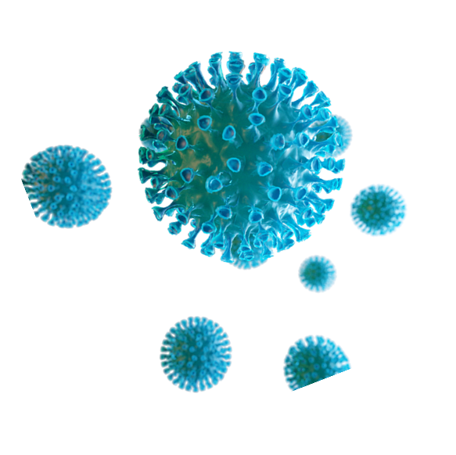
Conclusion
Recent events illustrate the importance of infection prevention and control;
NHS ASSURE offers an opportunity to advance knowledge in key areas in healthcare and beyond;
Evidence is urgently needed to define risk-based standards for the healthcare environment, including surfaces; equipment; water; and air;
We cannot underestimate the importance of the indoor healthcare environment in keeping people safe, whether it is from infection or anything else.
Notes:
People – personal hygiene; habits; hands; and includes screening!
Linen- clothes, uniforms, sheets, curtains and soft furnishings
Surfaces- hand touch, beside patient
Clinical equipment
Open windows
Target plumbing
Standards, maintenance, monitoring

Slide 31
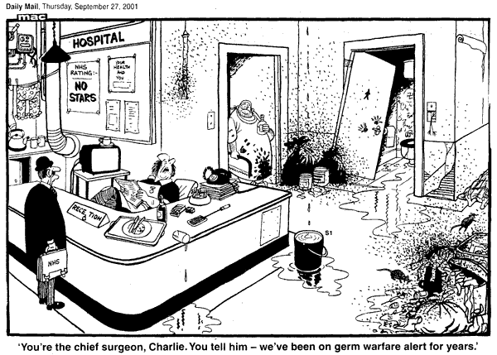
Notes:
Spot the companion pets.

