Slide 1
NHS Scotland ASSURE Research Fund
AIM:
Managing applications to the £1.55M research and innovation fund, in order to develop evidence-based guidance for the delivery of safe healthcare environments
TOPICS:
Water systems, including drainage (design, installation, commissioning and maintenance)
Ventilation systems
Pathogens, microbiome, AMR, transmission risks & disease burden in the hospital environment
Hospital design, including size and single room provision
Lessons learned from COVID-19
Human factors/Ergonomics and Infection Prevention and Control
Climate change requirements and the unintended consequences on built environment risks
The role of safety and harms in relation to medical gases, electrical systems and fire safety.

Slide 2
Healthcare-Associated Infection in Scotland
Back in 2016 a point prevalence survey showed that 1 in 22 patients develop a healthcare–associated infection (HAI); this means that HAIs affect one patient in every ward in every hospital across Scotland.
The annual pre-pandemic total for Scottish hospitals is 55,500 infections.
The most common HAIs are urinary tract; respiratory; and skin and soft tissue infections.
HAIs are caused by pathogens such as Staphylococcus aureus, Escherichia coli, Klebsiella pneumoniae, Clostridium difficile, Pseudomonas and enterococci. The most important fungal pathogen is Candida, and commonly encountered viral infections in healthcare include COVID-19, influenza and norovirus.

Slide 3
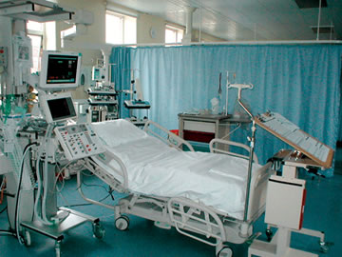
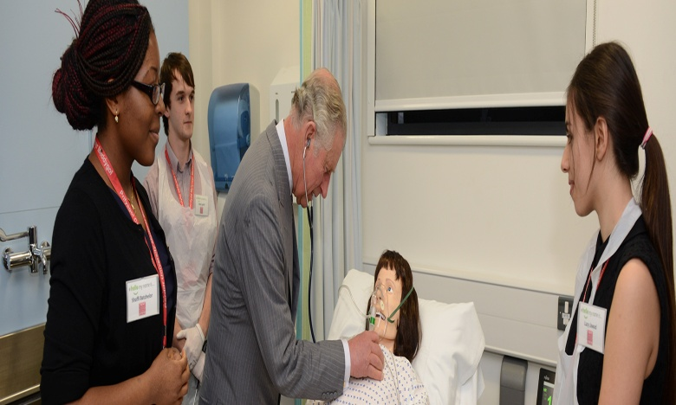

Environment
Pathogen Reservoirs
Air
People
Water
Hands

Slide 4
What can we do to reduce the HAI risk?
PROBLEM SOLUTION
Hand transmission…………………….............Hand hygiene
Contaminated environment………….........Cleaning; disinfectants
Airborne pathogens…………………..............Ventilation, air cleaners and purifiers
Infected patient…………………....................Isolation; barrier nursing; cohorting
Patient at risk…………………………...............Screening, e.g. MRSA
Medical equipment……………….................Decontaminate and label
Hospital-acquired infection…………………..Surveillance AND feedback
Drug resistance…………………………………….Antimicrobial stewardship
Pathogens in water……………………………….Plumbers
Building design…………………………………….Architects; engineers
Infection transmission………………………….INFECTION CONTROL TEAM
What is the evidence for these?
Notes:
What is the evidence for these?

Slide 5
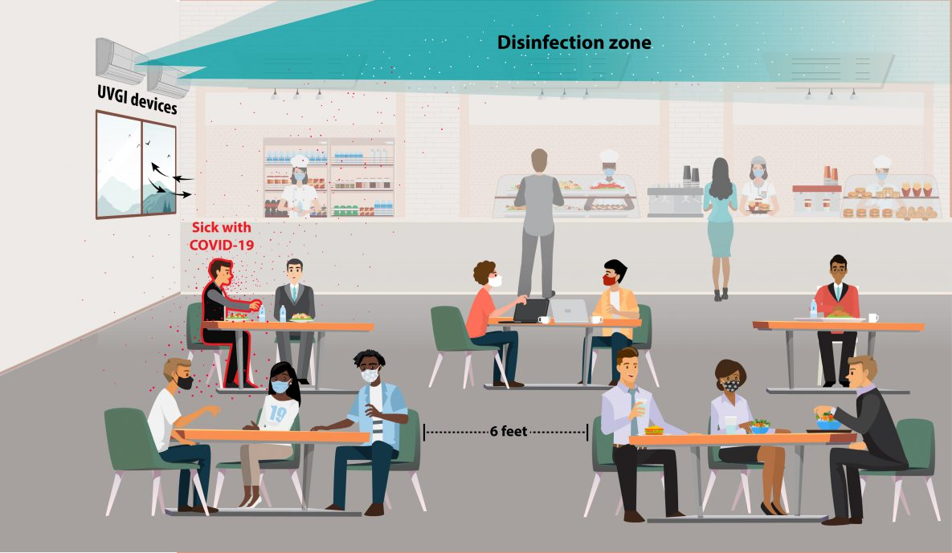
Upper-Room Ultraviolet Germicidal Irradiation
Cartoon courtesy of CDC
Notes:
Ultraviolet germicidal irradiation, or UVGI, is the use of ultraviolet (UV) energy to kill viral, bacterial, and fungal organisms. UVGI fixtures produce UV-C energy, which has shorter wavelengths than more penetrating UV-A and UV-B rays and pose less risk to human health. Upper-room UVGI refers to a disinfection zone of UV energy that is located above people in the rooms they occupy. This kills airborne pathogens in the room where they are released. Fixtures are installed to prevent direct UV exposures to people in the room.

Slide 6
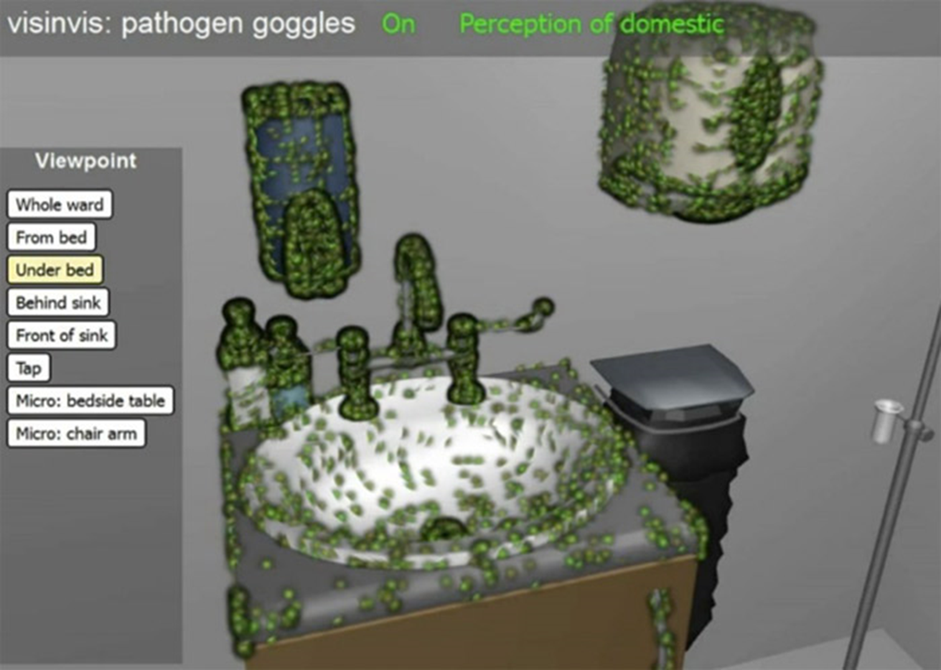
‘Seeing is believing’
Slide courtesy of A. Macdonald, GSA

Slide 7
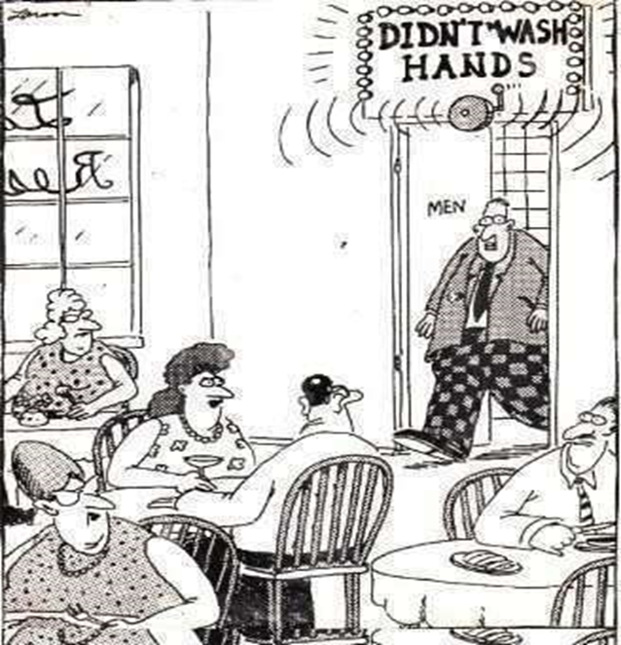

Slide 8
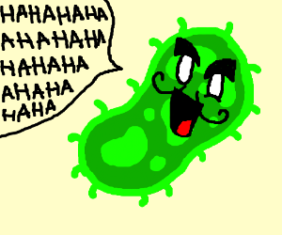
Thank you!
Web : https://www.napier.ac.uk/nhsscotlandassure
Email : NHSAResearchService@napier.ac.uk

