Slide 1
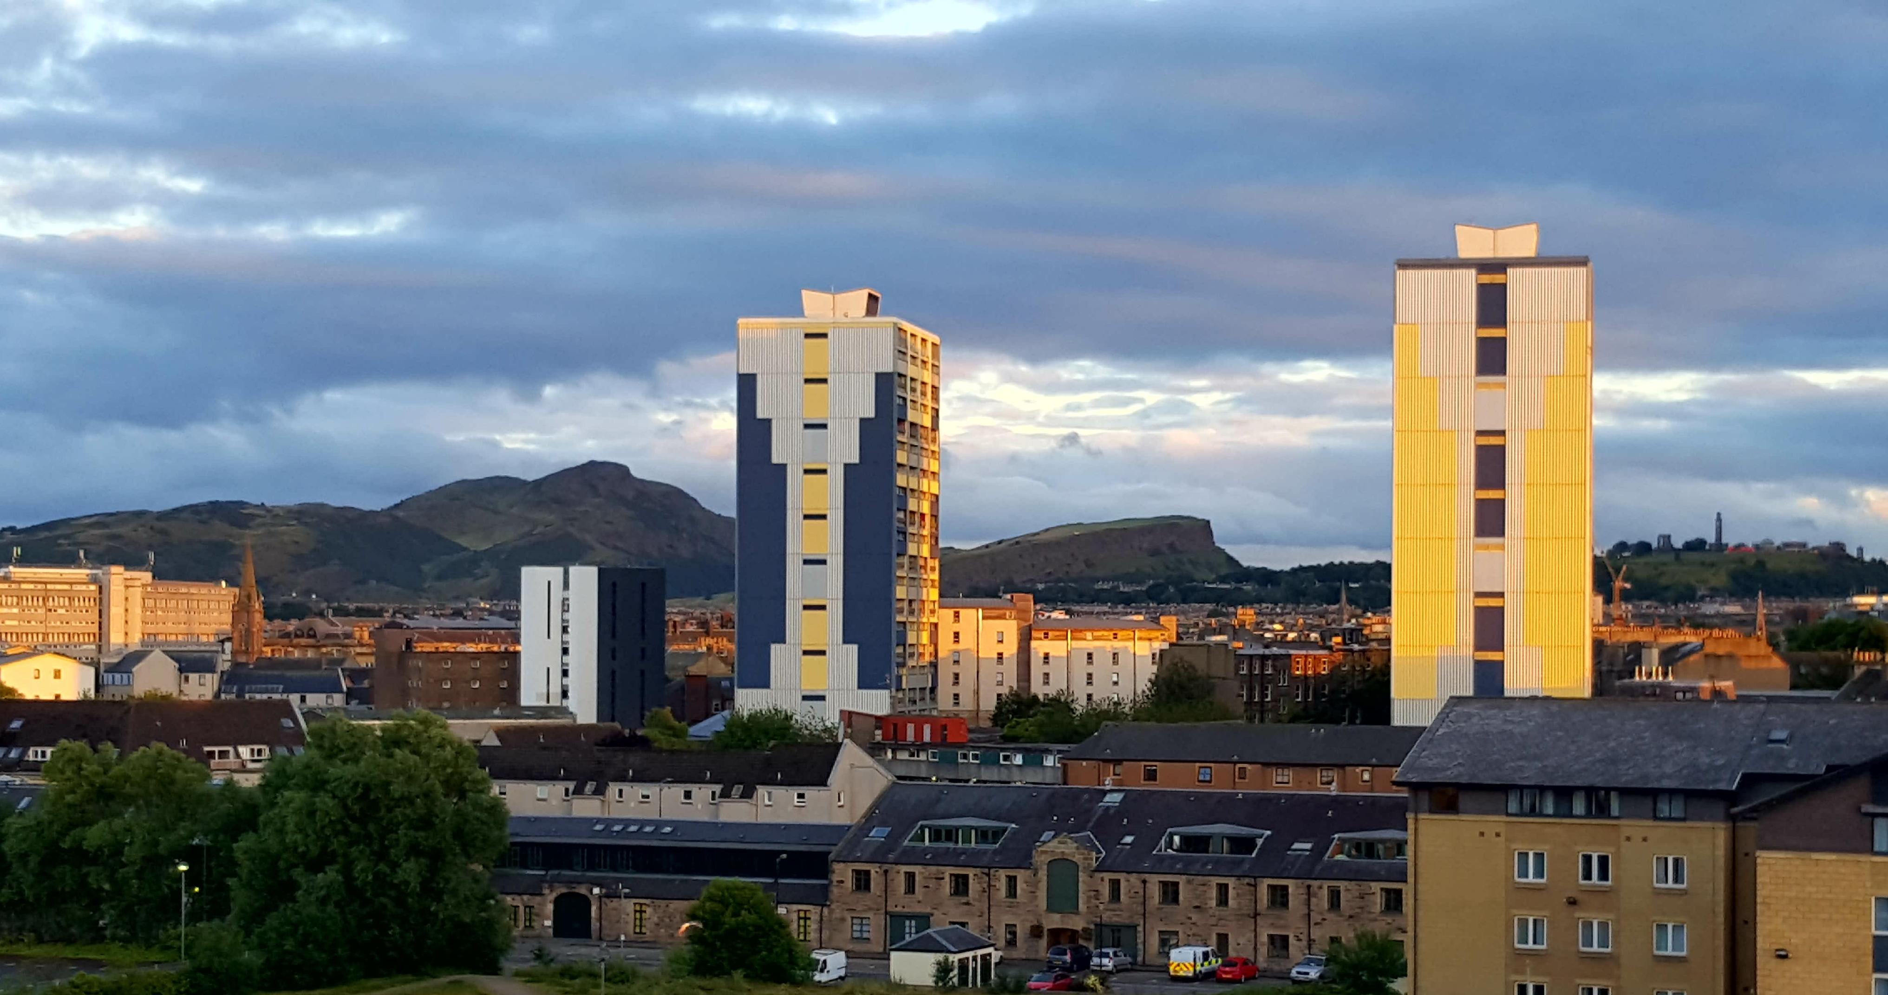
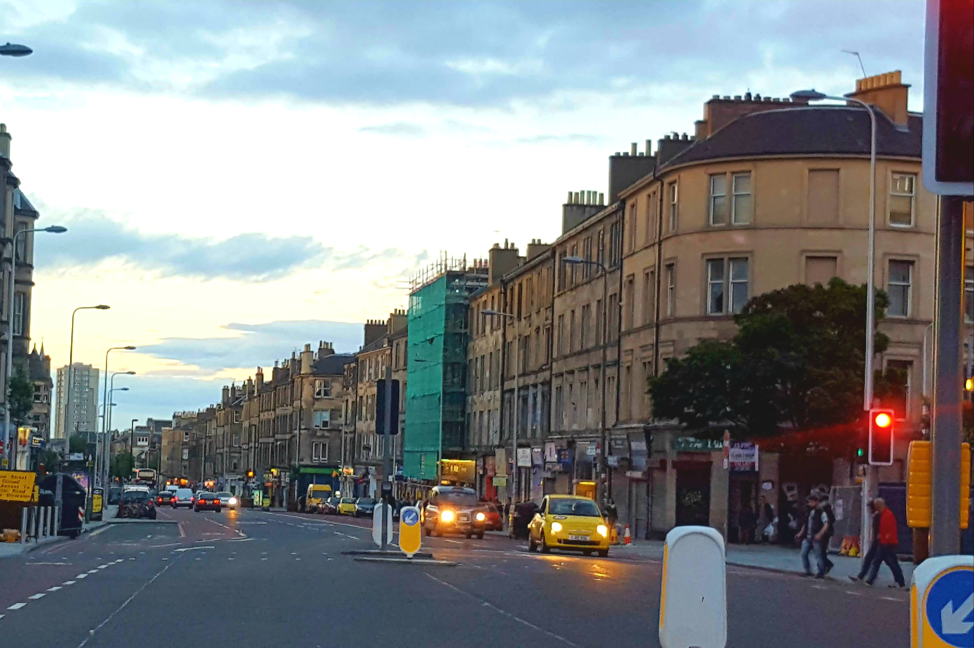
An interdisciplinary approach to community environmental health: Exploring socio-environmental relations. Dr Elaine Carnegie e.carnegie@napier.ac.uk
Do the spatial characteristics of an area determine health and wellbeing?
Is one’s health and the health of one’s neighbour valuable as an end in itself?
Population density
Environmental health determinants include proximity of risk, spatial relations and spatial patterning such as residential segregation, segregated networks and density. These can influence health within the built environment (Simons et al. 2014). Physiological and psychological responses to one’s environment and socio-economic status impact on the development of disease.
High density populations are associated with mortality rates, levels of trust and cohesion, health inequalities and attitudes towards distribution of wealth and benefits (Tunstall, Mitchell, Gibbs, Platt, & Dorling, 2012). Affluence is associated with being less inclined to articulate disquiet regarding inequalities and less inclined to encourage a redistribution of wealth. In contrast, those who would benefit from redistribution tend to actively encourage such policies (Bailey et al. 2013). Exploring spatial dimensions of health inequalities from disciplines of social justice and psychology will involve reflecting on relative group gratification and relative social deprivation. There is an opportunity to explore a “commons” of health based on mutuality and equality.
What is the extent of “equality” and “mutuality” within neighbourhoods?
Does population density influence the attitudes of residents towards a “commons” of health?
Methods
A geo-spatial analysis of population density as a determinate of health within specific data zones, and qualitative exploration of the views of those who are socio-economically advantaged residing in these same zones, followed by testing of potential mechanisms through which neighbourhood density might influence attitudes toward health inequalities.
Leith, Edinburgh has highest population density in Scotland 12,900 per km²
Neighbourhoods are an important unit of scale as they act as mediators or confounders of any health intervention (Chiu and West 2007, Tunstall et al 2014).
Is population density associated with health outcomes and health inequalities?
Does population density modify attitudes towards “community health rights” – does this differ across socio-economic groups?
EQUALITY - seeking a state of fairness for individuals, communities and populations.
The Built Environment
as a determinate of health
Does population density lead to knowledge transfer of health inequalities – does awareness traverse social, spatial and economic segregated networks?
MUTUALITY - seeking a state of health held in common with individuals, communities and populations.
Community participation is essential for human flourishing – this involves “practical knowing” where we share knowledge as co-inhabitants.
Conclusion
Opportunities exist for inter-disciplinary research including
Psychology, Urban Studies, the Built Environment and
Public Health to explore socio-environmental relations
traversing population density, health status, socio-
economic position and community attitudes towards
health and social inequalities.
References
Bailey, N., Gannon, M., Kearns, A., Livingston, M., & Leyland, A. H. (2013). Living apart, losing sympathy? How neighbourhood context affects attitudes to redistribution and to welfare recipients. Environment & Planning A, 45(9), 2154-2175; Chiu, L. F., & West, R. M. (2007). Health intervention in social context: Understanding social networks and neighbourhood. Social Science & Medicine, 65(9), 1915-1927. Fitzpatrick, K. M., & LaGory, M. (2003). “Placing” Health in an Urban Sociology: Cities as Mosaics of Risk and Protection. City & Community, 2(1), 33-46. Heron, J., & Reason, P. (1997). A Participatory Inquiry Paradigm. Qualitative Inquiry, 3(3), 274-294. Kearns, A. D. E., Bailey, N., Gannon, M., Livingston, M., & Leyland, A. (2014). ‘All in it Together’? Social Cohesion in a Divided Society: Attitudes to Income Inequality and Redistribution in a Residential Context. Journal of Social Policy, 43(3), 453-477. Mackie, P. (2010). Social justice and social responsibility: Towards a value-base for global public health. Public Health, 124(11), 620-625. Pritchard C and Evans B (1997) Population density and cancer mortality by gender and age in England and Wales and the Western World 1963-93. Public Health 111 215-220.; Quillian, L., & Lagrange, H. (2016). Socioeconomic Segregation in Large Cities in France and the United States. Demography, 1-34. Simons et al. (2014) Longitudinal associations between neighbourhood walkability and incident childhood asthma. Allergy, Asthma & Clinical Immunology 10(Suppl 1):A8; Smith, H., & Pettigrew, T. (2015) Advances in Relative Deprivation Theory and Research. Social Justice Research, 28 (1), 1-6. Tunstall H, Mitchell R, Gibbs J, Platt s, Dorling D (2011) Socio-demographic diversity and unexplained variation in death rates among the most deprived parliamentary constituencies in Britain. Journal of Public Health 34 2 296-304. Tunstall H, Mitchell R Pearce J, Shortt N (2014) The general and mental health of movers to more- and less disadvantaged socio-economic and physical environments within the UK. Social Science & Medicine 118 97e107.

