Slide 1

Dr Who and the Curriculum Planners: early observations from a longitudinal study of
Associate Students’ transition to University
Julia Fotheringham & Alastair Stupart, Edinburgh Napier University
International Conference on Enhancement
and Innovation in Higher Education
Crowne Plaza Hotel, Glasgow
9-11 June 2015

Slide 2
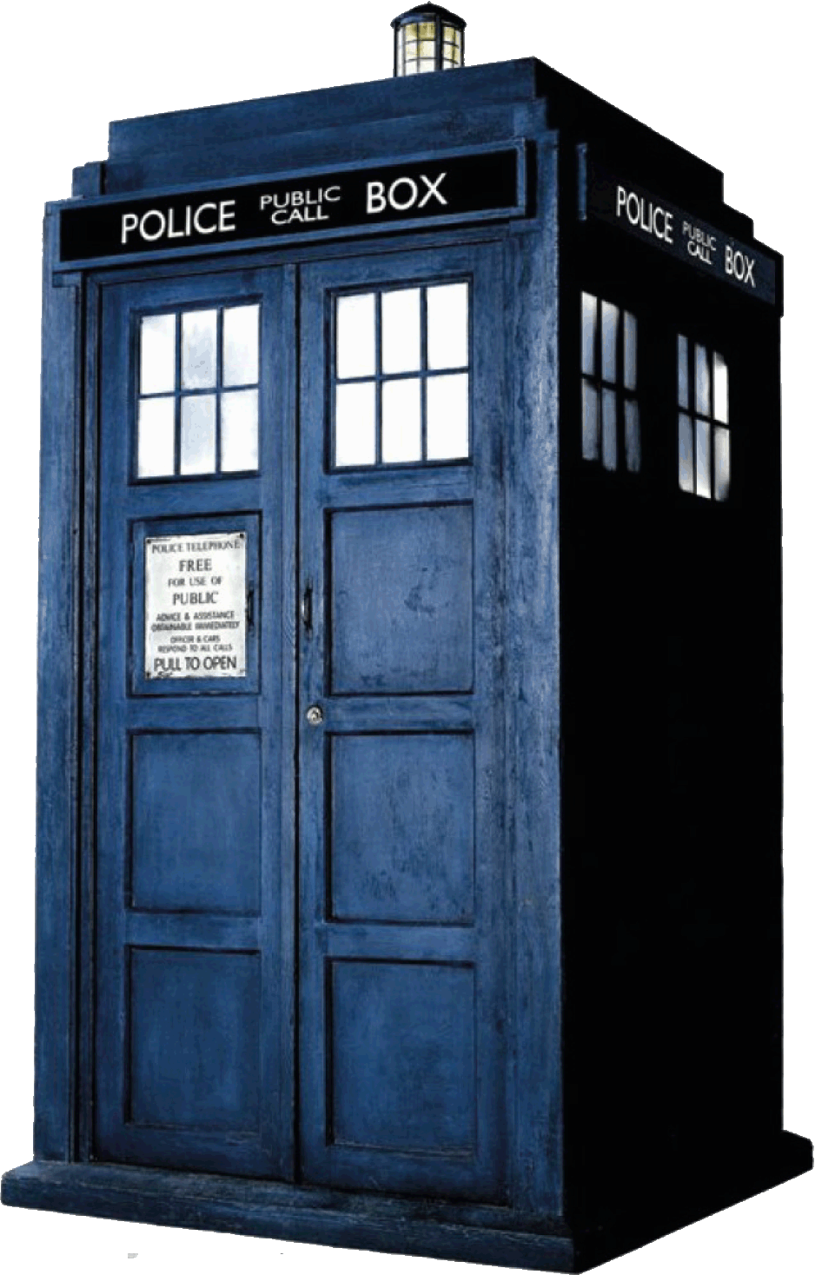


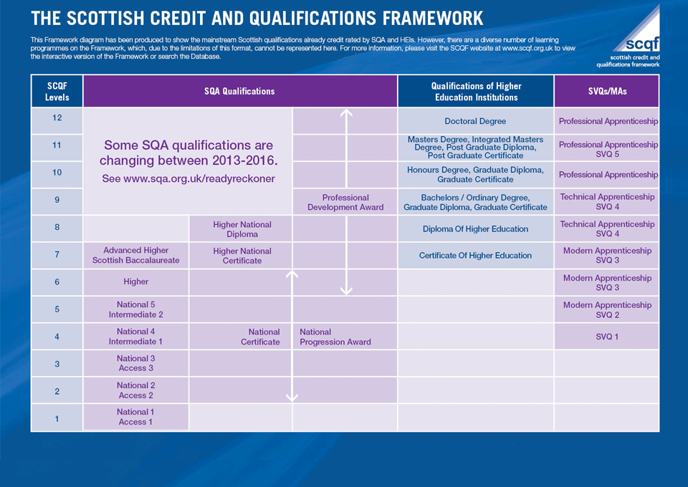

?
?
Dr Who and the Curriculum Planners: early observations from a longitudinal study of
Associate Students’ transition to University
?
?

Slide 3

Session outline
Provide a background to the Associate Student Project.
Discuss SCQF and its potential for supporting curriculum planning.
Consider two different conceptions of learning and their relevance to understanding transitions.
Introduce a longitudinal study of Associate Students.
Discuss early findings relating to students’ expectations and curiosities.

Slide 4
Background – Associate Student Project
Scottish Funding Council (SFC) in 2013 – offered four years of additional funded places at Colleges with guaranteed articulation (“2+2” model).
Different funding methodology - College receive enhanced funding for each Associate Student in College (equivalent to that offered to an undergraduate student), Universities receive 25% of that funding.
Universities are expected to provide a range of “interventions” which are intended to (1) enhance students’ chances of making effective transition to University and (2) improve retention.
Students are dual-matriculated (College & University).
Castle Modern University - 107 additional funded places per annum (for 4 years).
Castle Modern University - STEM subjects (e.g. civil/electrical engineering, computing).

Slide 5

2+2 at Castle Modern University
Associate Students while still at Colleges
Students arrive at University in 3rd year in 2015
Workshops from university staff:
Note taking
Report writing
Library skills
Tailored induction event at Freshers’ Week
Maths Plus workshops
Informal visits
Academic staff
Library
Student support
Academic Skills workshops
Associate Students visit University
Library tours
Campus tours
Meet the staff
Students’ Association
Mentoring
Maths workshops
Extras: site visits, employability skills event
Notes:
Could be worth mentioning that uptake of these activities varies

Slide 6
Scottish Credit and Qualifications Framework (SCQF)
SCQF outlines the relationship and equivalences of the different qualifications available in Scotland.
Enables learners to progress their education, moving between sectors with no loss of time.
Articulation agreements are underpinned by SCQF.

Slide 7
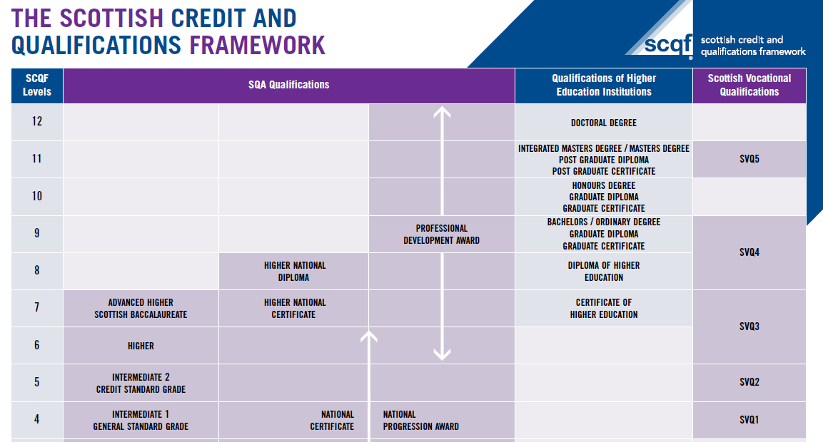
Notes:
I’ll check to see if anyone in the audience is not familiar with SCQF, and I’ll give more explanation if they are, but if everyone knows about it, I’ll rattle through this slide.

Slide 8


How does the SCQF see learning?
Individualistic, cognitivist perspective of learning.
Learners achieve the stated learning outcomes, storing the learning in their brains.
That learning then becomes available in the new learning context.
http://www.brainhealth.utdallas.edu/blog_page/the-brain-an-owners-guide-public-lecture-series-synopsis
But this does not take account of how the curriculum is enacted in each of the different college sites.
Notes:
There’s a number of problems with that perpsective that we can see, one of which is that it doesn’t take account of how the curriculum is enacted in each of the different college sites

Slide 9

Sociocultural view of learning
Learning is situated, entangled in social relations, embedded in practice and distributed amongst the participants in that practice
Problem – education policy is aligned with an individualistic cognitive view of learning. Whereas, research into academic transitions suggests a sociocultural view of learning, providing a more complex representation of the transition space

Slide 10
Ethnographic approaches to data generation
September – June 2015
HND Engineering Systems |  |  | HND Civil Engineering
College A (D) | College B | College C | College A (G)
2 observations | 2 observations | 1 observation (further one planned for June 15) | 3 observations
1 focus group | 1 focus group | 2 Informal group interviews | 2 focus groups
1 semi-structured interview (curriculum leader) | 1 semi-structured interview planned (curriculum leader) |  | 1 semi-structured interview (course leader)
1 informal interview (lecturer) | 1 informal interview (lecturer)

Slide 11
What do our Associate Students say?
“It’s in the articulation agreement so I think we’ll be fine”
“We’re studying exactly the same thing … they just do it faster”
Students are very trusting that the curriculum has been carefully planned. Even where they perceive lack of alignment, they expect that they will be protected from academic “fall-out” due to their status as Associate Students.

Slide 12
College staff take great care with curriculum planning to ensure alignment
“We’re trying to teach for progression”
“The more you can tell me about what you want the students to know when they come to University, the better it will be for everyone”
“I spend a lot of time making sure that what we do
here matches what is required
for xxx University”

Slide 13
Maths may not be perfectly aligned, but the students trust the curriculum planners
“I think from my point of
view, especially with the Maths thing, that because we have this Associate Degree kind of
already set, we’ll probably get in even if we didn’t have that part”
“There’s a lot of confusion over Maths but …. !”

Slide 14
Sociocultural differences
?
University
“Why is everyone Dr this and Dr that at Uni?”
Dr?
“I’m literally the first one in my family anyway so I haven’t got a clue what I’m going in to like “
Prof
Reader

Slide 15
Associate Students are curious about:
Physical environment at University (classroom, labs, lecture theatres…).
Titles - Doctor, Professor.
PhD.
Independent learning.
Their counterparts who have studied 1st and 2nd year at University, instead of College.
?
? ?
? ? ?
? ? ? ? ?
? ? ? ? ? ? ?
? ? ? ? ? ? ? ??

Slide 16
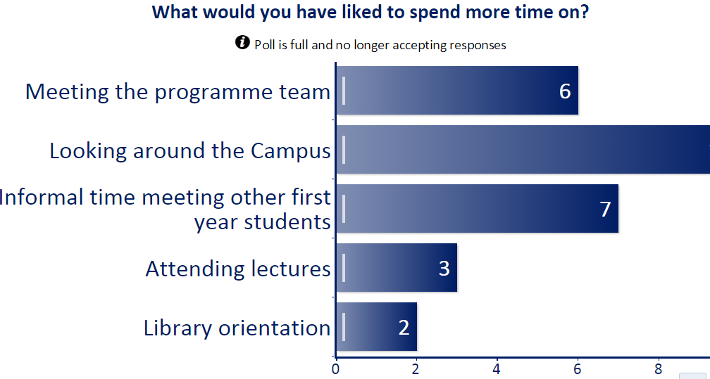
Feedback from an induction session (October 2014)
13

Slide 17
High expectations for University
The title of Doctor is a signifier for the role of research in the University.
Lecturers who are “at the top of their game” due to their Doctor status.
Better equipment.
Larger scale.
Everything is better planned.
Better food!

Slide 18
Conclusions?
Early findings suggest that transition for Associate Students to University is likely to be a much more complex process than is suggested by the neatly aligned rows and columns of the SCQF.
In September this year, the HND Associate Students arrive at University (year 3), and we will begin data generation again ; with observations and focus groups.
We will be investigating the matter of Maths.

Slide 19
Thank you
Questions?
_______________________________________________________
Julia Fotheringham j.fotheringham@napier.ac.uk
Alastair Stupart a.stupart@napier.ac.uk

