Slide 1
Working towards an inclusive LTA within large cohort modules
Stevie Robertson - November 2014
Notes:
Thanks for the opportunity to share some of my stories and experiences accumulated over the past few years.
I’ve been fortunate to work with some amazing people since I started teaching in 2008. My role has been as a conduit for their ideas and suggestions in how to make my teaching more inclusive.
I recognise that I’m working towards a more inclusive way of teaching and that journey is not yet complete. There will also be someone else who has a wee challenge for me.
As the title suggests my work is within very large cohort classes – somewhere between 180 and 320 students. I think this is significant because I don’t always have a lot of time to work one-on-one with students. I need to make the module as accessible as possible to the majority of the students as early in the term as possible.

Slide 2
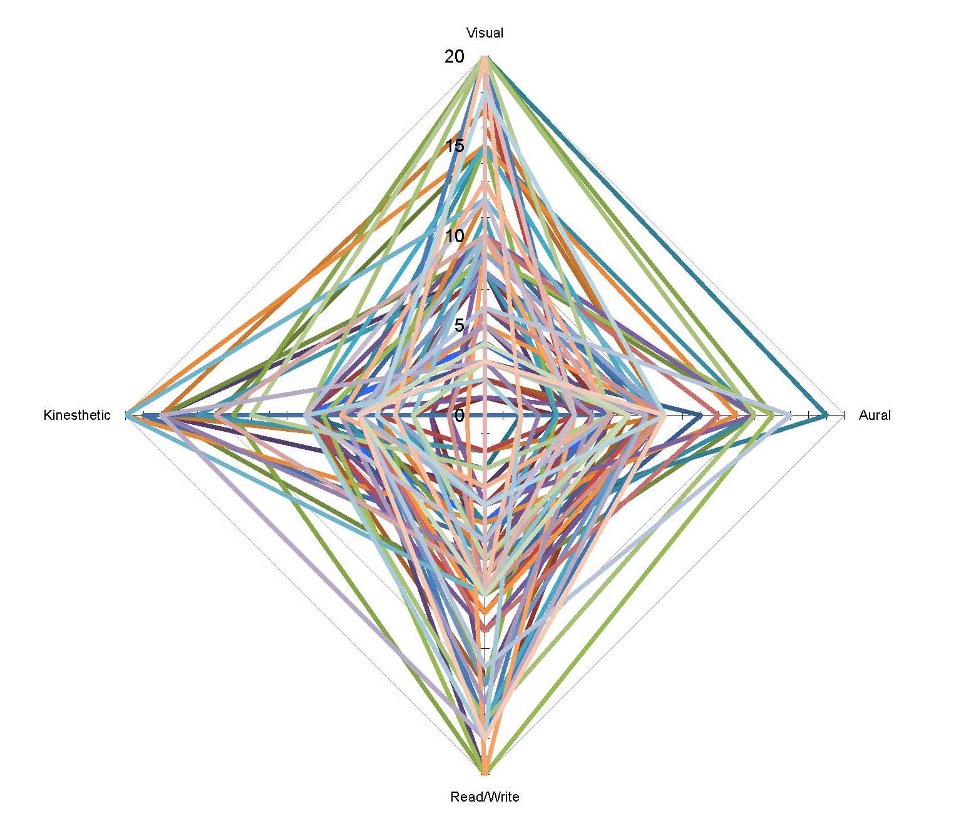
Notes:
For those of you who are old enough, this may remind you of a 1970’s string and nail picture. It is an accumulated polar diagram of student’s learning style for a class a few years back.
Each line represents a different student. Each has a unique learning style that makes teaching large modules even more daunting. I also have a unique learning style (highly skewed to kinaesthetic) so there’s a lot of adjustment to be made by everyone involved.
Add to this range of programmes in one of my classes, I teach business management, lawyers, festival & events and financial services students at one time. In another class I have accountants, economists and business studies students mixing with Business Information students from FEECI.
Plus, I have a number of exchange students with different cultural experiences and language skills.
We haven’t even thought yet about those with ‘special needs’. My view is that all students have special needs and my role is to include as many people as possible into the mainstream.

Slide 3
LTA Strategy
Listen
Trial
Accumulate
Notes:
This picture may be familiar to you. It appears on the web-site, has been used in emails and for a while was hanging on a wall or fence outside of campus. It’s a great photograph but when you know the student, you know the story.
This is Sophie. She graduated in July with First Class Honours in Business Management. Her average grades each year are impressive. Level Credits Average
10 – 72%
09 - 71%
08 – 75%
07 – 78%
By the way, she’s dyslexic. She didn’t find out until she came to University. I taught her in 2nd year and she asked me to supervise her dissertation because I understood the challenges she faced and we’d worked out a way of getting by.
It was through Sophie, and other students like her, that I learned more about dyslexia. Problems with reading, problems with writing. In Sophie’s case thinking – the challenge of sometimes finding the right word.
My first meeting with Sophie changed my teaching. After the introductory lecture, Sophie came to ask if it was okay if she recorded my lectures. As she fished around in her bag for the note that said she was allowed to, I agreed that I had no problems with that. Somewhere inside my post-teaching brain something clicked and I said “What if I do it instead? The sound quality will be better (I have a tendency to wander in class) and others can use them.” I’d been to a Academic Development session on podcasting but never quite got round to actually putting it into practice. I owned a voice recorded and microphone. I knew how to use sound editing software. This was the point that everything came together and I’ve recorded every lecture since.
That means that every student has access to a high-quality sound recording of the week’s lecture that they can use. Dyslexic students don’t have to ask. International students can revisit the class to get used to the accent. Audio learners can re-listen as many times as they like. Wherever they like. All students are encouraged to use them to help built up their notes after class.
The LTA strategy employed here is Listen to the students to understand what it they need help with, be aware of tools and techniques you can use and be ready to try them out. Rather than treat each case as an exception build that experience into the module design to make that as standard.

Slide 4
Lectures
Lectures recorded
Diagrams with minimal text
Simple colour-scheme
Slides available in advance
Different formats
No laptops or phones in class
Notes:
As there are a range of different challenges faced by students in any class, a range of approaches have been adopted in the lectures to make them accessible to a range of students.
I’ve chosen to remove laptops and phones in class. That’s not me being old-fashioned but there is a good body of work out there supporting this view. Why? To remove distractions. No Facebook. No football. No online shopping. But that means I have to be prepared to add other tools to support the students.
I use a lot of diagrams rather than wordy slides. Dyslexic students have said to me that slides packed with text are sometime intimidating and can turn them off in class.
I use a very simple colour scheme to reduce printing costs and leave them space to make notes on the slides in class.
I make notes available in advance so that students can prepare before class. I don’t do handouts as it wastes my time, I have copies for those who don’t show up and it encourages ‘learned helplessness’. I also treat the Moodle logs as a register.
The notes are available in PDF and PPT format for students to choose what suits them.

Slide 5
Tutorials
No pressure to speak up
Diagrams with minimal text
Colour blindness
No pressure to present
Material available in advance
Notes:
One of the things I learned from Sophie is that a quiet student does not mean a disengaged or confused student. There may be a very bright student who has part of an answer but is struggling to construct a response before someone else speaks up. That puts pressure on and increases the frustration. That’s not what I want to do. Culturally the student may not want to speak. A Chinese students explained to me that for him to sit whilst I stood was seen as disrespectful. There are language barriers. And some people are just quiet.
I use minimal text again in tutorials when explaining things.

Slide 6
LTA Strategy
Listen
Trial
Accumulate
Still learning

