Slide 1

Audio Feedback: it’s good and it works!
Kate Durkacz
Edinburgh Napier University

Slide 2
OVERVIEW
Method
Practicalities
Example audio feedback
Feedback from students
Conclusions
Notes:
Colleague had used audio when marking projects – I was sceptical re use for Maths
All maths assessments are class test and I give extensive feedback on scripts as written pieces of maths so not sure what audio will add.

Slide 3
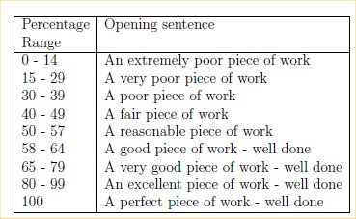
METHOD
Write text summarising each student’s performance
Notes:
After first trial decided to have an opening sentence summarising the work, as marks were deliberately not revealed
Wanted consistency hence the scheme above.
Students only told that excellent is 80% and above and that the word “poor” indicates a fail.

Slide 4
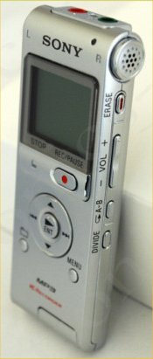
METHOD
Record digital MP3 file using Sony^{R} MP3 IC recorder (ICD-UX200)
(Picture courtesy of e-bay)

Slide 5
METHOD
Upload files to PC via USB connection
Check and re-label
Upload to VLE
Selectively release each file
Notes:
First 2 years VLE was WebCT – uploading painfully slow (batches of 10) and changing permissions slow
Last year moved to Moodle – uploading better but permissions have to be set per folder not per file so uploading first file is slow but rest quick

Slide 6
PRACTICALITIES: Timings
ACTIVITY | TIME REQUIRED (2010/2011) | TIME REQUIRED (2011/2012)
Writing time per student | 3 mins | 3 mins
Recording time per student | 3 mins | 3 mins
Uploading to PC per file | 2 mins | 1 mins
Uploading to VLE per 10 files | 5 mins | 5 mins
Setting viewing privileges per file | 2 mins | 1 mins
Total Time (yr 1) | 315 mins (30 students) | 510 mins (60 students)
Total Time (yr 2) | 235 mins (22 students) | 460 mins (54 students)
Notes:
Timings for using WebCT
Got quicker at uploading
Setting privileges quicker in 11/12 as I taught whole cohort in each case (Ann had retired) and had my files labelled in the same order that the students appeared on the module list in WebCT

Slide 7
PRACTICALITIES
In 10/11 and 11/12 the VLE was WebCT
In 12/13 moved to Moodle
Upload to VLE simplified – each student has their own folder in module space in Moodle
Selective release initially more time-consuming as each student has to have their own group and grouping

Slide 8
PRACTICALITIES
Notes:
Audio feedback is a section.

Slide 9
PRACTICALITIES
Notes:
Module team see entire list of student folders – numbering (Student 1 etc) required by group-grouping
Each individual student sees only their own 3 (in this case) audio files in their folder
Viewing as a student nothing is seen as there is no group for a generic student and no folder or feedback

Slide 10
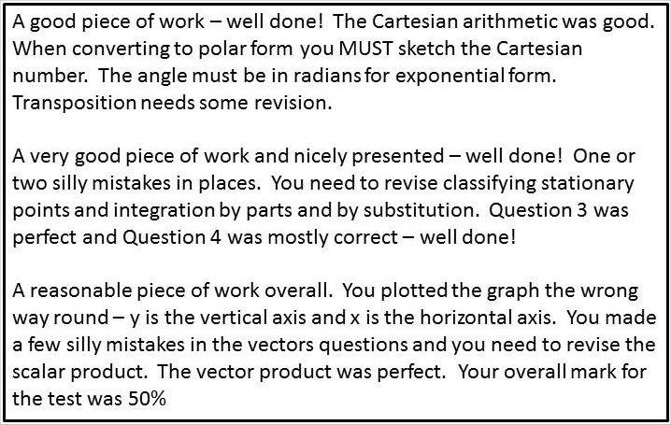
Example Audio Feedback
(ELE07102)
Notes:
Audio for:
Test 1 – Complex Nos
Test 3 – Calculus
Test 4 – Vectors and Stats
No audio for Test 2 (Walter) as it is marked on-line on completion
Test 4 runs in week 13 so included each student’s mark as the final sentence

Slide 11
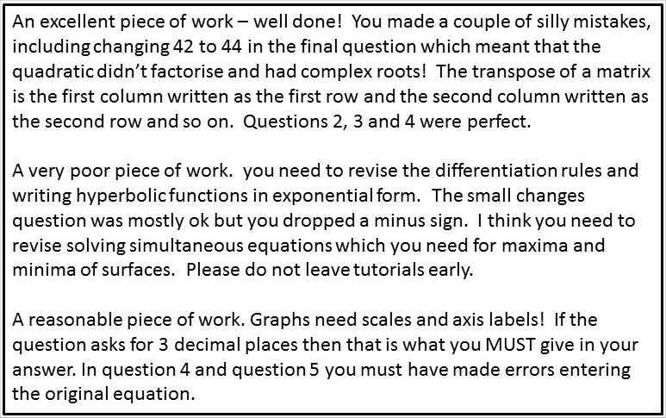
Example Audio Feedback
(ELE08102)
Notes:
Audio for:
Test 1 – Matrices
Test 2 – Hyperbolic functions and Partial Differentiation
Test 3 – Derive
Shorter files for Test 3 as this is a software package and it is not always obvious why the student has an incorrect answer.
Comment “Please do not leave tutorials early” included for any student who had failed the test and who I had already spoken to about leaving tutorials early!

Slide 12
Feedback from students
Liked lecturer’s voice summarising performance
Audio feedback helpful and good
Audio feedback was something different
Audio feedback personal and private
Audio was more memorable
“It may only be 30 seconds long but that can make a massive difference”
“You can listen more than once, ideally with your script in front of you”
“It’s good and it works”
Notes:
Feedback from students mostly from focus groups
Run by Elaine Mowat from office of VP:
I ran first one as Elaine was ill and didn’t get detailed feedback as the students knew that I knew how the audio feedback worked
Elaine brilliant at getting students to discuss and explain
Good attendance – maybe because I provide refreshments??
Feedback also given (unprompted) on module questionnaires
This year, in first year option (ELE07106) which I don’t give audio feedback for due to lack of time, one student wrote on his module questionnaire that the worst thing about the module was no audio feedback!
I realised when preparing the example audio feedback slides that what is missing is emphasis and my tone of voice.

Slide 13
CONCLUSIONS
Audio feedback has a powerful impact
Audio feedback more memorable
Audio feedback more useful if the script is returned as well
It is more personal and means more to the students
Time-consuming to provide audio feedback.
Students enthusiastic reception makes it
worthwhile
Notes:
in 2011/2012 I started returning the scripts to the students and most then listened to their audio file again, with the script in from of them.
I want to try and analyse the exam scripts from ELE08102, which includes material from tests 1 and 2, and see whether there is evidence of improvement in students performance.
Audio is time-consuming but so long as it is appreciated by the students I will find the time – extra time on WAM???!

