Slide 1
Lewis Grassic Gibbon Sunset Song
Dr Scott Lyall
Edinburgh Napier University
s.lyall@napier.ac.uk

Slide 3
James Leslie Mitchell / ‘Lewis Grassic Gibbon’(1901-35)

Slide 4
Work by J. Leslie Mitchell
Hanno, or the Future of Exploration (1928): exploration
Stained Radiance (1930): novel
The Thirteenth Disciple (1931): novel
The Calends of Cairo (1931): short stories
Three Go Back (1932): sci-fi
The Lost Trumpet (1932): novel
Persian Dawns, Egyptian Nights (1932): short stories
Image and Superscription (1933): novel
Spartacus (1933): novel
The Conquest of the Maya (1934): anthropology
Nine Against the Unknown (1934): biography/exploration
Gay Hunter (1934): sci-fi

Slide 5
Work by Lewis Grassic Gibbon
Sunset Song (1932), Cloud Howe (1933) and Grey Granite (1934), united as A Scots Quair (1946).
The short stories ‘Greenden’, ‘Smeddum’, ‘Forsaken’, ‘Sim’ and ‘Clay’, collected in Scottish Scene (1934), a book co-authored with the poet Hugh MacDiarmid.
Niger (1934), a biography of the Scottish explorer Mungo Park.

Slide 6
Key contexts
Diffusionism
Scottish Literary Revival, also known as the Scottish Renaissance Movement
Kailyard

Slide 7
‘About Nationalism. About Small Nations. What a curse to the earth are small nations! Latvia, Lithuania, Poland, Finland, San Salvador, Luxembourg, Manchukuo, the Irish Free State. There are many more: there is an appalling number of disgusting little stretches of the globe claimed, occupied and infected by groupings of babbling little morons – babbling militant on the subjects (unendingly) of their exclusive cultures, their exclusive languages, their national souls, their national genius...’
from ‘Glasgow’, in Scottish Scene (1934)

Slide 8
‘ “Culture” is the motif-word of the conversation: ancient Scots culture, future Scots culture, culture ad lib. and ad nauseam [...]. There is nothing in culture or art that is worth the life and elementary happiness of one of those thousands who rot in the Glasgow slums.’
from ‘Glasgow’, in Scottish Scene (1934)

Slide 9
Kailyard: a definition
‘In its “classic” form, the Kailyard is characterised by the sentimental and nostalgic treatment of parochial Scottish scenes, often centred on the church community, often on individual careers which move from childhood innocence to urban awakening (and contamination), and back again to the comfort and security of the native hearth.’
Thomas D. Knowles, Ideology, Art and Commerce: Aspects of Literary Sociology in the late Victorian Scottish Kailyard (Goteburg, 1983), p. 13.

Slide 11
Kailyard: critical works
The kailyard ‘made what many would regard as a legitimate functioning of Scottish imagination impossible, or extremely difficult, for generations.’
However, ‘To reject the kailyard is to reject much that is central to any attempt to define “Scottishness”.’
Ian Campbell, Kailyard (Edinburgh, 1981), pp. 128, 16.
See also:
George Blake, Barrie and the Kailyard School (London, 1951)
Andrew Nash, Kailyard and Scottish Literature (Amsterdam & New York, 2007)

Slide 12
Sunset Song and Kailyard
‘So that was Kinraddie that bleak winter of nineteen eleven and the new minister, him they chose early next year, he was to say it was the Scots countryside itself, fathered between a kailyard and a bonny brier bush in the lee of a house with green shutters. And what he meant by that you could guess at yourself if you’d a mind for puzzles and dirt, there wasn’t a house with green shutters in the whole of Kinraddie.’

Slide 13
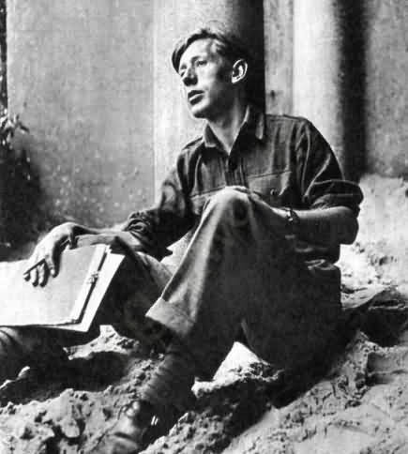
Laurie Lee, Cider with Rosie (1959)

Slide 14
‘two Chrisses’
‘So that was Chris and her reading and schooling, two Chrisses there were that fought for her heart and tormented her. You hated the land and the coarse speak of the folk and learning was brave and fine one day; and the next you’d waken with the peewits crying across the hills, deep and deep, crying in the heart of you and the smell of the earth in your face, almost you’d cry for that, the beauty of it and the sweetness of the Scottish land and skies. You saw their faces in firelight, father’s and mother’s and the neighbours’, before the lamps lit up, tired and kind, faces dear and close to you, you wanted the words they’d known and used, forgotten in the far-off youngness of their lives, Scots words to tell to your heart how they wrung it and held it, the toil of their days and unendingly their fight. And the next minute that passed from you, you were English, back to the English words so sharp and clean and true – for a while, for a while, till they slid so smooth from your throat you knew they could never say anything that was worth the saying at all.’

Slide 15
‘Nothing endures’
‘Nothing endures. And then a queer thought came to her there in the drookèd fields, that nothing endured at all, nothing but the land she passed across, tossed and turned and perpetually changed below the hands of the crofter folk since the oldest of them had set the Standing Stones by the loch of Blawearie and climbed there on their holy days and saw their terraced crops ride brave in the wind and sun. Sea and sky and the folk who wrote and fought and were learnéd, teaching and saying and praying, they lasted but as a breath, a mist of fog in the hills, but the land was forever, you were close to it and it to you, not at a bleak remove it held you and hurted you. And she had thought to leave it all!’

Slide 16
Select Bibliography
Ian S. Munro wrote a Life of Gibbon, Leslie Mitchell: Lewis Grassic Gibbon, in 1966. Despite its worth it is somewhat undernourished in biographical detail and range, and is not a critical biography, making little attempt to analyse LGG’s work, or relate his art to his life.
Academic monographs on LGG, designed for a purely scholarly audience, have been few, although there have been two recent works, each published in 2003, both of a specialised nature: Christoph Ehland’s Picaresque Perspectives – Exiled Identities: A Structural and Methodological Analysis of the Picaresque as a Literary Archetype in the Works of James Leslie Mitchell, and Margery Palmer McCulloch and Sarah M. Dunnigan (editors), A Flame in the Mearns: Lewis Grassic Gibbon: A Centenary Celebration.
Douglas F. Young’s Beyond the Sunset (1973), Douglas Gifford’s Neil M. Gunn and Lewis Grassic Gibbon (1983), A Blasphemer and Reformer (1984) by William K. Malcolm, and Ian Campbell’s Lewis Grassic Gibbon (1985) are the critical forerunners.
See also Cairns Craig’s The Modern Scottish Novel (1999).

