Slide 1
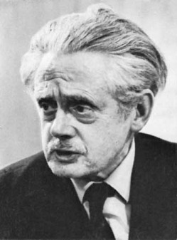
Hugh MacDiarmid and the
Limits of Community
Dr Scott Lyall
Edinburgh Napier University
s.lyall@napier.ac.uk

Slide 2
‘In its “classic” form, the Kailyard is characterised by the sentimental and nostalgic treatment of parochial Scottish scenes, often centred on the church community, often on individual careers which move from childhood innocence to urban awakening (and contamination), and back again to the comfort and security of the native hearth.’
Thomas D. Knowles, Ideology, Art and Commerce: Aspects of Literary Sociology in the late Victorian Scottish Kailyard (Goteburg, 1983), p. 13.

Slide 3
Peter Pan nae langer oor deity’ll be
And oor boast an endless infantilism.
Away, wi’ the auld superstitions. Let the sun up at last
And hurl a’ sic spooks into their proper abysm.
Hugh MacDiarmid, from ‘Envoi: On Coming Home’

Slide 4
‘I have often had cause to stress the fact that where there is a national literary renaissance nowhere else is interest in contemporary foreign literature more keenly manifest. Nationalism and Internationalism presuppose and confirm each other [. . .] renaissances do not grow in kailyards.’
Hugh MacDiarmid, writing as C. M. Grieve, ‘Leaves from a London Diary’, in The Scots Pictorial, 19 May 1923.

Slide 5
No’ the Esk that rins like a ribbon there
But gi’es and tak’s wi’ the cluds in the air
And outwith its stent boonds lies at the root
O’ the plants and trees for miles roondaboot,
And gethers its tributaries, yet pulse-beats back
Up through them and a’ that mak’s it helps mak’
Sae I wad that Scotland’s shape ʼud appear
As clear through a’ its sub-shapes here
As whiles through my separate works I see
Their underlyin’ unity
Hugh MacDiarmid, from ‘Scots Unbound’

Slide 6
Dark symbol of a society
Of ‘dog eat dog’.
Under which the people reveal themselves to the world
Completely naked in their own skin,
Like toads!
Yes, see, the dead snatch at the living here.
So the social corpse, the dead class,
The dead mode of life, the dead religion,
Have an after life as vampires.
They are not still in their graves
But return among us.
They rise with the fumes
From the chimney of the crematorium
And again settle down on the earth
And cover it with black filth.
Hugh MacDiarmid, from ‘Edinburgh’

Slide 7
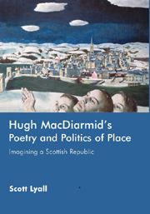

Slide 8
And in the toon that I belang tae
− What tho’ts Montrose or Nazareth? –
Helplessly the folk continue
To lead their livin’ death!
Hugh MacDiarmid, from A Drunk Man Looks at the Thistle

Slide 9
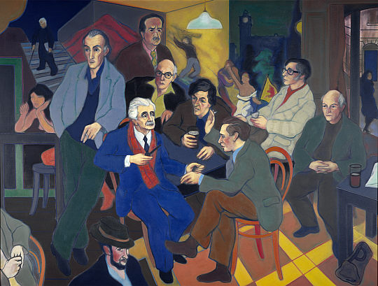
Poet’s Pub (1980), Alexander Moffat
From left to right,: Norman MacCaig, Hugh MacDiarmid, Sorley Maclean, Iain Crichton Smith, George Mackay Brown, Sydney Goodsir Smith, Edwin Morgan and Robert Garioch. In the foreground is Alan Bold and, on the steps behind, the art critic, John Tonge. The setting is an amalgam of the interiors of their favourite Edinburgh pubs: Milne's Bar, the Abbotsford and the Café Royal.

Slide 10
‘I was being told in this loud but subliminal way “You must read MacDiarmid and take those ideas on and espouse his ideas”, I was told there was this poem that I had to read; it was called A Drunk Man Looks at the Thistle. Drunk? Men? Thistle? What? This was what we’d been striving to get away from for umpteen years. This is the smoky darkness of those pubs that you weren’t allowed into because you were a woman. Yes? No. No, not for me.’
Kathleen Jamie in Robert Crawford et al., ‘A Disgrace to the Community’, PN Review, 19.3 (1993), p. 21.

