Slide 1
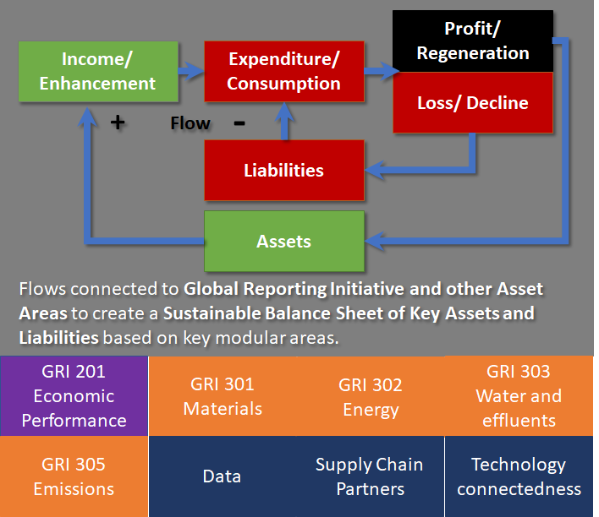
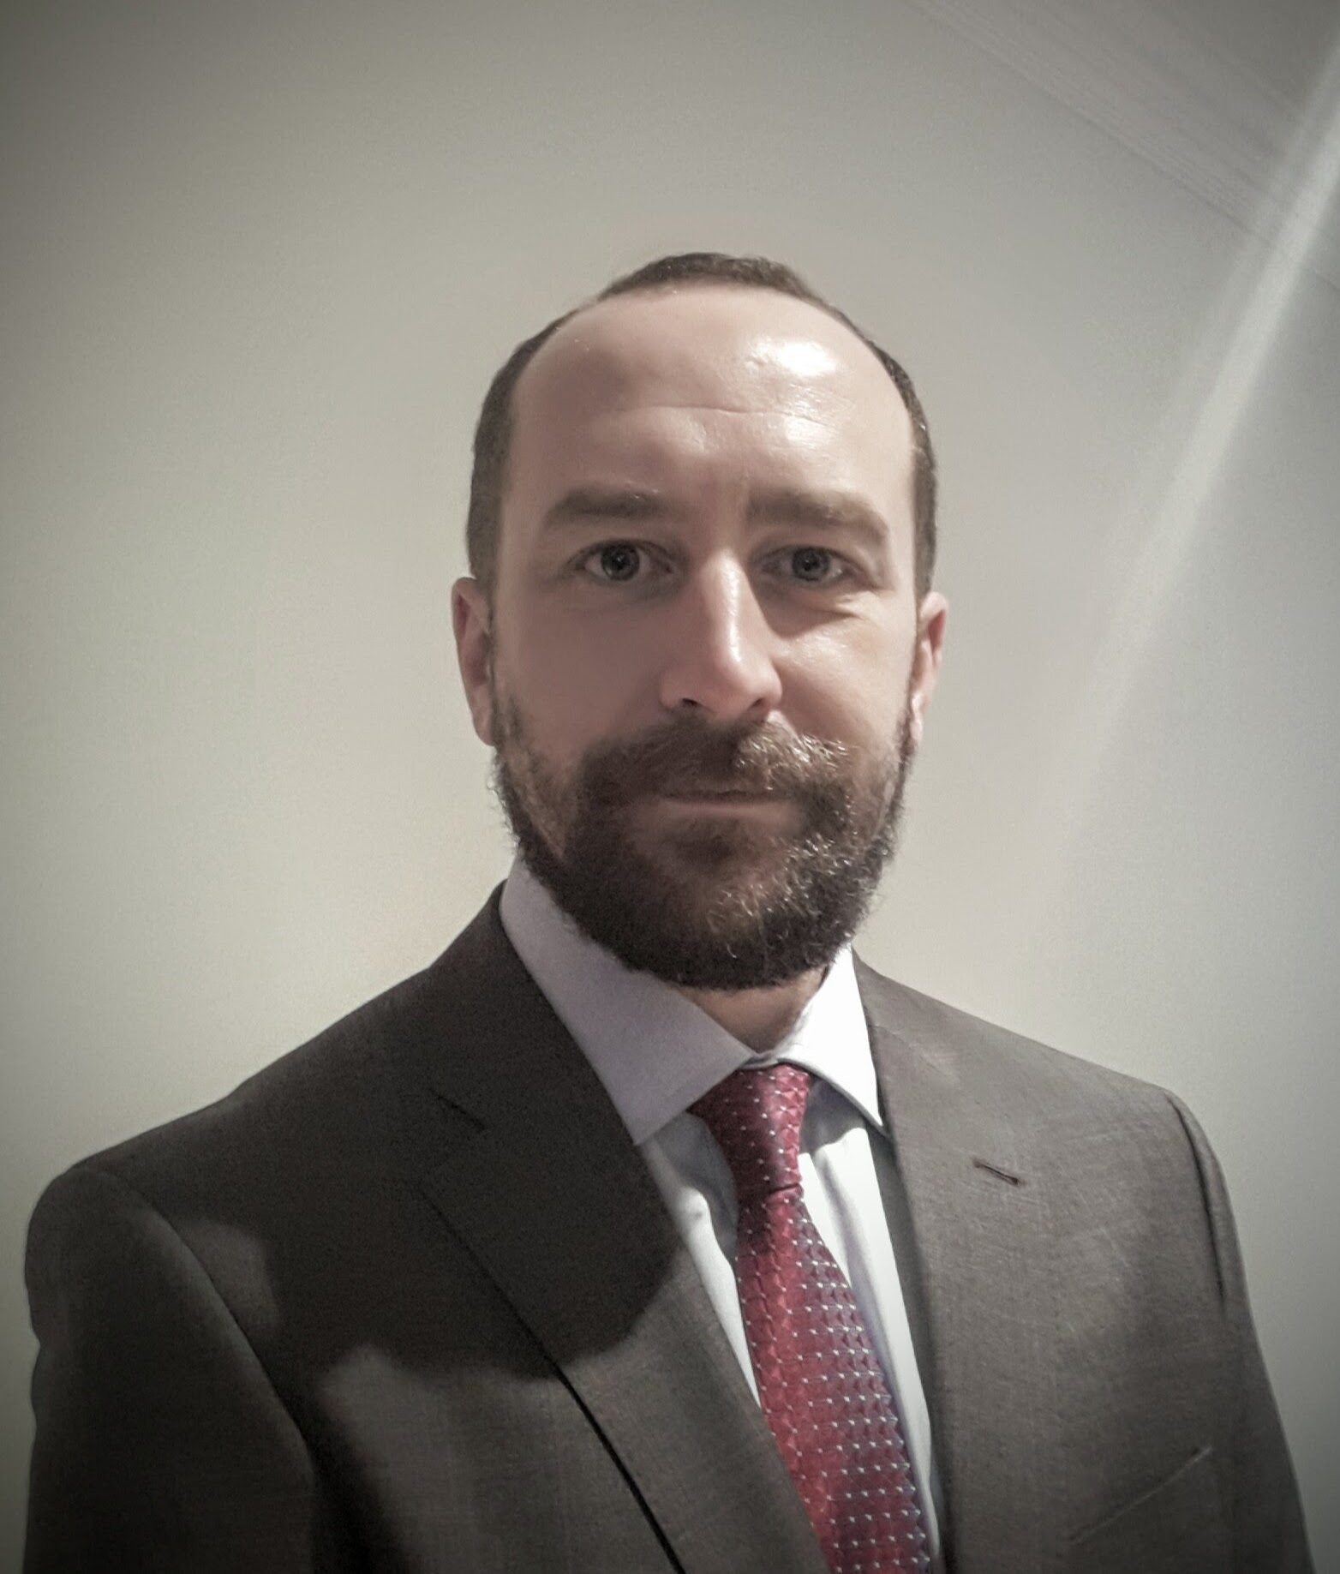
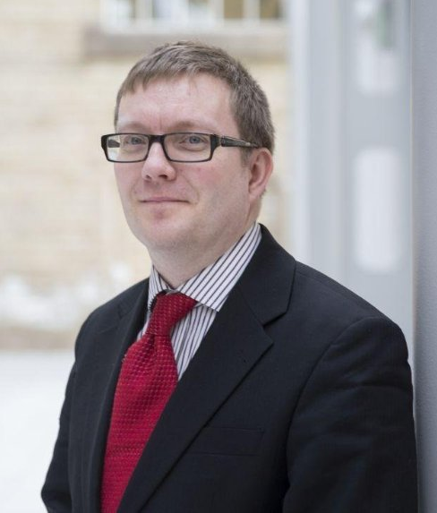
How Usership-based Business Models Can Serve the Circular Economy
Dr Xavier Pierron and Dr Chris Cramphorn
Edinburgh Napier Business School
Why businesses should switch to usership
Usership and benefits to the circular economy
Mobility services have placed usership front and centre for consumers (Mohamed et al. 2019). This concept has been around for sometime with business copiers as companies are interested in getting printouts, not owning a printer. The same can now been said for a wider variety of goods that become servitised. Drover (2019) is a start-up that proposes consumers to subscribe to mobility services. But it is different from leasing as organisations focused on usership will retain ownership, maintenance and other ancillary costs to only provide users with what they value: the experience. Here below are some arguments why companies are gradually shifting from selling goods and services to selling usership and experiences.
By focusing on usership, organisations incidentally place circular economy and sustainable objectives at the core of their strategy (Kuhl et al., 2019). Since organisations retain ownership they have a direct interest in manufacturing durable products at optimal costs. Not only will they improve production processes but they will design collection systems to refurbish efficiently products, from which they derive their revenues and profits.
Benefits for the organisaiton | Benefits to the circular economy
Costs reduction Efficiency drive to use fewer resources and improve energy efficiency Design for disassembly Products refurbishment Use of materials than can be easily recycled | Cleaner manufacturing Lower carbon footprint Fewer resources consumption Smart design
Quality improvements Products have a longer life-span as services are derived from products use Increased services quality | Manufacturing as the cornerstone of the service subscription economy Economy decoupling from resources consumption
Data analytics Internet of Things: products generate data that are used to monitor systems’ health and trigger preventive maintenance: better use and planification of internal resources to be deployed | Data driven economy Shared value creation for stakeholders
Triple Bottom Line objectives Decoupling of revenues from hardware Revenues coupling with services Increase in data generation and data analytics Increased service offering from analytics Reduced industrial impact | Circular Economy objectives Resources input to a minimum Refurbishment maximisation Data analytics to improve circularity
Ownership | Usership
Leasing Leasing is tied to a specific product Maintenance, insurance still need to be taken care of by the owner Inflexible Limited customisation | Subscribing Flexible Customisation Focused on selling an experience / services Market trends on outcomes and experiences
Customer relationship Focus on selling products or services / product or service focus Relationship stops when sale is performed | Subscriber relationship Focus on customer experience / satisfaction Relationship starts with subscription
Data Limited data generation Static data Limited analytics, looking backwards Products and services informed by market research | Analytics Expanded data generation Full-scale data generation and analytics Product and service are geared towards data generation Data analytics Products and services informed by data analytics
In terms of user value creation, there is more scope as data can be gathered to track user preferences and offer more personalised solutions (Isaksson et al. 2018).
A circular and more sustainable organisation will have a reduced impact on the environment and will decouple its profits from primary resources’ consumption. The Internet of Things will help companies monitor products life cycles, trigger preventive maintenance and end-of-use collection processes (Nagy et al., 2018).
From Micro to Macro (Dissemination & Up-Scaling)
Understanding Assets & Liabilities: Sustainable Balance Sheets
Local benefits from the move to more circular approaches require actions to enable substantive macro level benefits. Five key benefits areas and likely macro benefits are connected by dissemination/ up-scaling requirements.
Using Common Reporting Methods as a route to data - focus on Sustainable Assets & Liabilities. Existing secondary data connected to common reporting aids uptake, e.g. Global Reporting Initiative (GRI) is one possible Modular Standard to help guide key components for creating a Sustainable Balance Sheet of Assets and Liabilities for circular economy.
Area | Micro Benefit | Dissemination/ Up-scaling Requirements | Macro Benefit
Data / Analytics | Firm level understanding of data assets and responsibilities Better understand behaviors of stakeholders | Needs co-ordination of data at regional level? Requires improved data and analytics skill sets Requires inter-connectivity within supply networks | Data retention within countries disconnected from wider dominant players (e.g. Facebook, Google) Improved data for national analytics
Subscription Based Business Models | Improved revenue stability and asset controls Repeatable customers and users | Requires wider usership acceptance over ownership Shift in accounting/ investor understanding Shift in expectations of supply networks | Locks materials and high-quality (re)manufacturing into regional/ national level Reduces impact of low-cost emergent economies focused on products not services.
Distribution | Shift from one-way distribution to connected systems | Better co-ordination of two-way transport (e.g. component/ product delivery and removal) | Greater efficiency of transportation Better transport planning
Materials Monitoring | Local level stocks and utilisation, plus flows to enhance efficiency | Improved tagging of re-manufacturable components and materials | Ecosystem of materials monitoring at local, national & international levels
Triple Bottom Line | Improved understanding for firm level to improve assets, efficiencies, and connection to local communities | Standardisation and uptake of reporting functions• | Improved national metrics for sustainability, economics, and social connectedness
Key Next Steps
About Us
The research is moving forward with the following next steps:
Developing applied research & funding collaborations.
Utilising existing secondary data/measures to test models at an outline level.
Gathering primary data from organisations to identify opportunities and challenges when moving towards usership.
Development of dissemination cases to aid up-scaling and illustrate key changes, opportunities, and challenges.
Dr Xavier Pierron
Lecturer in Business Strategy and the Circular Economy at Edinburgh Napier Business School
Email: x.pierron@napier.ac.uk
Dr Chris Cramphorn
Associate Professor in Enterprise and Innovation at Edinburgh Napier Business School.
Email: C.Cramphorn@napier.ac.uk
A circular economy beneficial for the environment and society should be achieved by developing business opportunities linked to servitisation and usership. Thus enabling change within organisations and shifting customer expectations.
Chris is fascinated by complex problems, entrepreneurship, innovation and has applied his skills to world changing problems. His research focuses on developing new business models and creating sustainable growth.
Notes:
https://bmtoolbox.net/patterns/subscription/
https://hub.beesmart.city/strategy/the-circular-economy-and-smart-city-solutions

