Slide 1











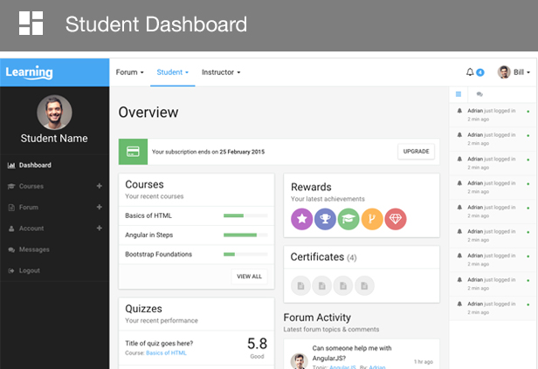



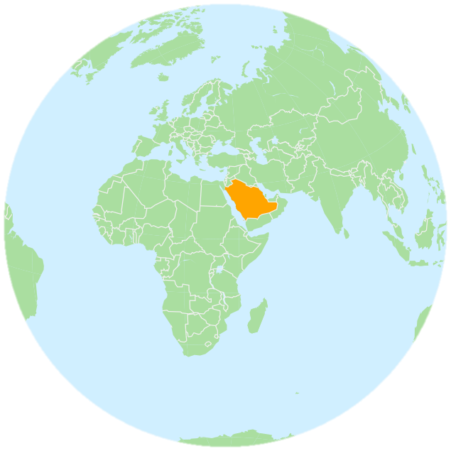



The Students’ Acceptance of Learning Management Systems in Saudi Arabia: A Case Study of King Abdulaziz University
Sami Binyamin^{1,2} , Malcolm Rutter¹, Sally Smith¹
¹Edinburgh Napier University – School of Computing, ²King Abdulaziz University – Computer and Information Technology
Download
Introduction
The development of information and communication technologies (ICT) led to the employment of technologies to enhance education in academic institutions. The term e-learning emerged in the field of education to capture learning achieved through, or facilitated by, online systems. Certainly, e-learning cannot be delivered without the employment of technologies. Learning management systems (LMS) are the most popular method for delivering e-learning. This study sets out to explore the success of LMS adoption at King Abdulaziz University (KAU), Saudi Arabia.
Methodology
Proposed Model
Perceived Ease of Use (PEOU)
H₄
Questionnaires were distributed.
All participants were students at KAU.
H₁
H₃
Attitude toward Use (ATU)
Behavioral Intention (BIU)
Perceived Usefulness (PU)
H₅
H₂
H₆
142 responses were analysed using SPSS 20
150 responses were received
Actual Use (AU)
Research Motivation
Learning management systems (LMS) have been worldwide phenomenon in higher education, and Saudi Arabia is no exception.
King Abdulaziz University (KAU) just adopted an LMS, and the students’ acceptance of the LMS has never been investigated.
In spite of its advantages, TAM has rarely been used in evaluating LMS within Saudi Arabia.
Findings
Demographic Information
Learning Management Systems (LMS)
1.0
Instruments’ Reliability
Correlation between Constructs
High
 | Cronbach’s alpha
PEOU | .893
PU | .875
ATU | .914
BIU | .934
AU | .851
 | PEOU | PU | ATU | BIU
PEOU | 1.000
PU | .546** | 1.000
ATU | .605** | .751** | 1.000
BIU | .535** | .737** | .797** | 1.000
AU | .423** | .481** | .577** | .529**
24 items,
α = 0.957
0.7
King Abdulaziz University (KAU)
160,000
Students
Low Reliability
1st
To adopt online learning in Saudi universities
0
** Correlation is significant at the 0.01 level (2-tailed)
The correlations were examined using the Spearman rank correlation test.
BIU is strongly associated with PU and ATU.
There is a moderate correlation between PEOU and PU, ATU, BIU and AU.
AU is moderately associated with PU, ATU and BIU.
Saudi Arabia
 | Path | β | p-value | Result
H₁ | PEOU → PU | .618 | < 0.001 | Supported
H₂ | PEOU → ATU | .633 | < 0.001 | Supported
H₃ | PU → ATU | .790 | < 0.001 | Supported
H₄ | PU → BIU | .752 | < 0.001 | Supported
H₅ | ATU → BIU | .789 | < 0.001 | Supported
H₆ | BIU → AU | .594 | < 0.001 | Supported
23rd
The top 50 universities under 50 years old
8,072
Faculty
8.361
Staff
Based on path analysis, the proposed model and hypotheses were examined.
The findings demonstrate the students’ acceptance of LMS in Saudi Arabia.
Students’ AU is influenced by BIU that is affected by students’ ATU and PU.
Students’ PEOU has an impact on the students’ ATU and PU.
In terms of the variance of constructs, 34.9% of variance in AU is predicted by BIU, and 66.2% of variance in BIU is explained by PU and ATU
65.3% of variance in ATU is explained by PU and PEOU. PEOU explains 37.8% of variance in PU.
PEOU
Technology Acceptance Model (TAM)
.752
1989
Fred Davis
.618
.790
ATU
BIU
PU
.789
TAM is one of the widely-used models in understanding the acceptance of technologies and has been employed in many empirical studies.
TAM provides users’ cognitive, affective and behavioral responses toward systems and technologies
.633
.594
AU
Hypotheses Testing
Results Model
Perceived Ease of Use (PEOU)
Perceived Usefulness (PU)
Acknowledgement
Contact Details
The authors would like to thank King Abdualziz University and the Saudi Arabian Ministry of Education for facilitating data collection and for the financial support of the study. Great gratitude is expressed for Mr. Ahmed Al-Shehri, PhD student at Edinburgh Napier University, for his assistance in the Arabic translation of the survey.
Sami Binyamin, MSc
PhD Student, Edinburgh Napier University
Lecturer, King Abdulaziz University
Mobile: +44 7473394575
E-mail: s.binyamin@napier.ac.uk
Attitude toward Use (ATU)
Behavioral Intention (BIU)
Actual Use (AU)

