Slide 1
The power of relationships: making transnational collaborations work
Dr Joan McLatchie
Edinburgh Napier University

Slide 2
Introduction
This empirical research project examined the lived experience of local academics in transnational partnerships¹. It explored:
  The participants’ experience of working within the competing realities of their cultural universe (Singer, 1998)
  The development of sense-making ‘hybrid’ identities
  The implications for their practice
¹Transnational education (TNE): “all types of higher education study programmes ... in which the learners are located in a country different from the one where the awarding institution is based” (UNESCO, 2001, p2)

Slide 3
Theoretical framework
Culture
Identity
Practice
The cultural dimension which an individual accesses informs his or her identity formation (Kreber, 2010)
This then forms the resources which shape practice, ie behavioural norms (Saunders, 2011)
Research explores the ways in which the participants adapt their practice to:
  Maintain an authentic sense of identity
  Accommodate their cultural universe

Slide 4
Methods
Sample:
  Thirteen volunteers from Indian college working with UK university
  All experienced in transnational partnerships
Qualitative Approach:
  Co-construction of meaningful data
  Depth rather than breadth
  Understanding rather than explanation (Blaxter, Hughes and Tight, 2006)
Data Collection:
  Email dialogue
  Dialogic interviews
  Participants invited to bring artefacts (Miller and Glassner 2004)

Slide 5
Findings
Key Themes:
  The complex cultural universe of local academics, which both defines and constrains their practice.
  The role of relationships in influencing behaviours within this environment
Typology:
  Participants’ relationships with institutions, colleagues and students
  Categorised by locus of power and level of individual agency

Slide 6
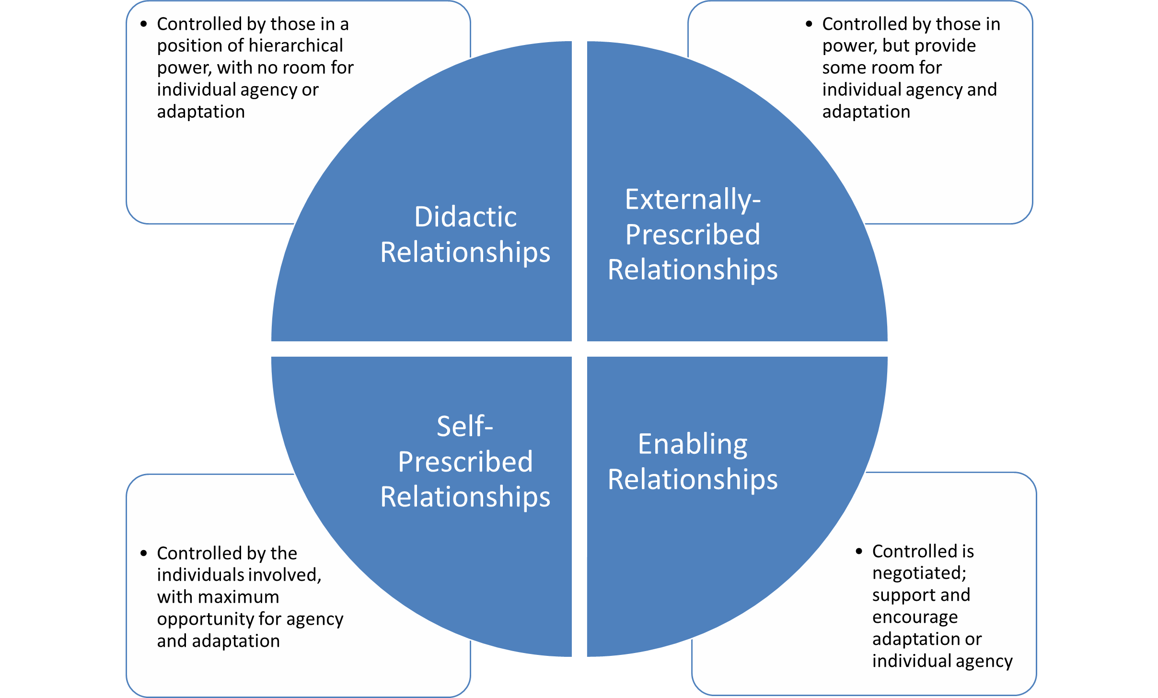
A typology of relationships
Cultural Capital
Social Capital
(Kanu, 2005)
Didactic Relationships
Controlled by those in a position of hierarchical power, with no room for individual agency or adaptation
Externally-Prescribed Relationships
Controlled by those in power, but provide some room for individual agency and adaptation
Enabling Relationships
Controlled is negotiated; support and encourage adaptation or individual agency
Self-Prescribed Relationships
Controlled by the individuals involved, with maximum opportunity for agency and adaptation

Slide 7
Implications for Policy/Practice
Awarding institutions should:
  Acknowledge the competing cultural imperatives
  Encourage enabling relationships, and extend the opportunity for self-prescription, to enhance the collaborative partnership

Slide 8
References
Blaxter, L, Hughes, C and Tight, M (2006) How to Research (3rd Ed), Maidenhead, Open University Press
Kanu, Y (2005) ‘Tensions and dilemmas of cross-cultural transfer of knowledge: post-structural/ postcolonial reflections on an innovative teacher education in Pakistan’, International Journal of Educational Development (25), pp 493-513
Kreber, C (2010) ‘Academics’ teacher identities, authenticity and pedagogy’, Studies in Higher Education (35:2), pp 171-194
Saunders, M (2011) ‘Setting the scene: the four domains of evaluative practice in Higher Education’, in Saunders, M, Trowler, P and Bamber, V (Eds) Reconceptualising Evaluation in Higher Education, Maidenhead, Open University Press, pp 1-17
Singer, M (1998) Perception and Identity in Intercultural Communication, Yarmouth, Intercultural Press
UNESCO (2001) Code of Good Practice in the Provision of Transnational Education. Available from http://portal.unesco.org/education/en/ev.phpURL_ID=22236&URL_DO=DO_TOPIC&URL_SECTION=201.html

