Slide 1

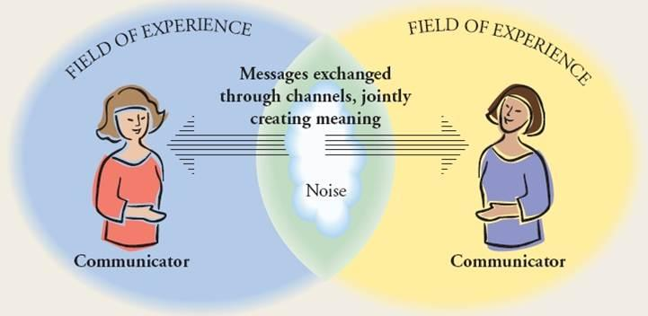

The Power of Relationships:
Making Transnational Collaborations Work
Dr. Joan McLatchie, Edinburgh Napier University
Introduction
Methods
Findings
This empirical research project examined the lived experience of local academics in transnational partnerships. It explored:
  The participants’ experience of working within the competing realities of their cultural universe¹
  The development of sense-making ‘hybrid’ identities
  The implications for their practice
Key Themes:
The complex cultural universe of local academics, which both defines and constrains their practice.
The role of relationships in influencing behaviours within this environment
Resulted in the creation of a typology of participants’ relationships with institutions, colleagues and students, categorised by locus of power and level of individual agency (see figure 1)
Sample:
Volunteers invited from an Indian college working in partnership with a UK university. 13 participants came forward, all experienced in transnational partnerships
Qualitative Approach:
To elicit co-construction of meaningful data:
Depth rather than breadth
Understanding rather than explanation⁵
Data Collection:
Email dialogue, encouraging reflection on practice
Dialogic interviews, which focused on issues of identity and culture, related to narratives of practice
Participants invited to bring artefacts which represented their identity as teachers, enabling them to set the agenda, therefore generating meaningful dialogue⁶
Theoretical Context
Figure 1: A Typology of Relationships
Conclusion
Didactic Relationships
Controlled by those in a position of hierarchical power, with no room for individual agency or adaptation
Externally-Prescribed Relationships
Controlled by those in power, but provide some room for individual agency and adaptation
Enabling Relationships
Controlled is negotiated; support and encourage adaptation or individual agency
Self-Prescribed Relationships
Controlled by the individuals involved, with maximum opportunity for agency and adaptation
Didactic and externally-prescribed relationships reflect cultural capital, i.e. the behaviour expected by dominant groups and constrained by the rules of their social context⁷
Enabling and self-prescribed relationships reflect the participants’ social capital, which enables reconciliation of behaviour and self-identity.
Social constructivist approach:
The data offers subjective perspectives²
Themes Identified in the literature:
Culture
Identity
Practice
The cultural dimension which an individual accesses informs his or her identity formation³. This then forms the resources which shape practice, ie behavioural norms⁴.
Research explores the ways in which the participants adapt their practice to:
Maintain an authentic sense of identity
Accommodate their cultural universe
Implications for Policy/Practice
Awarding institutions should:
  Acknowledge the competing cultural imperatives
  Encourage enabling relationships, and extend the opportunity for self-prescription, to enhance the collaborative partnership
Contact Information
References
Acknowledgements
Joan McLatchie
Edinburgh Napier University
Email: j.mclatchie@napier.ac.uk
Phone: 0131 455 4341
1. Singer, M (1998) Perception and Identity in Intercultural Communication, Yarmouth, Intercultural Press
2. Denzin, N K and Lincoln, Y S (2011) ‘The Discipline and Practice of Qualitative Research’, in Denzin, N K and Lincoln, Y S (Eds) The Sage Handbook of Qualitative Research (4th Ed), Thousand Oaks, Sage, pp 1-19
3. Kreber, C (2010) ‘Academics’ teacher identities, authenticity and pedagogy’, Studies in Higher Education (35:2), pp 171-194
4. Saunders, M (2011) ‘Setting the scene: the four domains of evaluative practice in Higher Education’, in Saunders, M, Trowler, P and Bamber, V (Eds) Reconceptualising Evaluation in Higher Education,
Maidenhead, Open University Press, pp 1-17
5. Blaxter, L, Hughes, C and Tight, M (2006) How to Research (3rd Ed), Maidenhead, Open University Press
6. Miller, J and Glassner, B (2004) ‘The “inside” and the “outside”: finding realities in interviews’, in Silverman, D (Ed) Qualitative research: theory, method and practice (pp 125-139), London, Sage
7. Kanu, Y (2005) ‘Tensions and dilemmas of cross-cultural transfer of knowledge: post-structural/ postcolonial reflections on an innovative teacher education in Pakistan’, International Journal of Educational Development (25), pp 493-513
Prof Murray Saunders, PhD supervisor
PhD awarded by
Poster designed by Laurie Anne Campbell and Joan McLatchie

