Slide 1
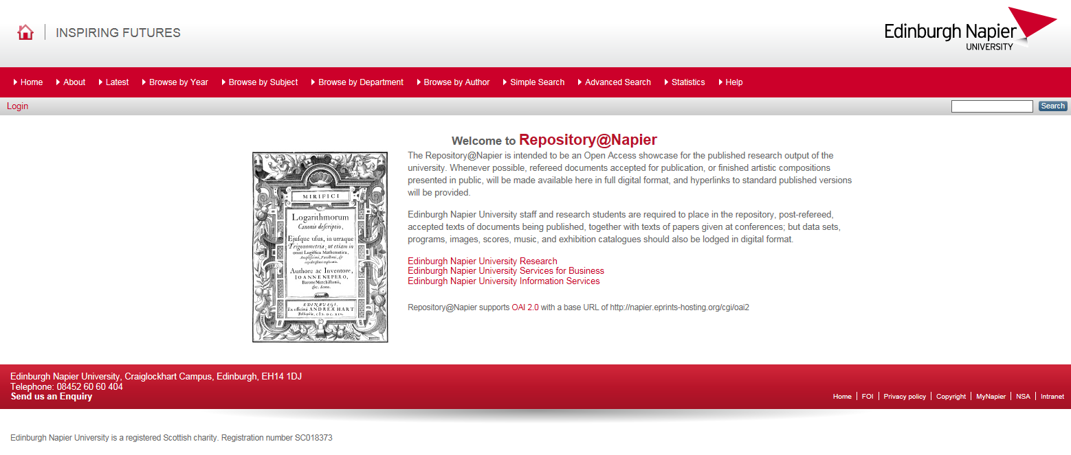
Are we there yet? Well…not quite
Celebrating the progress we have made with our institutional repository over the last 9 years and looking at the challenges still to come.
Lyn Gibson - Repository Administrator
Joyce Templeton – Assistant Information Services Advisor
Laura Ennis – Information Services Advisor
We’ve come a long way since 2008 when…
The Global Economic Crisis was underway
Barak Obama was elected the first African-American President of the USA
…and Edinburgh Napier University got its first institutional repository
Where are we now?
There have been challenges along the way since 2008:
Getting the message across that the repository benefits the academic researcher.
Open access:
Spreading the word about the benefits of open access and why it’s important.
Helping academics understand how they can achieve open access.
The implications for REF2021.
Awareness of the benefits of open access is growing but it needs more promotion.
The repository is established and growing. Statistics gathered by the repository demonstrate:
Researcher engagement demonstrated by increasing deposits.
Worldwide discovery of our research.
New Research Management System (RMS) in 2016:
A one-stop-shop with data from the RMS populating the University’s external website (see diagram on right). This helps with advocacy.
The RMS and its workflow and processes contribute to the institution’s shift in focus towards research and supports the University’s Strategy 2020 (Edinburgh Napier University, 2013).
997,652
10,873
2,994
repository items downloaded since 2008
items in the Repository
Items deposited in the last 12 months
Diagram illustrating the RMS modular structure and the information selected to display on the University’s external website.
The repository is a substantial university resource and ripe for exploiting
but there are challenges to making the most of this showcase of university research.
Academics are depositing work in the repository but how do we keep the momentum going?
Continue promoting to academics the importance of depositing within 3 months of acceptance to comply with REF2021 rules.
Repository awareness is embedded into staff induction.
Continuous promotion of the repository and related areas.
The open access message still needs more promotion.
Encourage academics to take ownership of repository data and recognise the benefit to their academic reputation.
Streamline the workflow for adding an output.
Clear lines of communication and points of contact between repository staff and academics.
Support information must be easy to access by researchers.
How do we demonstrate the repository’s value?
Repository software enables uploading and gathering of information for REF submission.
Promote the benefits of repository deposit so it becomes embedded in research culture.
The RMS populates Researcher Profiles which are prominent on the University’s external website.
Statistics show the reach of the researcher through download counts, referrer graphs and geographical reach diagrams.
Use repository data to create reports of activity for Heads of Schools and Directors of Research.
Encourage academics to add links to repository records in all communications, social media blog posts etc.
Ensure data is suitable for RDF, text and data mining.
How do we use our new repository?
Deposits are not limited to journal articles but include other types of outputs.
Target non-traditional research outputs and “defiant objects” (Nadim & Randall, 2013).
The repository is used to store the research data underpinning the outputs thus ensuring long term preservation and accessibility.
Academics use Worktribe to build their profile with projects, news, activities and a short biography.
Outputs are linked to projects.
Projects, outputs and people are tagged with research areas, themes and centres, creating interlinked information.
New researchers to the University should add their publications to the repository.
What are the continuing challenges?
We are working in uncertain times with budget cuts and reductions in staff numbers.
Sharing best practice across institutions.
Still a long way to go to make systems ‘talk’ to each other so we can harvest metadata from others and they can harvest ours.
The repository should work with external systems to deliver a fully automated process that eliminates the burden on the researcher.
Publishers policies are complex and navigating them is increasingly challenging.
Responsibility for APCs and offsetting deals require multi-disciplinary teams to manage them.
Reference and acknowledgements
Edinburgh Napier University (2013). Strategy 2020. Retrieved July 19, 2017 from http://joom.ag/yDip
Nadim, T. and Randall, R. (2013). Defiant Objects Project Report. Retrieved July 14, 2017 from http://research.gold.ac.uk/8731/
Background and additional images from https://pixabay.com
Diagram created by Joyce Templeton

