Slide 1
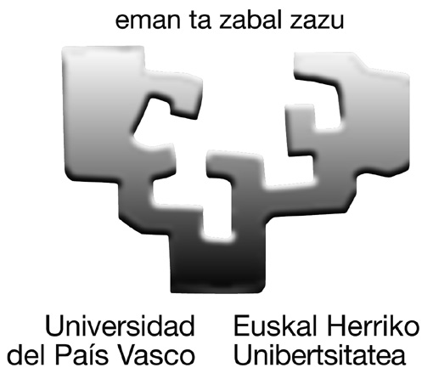
XYLAN-CELLULOSE FILMS
Oihana Gordobil,
Itziar Egüés, Rodrigo Llano-Ponte, Jalel Labidi
Coimbra, 8th May 2014
Biorefinery Processes Group
Department of Chemical and Environmental Engineering. University of the Basque Country, Pza. Europa 1, 20018 San Sebastian, Spain
jalel.labidi@ehu.es

Slide 2
OBJECTIVES
Evaluate the initial hemicellulose film characteristics
Increase films hydrophobicity
Improve thermal and mechanical properties

Slide 3
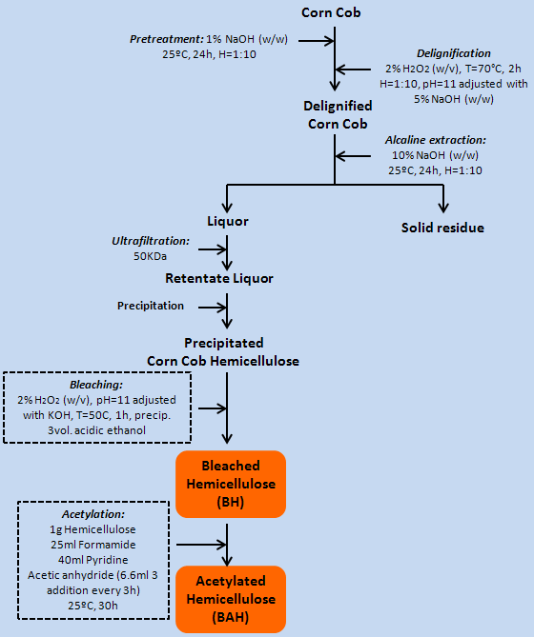
METHODOLOGY
HEMICELLULOSE
CELLULOSE
Commercial cellulose nanofibers
(University of Maine, Orono, United States)
Lengths →100-200 nm
Diameters → 10-20 nm
EXTRACTION
UNMODIFIED CELLULOSE
ACETYATED CELLULOSE
PURIFICATION
43º
78º
FILMS ELABORATION
HYDROPHILIC FILMS
Solvent casting in water
BH
+
Unmodified Cellulose
+
40% Glycerol
HYDROPHOBIC FILMS
Solvent casting in CHCl3
BAH
+
Acetylated Cellulose
ACETYLATION

Slide 4
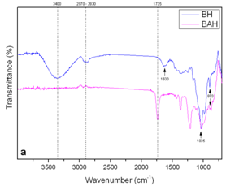
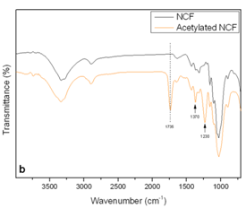
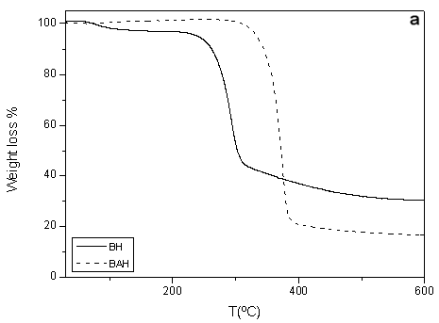
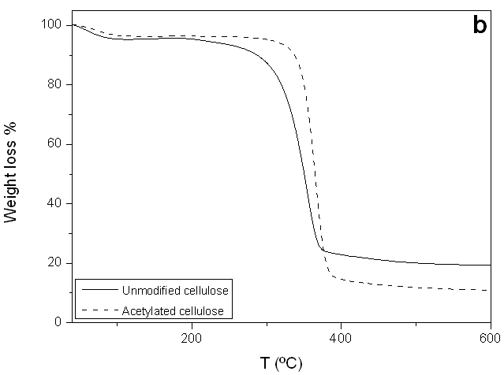
RESULTS
Sugar composition and weight average
 | Xylose | Galacturonic Acid | Arabinose | Glucose | Ara/Xyl ratio | Mn | Mw | IP
BH | 52.8 | 34.6 | 6.8 | 1.4 | 0.13 | 12343 | 54062 | 4.4
Infrared spectroscopy
Degree of
Substitution
(DS)
FTIR spectra of BH and cellulose after acetylation treatment showed a new peak at 1735 cm⁻¹, corresponding to a carbonyl vibration of the ester group formed in the reaction. This indicates that the acetylation process was successful.
Hemicellulose
(¹H NMR )
DS=1.8
Cellulose
(determined by saponification )
DS=0.54
Sugar monomeric characterization and weight average (M_{w}), number average (M_{n}) and polydispersity index (M_{w}/M_{n}) of bleached hemicellulose.
Thermal properties
 | T_{5%} | T_{max}
BH | 239 | 303
BAH | 334 | 372
Unmodified cellulose | 212 | 350
Acetylated cellulose | 305 | 366
Acetylated samples showed higher thermal stability than unmodified ones.
Thermal stability of (a) bleached and acetylated hemicellulose, (b) unmodified and acetylated cellulose.

Slide 5
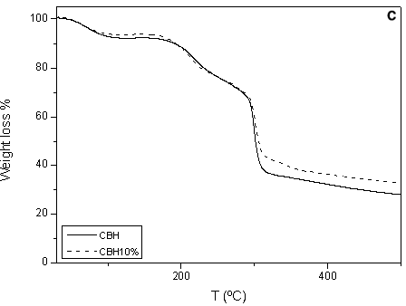
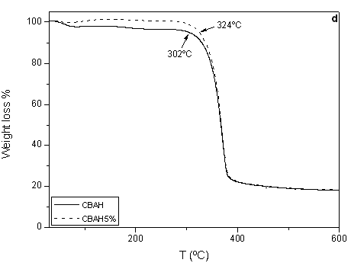
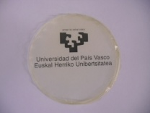
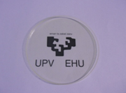
RESULTS
Thermal properties
Mechanical properties
 |  | Hydrophilic films |  |  | Hydrophobic films
 |  | Bleached hemicellulose + cellulose |  |  | Acetylated hemicellulose + acetylated cellulose
 |  | Tensile strength (MPa) | Tensile strain (%) | Young’s modulus (MPa) | Tensile strength (MPa) | Tensile strain (%) | Young’s modulus (MPa)
Cellulose content % | 0 | 3.3 ± 0.4 | 5.3 ± 1.7 | 3.3±0.9 | 44.1 ± 2.9 | 5.7 ± 2.1 | 2258 ± 207
 | 1 | 4.8 ± 0.4 | 19.7 ± 3.2 | 146.5±28.7 | 48.5 ± 4.3 | 3.5 ± 1.0 | 2824 ± 228
 | 5 | 5.8 ± 0.8 | 12.2 ± 4.9 | 206.3±2.5 | 51.0 ± 1.9 | 2.9 ± 0.8 | 3248 ± 408
 | 10 | 7.5 ± 1.2 | 12.4 ± 3.8 | 170.2±11.8 | -------- | -------- | --------
 | 20 | 4.5 ± 0.3 | 12.6 ± 1.4 | 90.3±20.9 | -------- | -------- | --------
The results demonstrate that the films obtained from bleached hemicellulose had poor properties but were improved with the addition of cellulose and plasticizer. Moreover the acetylation of bleached hemicellulose generated films with better mechanical properties, which were also improved with the addition of acetylated cellulose.
Thermal stability of (c) hydrophilic composites films without reinforcement (CBH) and with 10% of cellulose (CBH10%), and (d) hydrophobic composite films without reinforcement (CBAH) and with 5% of acetylated cellulose (CBAH5%).
HYDROPHILIC FILMS
HYDROPOBIC FILMS
A significant improvement was obtained in the thermal stability of the composites made ​​from acetylated hemicellulose and acetylated cellulose respect to elaborated ​​with bleached hemicellulose and unmodified cellulose.

Slide 6
Acknowledgements
Thanks for your attention

