Slide 1
Microfibril angles of softwood and hardwood pulp fibres
S. Heinemann, E. Retulainen
COST FP1105 Workshop, 8.-9.5.2014 Coimbra, Portugal

Slide 2
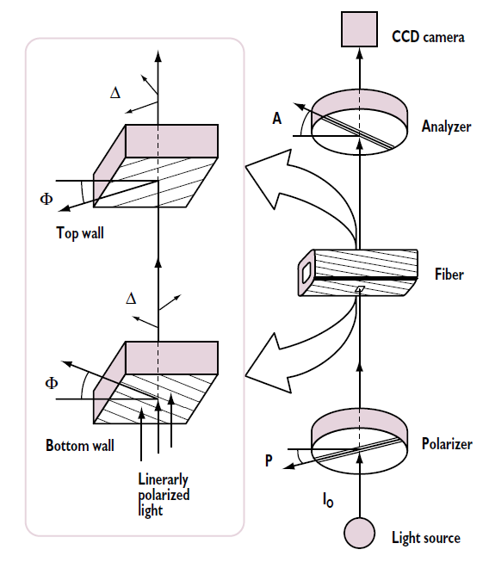
MFA measurement by polarised light
Microscopic method
modified according to Chun & Sundström
fibre sample between crossed polarisation filters
10°-stepwise rotating crossed filters
fibre imaging
determining the fibre position (angle versus horizontal)
selecting region of interest (ROI)
ascertaining the ROI-light intensity
fitting the intensity data as a function of the crossed filter position (sinusoidal function)
determining MFA from maximum intensity points
white light
Chun & Sundström (1997)

Slide 3
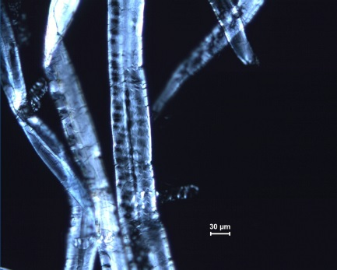
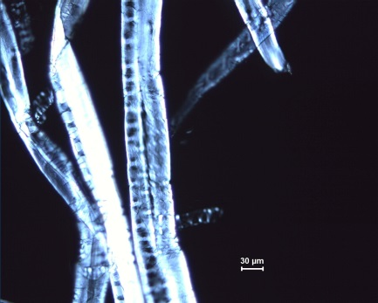
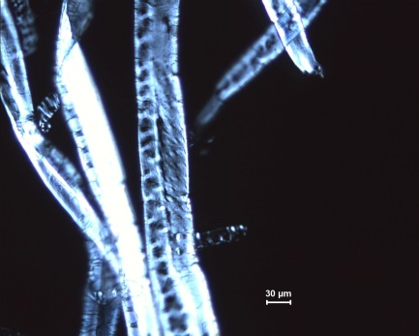
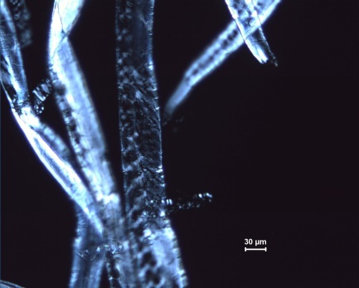
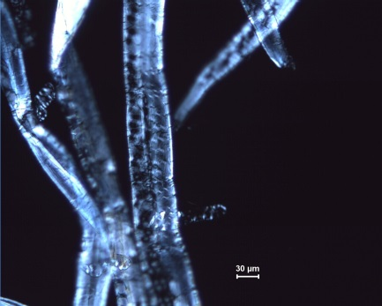
Microscopic imaging
Analyser
30°
50°
70°
90°
110°
120°
Polarizer
140°
160°
180°
200°
Example
softwood earlywood fibres – pine (middle), spruce (right)

Slide 4
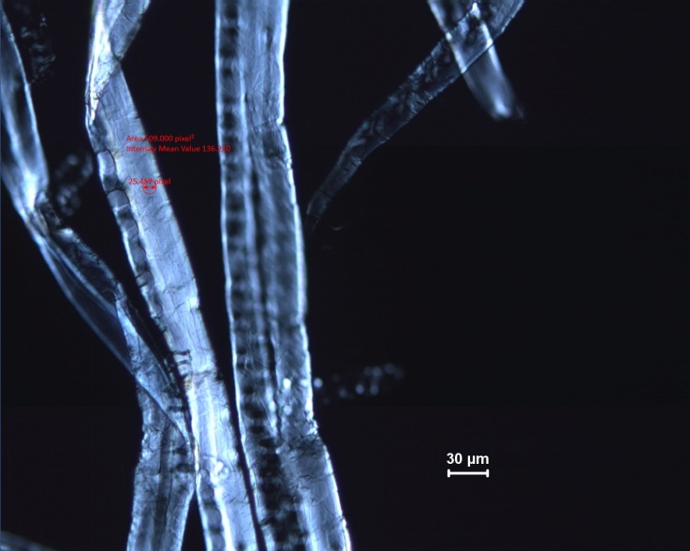
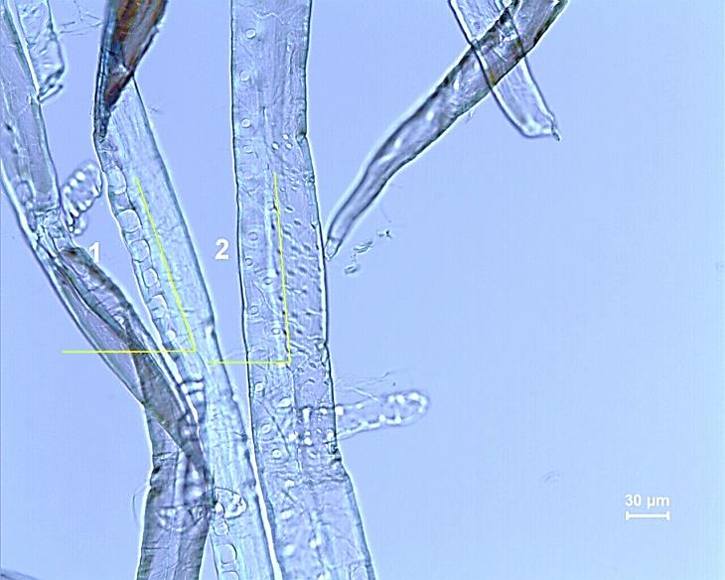
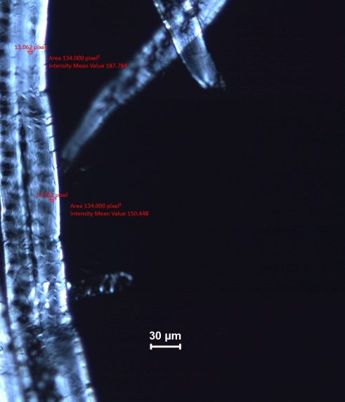
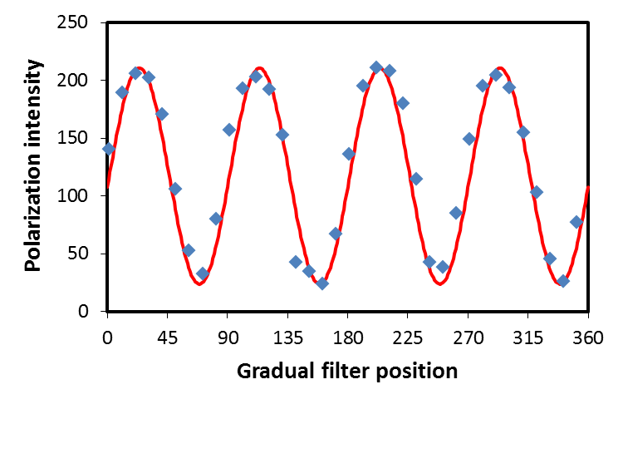
Image analysis – ROI light intensity
software earlywood fibres (pine 1 and spruce 2)
ZEN software (Zeiss)
1
pine
2
Area 134.000 pixel²
Intensity Mean Value 150.448
29
fibre position (angle versus horizontal)
 | Pine (1) | Spruce (2)
ROI size, µm² | 87.3 | 23.0
MFA, ° | 29 | 42 / 39

Slide 5
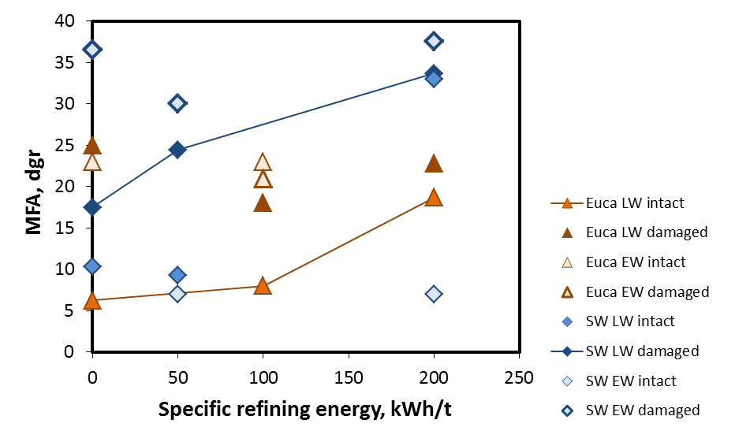
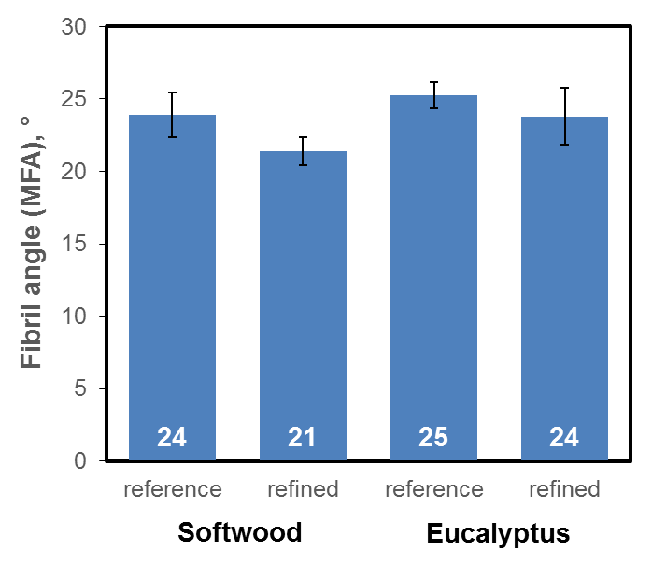
MFA results
MFA range of softwood and hardwood pulps
 | Softwood | Eucalyptus
unrefined | 3 – 45 | 3 – 44
100 / 50 kWh/t | 2 – 42 | 3 – 33
200 kWh/t | 7 – 43 | 3 – 43
Tendency corresponding to observations by Vainio et al (2007)
Many fibres to be measured for statistical confidence

Slide 6
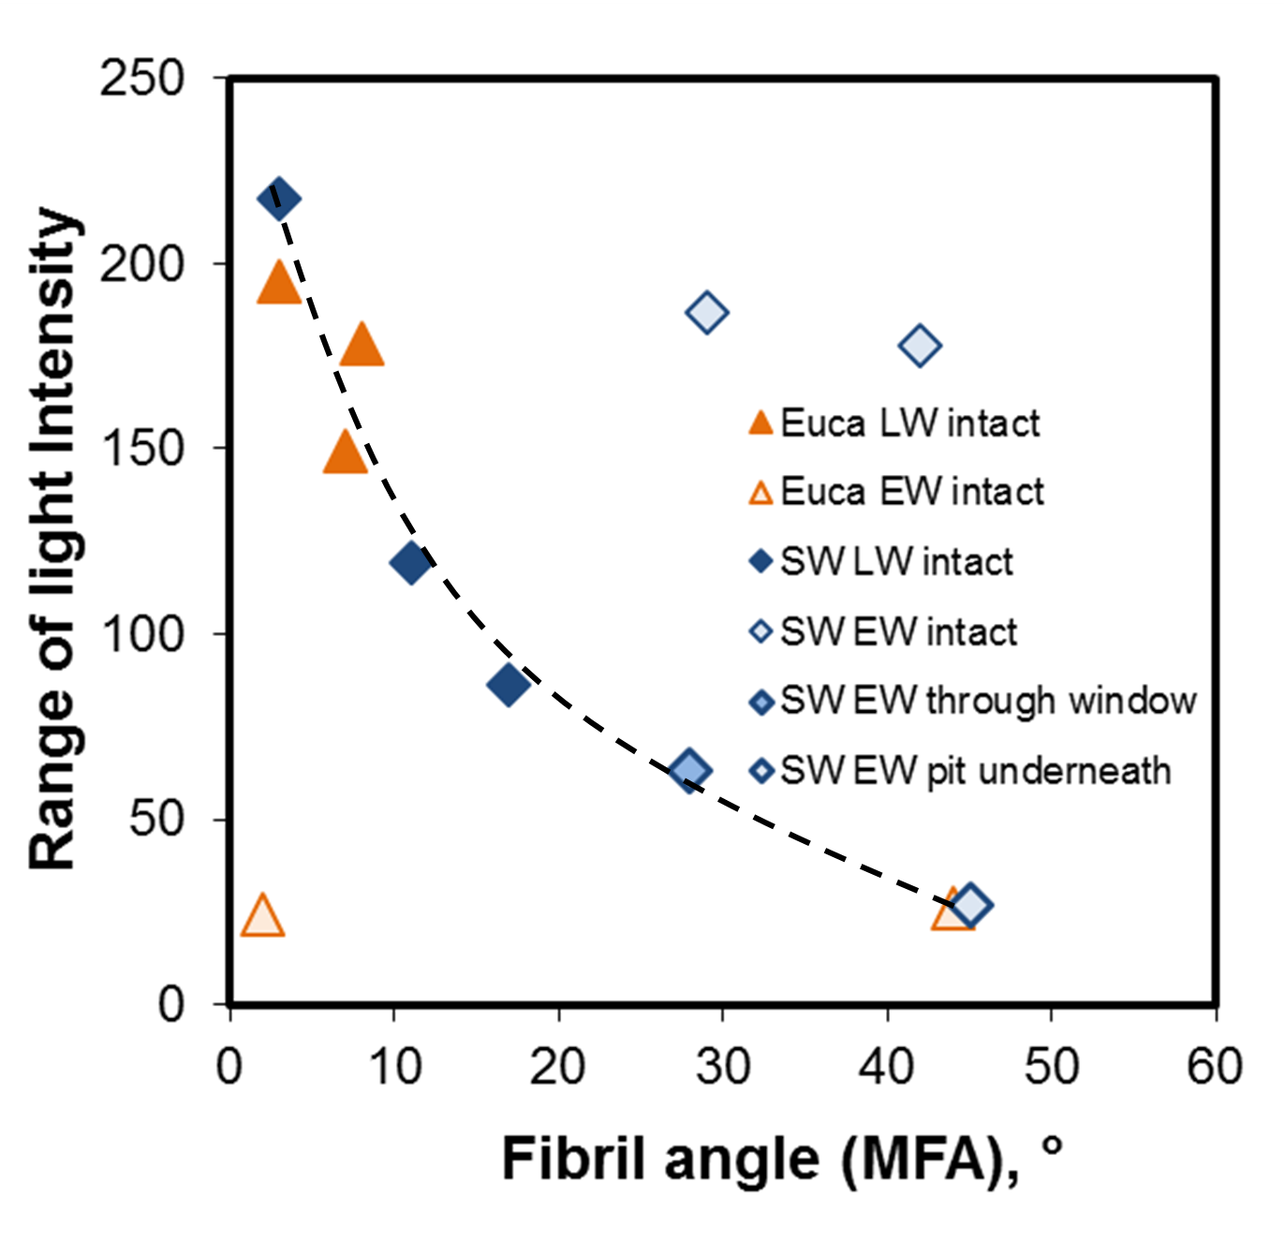
MFA results
Light intensity versus MFA
in light microscopy, determined MFA is average from all wall layers and structures
latewood – oriented S2-layer dominates = clearer result, low angles
earlywood – S1 and S3 affect result = higher average angles

Slide 7
TECHNOLOGY FOR BUSINESS
Thank you!
Notes:
Final slide is optional in VTT’s internal presentations

