Slide 1
Understanding wood cell wall structure, biopolymer interaction and composition for current products and new materials
FP1105: WoodCellNet
Start date: 01/07/2012
End date: 23 May 2016
Year: 2
Workshop No 4
Philip Turner
Chair of the Action

Slide 2
Objectives
To meet new people
Participate in discussions
Get out of your comfort zone and explore ideas across disciplines
Learn something new
Contribute your ideas and suggestions

Slide 3
FP1105 Action overview

Slide 4
Objectives supported through:
Multidisciplinary workshops
Coordinating, synergistic, collaborative research proposals
STSM’s
Training schools
Publications
Exchange of personnel
Sharing access to specialist equipment.

Slide 5
Areas of focus
Coordination of multidisciplinary proposals.
Identifying appropriate postdoctoral research projects and hosts + proposal writing.
Planning and promoting training schools to broadest possible audience.
Broadening access to specialist equipment

Slide 6
Use of COST Instruments
Activity (No.) | Year 1
MC/WG Meetings | MC meetings: 1 for the creation of the Action and 3 linked to workshops Core group meetings: (1 for development of Action strategy + 3 linked with workshops) WG Meetings 1 2 Task group meeting: WG1 met in September 2013. WG3 in Dec 2013. More this year ?
STSMs | 8 Scheduled for this year (2 already approved and 2 notified).
Training Schools | 1 in April 2014 (1 to be finalised for 2014)
Workshops or Conferences | 4 to date (The fifth is scheduled Nov 11th -12th 2014 in Zurich)
Joint Publications | 2 so far (please let us know of new ones)

Slide 7
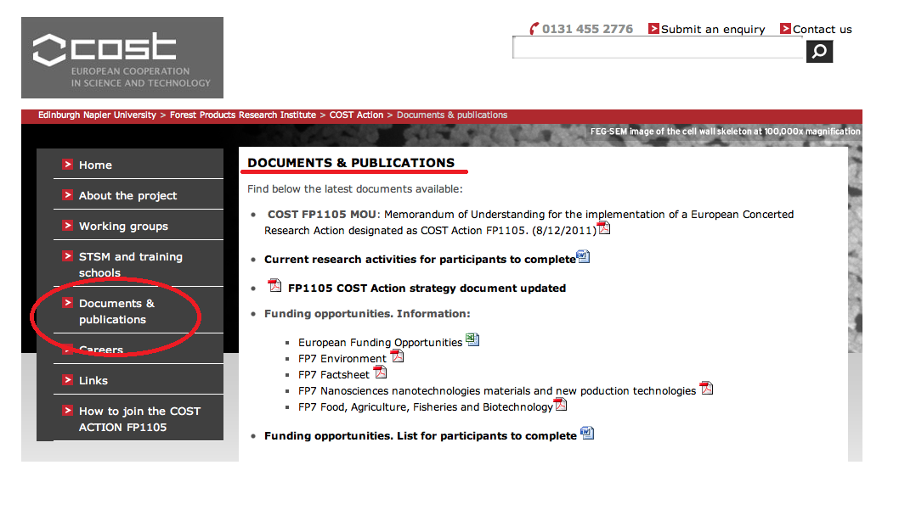
Workshop’s information
Documents

Slide 8
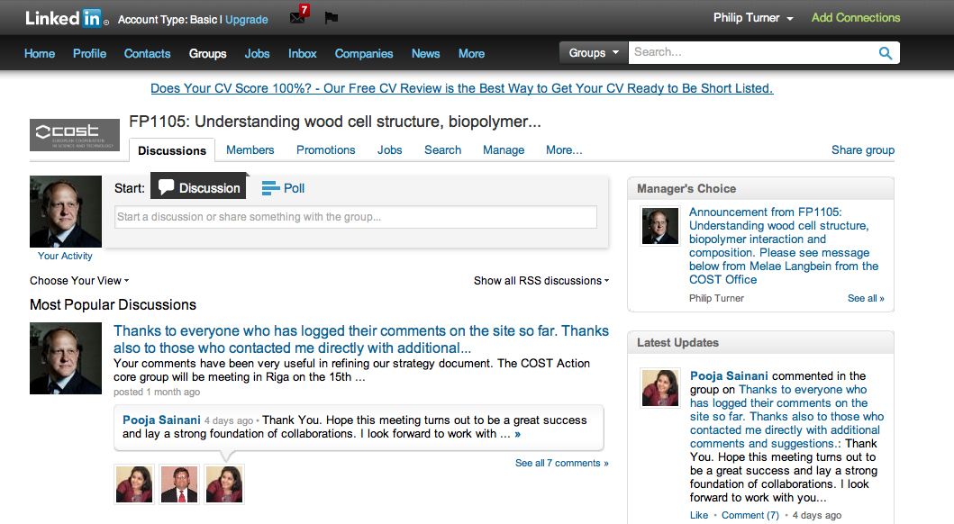
Workshop’s information
2. Ongoing communication

Slide 9
Reimbursement forms
To be sent by post by the 30th of May to the following address:
Edinburgh Napier University
Zurine Hernandez
Merchiston Campus
10 Colinton road
EH10 5DT Edinburgh
UK

Slide 10
Thank you to the workshop organisers in Coimbra

