Slide 1

Quantitative analysis of complex oligomeric mixtures by MS
Sheetal Gangula, Institute of Food chemistry

Slide 2
Quantitative Analysis of Cellulose Ethers
WHAT
Distribution of substituents along the polymer chain
  random distribution?
  high and low substituted areas?
WHY
structure-property relationships
  E.g. thermo-reversible gelation
HOW
quantitative mass spectrometry (MS) of oligomers
Notes:
problems partial hydrolysis

Slide 3
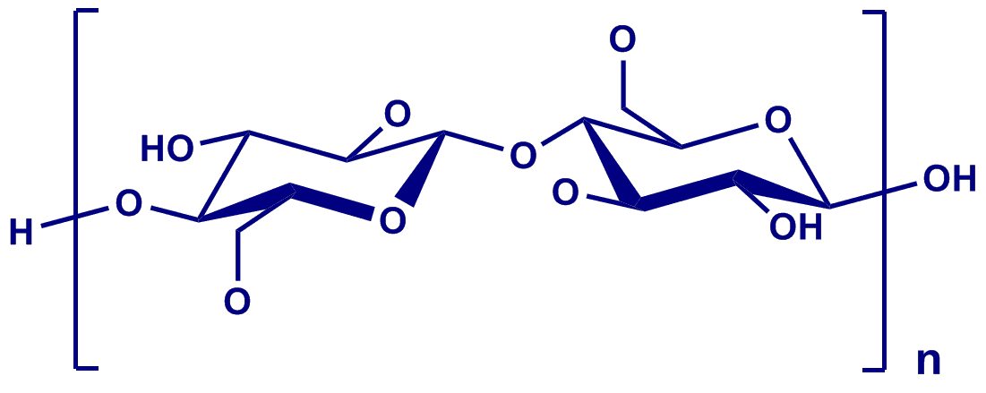
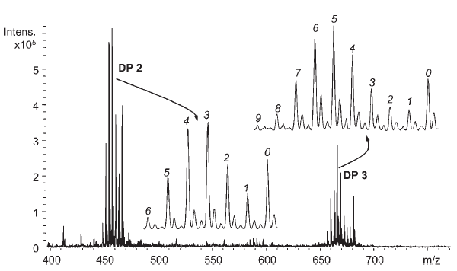
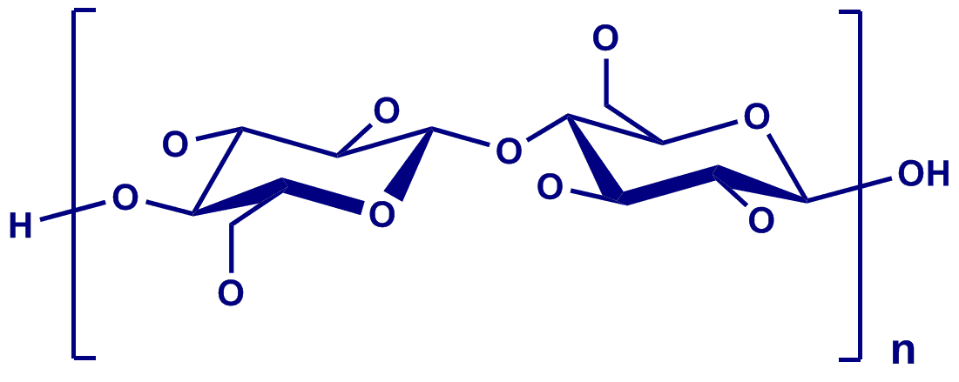
Quantitative MS of Methyl Cellulose
methyl cellulose
[M+Na]⁺
number of
permethylation
with CD₃I
CH₃
CD₃
R. Adden et al., Macromol. Chem. Phys., 207 (2006) 954-965
partial degradation to oligomers
mass spectrometric analysis
[M+Na]⁺
Notes:
problems partial hydrolysis

Slide 4
Analysis by MS
QUALITATIVE ANALYSIS
Peak Identified by m/z value
QUANTITATIVE ANALYSIS
Depends on peak intensity
But this is not simple as peak intensity varies depending on chemistry,instrumental parameters and mass differnce
4

Slide 5
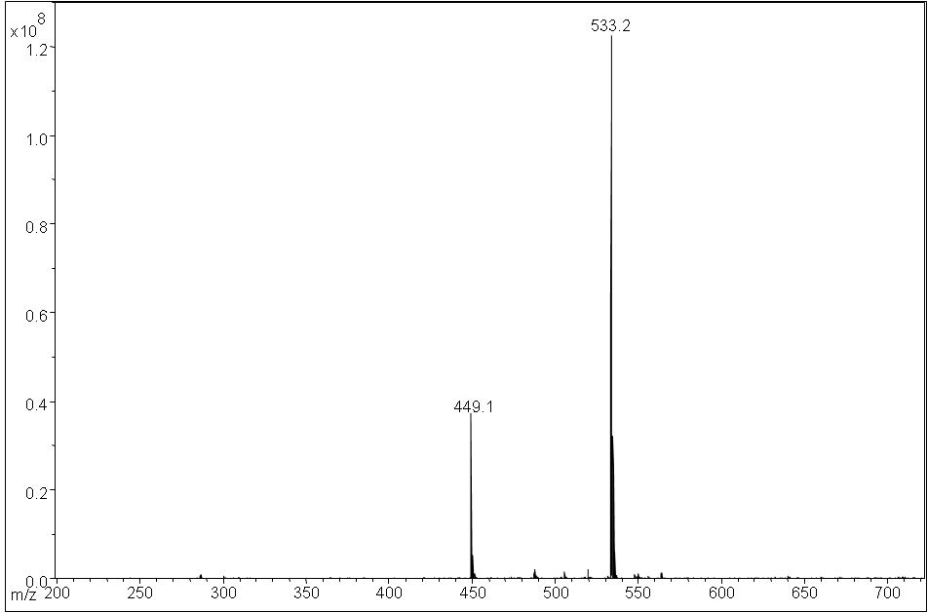
Analysis by MS
For example different compounds at equimolar concentrations give different peak intensities
m/z-
DP2-Me
Mass spectrum from ESI-IT-MS
DP2-Et
m/z-
The samples are seen as sodium adducts M+Na⁺ in MS
So for quantitative evaluation behaviour of different compounds with respect to chemistry and instrumental parameters has to be studied
5

Slide 6
Our current study
preparation of a roughly equimolar
oligosaccharide mixtures
determination of the
exact composition
Samples measured under defined conditions
ESI-IT MS
MALDI-ToF-MS
Evaluation of sodium adducts in mass spectrum
6

Slide 7
Sample Preparation
2,3,6-O-Me-β-CD
2,3,6-O-Med₃-β-CD
2,3,6-O-Et-β-CD
Partial hydrolysis
Reductive amination
LC/UV
Mixture of oligosaccharides
(DP1-DP7) are obtainted from each sample
Mixture of oligosaccharides
(DP1-DP7) after
reductive amination
7

Slide 8
Types of mixtures
Three types of mixtures are presented :
Methylated and deuteromethylated oligomeric mixtures (Me,Med₃)
Methylated and ethylated oligomeric mixtures (Me,Et)
Deuteromethylated and ethylated oligomeric mixtures (Med_{3,}Et)
8

Slide 9
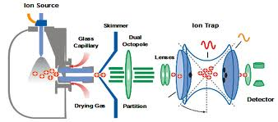
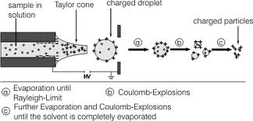
ESI-IT-MS (electrospary ionization mass spectrometry)
9

Slide 10
Results from ESI-IT-MS
Results are expressed as relative ion intensities. This is obtained by dividing the intensity of one compound in mass spectra by another compound w.r.t a certain DP in a mixture.
Me,Med₃ mixture Me,Et mixture Med_{3,}Et mixture
10

Slide 11
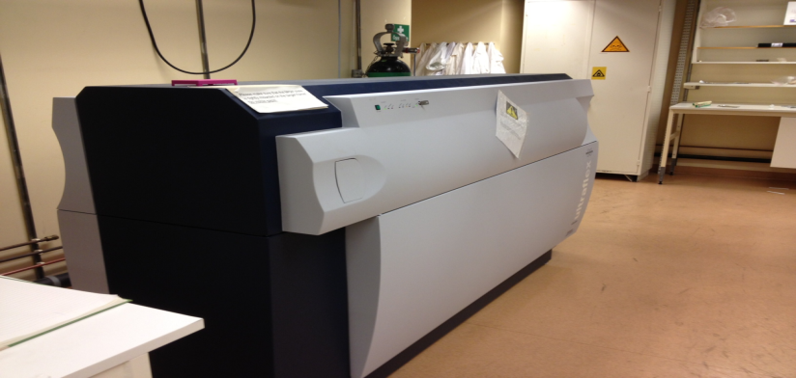
COST action FP1105 STSM
MALDI-ToF-MS:
Measurements were performed at:
The institute of Polymer Technology at KTH Royal Institute of Technology, Stockholm
Instrument used:
Bruker Daltonics Ultraflex

Slide 12
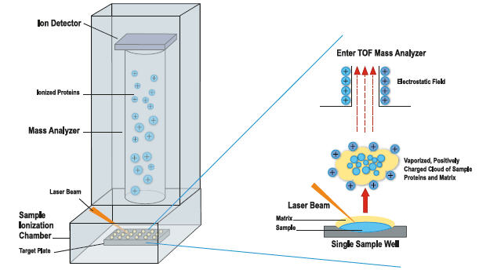
MALDI-ToF-MS (matrix assisted laser desorption mass spectrometry)
sDHB
11

Slide 13
Selection of laser power
Me,Med₃
Me,Et
LP 40 %
LP 50 %
LP 45 %
LP 55 %
LP 50 %
LP 60 %
12

Slide 14
Results from MALDI-ToF-MS
Results are expressed as relative ion intensities. This is obtained by dividing the intensity of one compound in mass spectra by another compound w.r.t a certain DP in a mixture.
Me,Med₃ mixture Me,Et mixture Med_{3,}Et mixture
DP2
DP2
13

Slide 15
SUMMARY
Under optimal conditions for both instruments...
Me and Med₃ oligosaccharides are similar in polarities, hence their relative ion intensities
in mass spectra are almost 1:1 with a little scattering for various DP. The scattering of data is lees in MALDI-ToF-MS compared to ESI-IT-MS.
Polarity of Et oligosaccharides is lower than that of Me-derivatives and Med₃-derivatives,
these compounds in
ESI-IT-MS:
    show 3-4 times higher intensities, but this factor is decreasing with DP
MALDI-ToF-MS:
    the factor is scattering around 1.5-2.5, but it has no clear trend. May be since there is difference in polarities of the compounds they may have different interaction with matrix so the scattering is higher. This has to be further investigated.
14

Slide 16

Thank you for your kind attention
15

