Slide 1
Thermal properties of different hardwood species
Carmen-Mihaela Popescu, Maria-Cristina Popescu
”Petru Poni” Institute of Macromolecular Chemistry of Romanian Academy, Iasi, Romania
COST FP1105 Meeting, San Sebastian, 26-27.05.2015

Slide 2
Purpose
Provide information concerning components composition and thermal properties of different hardwood species

Slide 3
Materials
Species | Average wood density | Average component percentage (%)
 |  | Cellulose | Lignin | Hemicelluloses and others
poplar (Populus tremula) | 0.45 | 48-49 | 21-25 | 26-31
lime (Tillia cordata) | 0.48 | 48-51 | 20-22 | 27-32
cherry (Prunus avium) | 0.50 | 45-47 | 18-21 | 32-37
maple (Acer pseudoplatanus) | 0.56 | 45-47 | 19-22 | 31-36
http://www.worldagroforestrycentre.org/sea/Products/AFDbases/WD/, R. B. Hoadley. Physical and chemical properties, in: Identifying wood. Accurate results with simple tools, Taunton Press, U.S., 1990, pp. 46-53, R. M. Rowell, R. Pettersen, J. S. Han, J. S. Rowell, M. A. Tshabalala, Cell Wall Chemistry, in: Handbook of wood chemistry and wood composites, ed. R. M. Rowell, CRC Press, 2005

Slide 4
Methods
Thermogravimetry
Infrared spectroscopy
Two dimensional correlation infrared spectroscopy

Slide 5
Thermal methods
TG + IR + 2DCOS
evaluation of the thermal stability and degradation degree as a function of the content of the obtained fractions
investigation of wood structural components
estimation of the kinetic parameters
thermal “fingerprints”
molecular arrangements and interaction between wood components

Slide 6
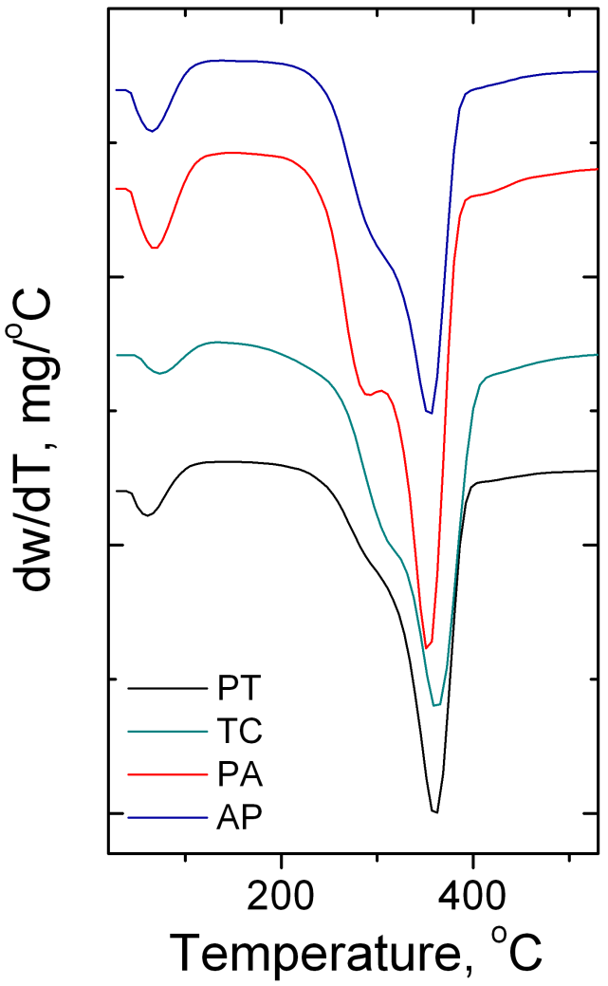
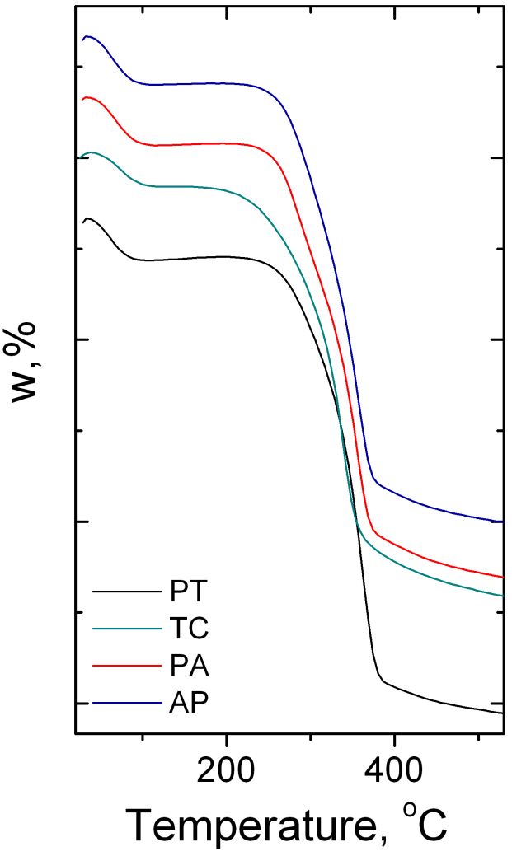
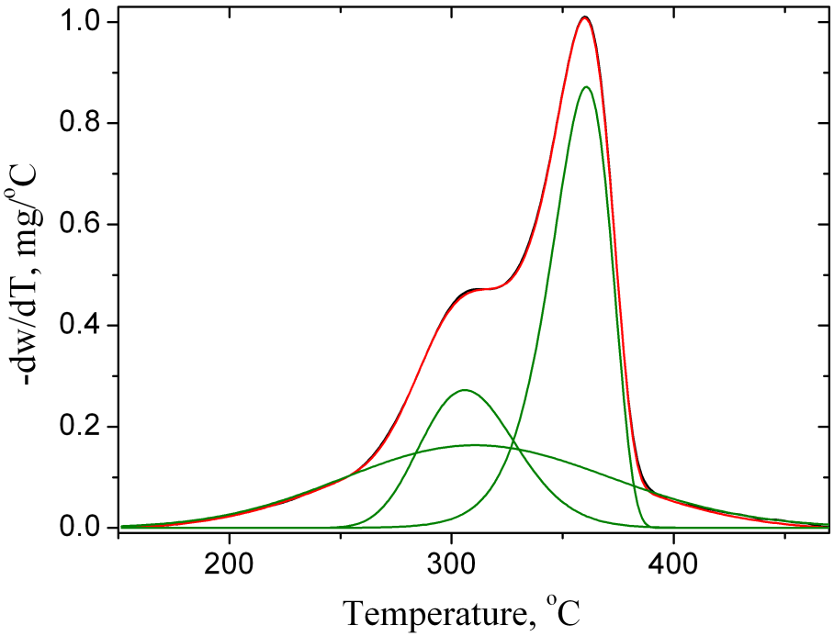
Termogravimetry
cellulose
hemicelluloses
lignin
Species | Step II
 | T_{i} | T_{sh} | T_{m} | T_{f} | W%
poplar (Populus tremula) | 153.7 | 287.2 | 359.0 | 525.8 | 74.8
lime (Tilia cordata) | 150.0 | 289.9 | 356.2 | 525.3 | 71.6
cherry (Prunus avium) | 153.9 | 290.5 | 353.3 | 519.6 | 71.0
maple (Acer pseudoplatanus) | 147.6 | 301.5 | 351.5 | 524.3 | 72.2

Slide 7
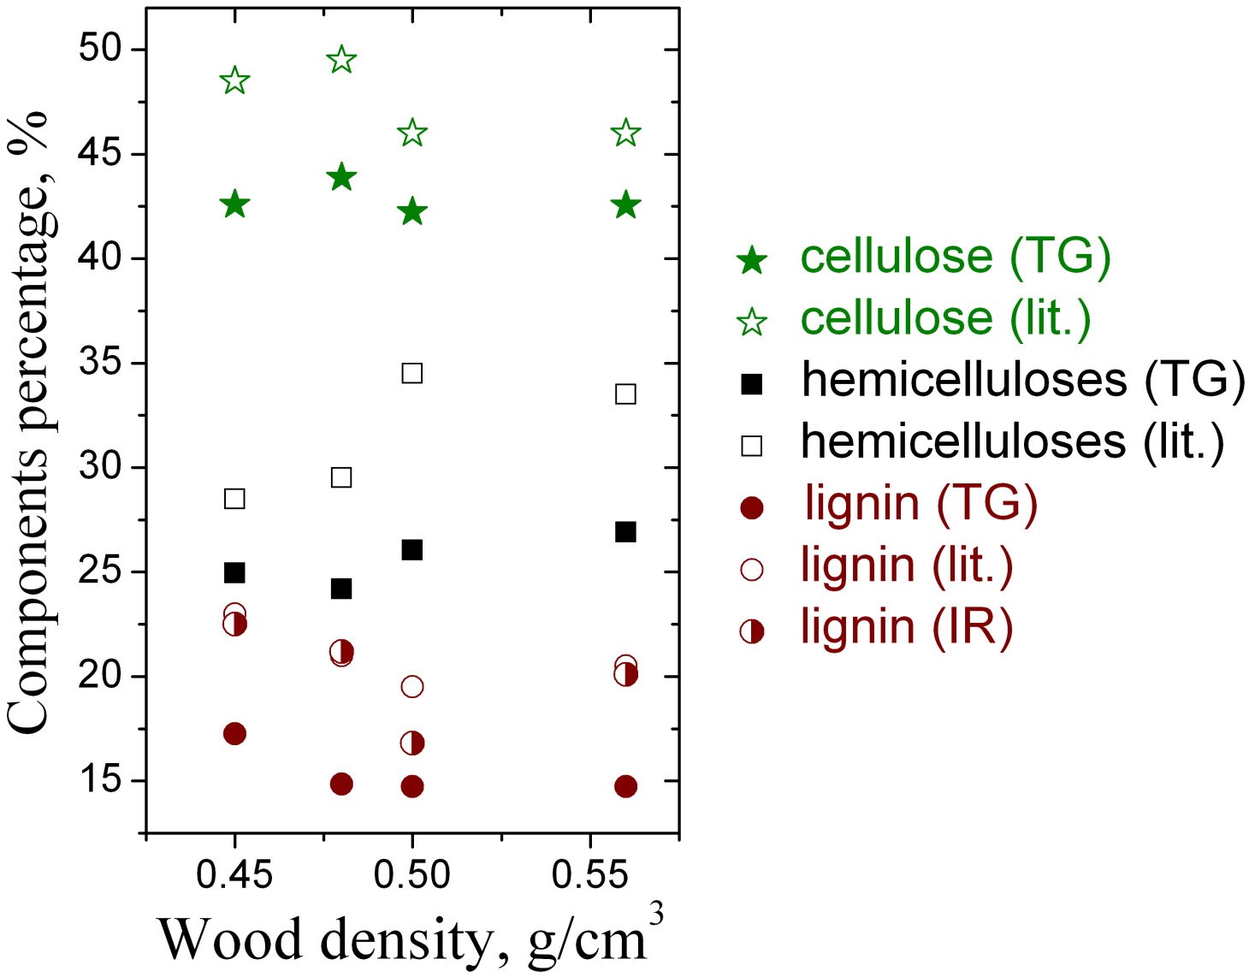
Termogravimetry

Slide 8
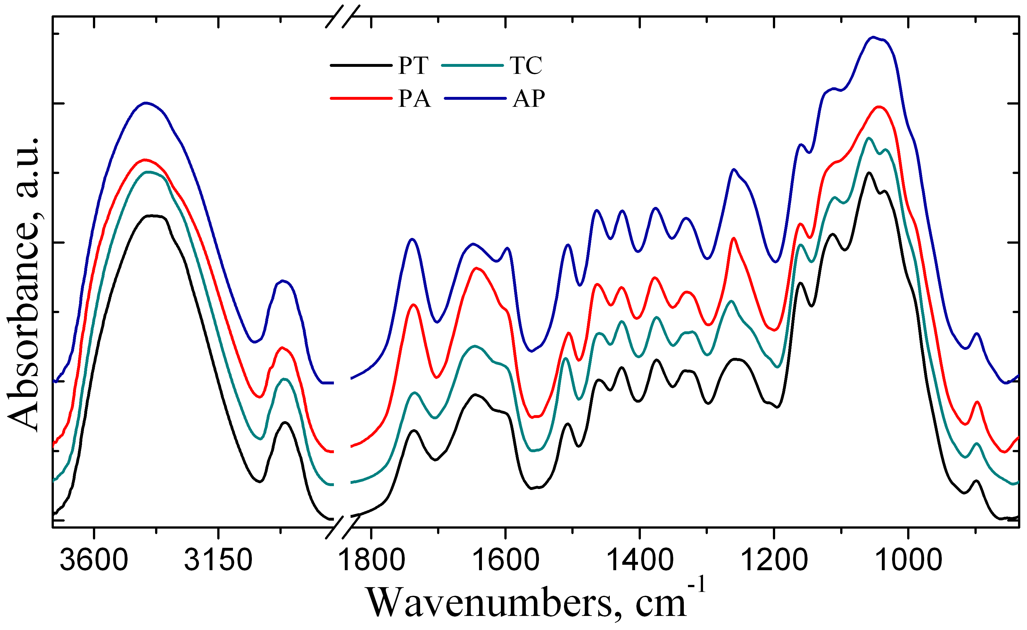
Infrared spectroscopy

Slide 9
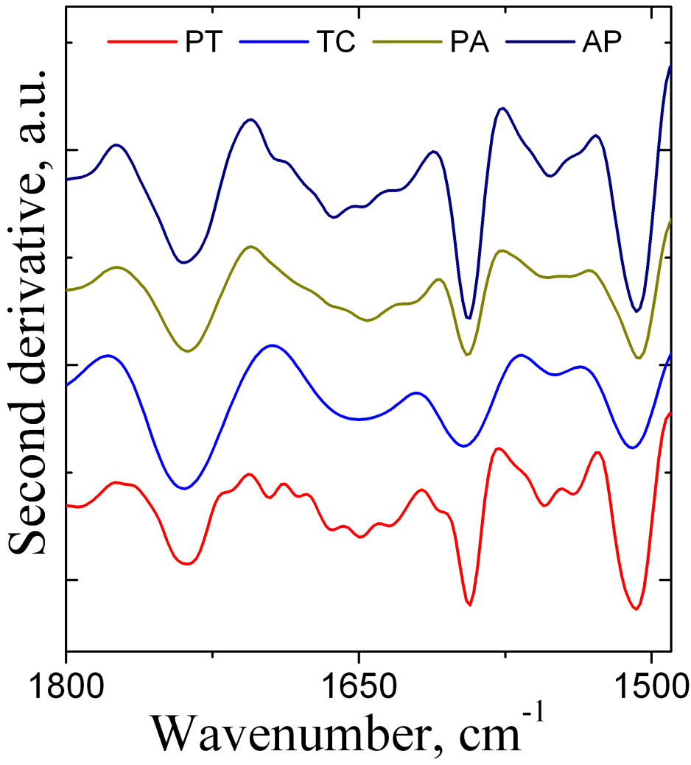
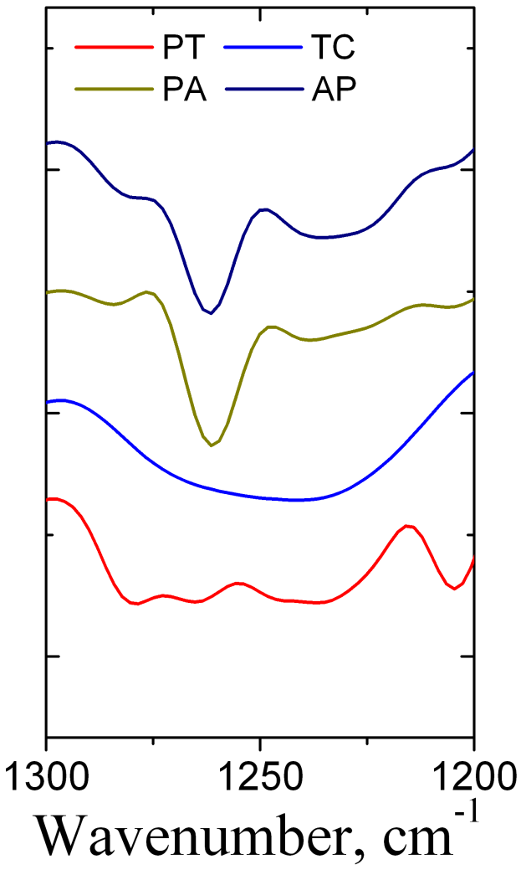
Infrared spectroscopy

Slide 10
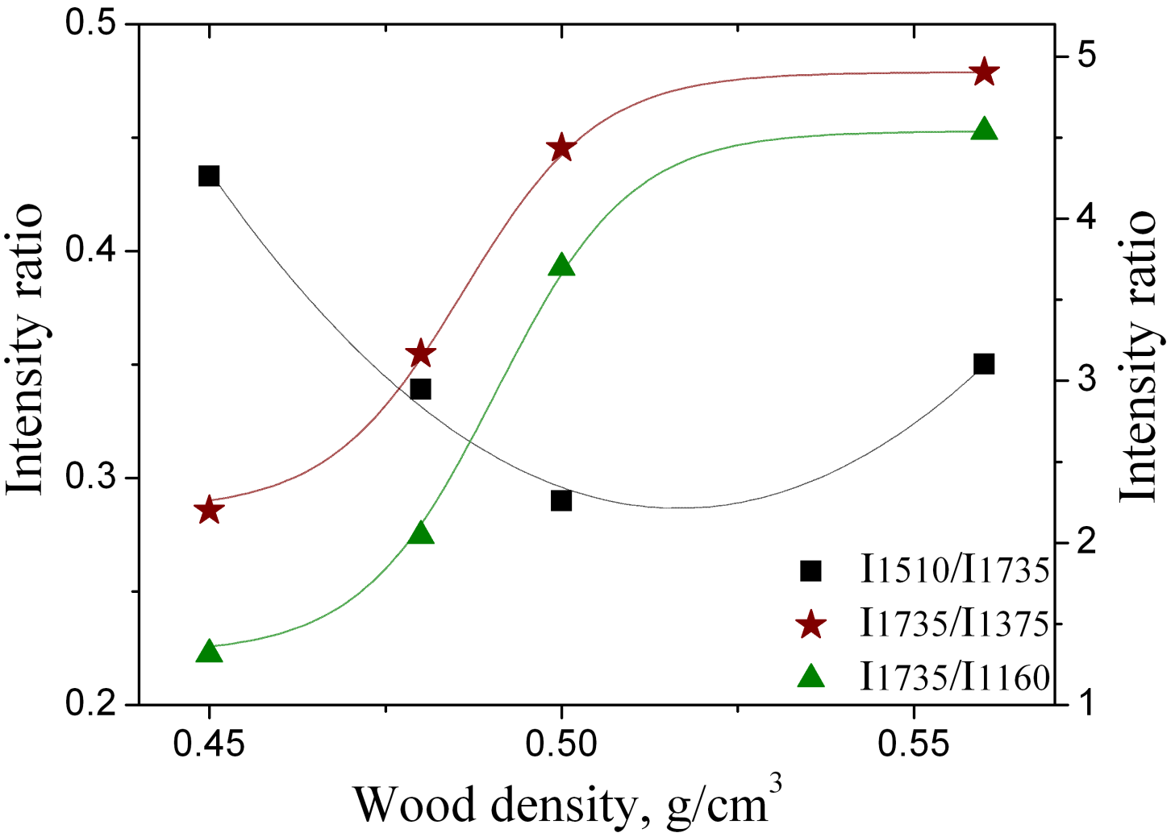
Infrared spectroscopy

Slide 11
Infrared spectroscopy
20 → 220 ºC (with 1 ºC/min)

Slide 12
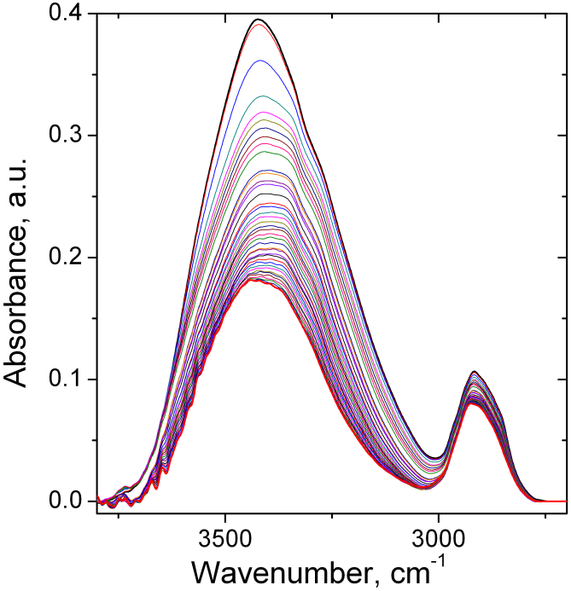
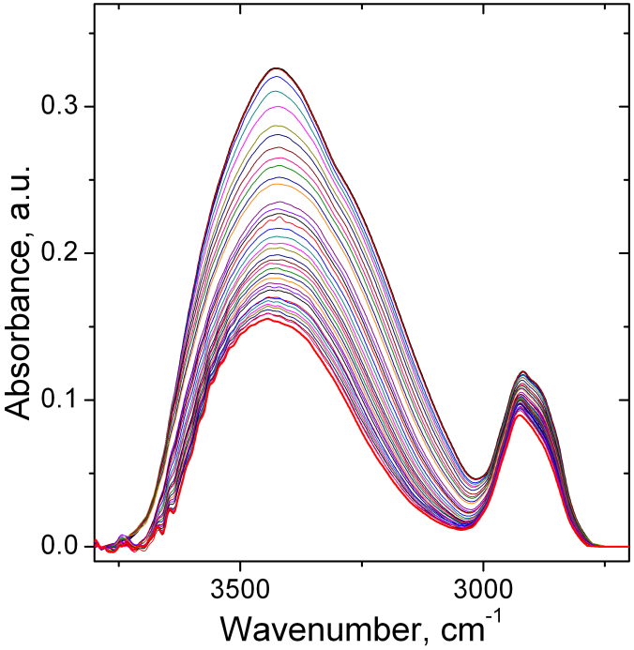
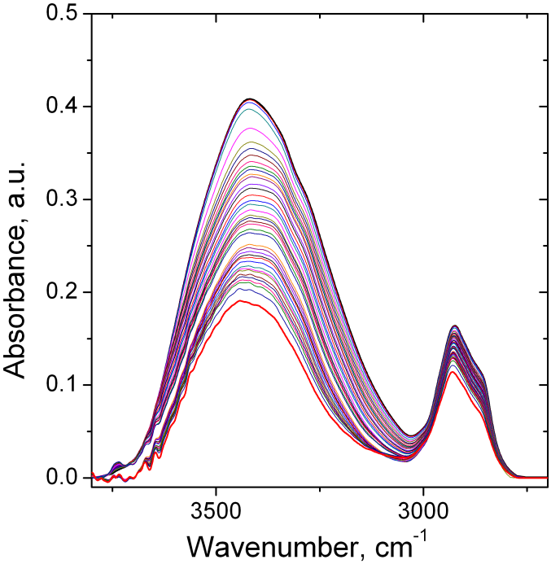
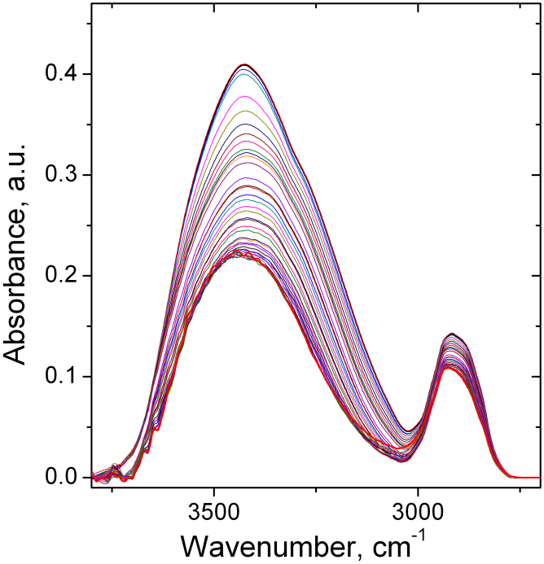
Infrared spectroscopy
PT
PA
20 ºC
220 ºC
TC
AP

Slide 13
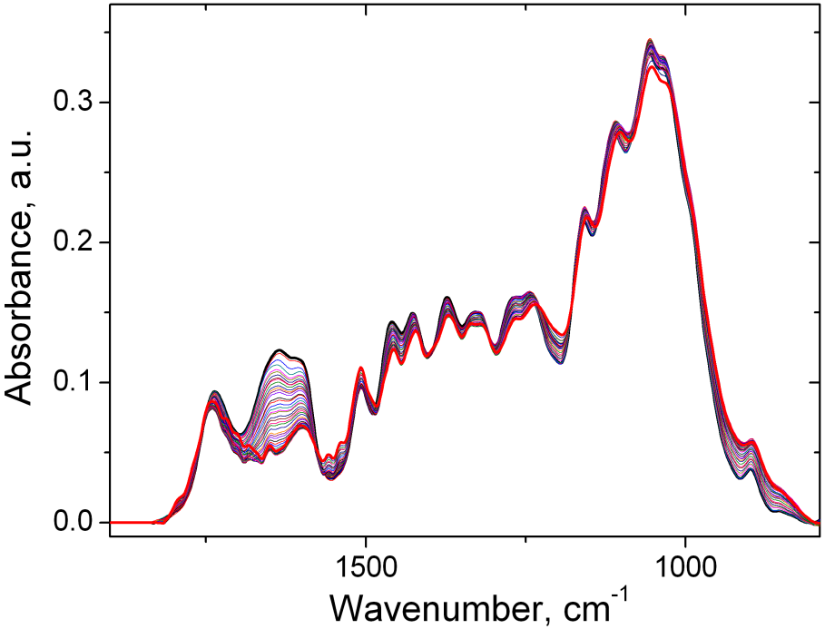
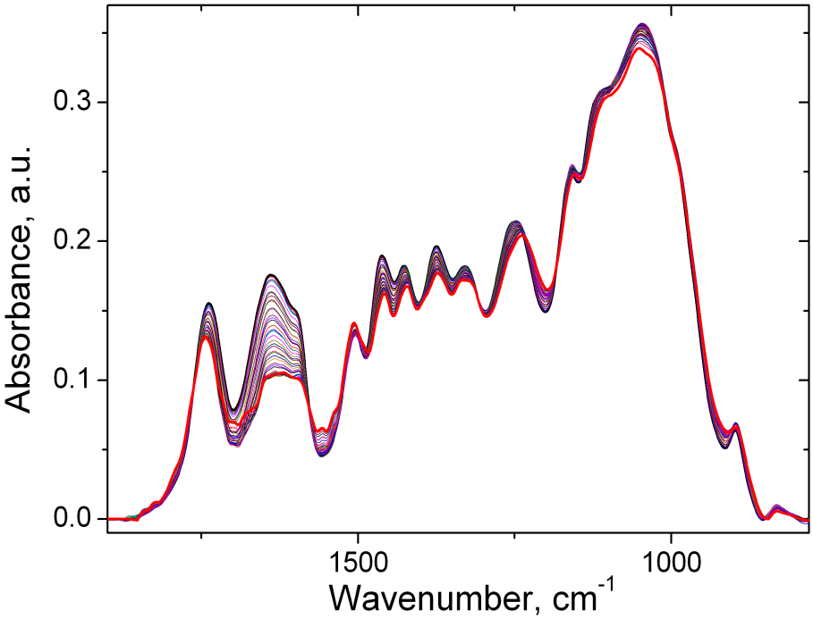
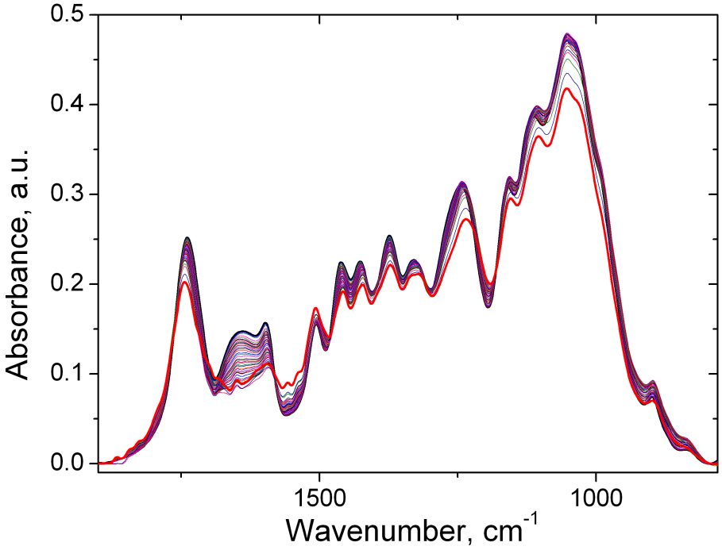
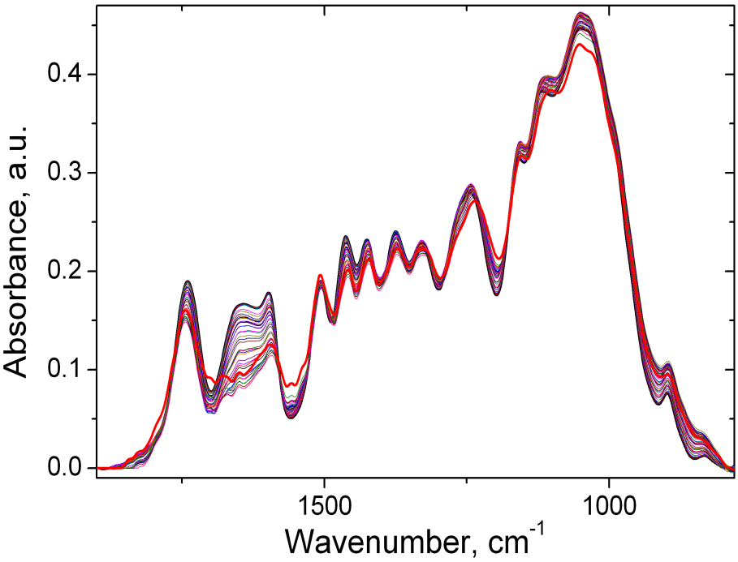
Infrared spectroscopy
PT
PA
TC
AP

Slide 14
Infrared spectroscopy
PT
C–O of Ph–O–C in lignin and C–O in xyloglucan → loss of acetyl groups
C=C in aromatic skeletal components in lignin → increase of the amount of lignin due to degradation of amorphous carbohydrates
C–O in quinines and C=O in various groups → degradation of the acetyl groups and formation of other structures

Slide 15
Two dimensional (2D) correlation spectroscopy
External perturbation (temperature)
electro-magnetic beam
spectrum
sample
dynamic

Slide 16
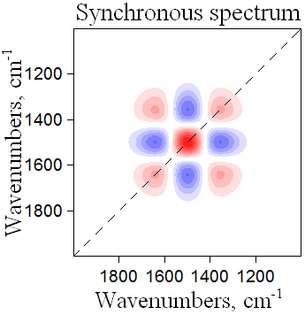
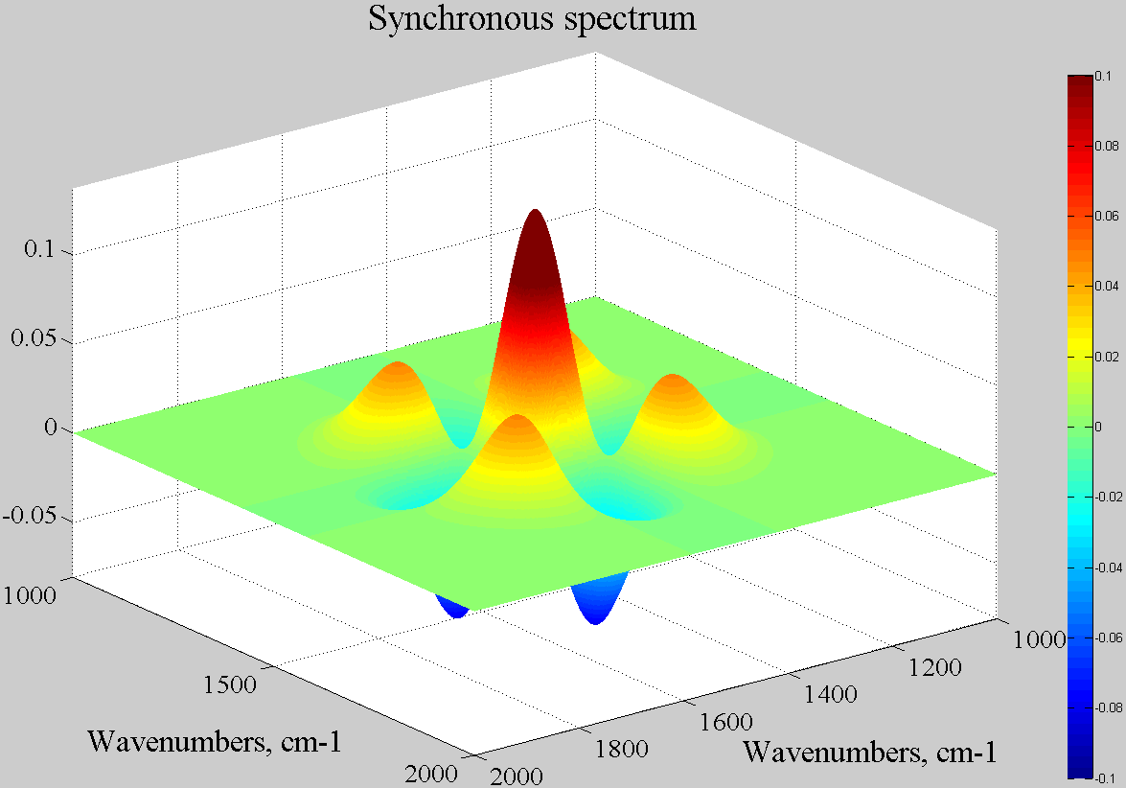
2D IR correlation spectroscopy
autopeak
ν₂
-
+
crosspeaks
ν₁
Synchronous 2D correlation spectra represent the simultaneous or coincidental changes of spectral intensities measured at the wavenumbers ν₁ and ν₂
The diagonal peaks are referred to as – “autopeaks” ν₁= ν ₂
The peaks located at the off–diagonal positions are referred as – “crosspeaks” ν₁≠ ν ₂

Slide 17
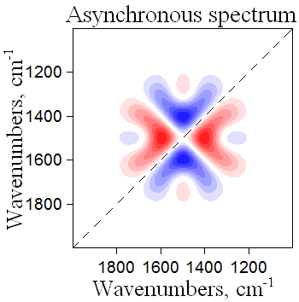
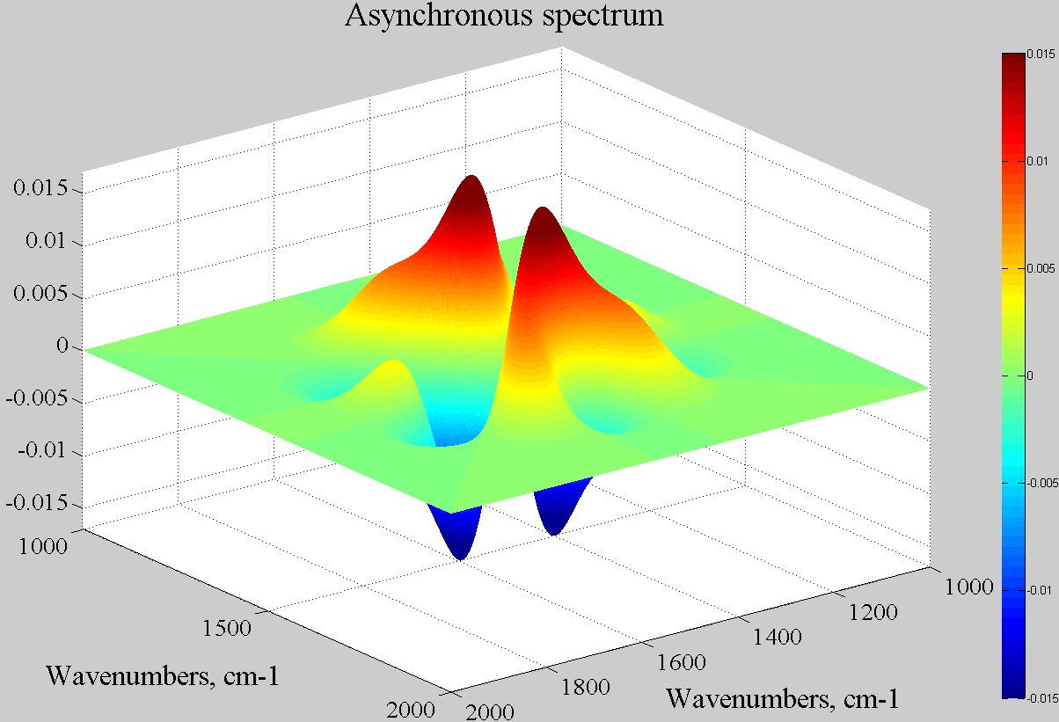
2D IR correlation spectroscopy
+
ν₂
-
crosspeaks
ν₁
Sequential, changes of spectral intensities at the wavenumbers ν₁ and ν₂. The spectrum is antisymmetric with respect to the diagonal line.
The peaks located at the off–diagonal positions are referred as – “crosspeaks” ν₁≠ ν₂

Slide 18
Advantages
Simplification of complex spectra and enhancement of spectral resolution
Detailed investigation of the intra- and intermolecular interaction
Study of the process of chemical reaction or the kinetics of molecular vibrations
Band assignments based on the correlation analysis between various bands

Slide 19
2D IR correlation spectroscopy

Slide 20
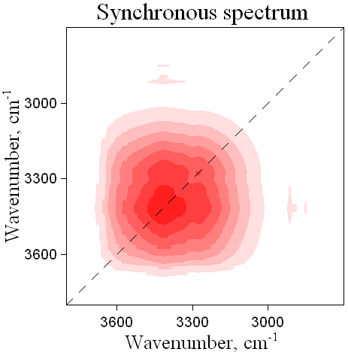
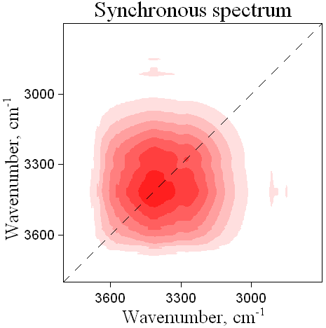
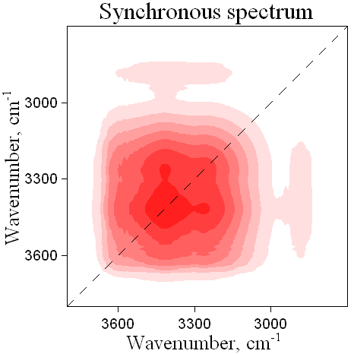
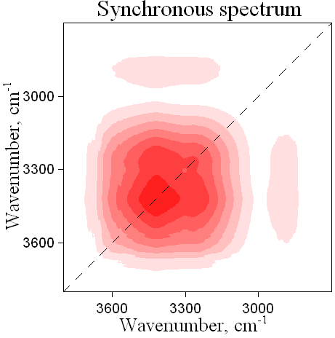
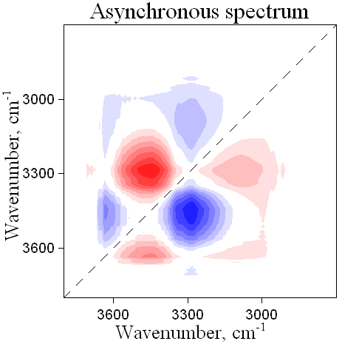
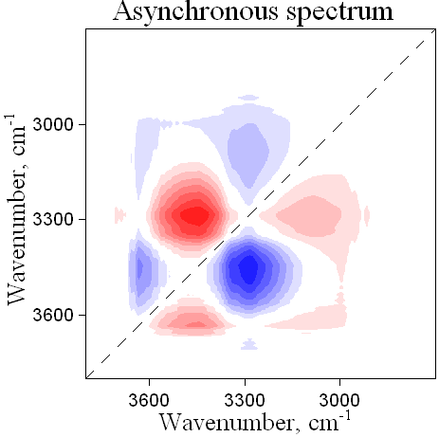
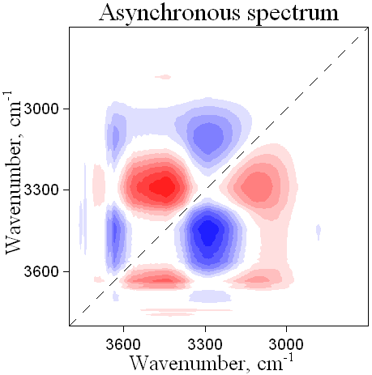
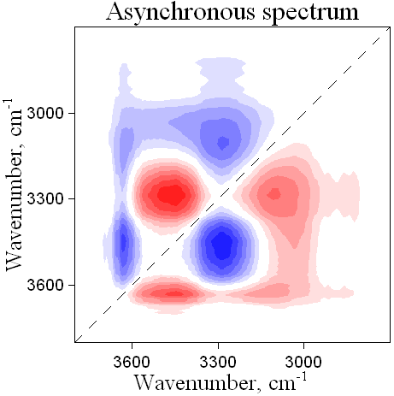
2D IR correlation spectroscopy
PT
TC
PA
AP
3287 > 3343 > 3456 cm⁻¹

Slide 21
2D IR correlation spectroscopy

Slide 22
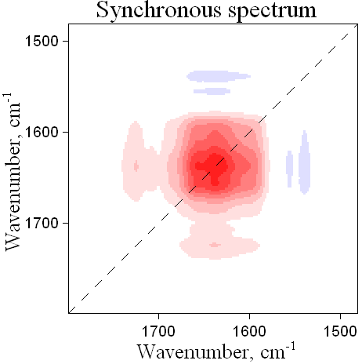
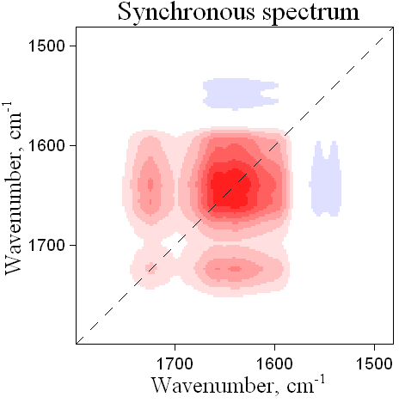
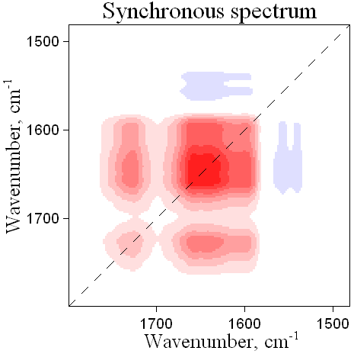
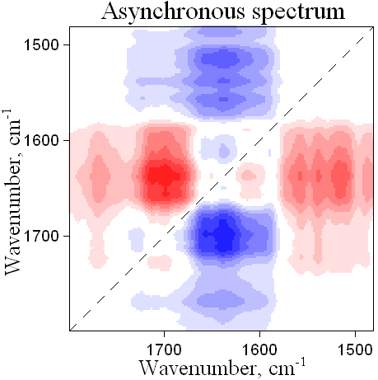
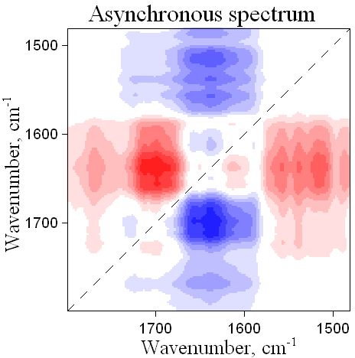
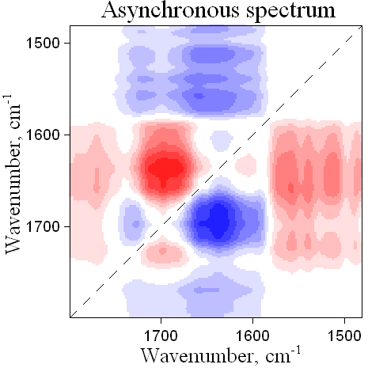
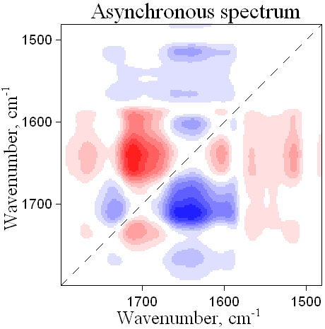
2D IR correlation spectroscopy
PT
TC
PA
AP
1720 > 1739 , 1558 > 1605 > 1651, 1504,
1538 > 1636 > 1785 cm⁻¹

Slide 23
Conclusions
Thermogravimetry indicated the thermal properties of the studied wood samples.
The calculated percentages of the components are in good correlation with the values from literature data.
The ratio values of lignin/carbohydrate IR bands decrease and of carbonyl/carbohydrate IR bands increases with increasing the average wood density.
The infrared and 2DCOS IR spectra indicates structural modifications (induced by different reactions) in the main components of wood.

Slide 24
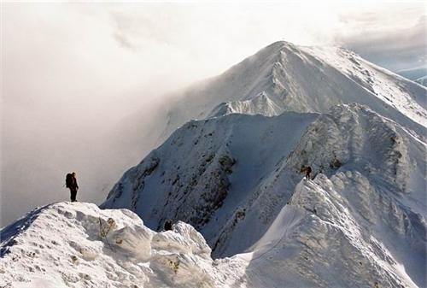
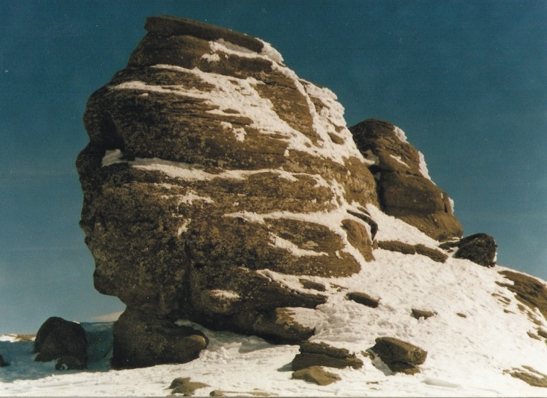
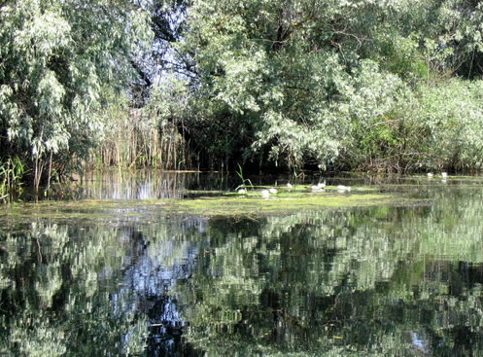
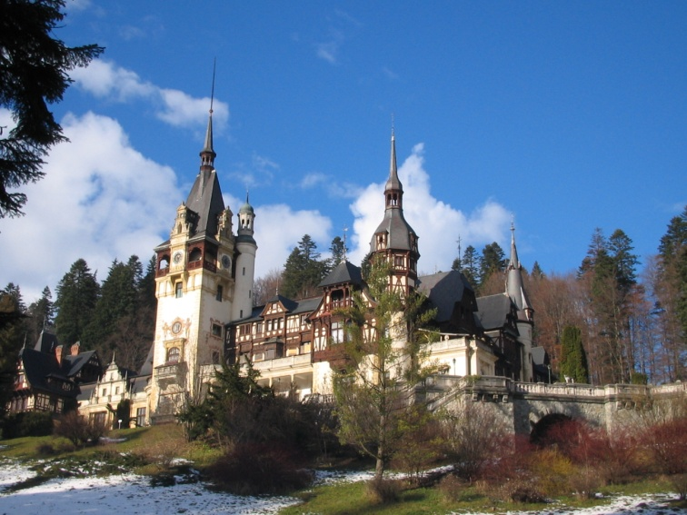
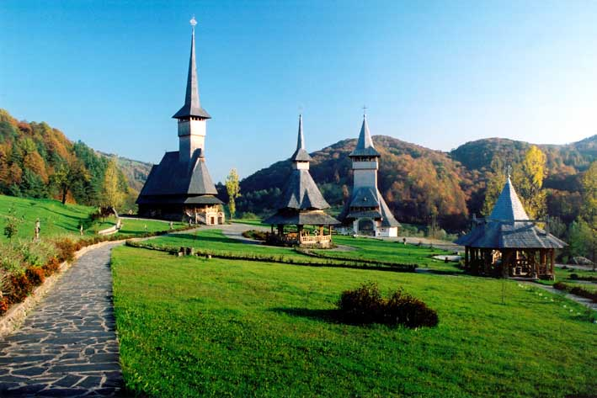
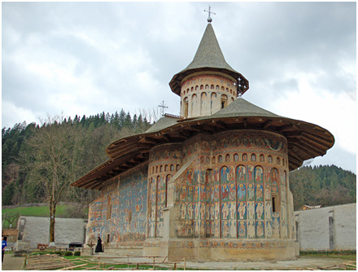
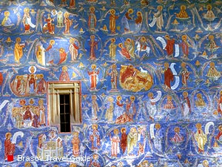
Thank you for your attention!

Slide 25
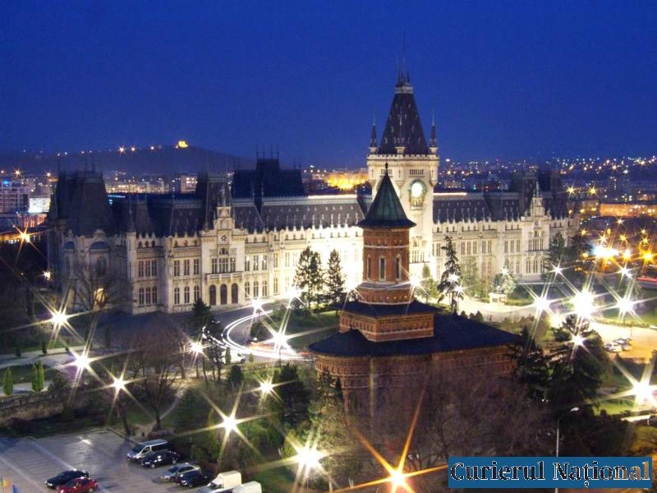
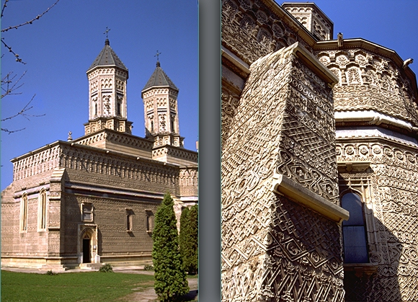
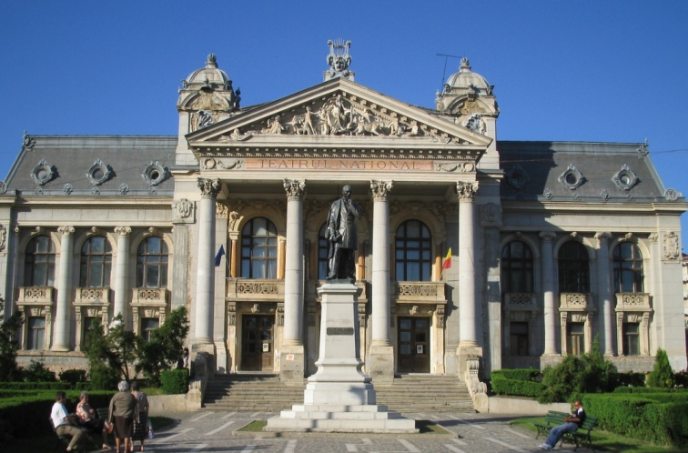
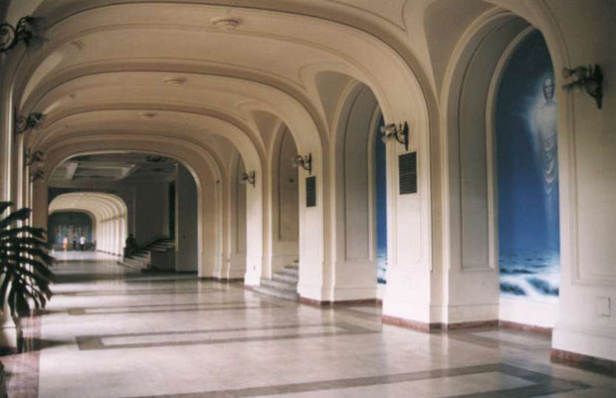
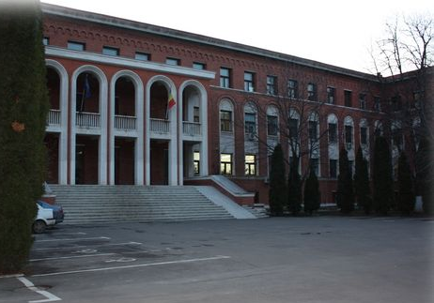
Questions?
Iasi

