Slide 1
Hybrid Nanocellulose-Clay Composites for Controlled Release
Supervisors: Peter SZABO, Anders Egede DAUGAARD, Ole HASSAGER
ESR: Jon TRIFOL GUZMAN
Danish Polymer Center
Department of Chemical and Biochemical Engineering
Technical University of Denmark
Kongens Lyngby, Denmark

Slide 2
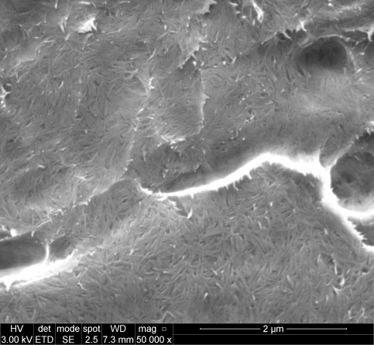
INTRODUCTION
NANOCOMPOSITE
- PLA (Polylactic acid)
Renewable source
Biodegradable
Suitable for industry
Good Mechanical properties
Transparent
~ Cost
Barrier properties
Thermomech. properties
Slow crystallization
Brittleness
NEED TO
BE FIXED
C30B
CNF
Improvement of properties?
Comparisson vs
Synergetic
When? How? How much?

Slide 3
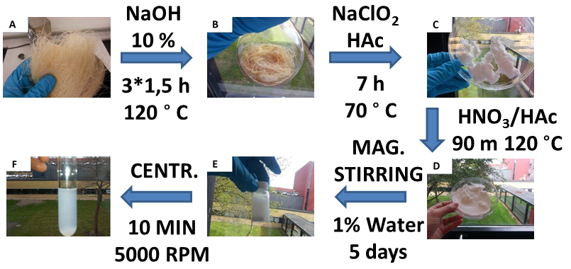
NANOCELLULOSE PRODUCTION
STABLE SUSPENSION

Slide 4
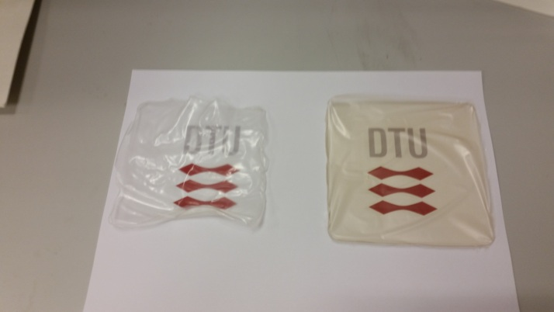
NANOCELLULOSE PRODUCTION

Slide 5
PLA BASED NANOCOMPOSITES
SOLVENT CASTING → BETTER FOR THE ”PROOF OF THE HYPOTHESIS”
→ ”UPSCALING” → NEXT RESEARCH → MULTIPLE POSSIBILITES
PLA & PLA +
C30B
PLA +
CNF +
C30B
PLA +
CNF
DCM
15 h 23 °C
DMF + 15 h 80 °C
BEST CONDITIONS FOR EACH NANOCOMPOSITE

Slide 6
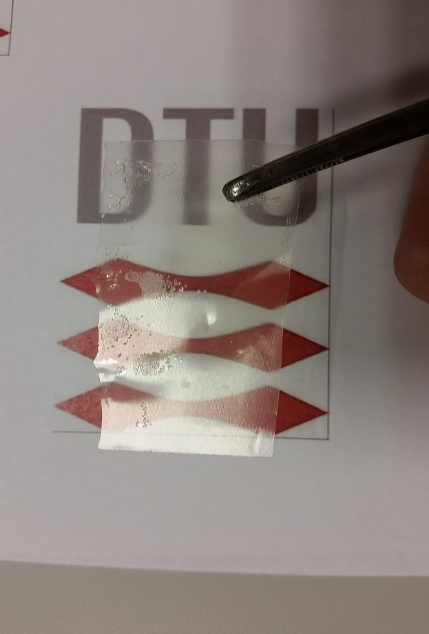
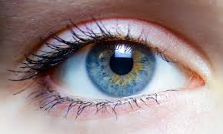
TRANSPARENCY
UV
BLOCKING?
HOT PRESSED
NANOCOMPOSITES
UV
INFRARED
PLA/CNF 1%/C30B 1% TRANSPARENT
AND CLEAR

Slide 7
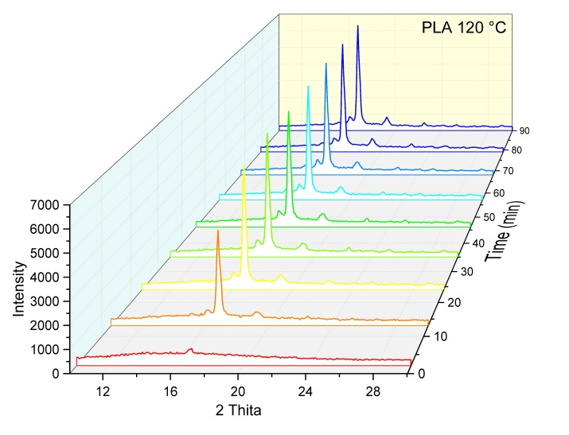
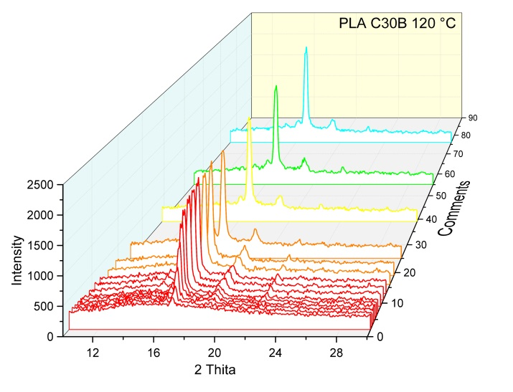
CRYSTALLIZATION: XRD, MDSC & POM
Kinetic → IMPROVEMENT
Size and shape → ?
PLA/C30B 1%
t_{1/2} = 3 min
PLA
t_{1/2} = 25 min
PLA CNF 1%
C30B 1%
t_{1/2} = 5 min
PLA CNF 1%
t_{1/2} = 9 min

Slide 8
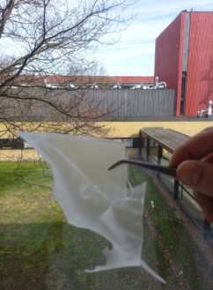
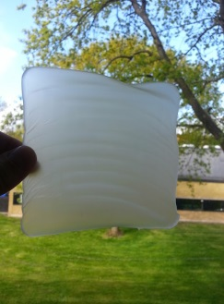
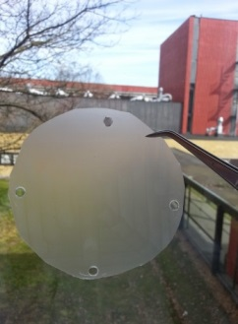
THERMOMECHANICAL PROPERTIES
There is also a synergetic behaviour
The improvement is really meaningful even at low load
Neat PLA
PLA CNF 5%
PLA CNF/C30B
1% 1%

Slide 9
BARRIER PROPERTIES
PLA/CNF 5%/C30B 5%
89% REDUCTION OTR
75% REDUCTION WVTR

Slide 10
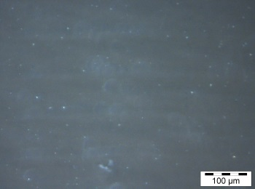
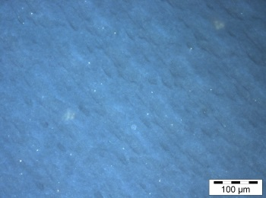
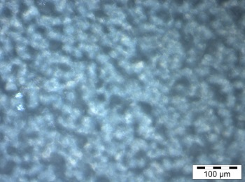
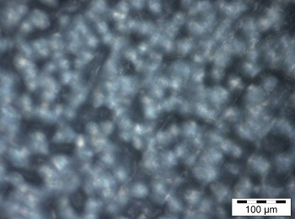
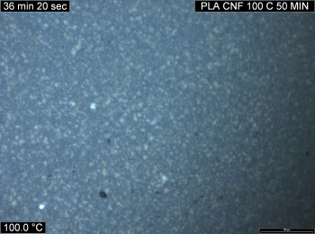
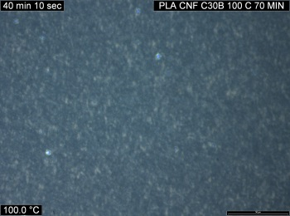
POLARIZED OPTICAL MICROSCOPY
PLA | PLA C30B 1% | PLA CNF 1% | PLA CNF C30B 1%
AFTER SOLVENT CASTING
AFTER ISOTHERMAL CRYSTALLIZATION @ 100 C (COMPARABLE DEGREE OF CRYSTALLINITY)
100 µm
100 µm
100 µm
100 µm
100 µm
100 µm
100 µm
100 µm

Slide 11
CRYSTALLINITY AND BARRIER PROPERTIES
PLA
SOLVENT CASTING
PLA/C30B 1%
5 MINUTES AT 170 °C - FAST COOLING
AMORPHOUS
PLA/CNF 1%
120 MINUTES 120 °C
PLA/CNF/C30B 1% 1%
FULLY CRYSTALLIZED
AMORPHOUS MOBILE/RIGID →
UNDER INVESTIGATION

Slide 12
WATER DIFFUSIVITY
QUARTZ SPRING MICROBALANCE
DIFFUSIVITY
CONTROLLED

Slide 13
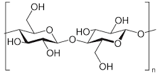
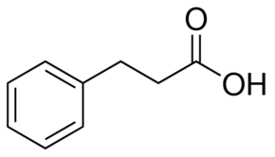
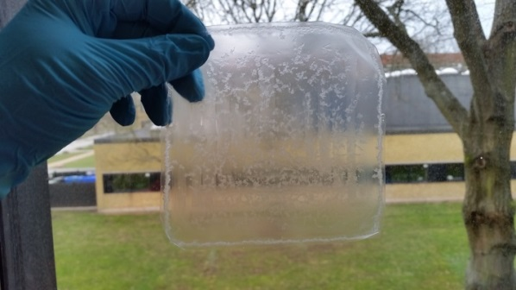
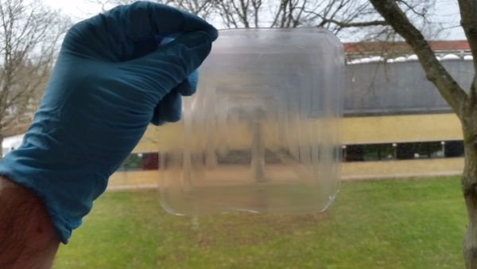
GRAFTING OF BZAA (SOLREACT)
Improve dispersion
+
GIVE AN EXTRA FUNCTION
ABSORBANT
+
ESTERIFICATION
Small vacuum
T= 130 °C
T_{b}(water) < T < T_{b} (agent to graft)
Removal of water → critical!
Not removal of the agent to graft
Acetate groups → acetic acid → removed ?

Slide 14
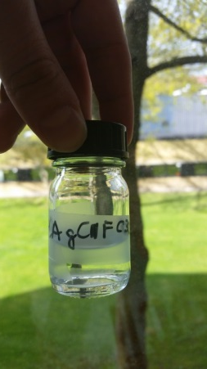
CONTROLLED RELEASE
95% MeOH on water → fatty food simulant.
SOLVENT CASTING
PLA + 6% CARVACROL
PLA CNF 3% + 6% CARVACROL
PLA gCNF 3% + 6% CARVACROL
PLA gCNF 3% C30B 5% + 6% CARVACROL
ISOTHERMAL
CRYSTALLIZATION
7,5 min at 120 ºC

Slide 15
CONTROLLED RELEASE
BAD CLAY
DISPERSION!

Slide 16
INTRODUCTION
NANOCOMPOSITE
- PLA (Polylactic acid)
Renewable source
Biodegradable
Suitable for industry
Good Mechanical properties
Transparent
~ Cost
Barrier properties
Thermomech. properties
Slow crystallization
Brittleness
NEED TO
BE FIXED
C30B
CNF
Improvement
of properties?
Comparisson vs
Sinergetic
When? How? How much?

Slide 17
INTRODUCTION
NANOCOMPOSITE
- PLA (Polylactic acid)
Renewable source
Biodegradable
Suitable for industry
Good Mechanical properties
Transparent
~ Cost
Barrier properties
Thermomech. properties
Slow crystallization
Brittleness
MANTAINED
C30B
CNF
ENHANCED
ENHANCED
ENHANCED
Improvement
of properties?
ENHANCED
Comparisson vs
Sinergetic
When? How? How much?

Slide 18
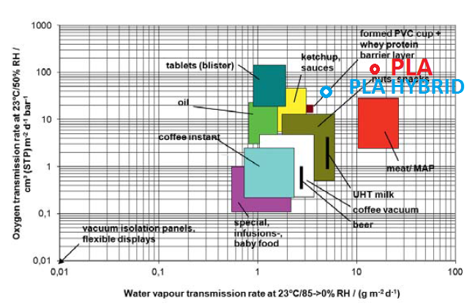
Langowski, H.-C., (2008) Permeation of Gases and Condensable Substances through Monolayer and Multilayer Structures. In: Plastic Packaging: Interactions with Food and Pharmaceuticals (Eds. Piringer O.G., Baner A.L.) 2008: Wiley-VCH, 297-347.

Slide 19
ACKNOWLEDGEMENTS
To my supervisor board for guiding me during my PhD.
To my coauthors for helping me and their valuable advices.
In memoriam to Prof. Iñaki Mondragón Egaña, whose dedication for the science is a inspiration for me.
To the Marie Curie (ITN) Program (Project: NewGenPak project No: 290098) for the financial support.
To this COST Action FP1105 for the invitation to several meetings where I have learnt a lot (I got some inspirations during meeting at Thesalonniki)

