Slide 1
POLYMERIC SORBENTS MANUFACTURED BY SYNTHESIS OF LIGNIN ACRYLATES WITH STYRENE AND DIWINYLBENZENE
B. Podkościelnaª, O. Sevastyanova^{b}, B. Gawdzikª
ªDepartment of Polymer Chemistry, Faculty of Chemistry, Maria Curie-Skłodowska University, pl. M. Curie-Skłodowskiej 5, 20-031 Lublin, Poland
^{b}KTH, Royal Institute of Technology, Department of Fibre and Polymer Technology, Division of Wood Chemistry and Pulp Technology, SE-10044 Stockholm, Sweden

Slide 2
The structural features of lignin have a high potential for chemical modifications, which can lead to value added polymeric materials with specific properties. Due to the presence in the lignin structure of phenolic and aliphatic hydroxyl groups (OH_{phen} and OH_{aliph}), its modification are very attractive and prospective (Figure 1). The ratio OH_{phen}/OH_{aliph} varies depending on the origin (hardwood or softwood) of the lignin and on the pulping process (e.g., kraft, alkali, organosolv pulping, etc.).
Functional groups in lignin (31P NMR method)
Sample | Aliph-OH (mmol/g) | Ph-OH |  |  | -COOH (mmol/g)
 |  | Con-densed | Guaicyl | Total
Aldrich alkali lignin | 2.43 | 1.54 | 1.91 | 3.45 | 0.44

Slide 3
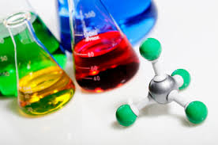
Acrylation of lignin for improved reactivity
The reaction with acrylic or methacrylic acid is one of the possible types of modifications resulting in the introduction of vinyl groups, capable for polymerization, into lignin structure. Subsequent lignin derivatives (LA and LEA) were copolymerized.
B. Podkościelna, M. Sobiesiak, Y. Zhao, B. Gawdzik, O. Sevastyanova, Holzforschung, DOI: 10.1515/hf-2014-0265

Slide 4
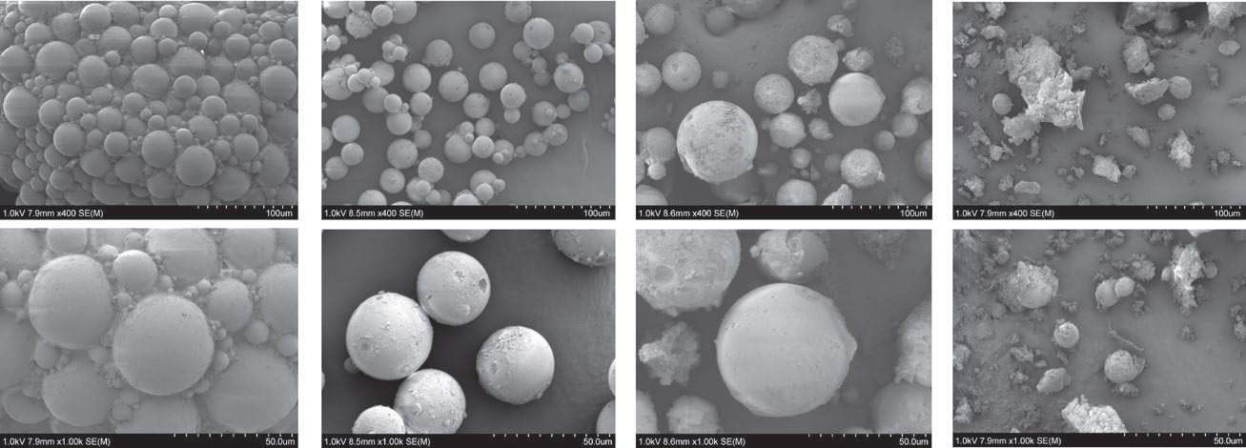
Copolymerization
Copolymerization of St with DVB or BPA.DA (bisphenol A glicerolate diacrylate) and lignin or lignin derivatives in form of microspheres was performed in the aqueous medium in suspension-emulsion procedure. After copolymerization with vinyl monomers lignin-modified microspheres possessed high mechanical and thermal resistance
as well as functional groups on the surface.

Slide 5
DSC analysis
In the figure we can see clear endothermic effects related to the thermal degradation of the samples

Slide 6
Conclusions
acrylic derivatives of lignin were successfully prepared by two methods: reaction with acrylic acid (LA) and a two-step reaction with epichlorohydrin and acrylic acid (LEA). The chemical structures of all the new derivatives were confirmed by ATR analysis.
after copolymerization lignin-modified microspheres possessed high mechanical and thermal resistance as well as functional groups on the surface.
the addition of unmodified lignin to BPA.DA-St copolymers improves its thermal stability – the thermal degradation temperatures increase from 415 to 430°C.

Slide 7
As a result of cooperation between UMCS (Poland) and KTH (Sweden) connected with the COST Action FP 1105 scientific paper is published:
Podkościelna B., Sobiesiak M., Zhao, Y. Gawdzik, B., Sevastyanova O.
„Preparation of lignin-containing porous microspheres through the copolymerization of lignin acrylate derivatives with styrene and divinylbenzene”
Holzforschung, 2015 (DOI: 10.1515/hf-2014-0265)

Slide 8
THANK YOU FOR YOUR ATTENTION

