Slide 1
CATIONIC AND ANIONIC NANOFIBRILLATED CELLULOSE FOR PAPERMAKING
GÜLİZ HOCAOĞLU , SEDAT ONDARAL
Department of Forest Industry Engineering, Karadeniz Technical University, Trabzon, TURKEY.
gulizhocaoglu@hotmail.com
COST FP1105 WoodCellNet Workshop in San Sebastian

Slide 2
CONTEX
TEMPO-oxidation
Cationic nanofibrillated cellulose
QCM-D data
Characterization

Slide 3
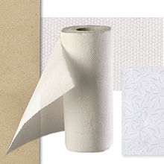
NANOFİBRİLLATED CELLULOSE

Slide 4
What is aim of?
In this study, cationic and anionic nanofibrilated celluloses were prepared by using a bleached sulphite pulp and their adsorption properties and effects on paper strength were investigated.

Slide 5
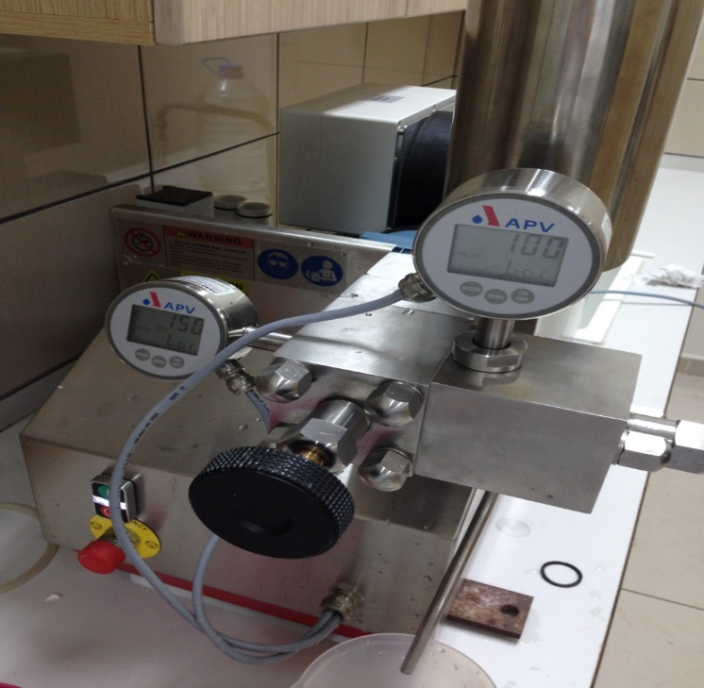
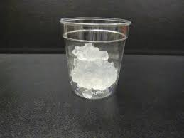
The cationic nanofibrilated cellulose (CNFC) was produced by homogenization of pulp fibres after cationic modification with glycidyltrimethylammonium chloride (GTMAC)
The anionic nanofibrilated cellulose (ANFC) was produced with treating fibres with 2,2,6,6-Tetramethylpiperidin-1-oxyl (TEMPO) oxidation and then, homogenization process with high pressure homogenizer was used for final disintegration of fibres to nanofibrils.

Slide 6
CHARACTERIZATIONS

Slide 7
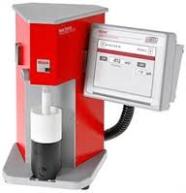
Determination of charge density
the charge density (q) was calculated by following formulation:
$q=\frac{V.n}{m}$
Charge density was calculated in meq/g. P-DADMAC and polyethylenesulphonate sodium salt (PES-Na) were used as a cationic titrant and an anionic titrant, respectively.

Slide 8
Conductometric titration
The carboxyl content of ANFC was determined by conductometric titration. Nanofibrils (50 mg) was added in 250 ml of deionized water. After 15 ml of 0.01 M HCl addition, suspension was stirred for 10 minute. ANFC suspension was then titrated with 0.01 M NaOH. The carboxyl content was calculated from the weak acid curve obtained during titration

Slide 9
Imaging with Atomic Force Microscopy
The structures of CNFC and ANFC on SiO₂ surface was studied by means of Atomic Force Microscopy with tapping mode (Nanoscope IV, Multimode SPM, Veeco Inc., USA). All experiments in which standard rectangular non-contact silicon cantilevers (RTESP, Veeco Instruments Inc., USA) were used were conducted under ambient conditions (23ºC and 50% relative humidity). CNFC sample was prepared giving CNFC directly on SiO₂ crystal. The wet samples were then dried with N₂ gas.

Slide 10
AFM images of ANFC and CNFC (Image size:1µm x1µm)

Slide 11
Adsorption on silicon oxide surface
Adsorption properties of nanofibrillated celluloses are important for many application especially for papermaking industry as well as packaging applications in which specific barrier properties are needed. QCM-D studies showed that frequency decreased significantly (-40 Hz at 3rd overtone) due to the CNFC adsorption to the negatively charged SiO₂ surface. Electrostatic interaction between CNFC and surface was dominating interaction for this adsorption. During rinsing surface with water (10⁻² M NaCl) at pH 7, frequency increased slightly. It can be due to removing surrounding and entangled nanofibrils from the adsorbed layer of CNFC.

Slide 12
QCM-D data obtained during adsorption nanofibrils (concentration of fibrils are 0.1 g/l, pH 7 and NaCl concentration 10-2 M).

Slide 13
Dry strength of paper
The nanofibrillated celluloses with cationic and anionic charges were also used to enhance dry strength of paper. CNFC was added to fibre solution alone because it has an electrostatic affinity to pulp fibres which have carboxyl groups of pulp fibres. On the other hand, ANFC was added into fibre suspension after treating fibres with CNFC giving cationic charge on the surface for anchoring ANFC.

Slide 15
Conclusion
AFM images of showed that CNFC produced GTMAC modification had bigger size than ANFC produce by TEMPO oxidation.
The charged groups of CNFC didn’t reached the same level with that of ANFC which promotes the highly disintegration of fibers to nanofibrils. Therefore, the repulsion between nanofibril segments was not enough higher and also slightly amphoteric structure can also decrease this repulsion.
It was found from QCM-D data that CNFC formed thicker layer than ANFC because of bigger size and lower charge density. These nanofibril were also used for enhancing dry strength of paper.
The tensile index of paper produced by sequentially addition of CNFC and ANFC was higher comparing with single addition of CNFC to fibre suspension. Addition to increase in molecular contact area, interdiffusion and interlocking nanofibrils were also possible responsible mechanisms for increase of paper strength.

Slide 16
THANK YOU FOR YOUR ATTENTION…
Assoc. Prof. Sedat ONDARAL
MSc. Güliz HOCAOĞLU

