Slide 1
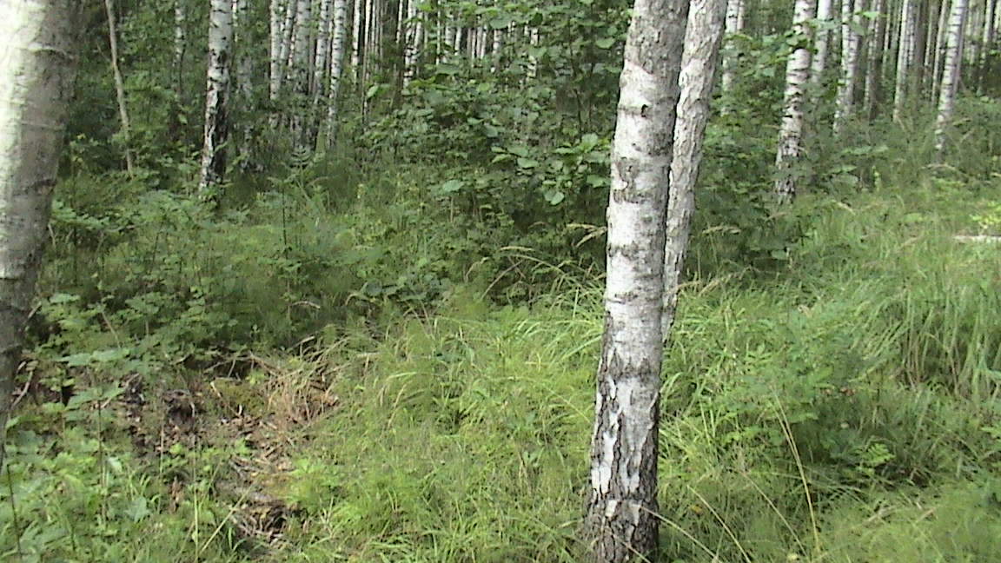
revealing of lignin structure-antioxidant activity relationship using Analytical pyrolysis and chemometry
Jevgenija Ponomarenko, Tatiana Dizhbite, Maris Lauberts, Galina Dobele, Alexander Volpert, Galina Telysheva
Latvian State Institute of Wood Chemistry, Riga, Latvia
Notes:
The present work describes the searching of structure - antioxidant activity relationship (SAR) for technical lignins for future development of a theoretic basis for their effective application as antioxidants for variety of substrates.

Slide 2
Motivations and Goal
Different materials, food products, means for human health care, etc. undergo oxidative degradation. In order to protect their properties and prolong their life-time, antioxidants have to be added to almost all organic substrates. The overall antioxidants markets, where share of natural antioxidants is accounted for ~30%, is valued at about USD 2 billions per year. Demand for natural antioxidants is constantly increasing and the search for new renewable resources for their manufacture is an urgent task.
The antioxidant activity of bio-renewable polymeric polyphenol lignin is well documented for a variety of polymeric composite materials, animal feed, and biological systems, however, the systematic investigations of mechanisms of the lignin antioxidant action and structure–antioxidant activity relationship are performed much more seldom. Structure–activity relationship is crucial to identify the most optimal antioxidants and to determine the most promising directions for upgrading of technical lignins in order to produce effective antioxidants for various application systems.
The aim of the work was characterization and quantification of the structure–antioxidant activity relationship (SAR and QSAR, respectively) for lignins.
COST Action FP1105 San Sebastian Meeting
May 26th – 27th, 2015
Notes:
Numbers on 2013. Demand for natural antioxidants is constantly increasing, primarily due to the doubtful safety of synthetic antioxidants and the rise of technical standards for industrial materials.
For example, lignins, comparing to flavanoids, have longer circulation time in human and animal organisms and are much less toxic.
, these high-molecular polyphenols due to their higher compatibility with polymeric systems, low volatility and lesser toxicity can be successfully applied in those fields in which the employment of a single polyphenol is inefficient. Bio-renewable polymeric polyphenol lignin is a suitable natural antioxidant for use in polymers due to its lower sensitivity to high temperatures and higher molecular mass in comparison with the low molecular weight natural antioxidants which are proposed for the stabilization of polymeric materials, e.g., -tocopherol.
/ˈkruːʃl/
The absence of rationalized conceptions about lignin structural features and physical–chemical properties influencing its antioxidant activity hinders the realization of lignin potential in the area of stabilization of materials and food/feed products against oxidative damage

Slide 3
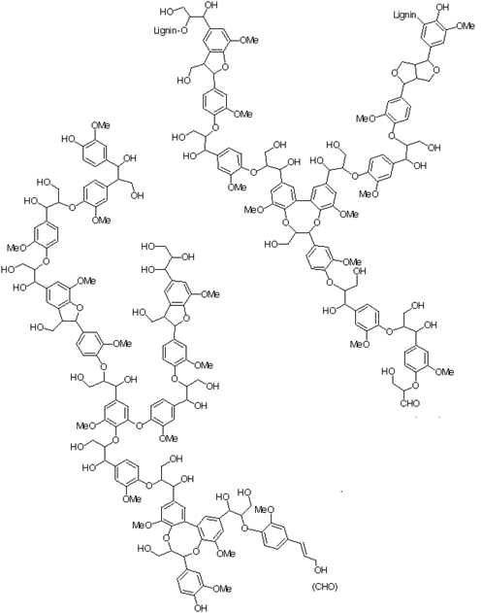
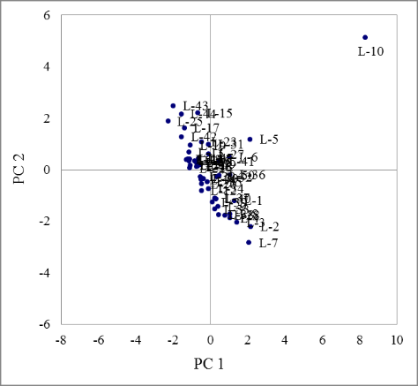
Materials and Methods
50 lignin samples obtained as by-products of the chemical processing of phytomass were the objects of the study. They differed by botanical origin (annual plants, coniferous trees, deciduous trees) and the isolation technique (alkaline, organosolv, kraft processes, the Bjorkman method, fast pyrolysis, hydrolysis).
The 9 structural descriptors, chosen on the basis of our previous studies of antioxidant activity of lignins and lignin-related low-molecular phenols were determined using mainly Py-GC-MS/FID and FTIR, EPR, SEC and wet-chemistry as complimentary methods.
Principal component analysis (PCA) showed that the chosen structural properties, together with the number of the samples, allowed to join all lignins under study in one group, without dividing them into clusters, depending on the botanical origin and/or the processing method.
Structural model of
softwood lignin
(G. Brunow et al. 2001)
Structural model of a
hardwood lignin fragment (J. Ralph et al., 2004)
loadings of
the lignins in PC1 and PC2
COST Action FP1105 San Sebastian Meeting
May 26th – 27th, 2015
Notes:
The chosen structural properties, together with the number of the samples, allowed to join all lignins in one group, without dividing them into clusters, depending on the botanical origin and/or the processing method. This is true not only for the 1st and 2nd coordinates but loadings of the data to further principal components’ coorinates also did not allow separating them in several groups. The sample L 10, which significantly differs from other samples, is the insoluble fraction (F-X) of the black alder alkaline lignin, which was obtained after the extraction by organic solvents. This sample is characterized by a high content of carbohydrates, as well as by a molecular mass, which is untypically high for alkaline lignins.

Slide 4
Materials and Methods
Antioxidant activity
For the investigation of antioxidant activity, the methods of the deactivation of DPPH● and ABTS^{●+} radicals were applied. A combination of these methods allows to gain information about the reactions of low molecular phenols with radicals by both proton coupled electron transfer (PCET) and sequential proton lost electron transfer mechanisms (SPLET) as well as about the stoichiometry of the reactions.
PCET mechanism: ArO-H + R• → ArO• + R-H
BDE=H°(ArO●)+H°(H●)- H°(ArOH)
SPLET mechanism: ArO-H → ArO⁻ + H⁺
ArO⁻ + R• → ArO• + R⁻
R- + H⁺ → RH
ETE = H°(ArO●) + H°(e⁻) - H°(ArO⁻)
The antioxidant activity was expressed as radical deactivation index (RDI): number of deactivated radicals, calculated per one phenolic hydroxyl group of lignin. The use of this parameter prevents the expression of activity per gram of a polymer or an extract (which is not suitable for the structure-activity studies)
The multivariate regression and correlation analysis were used to describe the influence of lignin structural parameters on antioxidant activity and to obtain a model, which gives quantitative information about their contribution.
COST Action FP1105 San Sebastian Meeting
May 26th – 27th, 2015
Notes:
The process by PCET mechanisms are governed by BDE – bonds dissociation enthalpy saites disociācijas entalpija;
ETE –electron transfer enthalpy
The use of the latter parameter allows preventing the problems, which occur if the activity is expressed per gram of a polymer or an extract (which is not suitable for the structure-activity studies), and it clearly demonstrates the factors, which significantly increase or decrease the activity of the phenolic hydroxyl groups.

Slide 5
Results: SAR
For the studies of the correlation between the structure and antioxidant activity, partial correlations were used, because each structural property could influence the antioxidant activity of lignin.
In the case of lignins, the structural parameters, which influence the antioxidant activity in the DPPH● tests, can easily be explained by means of the PCET mechanism. The factors, which determine the antioxidant activity in the ABTS^{●+} test, show the contribution of SPLET mechanism.
Antioxidant activity descriptors | Pearson’s correlation coefficient (n=50, a=0.05) Critical value = 0,28
 | DFPH● | ABTS^{●+}
relative content of G+S phenols, % | 0,58 | -0,18
CH₂-groups in the a-position of the side chain, % | 0,47 | 0,22
Oxygen-containing groups in the side chain, % | -0,48 | -0,27
size of the p-conjugated systems, number of H atoms in spin delocalization region | -0,34 | -0,45
Double bonds in the a-position of the side chains, % | 0,01 | 0,21
Carbohydrates, % | -0,10 | -0,58
(ArC₁+ArC₂)/ArC₃ | 0,08 | 0,74
-OCH₃/PPU | 0,19 | 0,05
M_{w}, g/mol | 0,04 | -0,11
COST Action FP1105 San Sebastian Meeting
May 26th – 27th, 2015

Slide 6
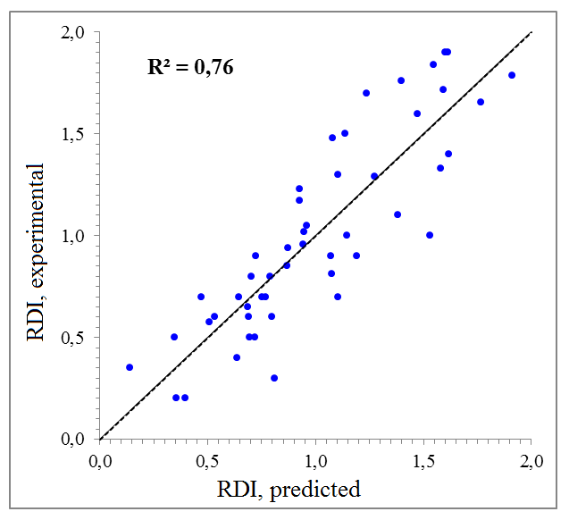
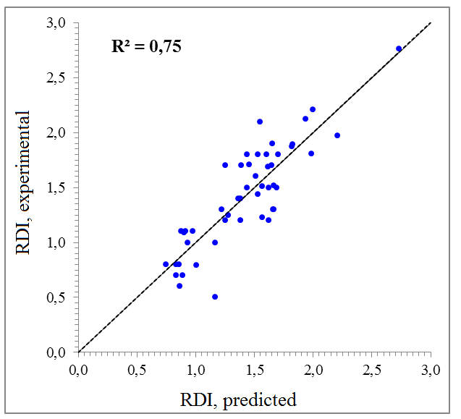
Results: QSAR
The results of PCA were used for precise the chosen structural descriptors for lignin QSAR ,
For the QSAR studies, the multivariate “Correlated Component Regression” (CCR) analysis was used and the structure-activity relationships equations were obtained on the basis of the DPPH● and ABTS^{●+} tests results.
Y_{DPPH}• = -3.08+0.043×X₁+0.018×X₂-0.018×X₃-0.014×X₇+0.24×X₈
Y_{ABTS}^{•+} = 1.46 -0.013×X₃-0.015× X₄+0.050 X₅-0.018×X₇+0.32×X₈
Predicted and experimental RDI values in the DPPH● test
Predicted and experimental RDI values in the ABTS^{●+} test
COST Action FP1105 San Sebastian Meeting
May 26th – 27th, 2015

Slide 7
Results: QSAR
According to the results of the CCR analysis, the structural descriptors, which determine the lignin antioxidant activity by PCET mechanism, can be classified by their contribution as relative content of the G+S phenylpropane units (0.51) > relative content of the phenylpropane units with CH₂-groups in the α-position of the side chains (0.37) > relative content of the phenylpropane units with oxygen-containing groups in the side chains (-0.40) > size of the -conjugated systems (-0.23) > OCH₃/PPU
The structural descriptors, which determine the lignin antioxidant activity by SPLET mechanism, can be classified by their contribution as follows : (ArC1+ArC2)/ArC3 (0.92) > relative content of carbohydrates (-0.51) > relative content of phenylpropane units with oxygen-containing groups in the side chains (-0.33) > size of the π-conjugated systems (-0.32) > – OCH₃/PPU (0.16).
The obtained results are in agreement with the results of PCA. The coefficient of determination, which shows the part of the variation of the antioxidant activity, which can be explained by the descriptors included in the model, is 0.76. The obtained model can successfully be used for the prediction of the antioxidant activity of technical lignins, however approximately 24% of the factors, influencing the antioxidant activity of lignins still remain unclear.
COST Action FP1105 San Sebastian Meeting
May 26th – 27th, 2015
Notes:
The process by PCET mechanisms are governed by BDE – bonds dissociation enthalpy saites disociācijas entalpija;
ETE –electron transfer enthalpy
The use of the latter parameter allows preventing the problems, which occur if the activity is expressed per gram of a polymer or an extract (which is not suitable for the structure-activity studies), and it clearly demonstrates the factors, which significantly increase or decrease the activity of the phenolic hydroxyl groups.

Slide 8
PUBLICATIONS
J. Ponomarenko, T. Dizhbite, M. Lauberts, A. Viksna, G. Dobele, O. Bikovens, G.Telysheva, Characterization of softwood and hardwood LignoBoost kraftlignins with emphasis on their antioxidant activity, Bioresources 9 (2014)2051–2068.[30]
Ponomarenko J., Trouillas P., Martin N., Dizhbite T., Krasilnikova J., Telysheva G. Elucidation of antioxidant properties of wood bark derived saturated diarylheptanoids: A comprehensive (DFT supported) understanding. Iesniegts publicēšanai žurnālā Phytochemistry 103:178–187.
J. Ponomarenko, T. Dizhbite, M. Lauberts, A. Volperts, G.Dobele, G. Telysheva, Analytical pyrolysis – A tool for revealing of lignin structure-antioxidant activity relationship, J. Anal. Appl. Pyrol. (2015), http://dx.doi.org/10.1016/j.jaap.2015.02.027
J. Ponomarenko, T. Dizhbite, M. Lauberts, L. Lauberte, V. Jurkjane, G. Telysheva, Antioxidant activity of various lignin nd lignin-related phenylpropanoid units with high and low molecular weight, Holzforschung. ISSN (Online) 1437-434X, ISSN (Print) 0018-3830, DOI: 10.1515/hf-2014-0280, April 2015
COST Action FP1105 San Sebastian Meeting
May 26th – 27th, 2015

Slide 9
Thank you for your attention!
COST Action FP1105 San Sebastian Meeting
May 26th – 27th, 2015

