Slide 1
Correlations of the Antioxidant Properties of Kraft Lignin Fractions with the Thermal Stability of its Blends with Polyethylene
Hasan Sadeghifar, Dimitris S. Argyropoulos,
Departments of Chemistry and Forest Biomaterials
North Carolina State University , Raleigh , NC USA
Department of Chemistry &
Center of Excellence for Advanced Materials Research,
King Abdulaziz University, Jeddah, Saudi Arabia.
COST Action FP1105 Principles of cell wall assembly – Understanding and Implementation. 26-27/May/2015 San Sebastian, Spain

Slide 2
Kraft Lignin; A Valuable Resource
What are key questions/objectives that will significantly(but not incrementally) advance the field?

Slide 3
Kraft lignin is a by-product of the paper industry;
The Kraft process is continuously adjusted/monitored/modified with the aim to produce paper not lignin;
Manufacturing/Seasonal/Geographical & other variations; by definition offer a Heterogeneous/Polydisperse/Irregular & notoriously reactive & irreproducible material.

Slide 4
Kraft Lignin; A Valuable Resource
What are key questions/objectives that will significantly (but not incrementally) advance the field?
If Kraft lignin is to be used as a valuable chemical resource is it possible to have it Refined & Upgraded to the level of becoming a reliable commodity chemical?
Is it possible to arrive at functional kraft lignin polymers/phenolic precursors
- of consistent quality & specs on a daily basis ?
- of functionality that defines it as a polyol ?
- of fractions that defines it as polymeric precursor of defined/controlled reactivity ?

Slide 5
Objective
To understand the fundamental antioxidant properties of softwood kraft lignin and its fractions on the thermal stability of its blends with polyethylene.
To elucidate the role of the Molecular weight of the Lignin
To elucidate the role of the free phenolic OH on the lignin
To correlate the above with the Oxidation Induction Temperature of lignin and its blends with PE

Slide 6
Lignin and polyethylene Samples
Softwood Kraft lignin; KL (Mw 6300 g/mol)
Fully methylated Kraft lignin
Acetone Soluble KL (representing 65% of total lignin); ASKL
Fully Methylated Acetone Soluble KL; (Mw 3500 g/mol)
Acetone Insoluble KL (representing 35% of whole lignin): AIKL
Fully methylated AIKL (Mw 14000 g/mol)
Polyethylene
Equistar
Density 0.93 g/cm³
Melt Flow Index 1.2 g/10 min

Slide 7
Functional groups of Kraft lignin Samples Before & After Methylation (mmol/g)
Samples | Aliphatic-OH | Condensed Phenolic-OH | Non-condensed Phenolic-OH | Total phenolic-OH | COOH
Original Kraft Lignin | 2.24 | 2.07 | 2.18 | 4.25 | 0.42
Methylated Kraft lignin | 1.98 | 00.00 | 00.00 | 00.00 | 0.41
ASKL | 1.63 | 2.41 | 2.85 | 5.26 | 0.57
Methylated ASKL | 1.59 | 00.00 | 00.00 | 00.00 | 0.48
AIKL | 2.74 | 2.10 | 1.76 | 3.86 | 0.35
Methylated AIKL | 2.71 | 00.00 | 00.00 | 00.00 | 0.33
Complete & selective phenolic methylation is evident
Total amount of phenolic OH is Highest in the Low Molecular Weight Fraction (ASKL) about + 20% based on KL
Total amount of phenolic OH is Lowest in the High Molecular Weight Fraction (AIKL) - 10% based on KL

Slide 8
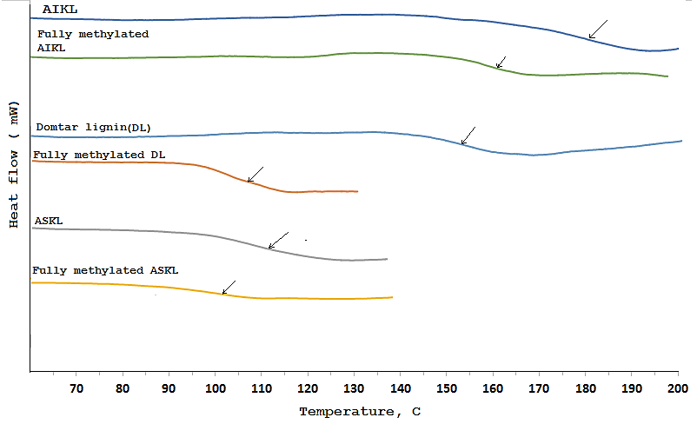
Glass Transition Temperatures of Initial KL, Fractions & Methylated Lignins
High Mol Wt (AIKL) displays dramatically higher Tg than ASKL
Methylation Brings the Tg down
Sample ID | KL | Methylated KL | AIKL | Methylated AIKL | ASKL | Methylated ASKL
Tg, °C | 153 | 110 | 182 | 162 | 114 | 101

Slide 9
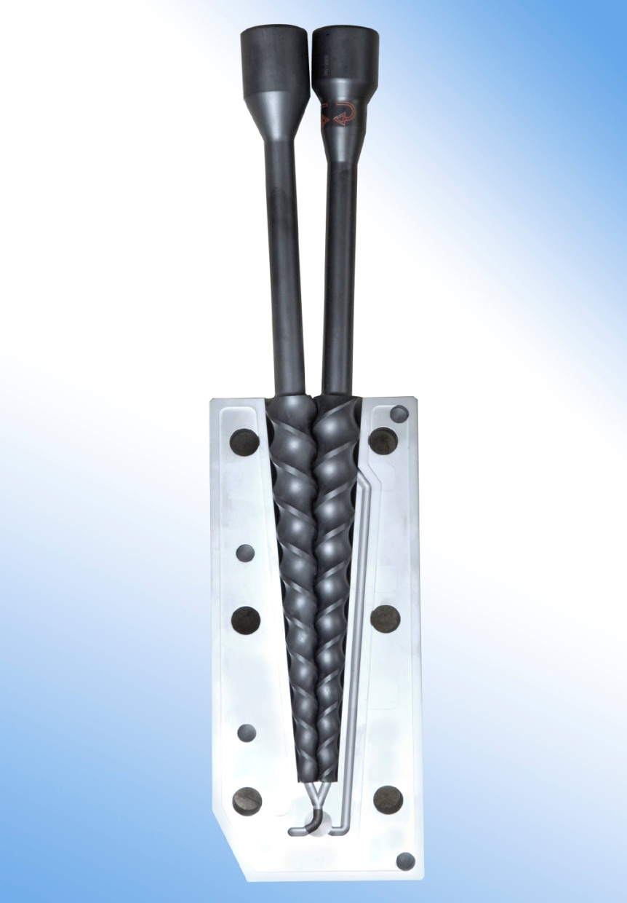
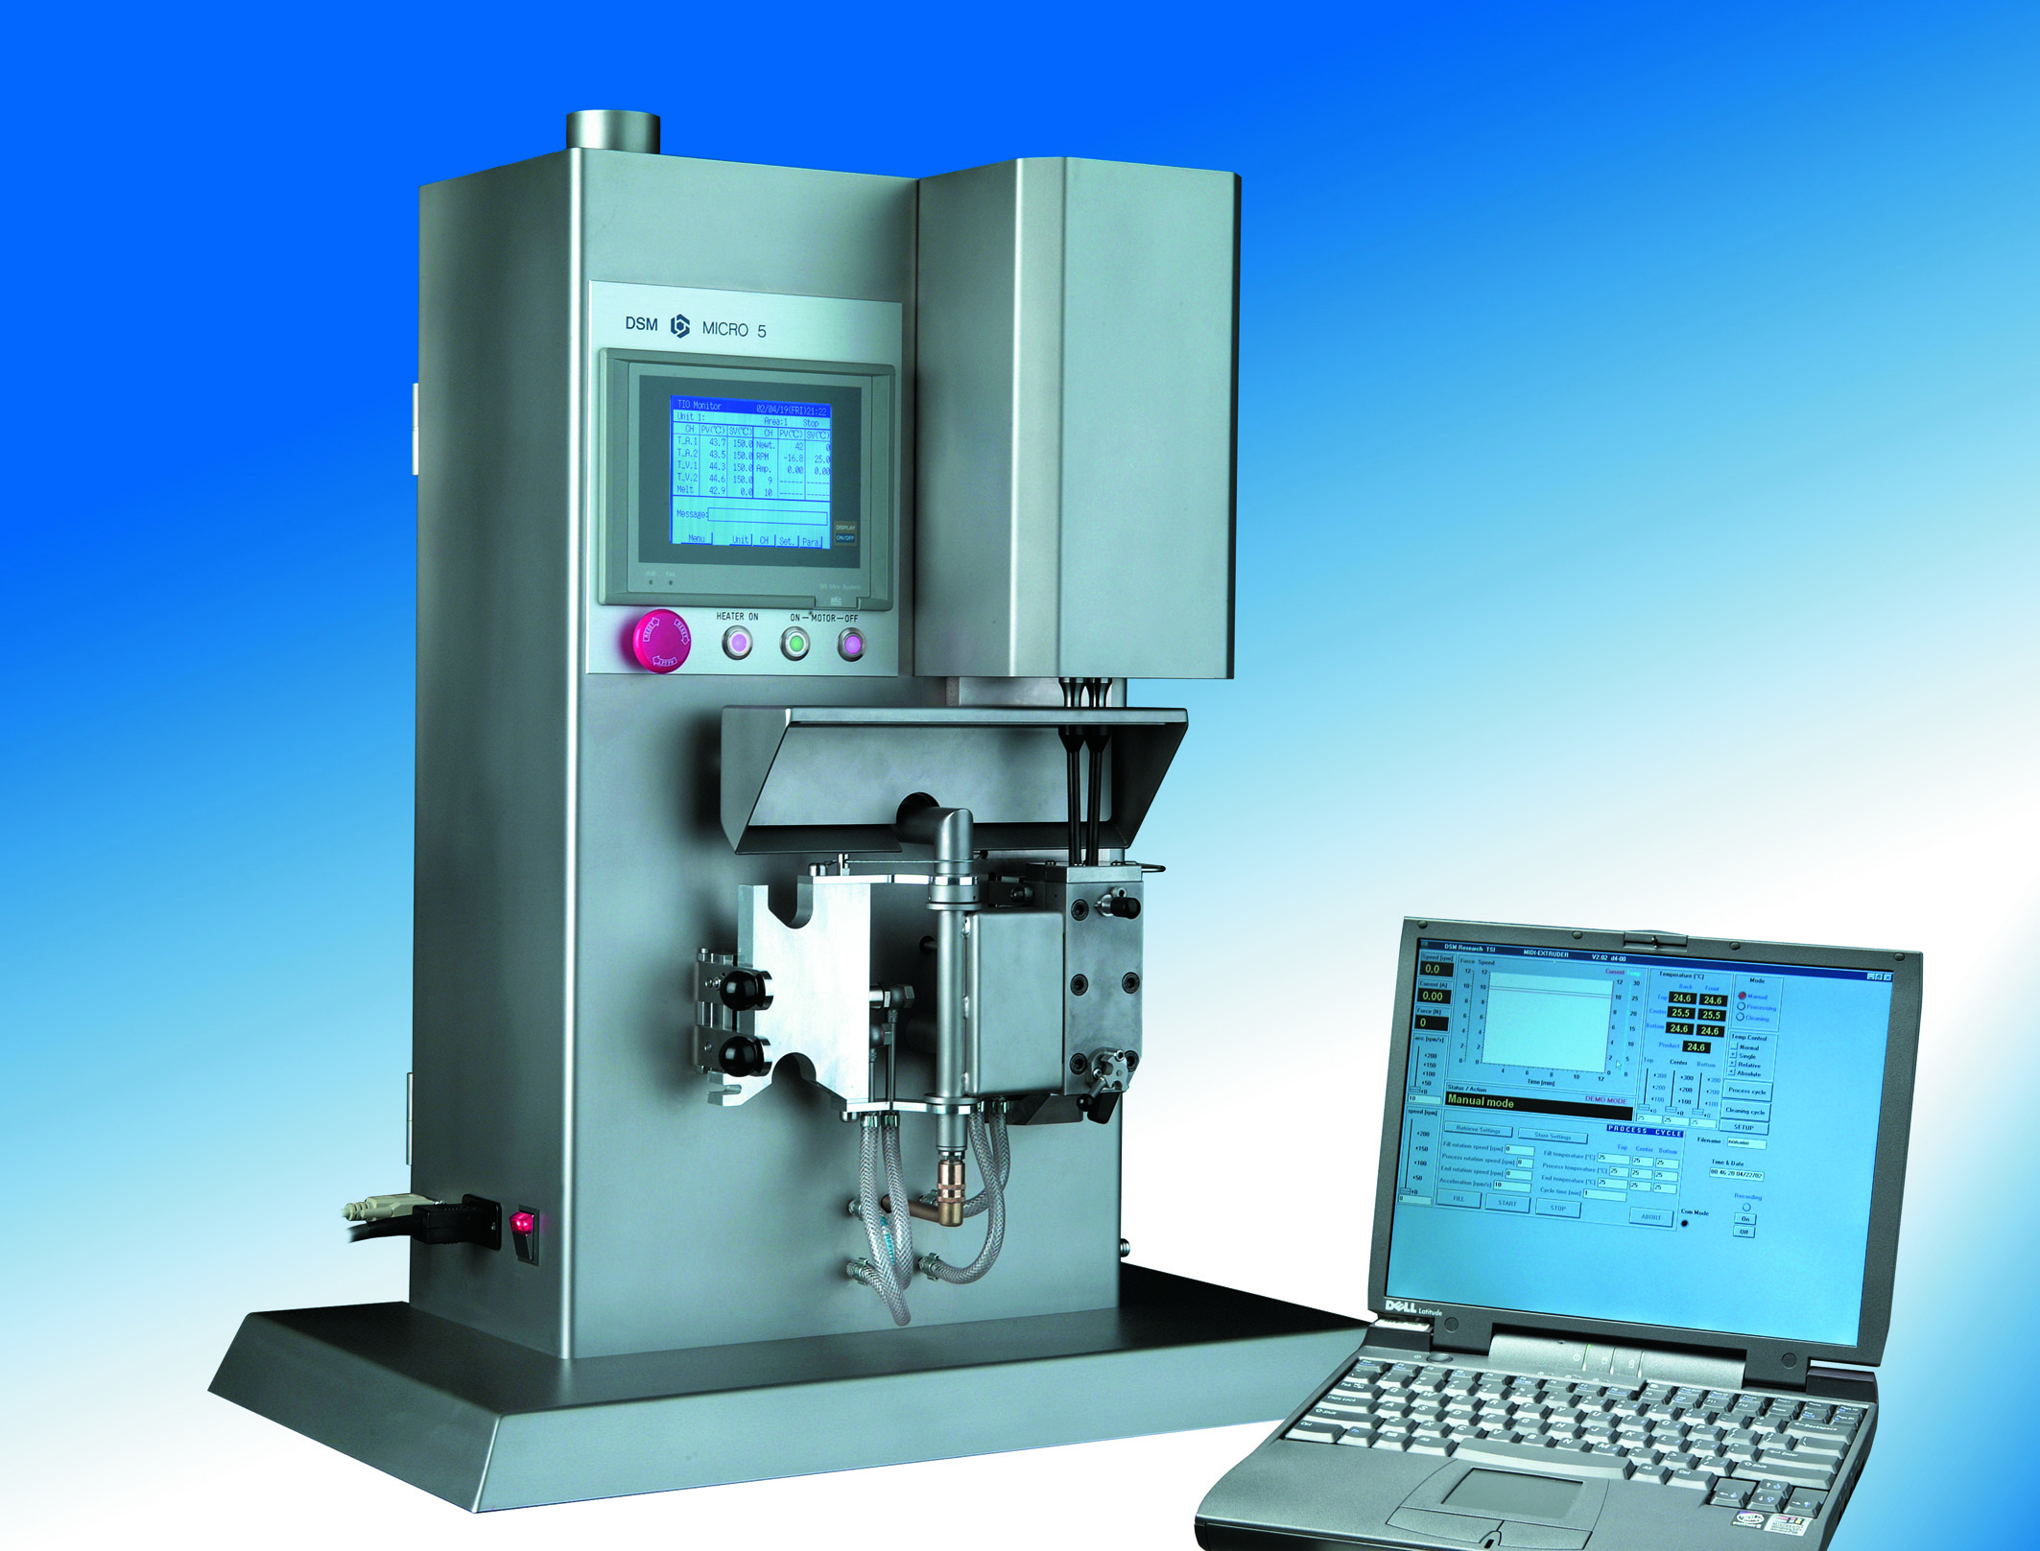
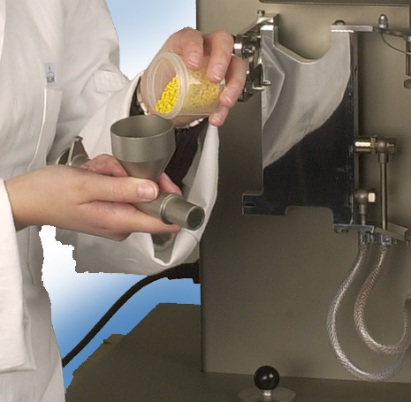
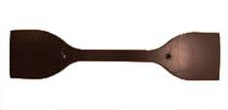
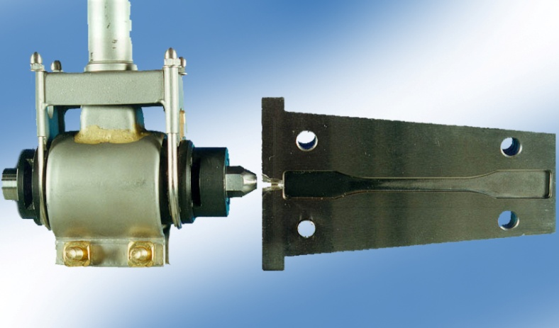
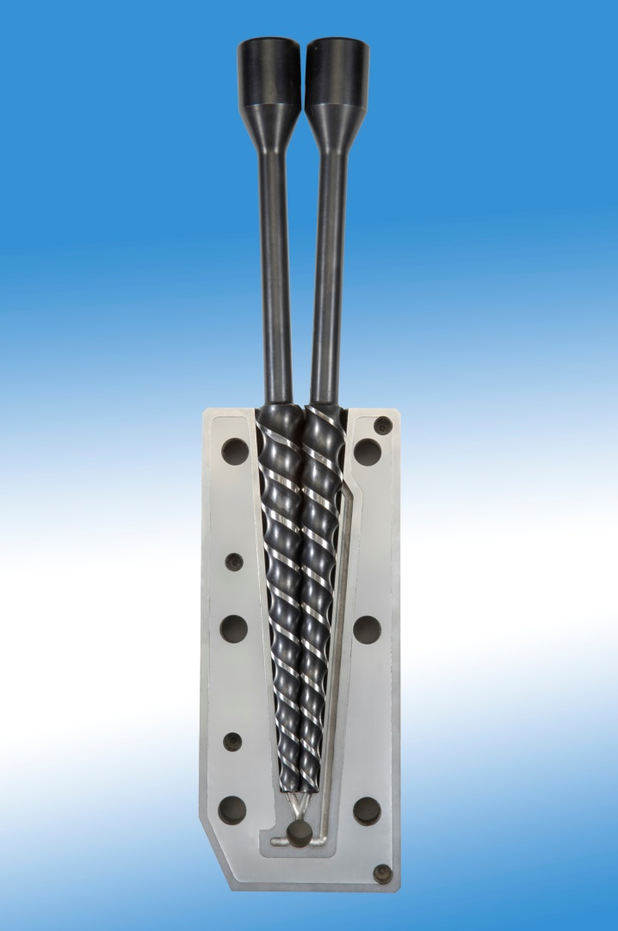
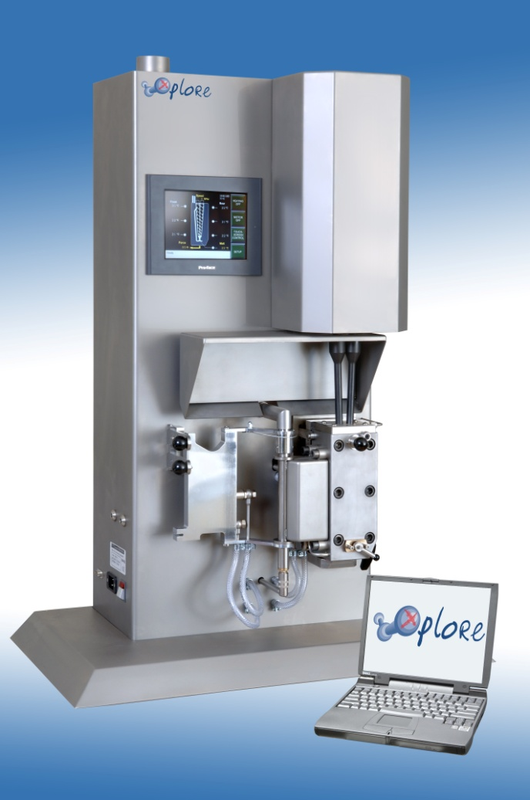
Work with a Small Scale Twin Screw Mini Compounder
Conical twin screw compounder
Fully intermeshing
Co-rotating (mixing) or
Batch size 15 ml
Melt thermocouple and control
2 x 3 Heating zones (temp. gradient)
Vertical barrel
Rheological data
Digital and graphic data display
17 cm
Tensile Tests
XRD Analysis: 2Ө = 1-10°
SEM Analysis
TEM Analysis
Image analysis SEM & TEM micrograph
Compounded material directly injection-molded into standard test samples
Materials compounded in the corrosion/abrasive resistant barrel
Figure 2. Schematic representation of experimental procedure

Slide 10
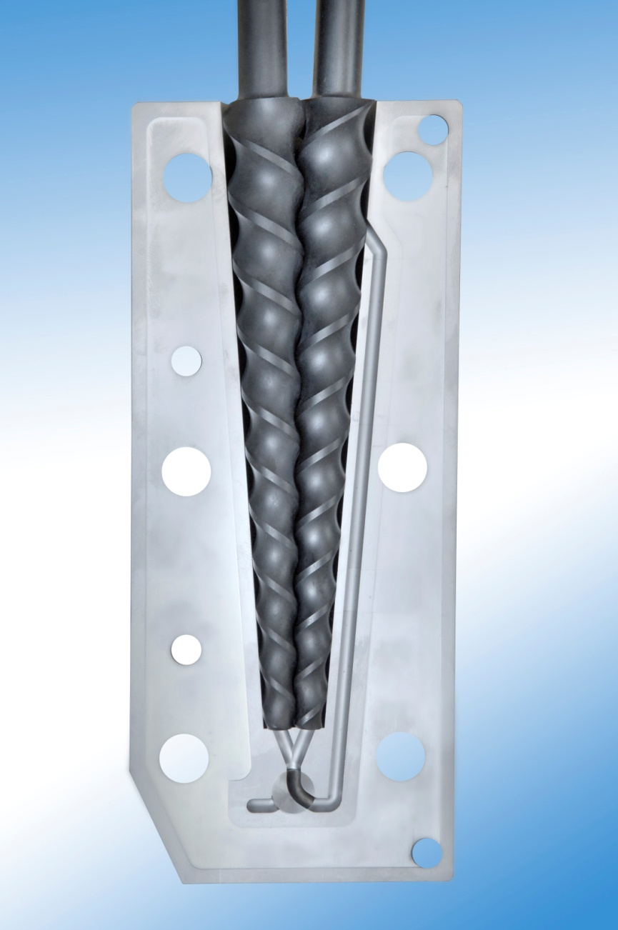
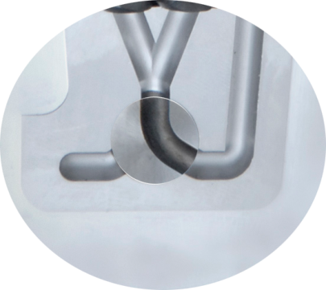
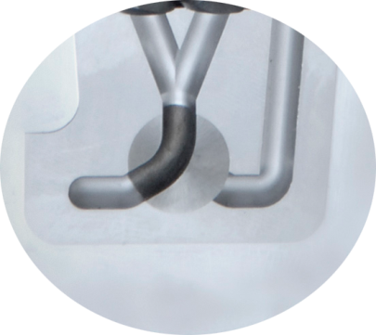
Compounding of the Melt; Measuring the Torque
Flow re-circulation for controlled residence time by solid carbide valve
Recirculation
Valve to outlet
Notes:
Residence time is controlled by a valve not by screw geometry

Slide 11
Comparison of Torque ( N ) as a function of melt mixing time for Blends of PE with Non Derivatized (Un-Methylated) and Fully Methylated Kraft Lignin
25% lignin
Un-methylated
Methylated
There is no melt stability for non-derivatized Kraft Lignin due to the onset of crosslinking reactions
The melt stability of methylated Kraft Lignin has been verified using melt torque measurements

Slide 12
To Further delve into the molecular origins of these effects we
examined the antioxidant activity of the lignins
before and after methylation

Slide 13
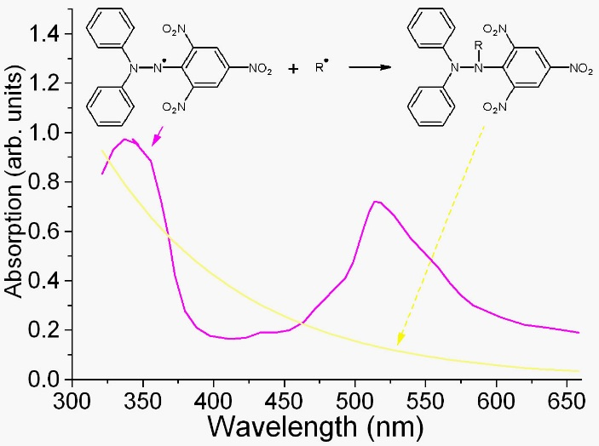
Lignin sample in Dioxane:water ( 9:1 , v/v) ( 25-200 mg/L)
DPPH Solution ( 80 mg/L )
Incubation for 60 min.
UV absorption at 517 nm
I% = ${[(Ab0−Abc }/{Ab0]x 100}$ , where Ab₀ is the absorbance of control and Ab_{c} is the absorbance of DPPH solution with lignin sample.
The IC₅₀ ( concentration providing 50% inhibition) was calculated graphically using a calibration curve in the linear range by plotting the sample concentration vs. the corresponding scavenging effect.

Slide 14
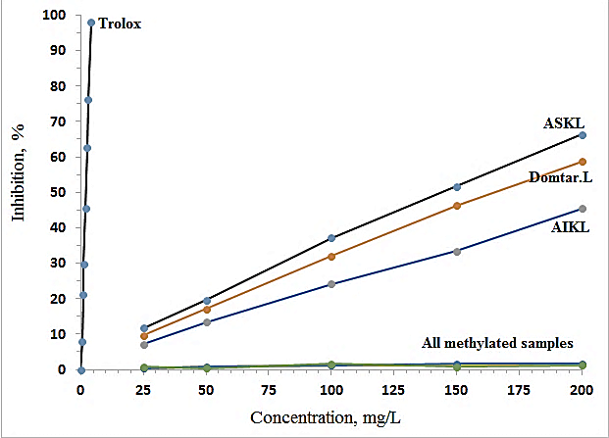
Antioxidant Activity of Initial Kraft Lignin Before & After Methylation
Lower Mol wt. (highest Phenolic OH content) ASKL showed better antioxidant activity.

Slide 15
Antioxidant Activity of Initial Kraft Lignin Before & After Methylation
In all samples, antioxidant activity was Completely eliminated once the phenolic-OH’s were eliminated

Slide 16
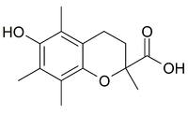
IC₅₀ of Kraft Lignin & its Fractions with Trolox Control
Samples | ASKL | Whole Lignin | AIKL | Trolox
IC₅₀ ( mg/L) | 145.7 | 166.1 | 223.2 | 1.86

Slide 17
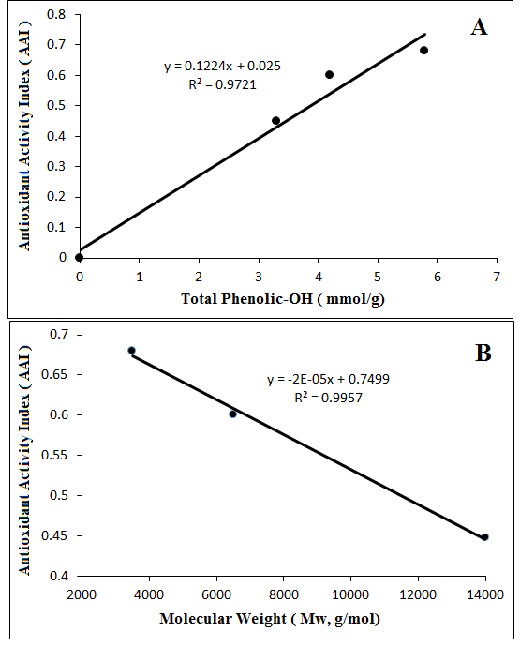
AAI is linearly correlated to Phenolic OH.
AAI is inversely correlated to the Mol. Weight of the Lignin Fraction

Slide 18
Determination of Free Radical Content in Kraft & Methylated Lignins
Using Quantitative EPR Spectroscopy
Total Free Radicals Content :
Initial Kraft Lignin : 2.8 x 10¹⁶ spins/g (using Pitch & TEMPO as calibration standards)
Methylated Kraft Lignin : 2.8 x 10¹⁶ spins/g
Our 2D EPR work also points out to the fact that the Free Radicals measured are not Oxygen centered Phenoxy Radicals (work in progress)

Slide 19
Efforts to correlate our findings so far
to the thermal properties of lignin/PE blends
Using
Oxidation Induction Temperature Measuremetns

Slide 20
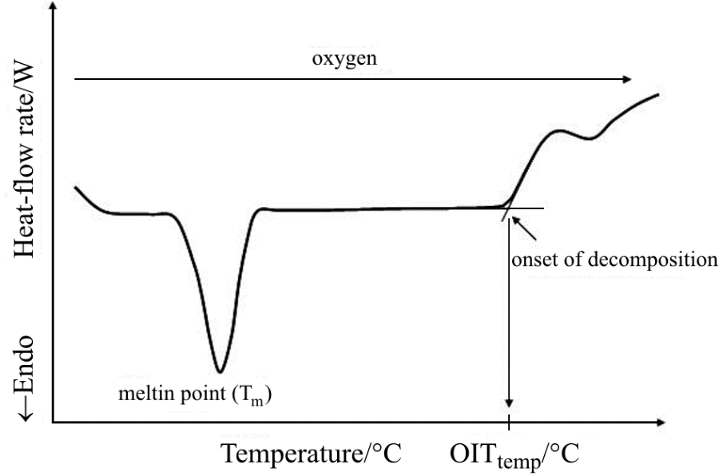
Oxidation induction Temperature ( OIT) Measurements
on KL-Polyethylene Blends
About 5 mg of sample placed in a hermetic DSC pan & cold pressed
4 small holes were created on the lid
Samples heated under O₂ atmosphere (Flow rate:40 ml/min,pressure:20 psi, Heating Rate 10 °C/min )
Melting Point (T_{m})

Slide 21
Typical OIT Profiles for 5% KL Blends with Polyethylene
5% ASKL-PE
5% Initial Kraft Lignin-PE
5% AIKL-PE
Polyethylene
Samples | Polyethylene | AIKL | Initial KL | ASKL
OITtemp. , °C | 208 | 238 | 251 | 256
Addition of 5% of ASKL and whole lignin into polyethylene, improved its OIT by more than 45 °C.

Slide 22
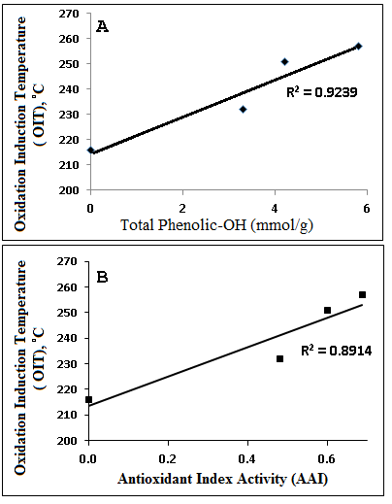
OIT is linearly correlated to Phenolic OH.

Slide 23
OIT is linearly correlated to Phenolic OH.
OIT is linearly correlated to the Antioxidant Activity Index (AAI)

Slide 24
OIT is linearly correlated to Phenolic OH.
OIT is linearly correlated to the Antioxidant Activity Index (AAI)
Phenolic OH’s in KL are of benefit to Thermally stabilizing its blends with Polyethylene

Slide 25
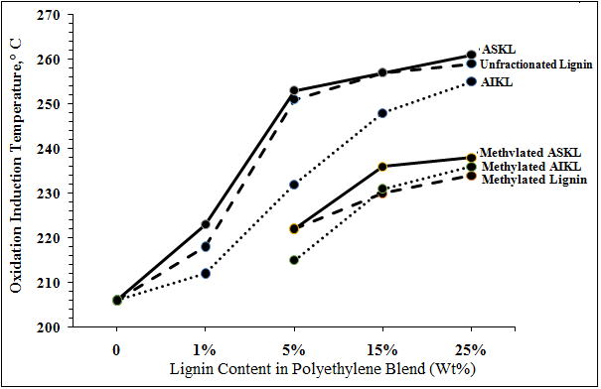
OIT Data as a function of KL Content in PE Blends
Pure PE

Slide 26
OIT Plots as a function of KL Content in PE Blends
KL beneficially affects OIT.
Pure PE

Slide 27
OIT Plots as a function of KL Content in PE Blends
KL beneficially affects OIT.
Elimination of the Phenolic OH reduces these benefits
Pure PE

Slide 28
OIT Plots as a function of KL Content in PE Blends
KL beneficially affects OIT.
Elimination of the Phenolic OH reduces these benefits
However, small amounts of KL (even when fully methylated are of benefit to OIT
Pure PE

Slide 29
OIT Plots as a function of KL Content in PE Blends
However, small amounts of KL (even when fully methylated are of benefit to OIT
Pure PE
Possibly, the aromatic nature of the char (originating from the lignin) that is created at elevated processing temperatures reduces the polyethylene degradation rate, which eventually increases the polyethylene thermal degradation temperature

Slide 30
CONCLUSIONS
The anti-oxidative character of Kraft Lignin is linearly correlated to its Phenolic OH content
Lower Molecular weight fractions of Kraft Lignin posses better antioxidant activity
The thermal stability of KL-Polyethylene blends is reduced when its phenolic character is eliminated
However, small amounts of KL (even when fully methylated are of benefit to the OIT of KL/PE blends

Slide 31
Acknowledgements
United States Department of Agriculture (USDA)
Domtar Corporation.

