Slide 1
FP1105: Understanding wood cell wall structure, biopolymer interaction and composition: implications for current products and new material innovation
Management Committee meeting
Escuela Politecnica San Sebastian, Spain 27th of May 2015

Slide 2
1. Adoption of the Agenda
1. Adoption of agenda
2. Matters arising
3. COST Action FP1105 update
  3.1 Status of Action, including participating countries
  3.2 Budget Status, budget planning and allocation process (LOS t.b.a)
  3.3 COST office update
4. Action planning
  4.1 Action Budget Planning
  4.2 Action Planning (including meetings)
    4.3.1 Location and date of next meeting
    4.3.2 Plans for the remainder of the Action (locations and dates of future meetings)
5. STSM status, applications
6. Publications, dissemination and outreach activities
7. Promotion of gender balance and of Early Stage Researchers (ESR)
8 Non-COST country participations
9. AOB

Slide 3
2. Matters arising from previous MC meeting
None

Slide 4
Agenda
1. Adoption of agenda
2. Matters arising
3. COST Action FP1105 update
  3.1 Status of Action, including participating countries
  3.2 Budget Status, budget planning and allocation process (LOS t.b.a)
  3.3 COST office update
4. Action planning
  4.1 Action Budget Planning
  4.2 Action Planning (including meetings)
    4.3.1 Location and date of next meeting
    4.3.2 Plans for the remainder of the Action (locations and dates of future meetings)
5. STSM status, applications
6. Publications, dissemination and outreach activities
7. Promotion of gender balance and of Early Stage Researchers (ESR)
8 Non-COST country participations
9. AOB

Slide 5
3.2. Status of the COST Action
MoU | oc-2011-1-9681
CSO Approval date | 01/12/2011
Start of Action | 24 My 2012
Entry into force | 12/01/2012
End of Action | 23 May 2016
24 May 2012

Slide 6
3.2. Status of Action: participating countries
24 COST countries
Austria | Latvia
Bulgaria | Luxembourg
Croatia | Norway
Czech Republic | Poland
Denmark | Portugal
Finland | Romania
France | Slovenia
Germany | Spain
Greece | Sweden
Hungary | Switzerland
Israel | Turkey
Italy | United Kingdom

Slide 7
3.2. Status of Action: COST countries not participating in the Action
COST countries NOT signed up to the FP1105 Action
Bosnia and Herzegovina
Brussels
Cyprus
Estonia
Iceland
Ireland
Lithuania
Malta
Netherlands
Slovakia
Sebia
Former Yugoslav Republic of Macedonia Montenegro

Slide 8
3.2. Status of Action: FP1105 Participation
24 countries participating from a total of 36
Proposal that we do not actively aim to increase this number but continue to welcome additional participants and countries.

Slide 9
FP1105 Cost Action Links
COST Action FP1006: Bringing new functions to wood through surface modification
COST Action FP1205: Innovative applications of regenerated wood fibres
COST Action FP0901: Analytical techniques for biorefineries
COST Action MP1006: Fundamental Problems in Quantum Physics

Slide 10
3.2. Budget Status
Grant period: 01/07/2014 - 30/06/2015
Allocated budget: € 145, 000
A. SUMMARY BUDGET
(1) TRAVEL COST FOR MEETINGS 84,240 €
(2) SHORT-TERM SCIENTIFIC MISSIONS 20,000 €
(3) TRAINING SCHOOLS 21,400 €
(4) PUBLICATIONS, DISSEMINATION, OUTREACH 500 €
(5) OTHER EXPENSES 0 €
B. TOTAL SCIENCE EXPENDITURE (sum of (1) to (5)) 126,140 €
C. Financial & Scientific Administration and Coordination
(max. of 15% of B.) 18,921 €
D. TOTAL EXPENDITURE (B+C) 145,061 €

Slide 11
3.2. Budget Status: Changes approved
Sixth Workshop: San Sebastian. Original budget €37,740 for 37 participants changed to €73,200.00 for 60 participants.
Training school €21,440.00 cancelled and moved to next year.
WG2 Task group meeting €10,800.00 cancelled.
New COST Action publication Task group meeting in San Sebastian €2000.
20 000 euros for STSM's for 8 people reduced €18 000.00

Slide 12
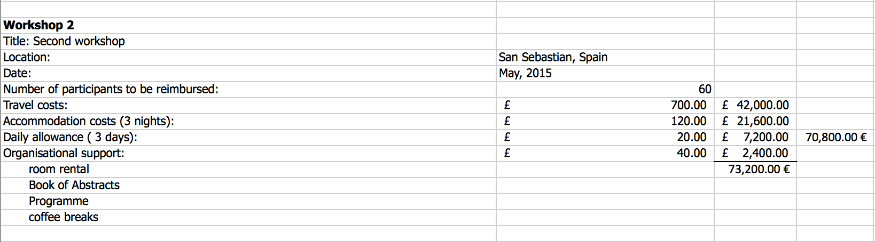
3.3. Budget Status: Budget allocated for this workshop

Slide 13
3.3. Budget Status: Local organiser support
Local organiser support for San Sebastian requires MC approval:
60 participants x 20€ per day/per participant = 2,400€ (depends on the number of participants that have finally attended the workshop, so this amount it can vary)

Slide 14
3.3. COST office update
Fatima Bouchama

Slide 15
Agenda
1. Adoption of agenda
2. Matters arising
3. COST Action FP1105 update
  3.1 Status of Action, including participating countries
  3.2 Budget Status, budget planning and allocation process (LOS t.b.a)
  3.3 COST office update
4. Action planning
  4.1 Action Budget Planning
  4.2 Action Planning (including meetings)
    4.3.1 Location and date of next meeting
    4.3.2 Plans for the remainder of the Action (locations and dates of future meetings)
5. STSM status, applications
6. Publications, dissemination and outreach activities
7. Promotion of gender balance and of Early Stage Researchers (ESR)
8 Non-COST country participations
9. AOB

Slide 16
4.1 Budget Planning
Grant period: 01/07/2015 - 23/05/2016
Allocated budget: € 128, 333
A. SUMMARY BUDGET
(1) TRAVEL COST FOR MEETINGS 77,560 €
(2) SHORT-TERM SCIENTIFIC MISSIONS 10,000 €
(3) TRAINING SCHOOLS 20,000 €
(4) PUBLICATIONS, DISSEMINATION, OUTREACH 3,000 €
(5) OTHER EXPENSES 0 €
B. TOTAL SCIENCE EXPENDITURE (sum of (1) to (5)) 110,560 €
C. Financial & Scientific Administration and Coordination
(max. of 15% of B.) 16,584 €
D. TOTAL EXPENDITURE (B+C) 127,144 €

Slide 17
4.2. Action budget planning
Workshops
Location: | Zurich, Switzerland
Date: | 31 August and 1 September 2015
Number of participants to be reimbursed: | 35
Travel costs: | £500.00 | 17,500.00 €
Accommodation costs (3 nights): | 120.00 | 12,600.00 €
Daily allowance: | £20.00 | 4,200.00 €
Organisational support: | £40.00 | 1,400.00 €
 |  | 35,700 €
Final workshop
Location: | Espoo, Finland
Date: | t.b.d.
Number of participants to be reimbursed: | 38
Travel costs: | 500.00 | 19,000.00€
Accommodation costs (3 nights): | £120.00 | 13,680.00 €
Daily allowance: | £20.00 | 4,560.00 €
Organisational support: | £40.00 | 1,520.00 €
 |  | 38,760 €

Slide 18
4.2. Action budget planning
Publication group meeting
Title: Publication meeting
Location: | Zurich, Switzerland
Date: | 2 September
Number of participants to be reimbursed: | 10
Travel costs: | Not applicable | -----
Accommodation costs (1 night): | 120.00 | 1,200.00 €
Daily allowance: | 20.00 | 800.00 €
Organisational support: | 20.00/day | 200.00 €
 |  | 2,200.00 €

Slide 19
4.2. Action budget planning
STSM
6 STSMs |  | 10,000 €

Slide 20
4.2. Action budget planning
TRAINING SCHOOLS
Title: | Frontiers in lignocellulosic nanoparticles: metrology and applications
Location: | Espoo, Finland
Date: | 23-25 September
Number of participants to be reimbursed: | 15
Trainees Grants: | 300 € | 4,500.00
Number of Trainers to be reimbursed: | 4
Travel costs: |  | 6,400.00
Organisational support: | 20€/day | 900.00
 |  | 11,800.00 €

Slide 21
4.2. Action budget planning
TRAINING SCHOOLS
Location: | Edinburgh, UK
Date: | March 2016 (3 days)
Number of participants to be reimbursed: | 18
Trainees Grants: | 300 € | 5,400.00
Number of Trainers to be reimbursed: | 1
Travel costs: |  | 1,700.00
Organisational support: | 20€/day | 1080.00
 |  | 8,180.00 €

Slide 22
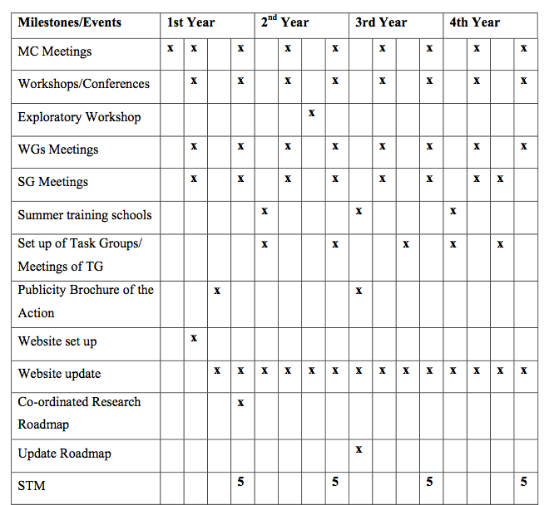
4.3. Action planning

Slide 23
4.3.1 Action planning: Location of next meeting
Location: Zurich (Switzerland)
Dates: 31 August & 1 September 2015
Local organiser: Ingo Burget

Slide 24
4.3.2 Action planning: Long term planning
COST Action FP1105 last meeting
Location: Espoo, Finland
Dates: March 2016 (MC to vote)

Slide 25
Agenda
1. Adoption of agenda
2. Matters arising
3. COST Action FP1105 update
  3.1 Status of Action, including participating countries
  3.2 Budget Status, budget planning and allocation process (LOS t.b.a)
  3.3 COST office update
4. Action planning
  4.1 Action Budget Planning
  4.2 Action Planning (including meetings)
    4.3.1 Location and date of next meeting
    4.3.2 Plans for the remainder of the Action (locations and dates of future meetings)
5. STSM status, applications
6. Publications, dissemination and outreach activities
7. Promotion of gender balance and of Early Stage Researchers (ESR)
8 Non-COST country participations
9. AOB

Slide 26
STSM status
 | 1st Year | 2nd Year | 3rd Year | 4th Year
STSM | 8 | 8 | 8 | 6
SHORT-TERM SCIENTIFIC MISSIONS BUDGET (14/15): 18,000 (2 250€/STSM)
SHORT-TERM SCIENTIFIC MISSIONS BUDGET (15/16): 10,000 (1 666€/STSM)

Slide 27
5. STSM applications
Approved STSM for 2014 - 2015
Applicant | Host Institution | Duration (days) | Grant (€)
Dr Emil Engelund Thybring | Aalto University | 5 | 800
Dr Beata Podkoscielna | The Royal Institute of Technology, KTH, | 14 | 1,800
Ms Gabriella Josefsson | University of Helsinki | 5 | 650
Ms Marina Jajcinovic | Tampere University of Technology | 5 | 1,039
Dr Olena Sevastyanova | Maria Curie University | 7 | 840
Mr Alejandro Salvador Polo | University of Coimbra | 14 | 1,200
Dr Carmen-Mihaela Popescu | The Norwegian Forest and Landscape Institute | 14 | 1,900
Mr Florian Zikeli | University of Rome | 18 | 1,330

Slide 28
5. STSM applications
Requested STSM for 2015 - 2016
Applicant | Host Institution | Duration | Grant
Mr Abdul Ghafar | Hamburg University | 3 months | 2,500
Michael Kowalzky | Latvian State Institute of Wood Chemistry | 3 months | 2,500

Slide 29
Agenda
1. Adoption of agenda
2. Matters arising
3. COST Action FP1105 update
  3.1 Status of Action, including participating countries
  3.2 Budget Status, budget planning and allocation process (LOS t.b.a)
  3.3 COST office update
4. Action planning
  4.1 Action Budget Planning
  4.2 Action Planning (including meetings)
    4.3.1 Location and date of next meeting
    4.3.2 Plans for the remainder of the Action (locations and dates of future meetings)
5. STSM status, applications
6. Publications, dissemination and outreach activities
7. Promotion of gender balance and of Early Stage Researchers (ESR)
8 Non-COST country participations
9. AOB

Slide 30
6. Publications, dissemination and outreach activities
Informed of 5 publications to date:
  Need more feedback on this
Planned dissemination for the end of Action publication. To be discussed.
Main focus the Action book.

Slide 31
7. Promotion of gender balance and ESR
 | Year 1 | Year 2 | Year 3 | Year 4
Total No. of Individuals | 147 | 192 | 230 | 285
ESRs | 30 | 30 | 52 | 78
Female | 42 | 66 | 85 | 102

Slide 32
8. Non-COST country participations
8 Non-COST countries
Argentina
Australia
Brazil
Canada
China
New Zealand
South Africa
US

Slide 33
Request for new members
New requests are approved by the management committee members via email.
Professor Emily Cranston request from M^{c} Master University (Canada) to join the Action has been approved.
Israel’s participation also approved
Itan Preis - our first participant

Slide 34
11. AOB

