Slide 1
Update from the
COST Association
to the Management Committee
Dr. Fatima Bouchama
Science Officer- COST Association
COST FP1105 San Sebastian Meeting (ES) 26-27th May 2015

Slide 2
The COST Association
Resolution adopted by all the Representatives of the Governments of the 35 COST Member Countries on 6 September 2013, the ‘COST Association’ was established on 19 September 2013 with the aim of providing the legal entity for the implementation of COST activities
The COST Association is established as an International Non-Profit Association under Belgian law (AISBL).
The Committee of Senior Officials has decided in its 194th CSO meeting held on 12-13 May in Stockholm to include Montenegro as the 36th COST Member Country.

Slide 3
COST Budget in H2020
EUR 300 million for 7 years from two H2020 work programmes:
    Challenge 6 “Europe in a changing world – inclusive, innovative and reflective Societies”
    “Spreading Excellence and Widening Participation”
    In the EFSI context, strong concerns regarding a potential budget cut of 7% for COST
    “Engaging for COST”: online petition
    http://www.cost.eu/media/newsroom/governing-board-alarmed-diminishing-budget-EFSI
27

Slide 4
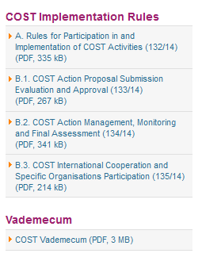
New set of
COST Implementation Rules
COST Vademecum
  See http://www.cost.eu/participate

Slide 5
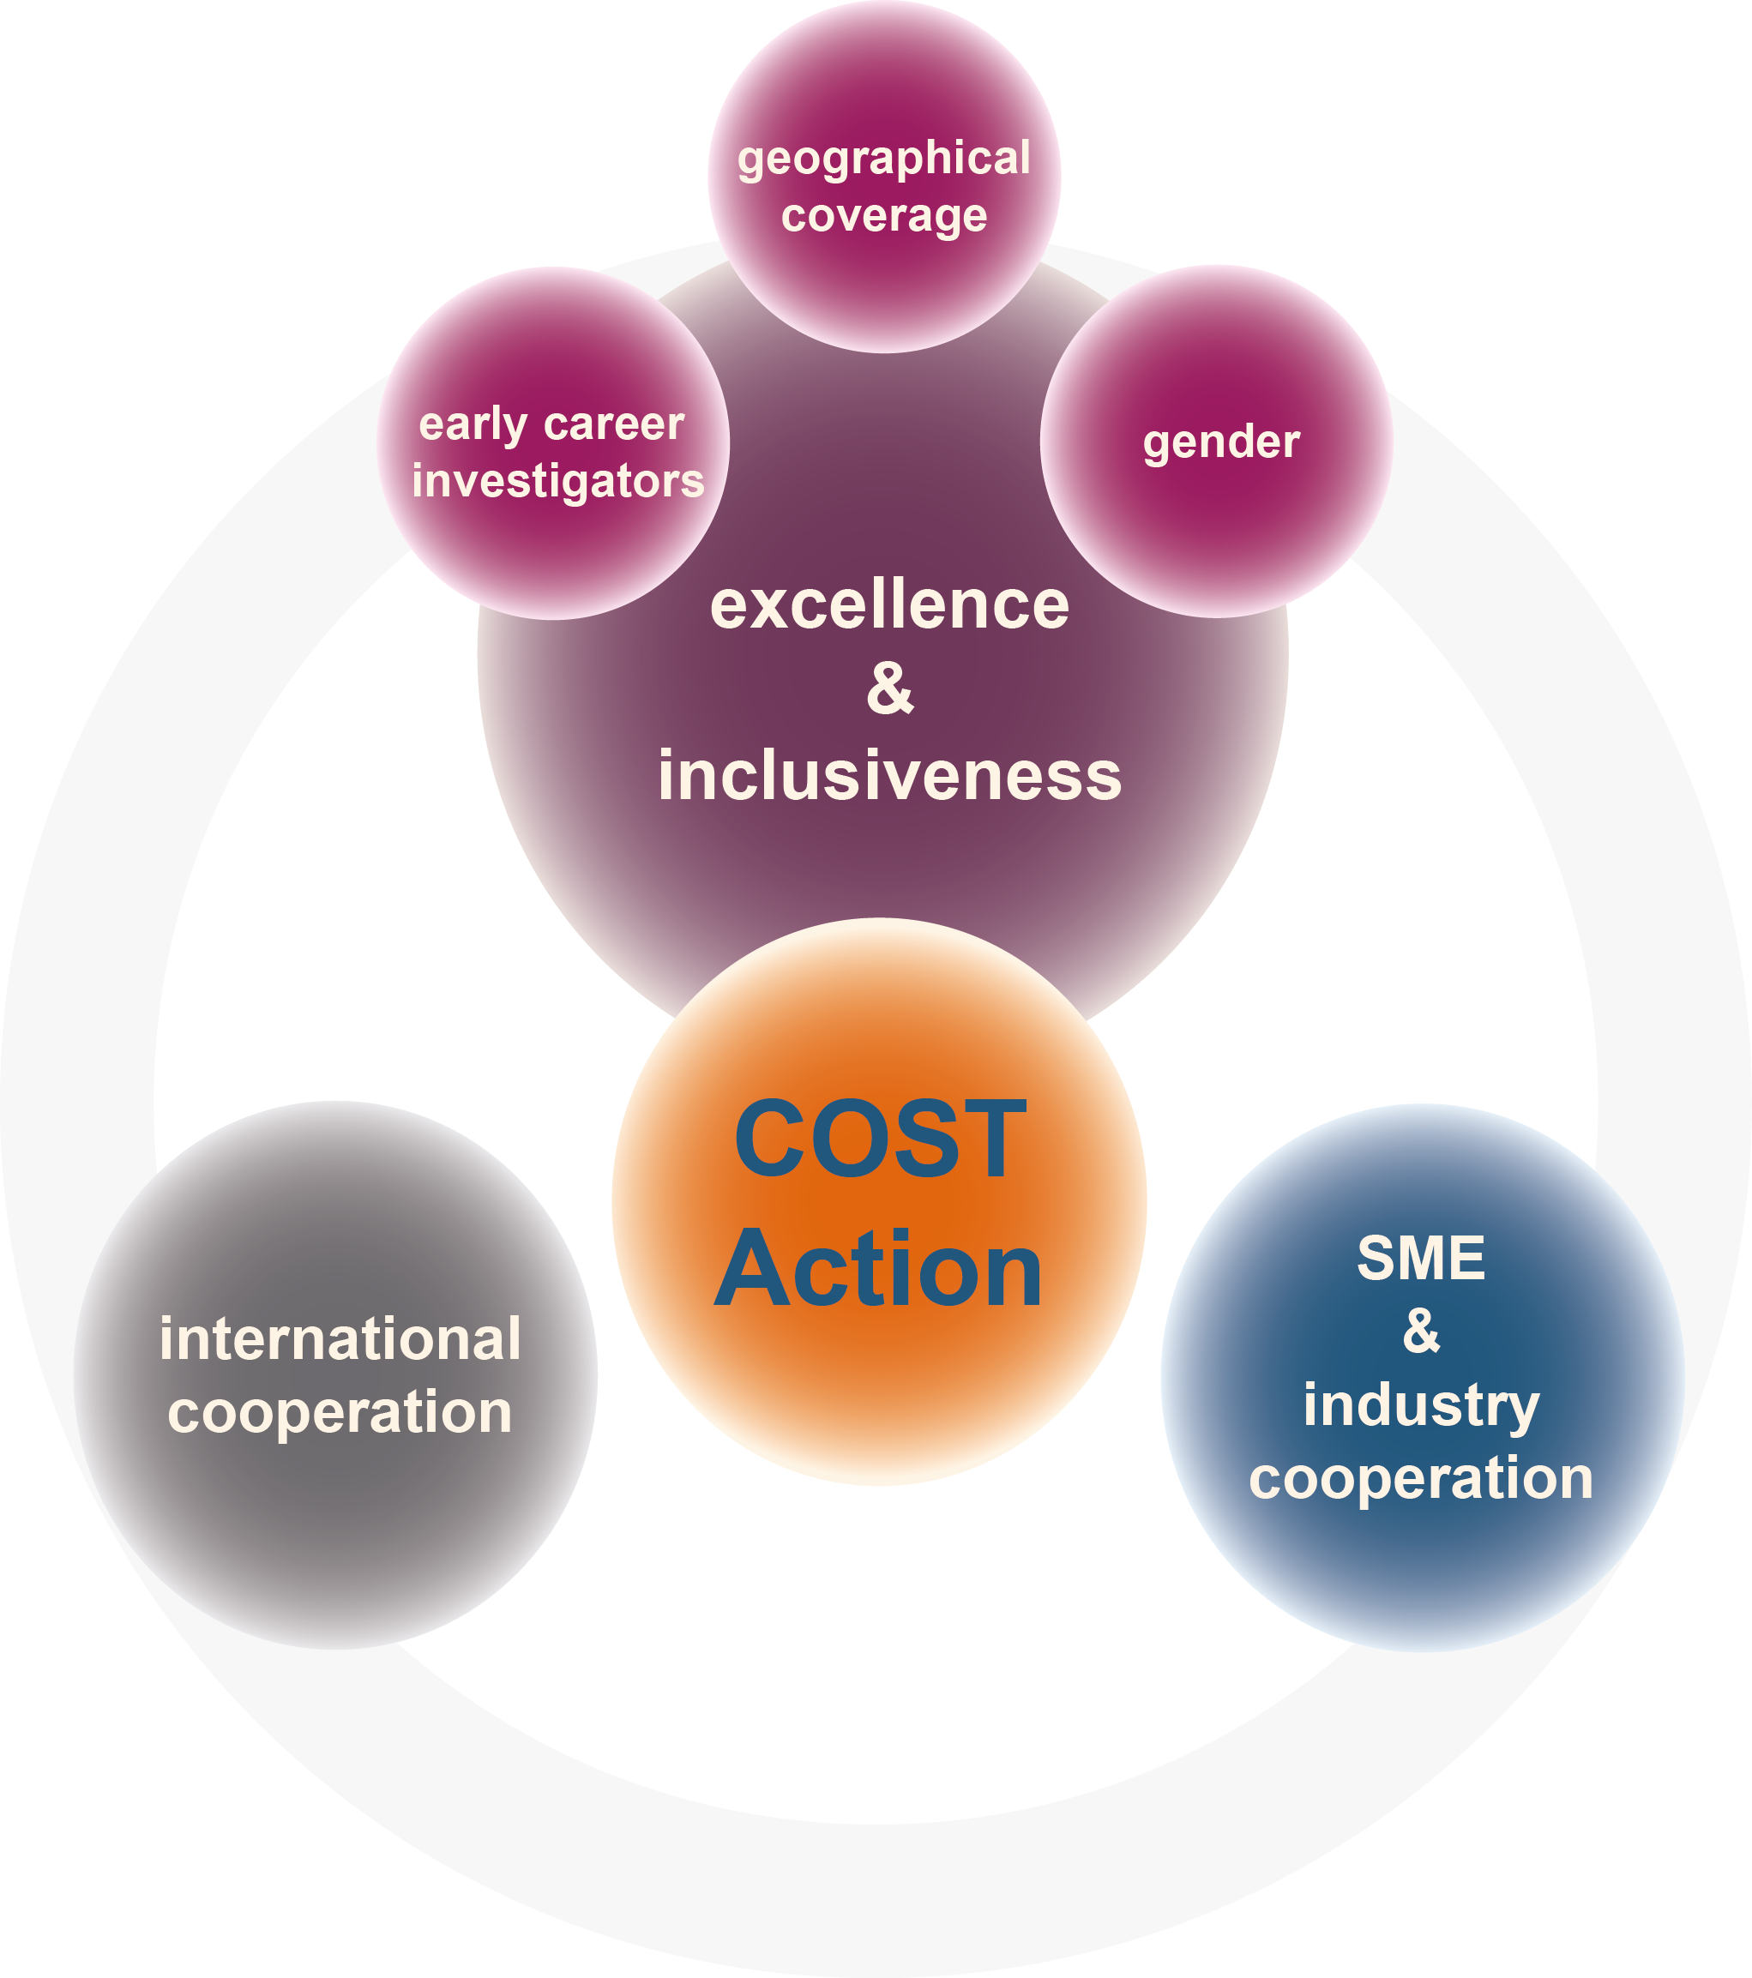
COST Policies

Slide 6
Excellence and Inclusiveness Policy
Implementation Strategy by the MC
The Action should have a plan towards inclusiveness :
Geographical Coverage (see : ITC list)
Early Career Investigator involvement (see definition: PhD + up to 8 years)
Gender Balance
The plan should be revised and updated at every MC meeting and should develop a strategy to attract researchers and stakeholders.
SOME EXAMPLES:
  Leadership roles
  Organising and locating Action meetings and events
  Benefiting from COST networking tools
  Promoting STSMs
  Action Think Tank for Early Career Investigators

Slide 7
Inclusiveness Target Countries (ITC)
Originated from:
  The political context of the Innovation Union (Horizon 2020)
  The intergovernmental context of the COST Member Countries
With the aim to:
  Encourage and enable researchers from less research-intensive countries across the COST Member Countries to set up and/or join COST Actions and get more intensively involved in all COST activities
  Counterbalance research communities unequal access to knowledge infrastructures, funding and resources distribution
  Connecting “pockets of excellence“ in science and technology operating from diverse locations in Europe

Slide 8
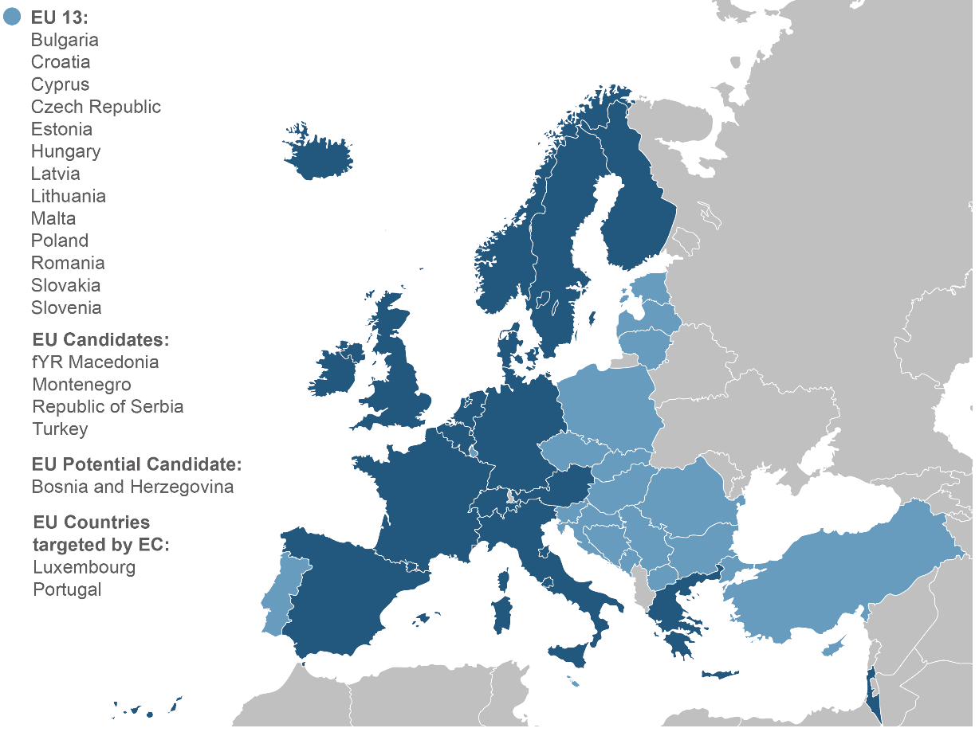
Inclusiveness Target Countries

Slide 9
Monitoring and Final Assessment (MFA) of Actions
First Progress and Monitoring Report – 18 months
Second Progress and Monitoring Report – 30 months
Final Achievement Report – 48 months (end of Action)
Action Rapporteur
reports remotely
44

Slide 10
Monitoring: Implementation
COST Actions will be monitored and assessed by COST Action Rapporteurs
Each COST Action will have one Action Rapporteur
Action Rapporteur will be independent external expert
  (2 months before the due date of the report, name & details communicated to MC Chair)
S/he will evaluate remotely (unless exceptionally their presence is requested)
  S&T and Networking progress of the Action
  Progress in the implementation of COST Policies
Their honoraria will be paid directly by the COST Association

Slide 11
Monitoring and Final Assessment of Actions
Element | Purpose and features
Final Assessment Month 48 | Identify how well the Action has reached the defined MoU objectives and deliverables
 | Information on initiation of any follow-up activities and its impact on R&D activities in the area covered by the Action
 | Collects data for:
 | COST Association reporting to EC
 | Impact Analyses
 | Identifying success stories
 | Identifying ‘early weak signals’ (or emerging issues)

Slide 12
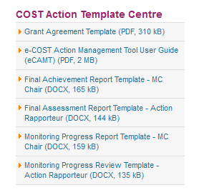
Monitoring and Final Assessment of Actions
  See http://www.cost.eu/participate
FP1105: FA (Month 48)
(should be e-cost based MFA procedure)
44

Slide 13
FP1105 Monitoring
Key dates
  Action Chair will submit FA at 48th month by the 24/06/2016
  Rapporteur will submit his/hers by 24/07/2016
  Outcome to be communicated to MC by 16/08/2016

Slide 14
FP1105: next GP
GP4: 01/07/2015-23/05/2016
Allocated Action Budget (incl. FSAC) : up to 128 333 EUR
(prorated to GP duration)
e-CAMT (e-COST Action Management Tool) will be used to submit WBP and sign Action Grant Agreement
44

Slide 15
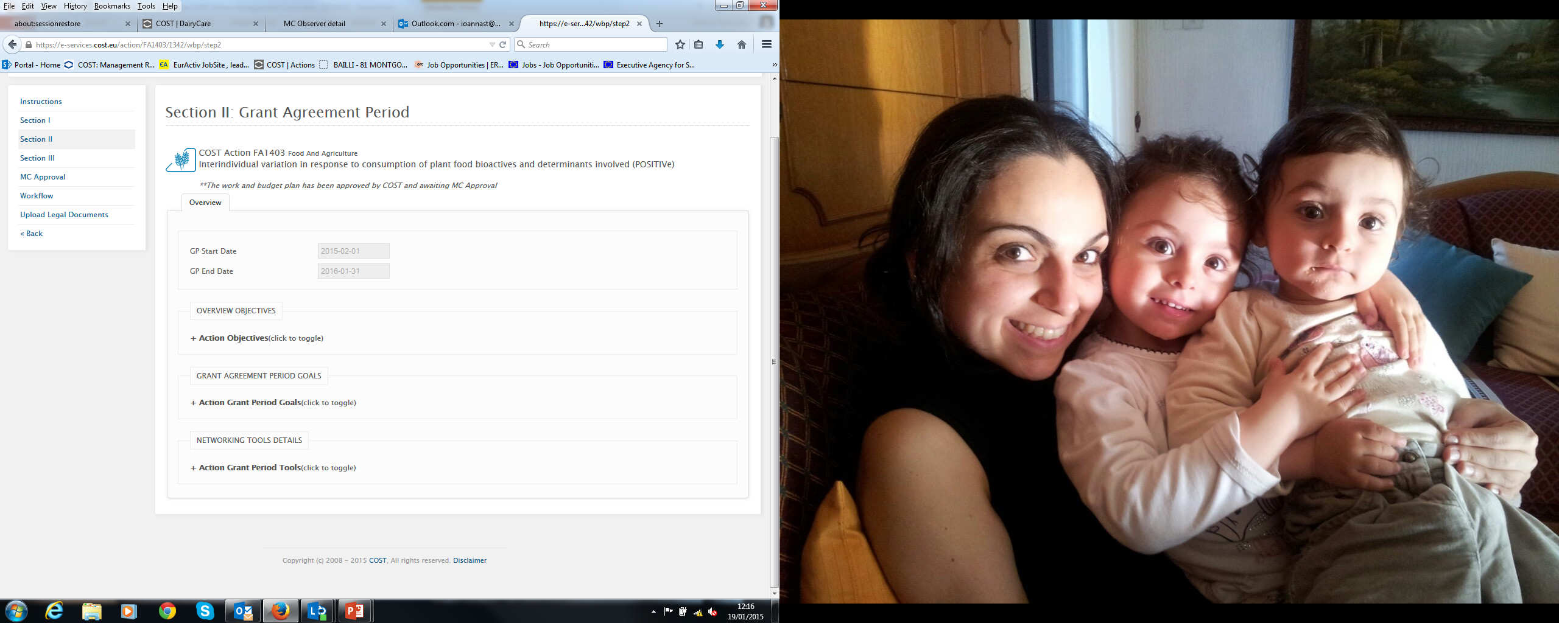
FP1105: next GP
1) Enter Grant Period Goals to achieve MoU objectives and deliver MoU deliverables
2) Enter Activities using the COST Networking Tools planned for the Grant Period: Meetings, Training Schools, STSMs, Dissemination.
(specifying to which Grant Period Goal it contributes to, Description and Outputs of the activity, “Logistical/ financial” details)
Action Objectives as stated in MoU
How the GP goals activities relate to the MoU aim and objectives
How the networking activities relate to the GP goals
44

Slide 16
FP1105: next GP
GP goals (to be identified in collaboration with the WG Leaders)
- must be specific to the Action (avoid general comments)
- should enable the i) fulfilment of the foreseen objectives and ii) achievement of the foreseen deliverables as outlined in the MoU
- key tasks per WG included already in the MoU – good starting point for defining the GP goals
Please note: organisation of a conference is not a GP goal is a networking activity

Slide 17
FP1105: next GP
Networking activities (important points):
- Take into account COST policies
- Link activity to GP Goals
- Provide details in the description
- List specific outputs

Slide 18
FP1105: next GP
Networking activities (important points):
COST Actions cannot sponsor external events
If COST Actions co-organise activities with an external event the Action must be fully integrated into the scientific programme of the organising committee
COST must be visible (COST logo, Action number and title) as co-organiser on the event ‘s website and the publication/dissemination materials

Slide 19
Acknowledging COST
All COST funded material needs to respect corporate branding:
  COST logo
  EU emblem
  Disclaimer (the views expressed in the dissemination material belongs solely to the Action and should not in any way be attributed to COST)
See instructions at www.cost.eu/visualidentity

Slide 20
Become a COST Expert!
As a COST Expert, you will have the opportunity to:
contribute to the evaluation of COST Open Call proposals;
participate in the assessment of Action results and outcomes;
take part in the assessment of COST strategic activities
New experts can express their interest via the COST Expert online registration form (www.cost.eu/experts)
An updated Curriculum Vitae with a list of publications is required to demonstrate competence in specific areas of expertise.
More on COST Experts: www.cost.eu/participate/experts

Slide 21






Thank you!
COST – European Cooperation in Science and Technology
Avenue Louise 149
1050 Brussels, Belgium
T: +32 (0)2 533 3800
F: +32 (0)2 533 3890
www.cost.eu

