Slide 1
MODIFICATION OF CELLULOSIC FIBRES BY GRAFTING WITH FATTY ACIDS
Maria - Cristina Popescu, Carmen - Mihaela Popescu
“Petru Poni” Institute of Macromolecular Chemistry of Romanian Academy, Iasi, Romania

Slide 2
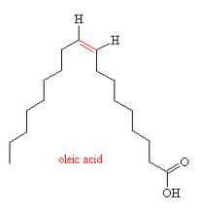
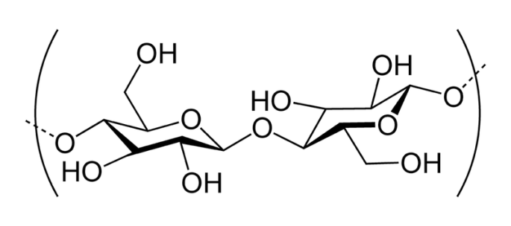
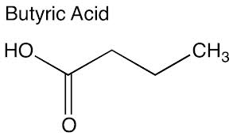
Materials
Cold plasma
Methods
FT-IR spectroscopy, XPS spectroscopy, SEM

Slide 3
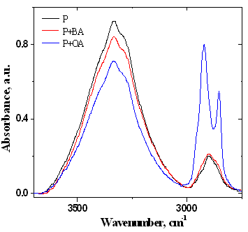
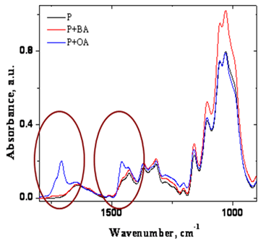
FT-IR SPECTROSCOPY
Grafting degree
15 % P+BA
56 % P+OA

Slide 4
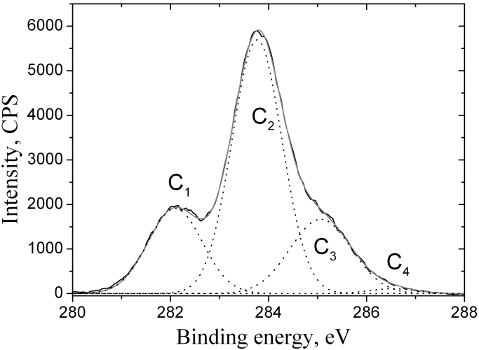
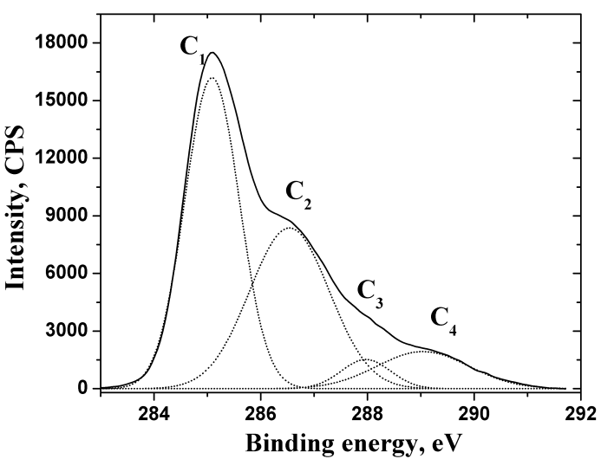
XPS SPECTROSCOPY
Grafting degree
15 % P+BA
55 % P+OA

Slide 5
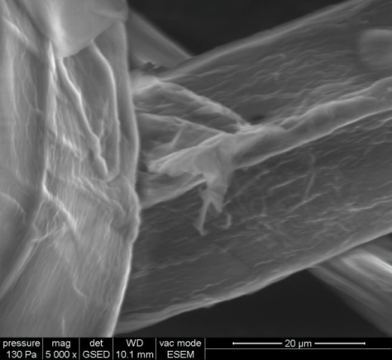
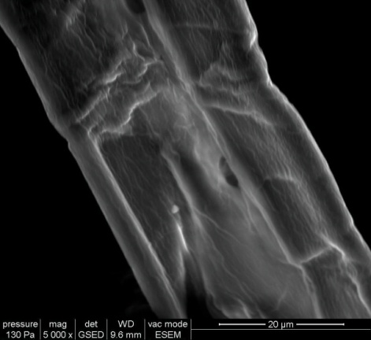
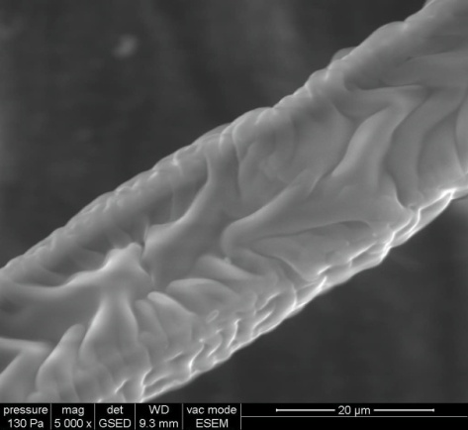
SEM
P
P+BA
P+OA
Plasma grafting treatment with butyric acid on the fibre surface presents a surface like rough, fragmented and the formation of pits on the fibre surface.
Treatment with oleic acid shows more roughness and also shows a deposition of oleic acid on fibre surface.

Slide 6
CONCLUSIONS
The investigation was focused on obtaining fibers with new or significantly improved properties, with tailored functionalities for special applications; starting from natural fibers, based on the concept of environmentally friendly and energy-efficient processing, by their surface modification.
All methods used reveal that fatty acids were successfully grafted on cellulose by cold plasma treatment.

Slide 7
Tank you!

